Slide 1
MES – całkowanie numeryczne

Slide 2
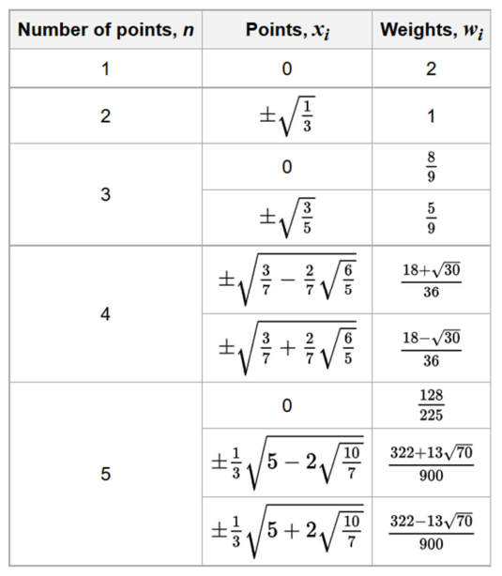
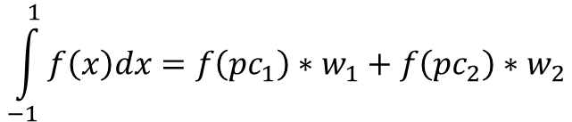
a
Δx
Δx
Δx
Δx
b
a
-0.577
0
0.577
b
$$w_{2}$$
$$w_{1}$$
$$\int_{−1}^{1}{f\left(x\right)dx=f\left({pc}_{1}\right)∗w_{1}+f\left({pc}_{2}\right)∗w_{2}}$$

Slide 3


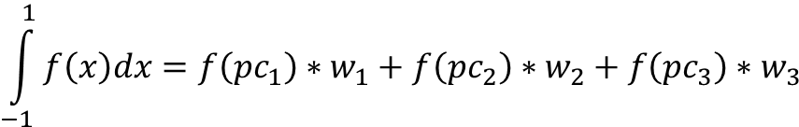


a
-0.77
0
0. 77
b
$$\frac{5}{9}$$
$$\frac{8}{9}$$
$$\frac{5}{9}$$
$$\int_{−1}^{1}{f\left(x\right)dx=f\left({pc}_{1}\right)∗w_{1}+f\left({pc}_{2}\right)∗w_{2}+f\left({pc}_{3}\right)∗w_{3}}$$
$f\left(x\right)=2x^{2}+0.1x+3$
$$\int_{−1}^{1}{f\left(x\right)dx=?}$$

Slide 4










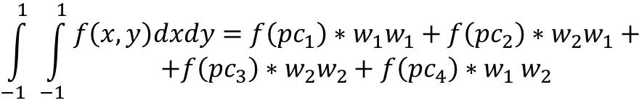








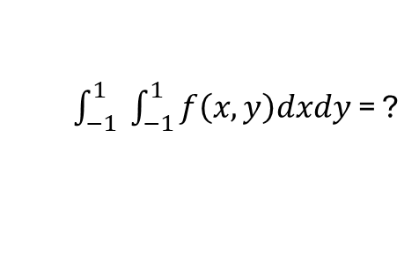
$$\int_{−1}^{1}{ \int_{−1}^{1}{\begin{aligned}f\left(x,y\right)dxdy=f\left({pc}_{1}\right)∗w_{1}w_{1}+f\left({pc}_{2}\right)∗w_{2}w_{1}+ \\ +f\left({pc}_{3}\right)∗w_{2}w_{2}+f\left({pc}_{4}\right){∗w}_{1}w_{2}\end{aligned}}}$$
$$f\left(x,y\right)$$
$$y$$
$$\sum_{i=1}^{n}{ \sum_{j=1}^{n}{f\left(x_{i},y_{j}\right)∗w_{i}w_{j}}}$$
$$1$$
$$f\left(x_{ },y_{ }\right)=−2x^{2}y+2xy+4$$
$\int_{−1}^{1}{ \int_{−1}^{1}{f\left(x,y\right)dxdy}}$ = ?
$${pc}_{4}$$
$${pc}_{3}$$
$$1$$
$$w_{2 }=1$$
$$−1$$
$$x$$
$${pc}_{1}$$
$${pc}_{2}$$
$$\left(−\frac{1}{\sqrt{3}};−\frac{1}{\sqrt{3}}\right)$$
$$−1$$
$$w_{1 }=1$$
 | $${pc}_{1}$$ | $${pc}_{2}$$ | $${pc}_{3}$$ | $${pc}_{4}$$
$$x$$ | $$−\frac{1}{\sqrt{3}}$$ | $$\frac{1}{\sqrt{3}}$$ | $$\frac{1}{\sqrt{3}}$$ | $$−\frac{1}{\sqrt{3}}$$
$$y$$ | $$−\frac{1}{\sqrt{3}}$$ | $$−\frac{1}{\sqrt{3}}$$ | $$\frac{1}{\sqrt{3}}$$ | $$\frac{1}{\sqrt{3}}$$
$$w_{ 1}$$ | $$1$$ | $$1$$ | $$1$$ | $$1$$
$$w_{ 2}$$ | $$1$$ | $$1$$ | $$1$$ | $$1$$
$$w_{ 1}=1$$
$$w_{2 }=1$$

Slide 5



$$f\left(x,y\right)$$
$$y$$
$$\sum_{i=1}^{n}{ \sum_{j=1}^{n}{f\left(x_{i},y_{j}\right)∗w_{i}w_{j}}}$$
$$1$$
$$f\left(x_{ },y_{ }\right)=−5x^{2}y+2xy+10$$
$\int_{−1}^{1}{ \int_{−1}^{1}{f\left(x,y\right)dxdy}}$ = ?
$$\frac{5}{9}$$
$$1$$
$$−1$$
$$x$$
$$\frac{8}{9}$$
$$−1$$
$$\frac{5}{9}$$
$$\frac{5}{9}$$
$$\frac{8}{9}$$
$$\frac{5}{9}$$

Slide 6

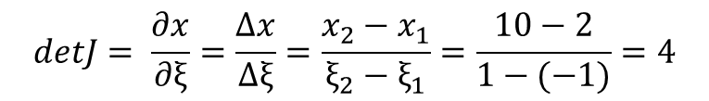










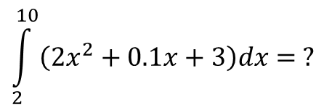


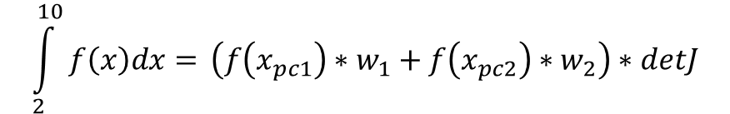
$$\int_{2}^{10}{f\left(x\right)dx=?}$$
$$N_{1}$$
$$N_{2}$$
$N_{1}= \frac{x_{2}− x_{ }}{x_{2}−{ x}_{1}}= \left|\begin{matrix}x_{1}=−1 \\ x_{2}=1\end{matrix}\right|$ = $\frac{1 −{ x}_{ }}{1 −(−1)}$ = $\frac{1}{2}(1−x)$
$N_{2}= \frac{x −{ x}_{1}}{x_{2}−x_{1}}$ = $\left|\begin{matrix}x_{1}=−1 \\ x_{2}=1\end{matrix}\right|$ = $\frac{x −{ (−1)}_{ }}{1 −(−1)}$ = $\frac{1}{2}(1+x)$
$$ξ_{1}=−1$$
$$ξ_{2}=1$$
$N_{1}\left(−0.577\right)= \frac{1}{2}\left(1−\left(−0.577\right)\right)=0.788$
$$N_{1}$$
$$N_{2}$$
$N_{2}\left(−0.577\right)= \frac{1}{2}\left(1+\left(−0.577\right)\right)=0.212$
$$detJ= \frac{∂x}{∂ξ}=\frac{Δx}{Δξ}=\frac{x_{2}−x_{1}}{ξ_{2}−ξ_{1}}=\frac{10−2}{1−(−1)}=4$$
$$x_{1}=2$$
$$\int_{2}^{10}{f\left(x\right)dx=} \left(f\left(x_{pc1}\right){∗w}_{1}+ f\left(x_{pc2}\right){∗w}_{2}\right)∗detJ$$
$$w_{ 1}=4$$
$$w_{2 }=4$$
$$x_{2}=10$$
$x_{pc1}= N_{1}x_{1}$+ $N_{2}$ $x_{2}=0.788∗2+0.212∗10=3.696$
$$\int_{2}^{10}{\left(2x^{2}+0.1x+3\right)dx= ?}$$
$x_{pc2}= N_{1}x_{1}$+ $N_{2}$ $x_{2}=0.212∗2+0.788∗10=8.304$

Slide 7
Praca domowa
Zaimplementowanie funkcji, która w układzie (-1;1) realizuje całkowanie 2 i 3 punktowe. Funkcja otrzymuje schemat całkowania i całkuje dowolną funkcję 2D.

