Slide 1
BAKERY E-COMMERCE WEBSITE
PRN292 PROJECT PRESENTATION

Slide 2
Members
Vu Do Phuong Thanh
Do Hoang Truc Giang
Tran Phu Tai
Bui Hai Nam
Nguyen Anh Tai
Huynh Phu Ty

Slide 3
Table of contents
Introduction
Planning sheet
Features
Database
Pages
Demo website
Q&A

Slide 4
1. Introduction
Providing an effective way for shopping.
Easier to manage products.

Slide 5
2. Planning sheets
Members | Side | Features
Vu Do Phuong Thanh | Admin | Manage orders
Do Hoang Truc Giang | Admin | Manage product
Tran Phu Tai | Admin | Manage accounts
Bui Hai Nam | User | Shopping cart
Nguyen Anh Tai | User | Products
Huynh Phu Ty | User | UI and Account profile

Slide 6
3. Feature
Admin role
Accounts management
View, Create, Update.
Products management
View, Insert, Update, Delete.
Orders management
View, Update.

Slide 7
3. Feature
User role
Account features
Sign up, sign out.
Register.
Update.
Shopping Cart
Add product to cart.
View, Update, Delete.
Check out, Place order.
Tracking orders.

Slide 8
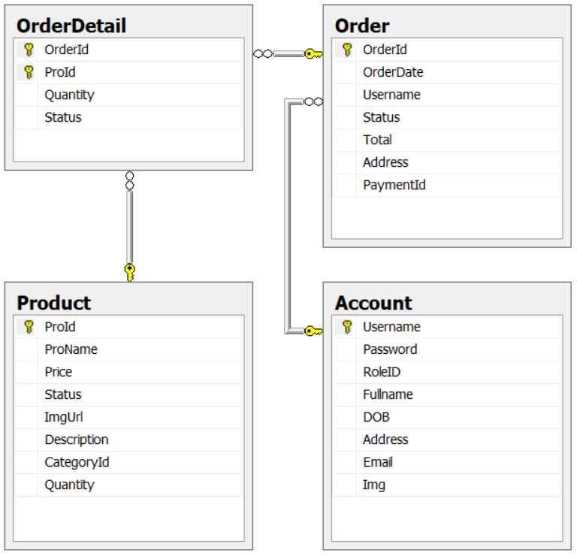
4. Database
Entity Relational Diagram (ERD)

Slide 9
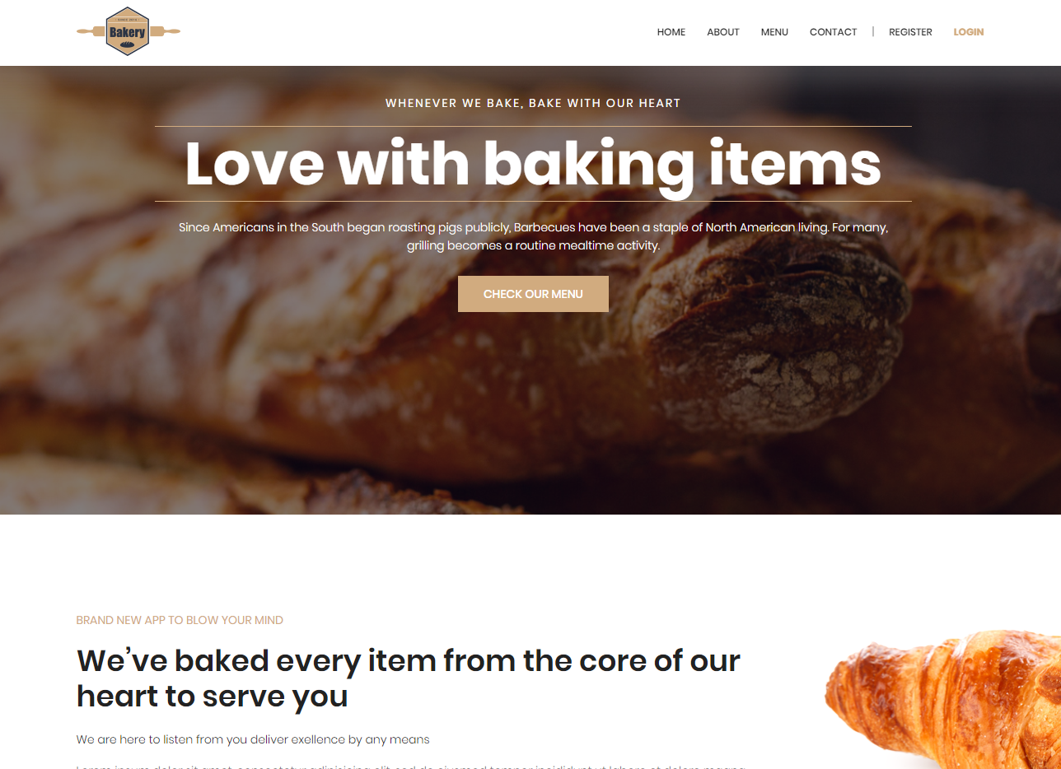
5. Page
Index

Slide 10
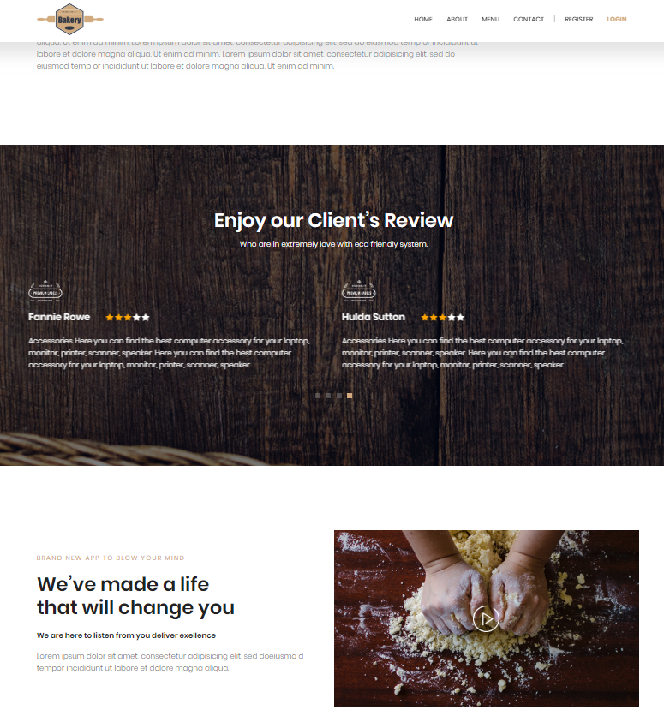
5.Page
About

Slide 11
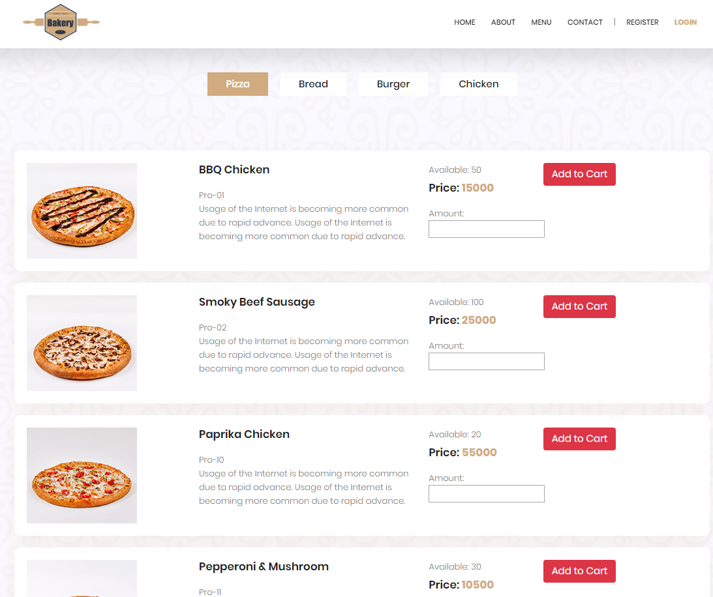
5. Page
Menu

Slide 12
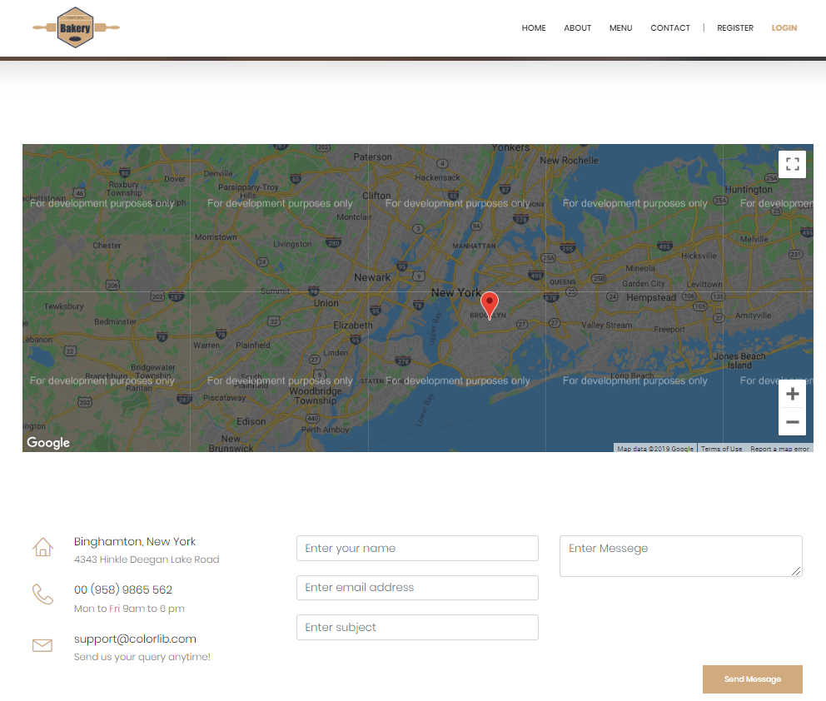
5. Page
Contact

Slide 13
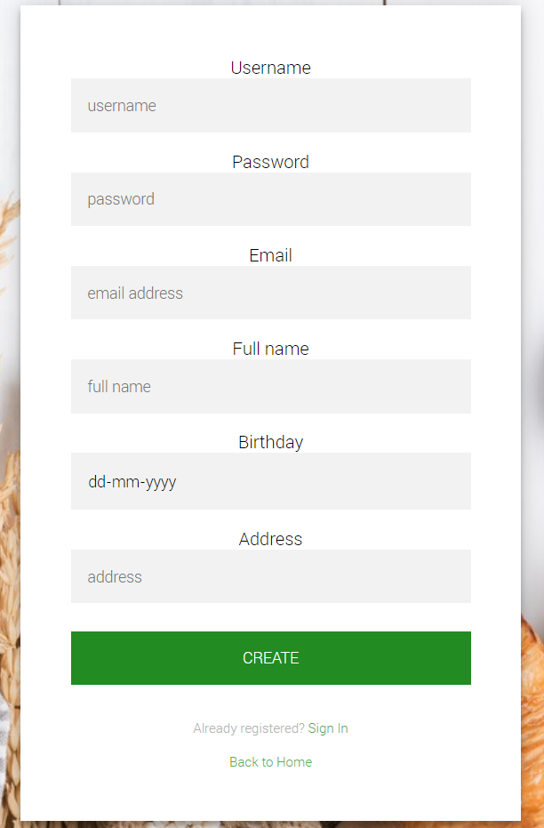
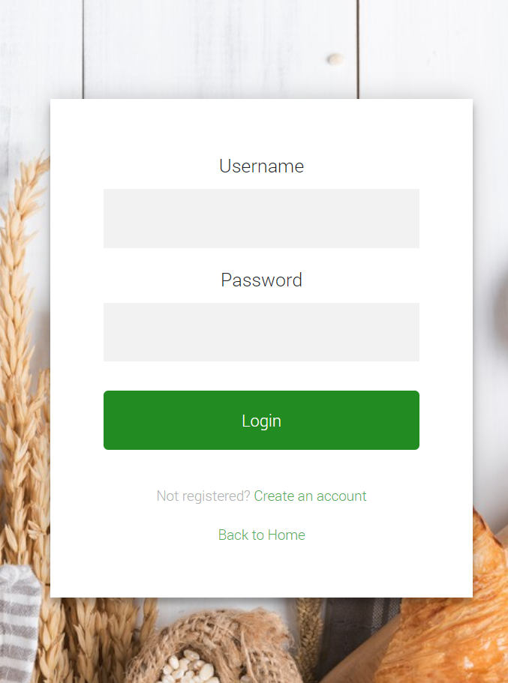
5. Page
Login and Register

Slide 14
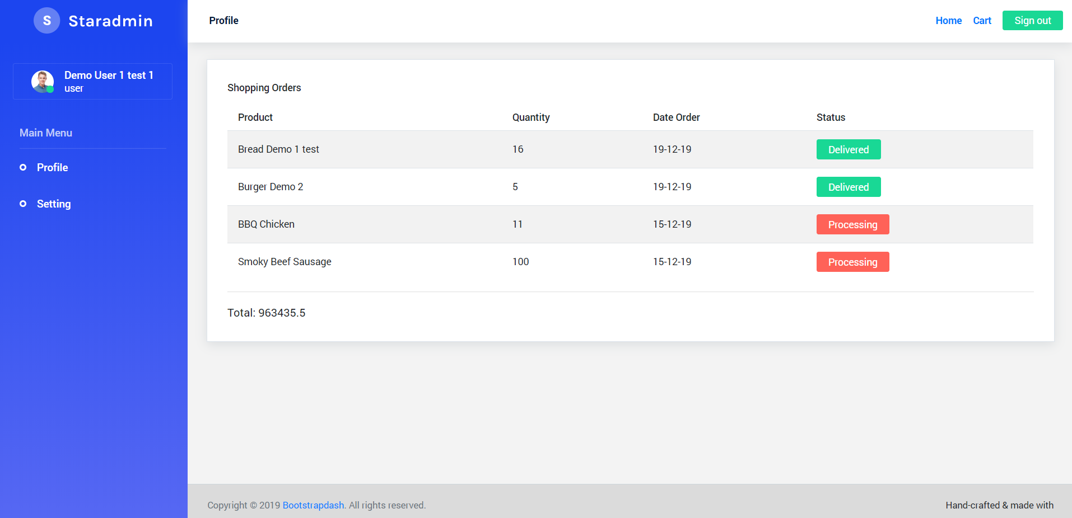
5. Page
Account Profile

Slide 15
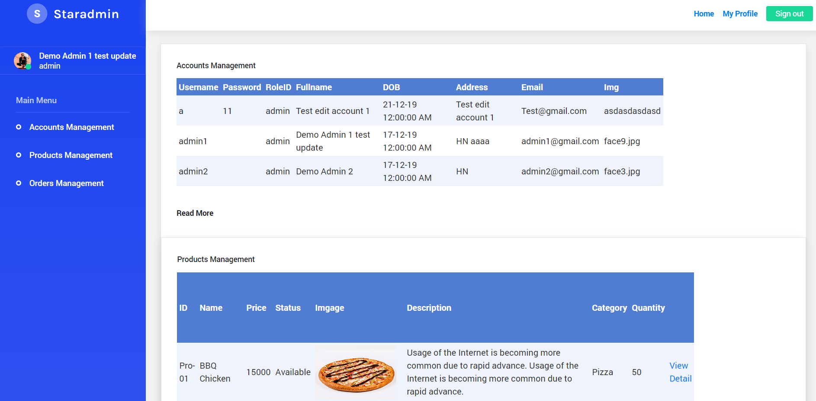
5. Page
Admin dashboard

Slide 16
6. Demo website

Slide 17
7. Q&A

Slide 18
THANKS FOR LISTENING

