Slide 1
Automated Essay Grading
Using Neural Networks
Revathi Bhuvaneswari
Tianying Luo

Slide 2
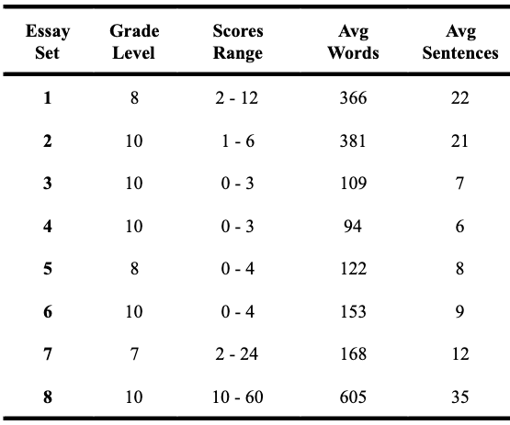
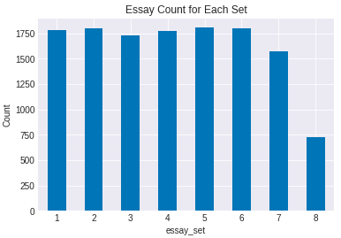
Dataset
Kaggle (The Hewlett Foundation)
13K Train Essays
4K Validation Essays
4K Test Essays

Slide 3
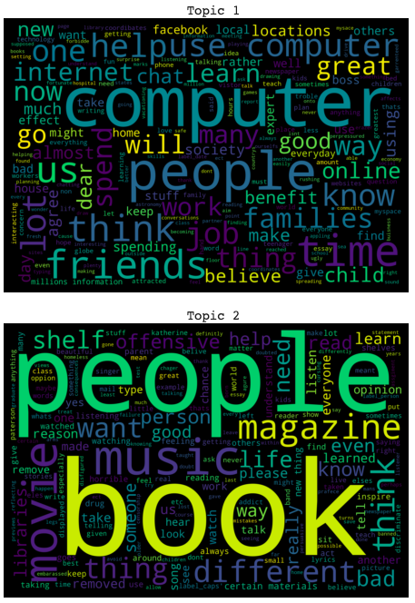
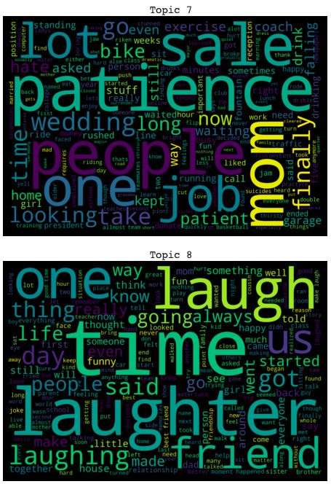
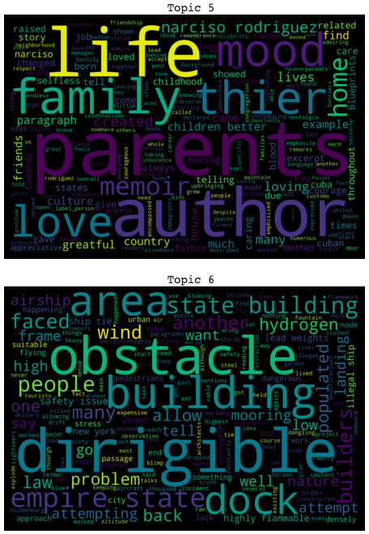
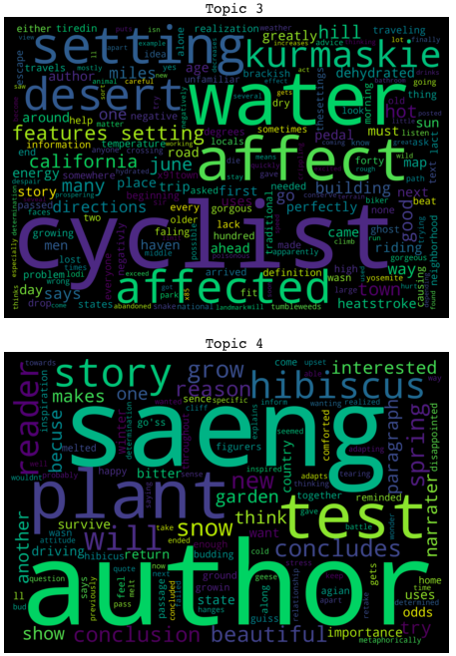
Dataset

Slide 4
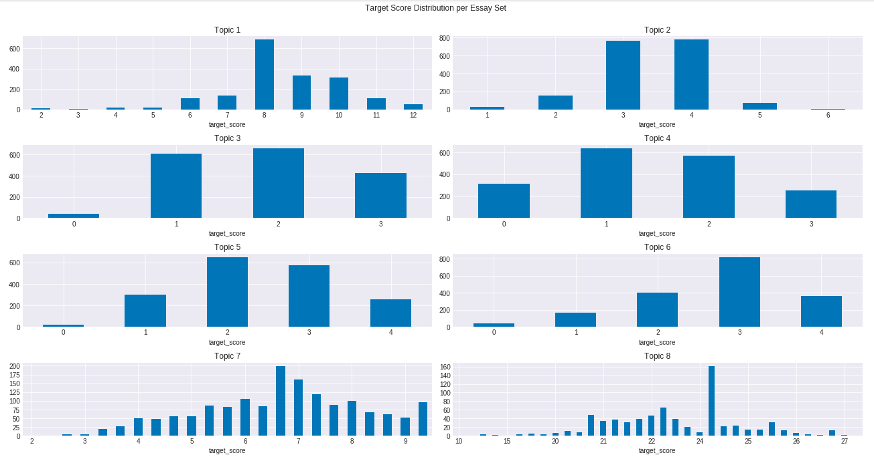
Target Score Distribution - Per Essay Set

Slide 5
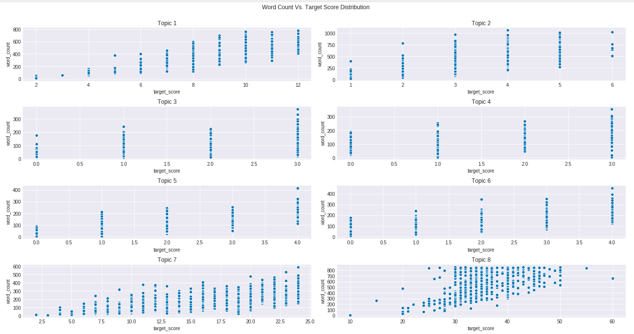
Target Score Distribution - Word Count

Slide 6
Pre-Processing: Essay Corpus
Computers a good because you can get infermation, you can play games, you can get pictures, But when you on the computer you might find something or someone that is bad or is viris. If ther is a vris you might want shut off the computers so it does not get worse. The are websites for kids, like games, there are teen games, there are adult games. Also pictures are bad for kids because most of the time they lead to inapropreit pictures. You should only look up infermation that you need not things like wepons or knifes. Also there are differnt kinds of companies like @CAPS1 @CAPS2. @CAPS2 is a good place to get computers @CAPS1 so is @CAPS1.

Slide 7
Pre-Processing: Essay Corpus
Computers a good because you can get infermation, you can play games, you can get pictures, But when you on the computer you might find something or someone that is bad or is viris. If ther is a vris you might want shut off the computers so it does not get worse. The are websites for kids, like games, there are teen games, there are adult games. Also pictures are bad for kids because most of the time they lead to inapropreit pictures. You should only look up infermation that you need not things like wepons or knifes. Also there are differnt kinds of companies like @CAPS1 @CAPS2. @CAPS2 is a good place to get computers @CAPS1 so is @CAPS1.
computers good get infermation, play games, get pictures, computer might find something someone bad viris. ther vris might want shut computers get worse. websites kids, like games, teen games, adult games. also pictures bad kids time lead inapropreit pictures. look infermation need things like wepons knifes. also differnt kinds companies like label_caps label_caps. label_caps good place get computers label_caps label_caps.

Slide 8
Pre-Processing: Essay Corpus
Computers a good because you can get infermation, you can play games, you can get pictures, But when you on the computer you might find something or someone that is bad or is viris. If ther is a vris you might want shut off the computers so it does not get worse. The are websites for kids, like games, there are teen games, there are adult games. Also pictures are bad for kids because most of the time they lead to inapropreit pictures. You should only look up infermation that you need not things like wepons or knifes. Also there are differnt kinds of companies like @CAPS1 @CAPS2. @CAPS2 is a good place to get computers @CAPS1 so is @CAPS1.
computers good get infermation, play games, get pictures, computer might find something someone bad viris. ther vris might want shut computers get worse. websites kids, like games, teen games, adult games. also pictures bad kids time lead inapropreit pictures. look infermation need things like wepons knifes. also differnt kinds companies like label_caps label_caps. label_caps good place get computers label_caps label_caps.
['computers', 'good', 'get', 'infermation', 'play', 'games', 'get', 'pictures', 'computer', 'might', 'find', 'something', 'someone', 'bad', 'viris', 'ther', 'vris', 'might', 'want', 'shut', 'computers', 'get', 'worse', 'websites', 'kids', 'like', 'games', 'teen', 'games', 'adult', 'games', 'also', 'pictures', 'bad', 'kids', 'time', 'lead', 'inapropreit', 'pictures', 'look', 'infermation', 'need', 'things', 'like', 'wepons', 'knifes', 'also', 'differnt', 'kinds', 'companies', 'like', 'labelcaps', 'labelcaps', 'labelcaps', 'good', 'place', 'get', 'computers', 'labelcaps', 'labelcaps']

Slide 9
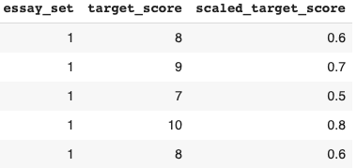
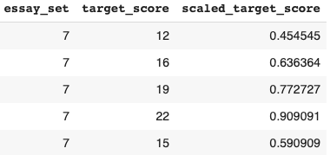
Pre-Processing: Essay Scores
Scale Scores to range [0, 1] - per essay set (MinMaxScaler)
Set 1: [2, 12]
Set 7: [2, 24]

Slide 10
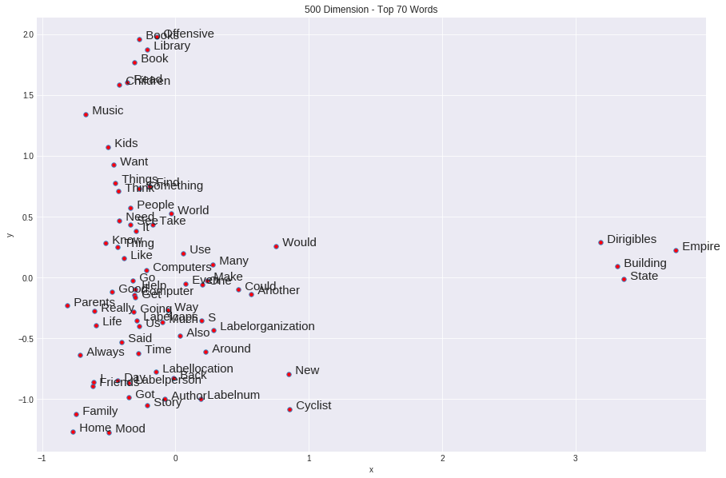
Word Embeddings

Slide 11
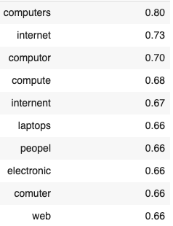
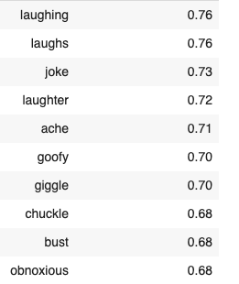
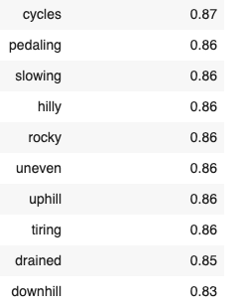
Word Embeddings
Top 10 Similar Words & Cosine Similarities
‘computer’
‘laugh’
‘cycle’

Slide 12
Model Approach
Keras Tokenizer API
MLP
Embedding Layer (Trained Weights)
CNN
Embedding Layer (Custom Weights)
LSTM
Average Custom Vectors Per Word
Bi-LSTM

Slide 13
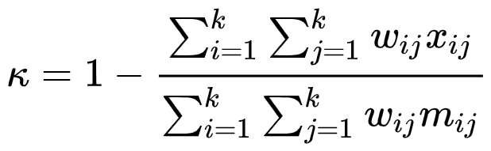
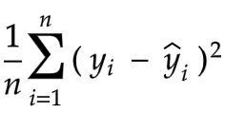

Evaluation Metrics
MSE Loss Function
Quadratic Cohen Kappa Score
Human Raters’ 𝜅 = 0.7544
Leaderboard 𝜅 = 0.81407

Slide 14
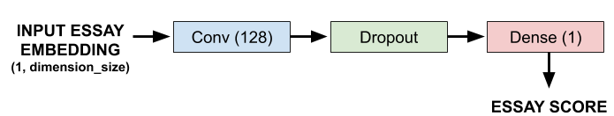
Multi-Layer Perceptron

Slide 15
Multi-Layer Perceptron
Parameters: Batch Size = 128, Epochs = 100, Dropout = 0.2, Dimension = 300
Optimization Algorithm | Test Kappa Score
Stochastic Gradient Descent | 0.4338
RMSprop | 0.6268
Adam | 0.6388

Slide 16
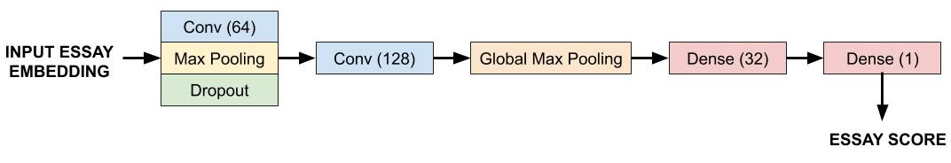
Convolutional Neural Network

Slide 17
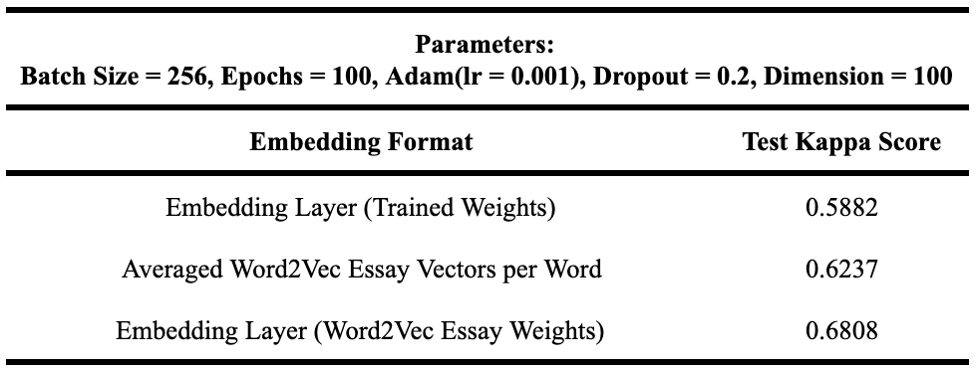
Convolutional Neural Network

Slide 18
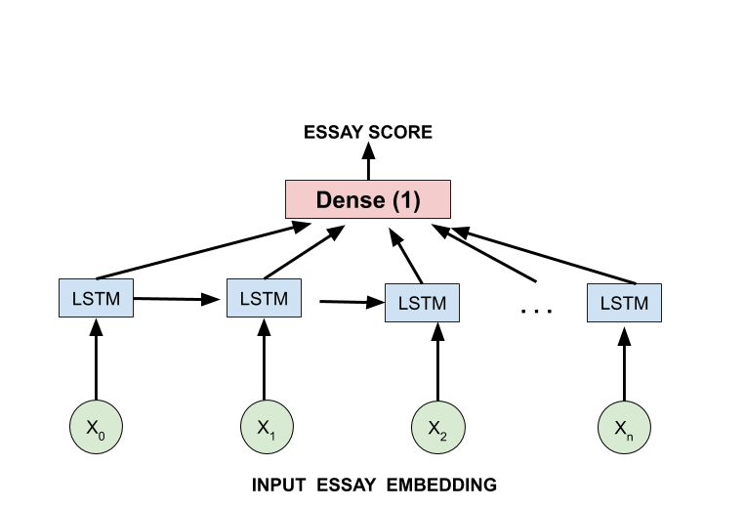
Long-Short Term Memory (LSTM)

Slide 19
Long-Short Term Memory (LSTM)
Parameters: Batch Size = 128, Epochs = 100, Dimension = 100
Dropout Rate | Test Kappa Score
0.1 | 0.5992
0.2 | 0.6053
0.3 | 0.5881
0.4 | 0.5976
0.5 | 0.5871

Slide 20
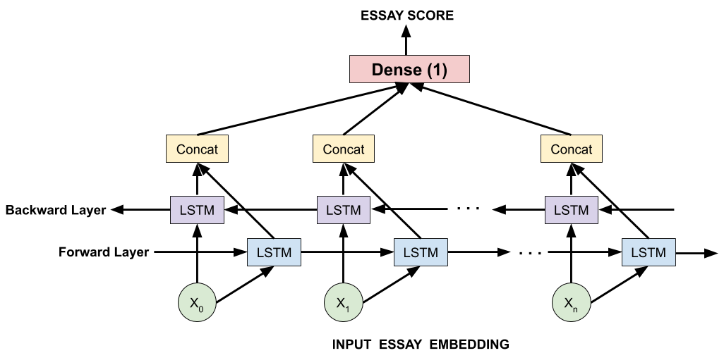
Bidirectional LSTM

Slide 21
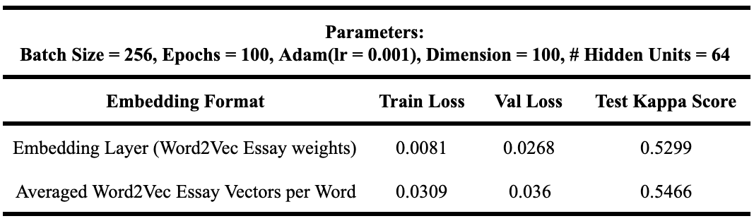
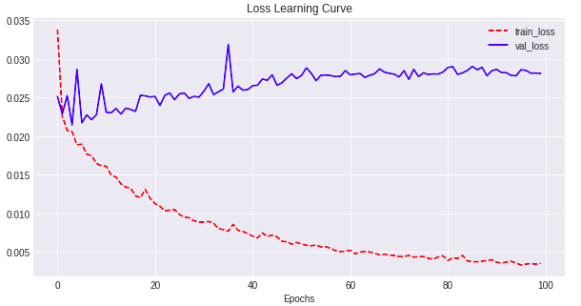
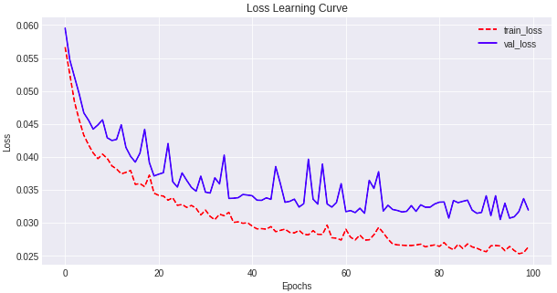
Bidirectional LSTM
Loss: Embedding Layer Model
Loss: Average Vector Model

Slide 22
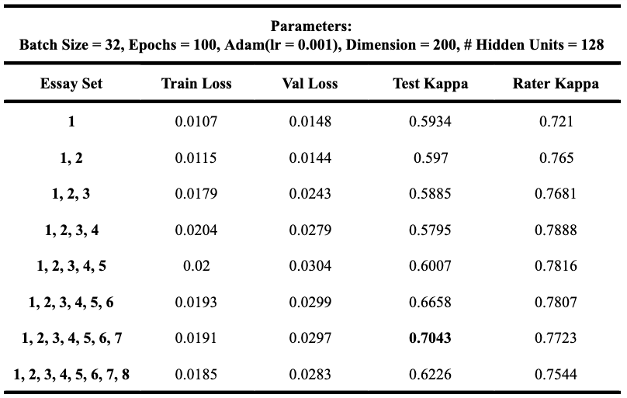
Bidirectional LSTM

Slide 23
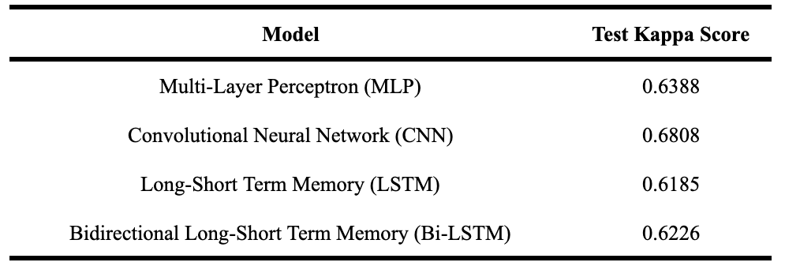
Final Results

Slide 24
Conclusion
&
Future Work
Correct Grammar & Spelling
Stemming & Lemmatization
Feature Engineering
Essay Generation

Slide 25
Thank You!
Questions?

