Slide 1
C/C++ Program Design
Lab 4, Makefile
廖琪梅, 王大兴, 于仕琪

Slide 2
Makefile
What is a Makefile?
Makefile is a tool to simplify and organize compilation. Makefile is a set of commands with variable names and targets . You can compile your project(program) or only compile the update files in the project by using Makefile.

Slide 3
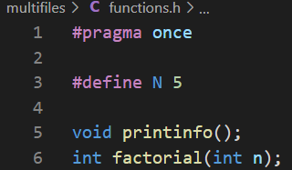
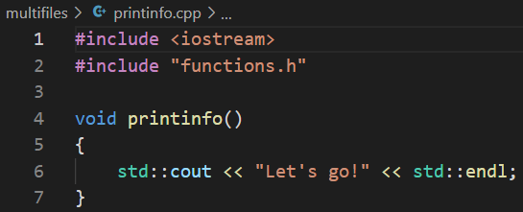
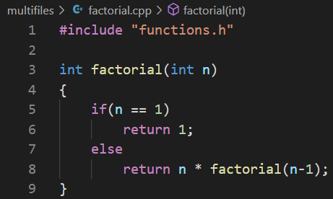
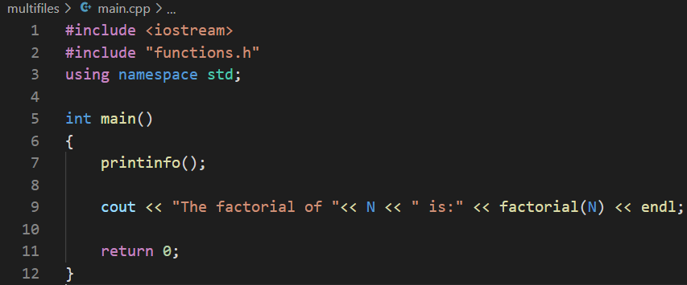
Suppose we have four source files as follows:
Normally, you can compile these files by the following
command:
or

Slide 4
How about if there are hundreds of files to compile? If only one source file is modified, need we compile all the files? Makefile will help you.
The name of makefile must be either makefile or Makefile without extension.
You can write makefile in any text editor. A rule of makefile including three
elements: targets, prerequisites and commands. There are many rules in the
makefile.

Slide 5
A makefile consists of a set of rules. A rule including three elements: target,
prerequisites and commands.
targets : prerequisites
<TAB> command
The target is an object file, which is generated by a program.
Typically, there is only one per rule.
The prerequisites are file names, separated by spaces, as input to create the target.
The commands are a series of steps that make carries out.
These need to start with a tab character, not spaces.

Slide 6
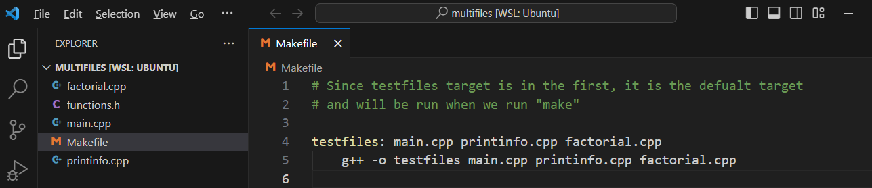
comments begins with #
prerequisites
target
Place the
Makefile
together
with your
programs.
start with <TAB>
commands
g++ is compiler name, -o is linker flag and
testfiles is binary file name.

Slide 7
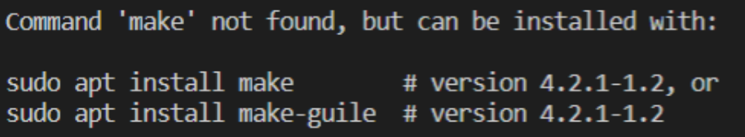

Type the command make in VScode
If you don’t install make in VScode, the information will display on the screen.
Install it first according to the instruction.
Run the commands in the makefile automatically.
Run your program
output

Slide 8
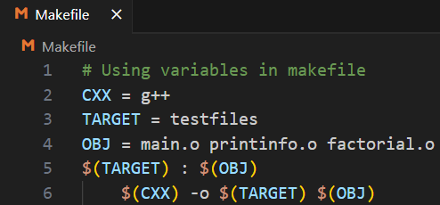
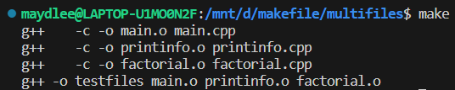
Define Macros/Variables in the makefile
To improve the efficiency of the makefile, we use variables.
variables
start with <TAB>
Write target, prerequisite and commands by variables using ‘$()’
Compile and link the source file
one by one
Note: Deletes all the .o files and executable file created previously before using make command. Otherwise, it’ll display:

Slide 9
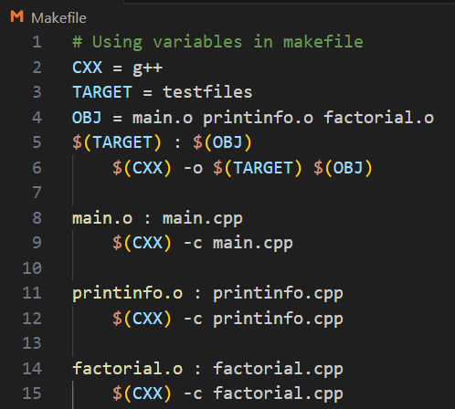

If only one source file is modified, we need not compile all the files. So, let’s
modify the makefile.
If main.cpp is modified, it is compiled
by make.
targets

Slide 10
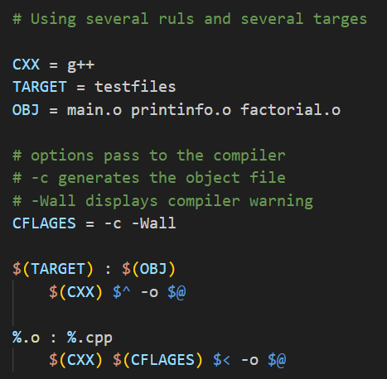
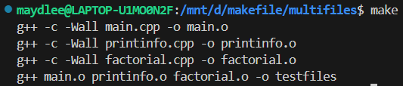


All the .cpp files are compiled to the .o files, so we can modify the makefile like this:
$@: the target file
$^: all the prerequisites files
$<: the first prerequisite file
or
This is a model rule, which indicates that all the .o objects depend on the .cpp files

Slide 11
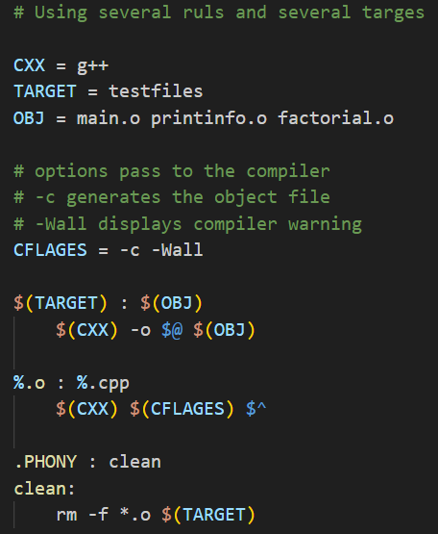
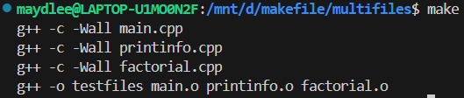
Using phony target to clean up compiled results automatically
Because clean is a label not a target, the command make clean can execute the clean part. Only make command can not execute clean part.
After clean, you can run make again
Adding .PHONY to a target will prevent making from confusing the phony target with a file name.

Slide 12
Functions in makefile
Search all the .cpp files in the current directory, and return to SRC
wildcard: search file
for example:
SRC = $(wildcard ./*.cpp)
All .cpp files in the current directory

Slide 13

patsubst(pattern substitution): replace file
$(patsubst original pattern, target pattern, file list)
Replace all .cpp files with .o files
for example:
OBJ = $(patsubst %.cpp, %.o, $(SRC))
Replace all .cpp files with .o files

Slide 14
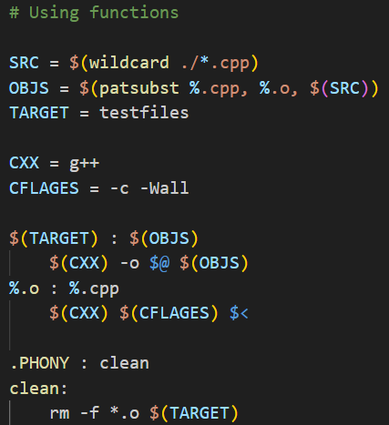
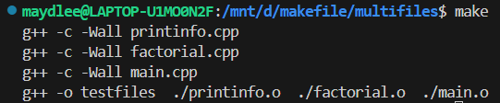
vs

Slide 15
Use Options to Control Optimization
-O1, the compiler tries to reduce code size and execution time, without performing any optimizations that take a great deal of compilation time.
-O2,Optimize even more. GCC performs nearly all supported optimizations that do not involve a space-speed tradeoff. As compared to -O1, this option increases both compilation time and the performance of the generated code.
-O3, Optimize yet more. O3 turns on all optimizations specified by -O2.
https://gcc.gnu.org/onlinedocs/gcc/Optimize-Options.html
https://blog.csdn.net/xinianbuxiu/article/details/51844994

Slide 16
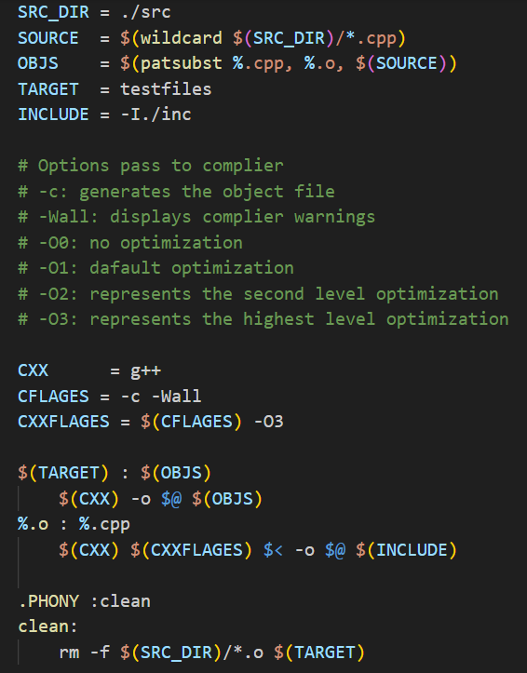
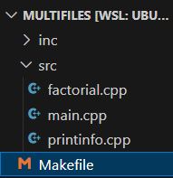
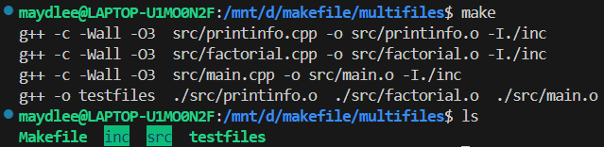
All .h files are in inc
-I means search file(s) in the specified folder i.e. inc folder
All .cpp files are in src
GNU Make Manual
http://www.gnu.org/software/make/manual/make.html

Slide 17
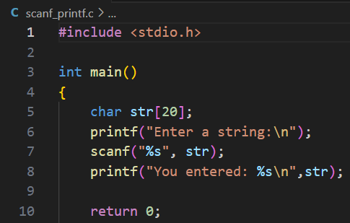
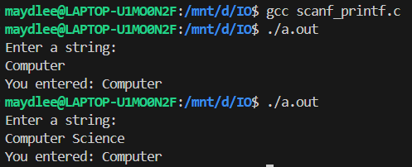
Keyboard input and terminal output of character array
1. C: scanf & printf
%d ----int
%f ----float
%c -----char
%s -----string
There is no &
Why only
Computer?
scanf uses whitespace—spaces, tabs, and newlines to delineate a string.

Slide 18
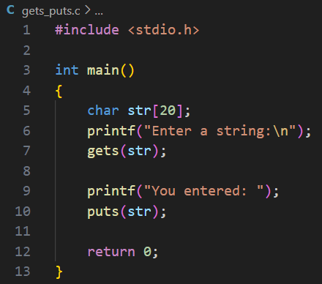
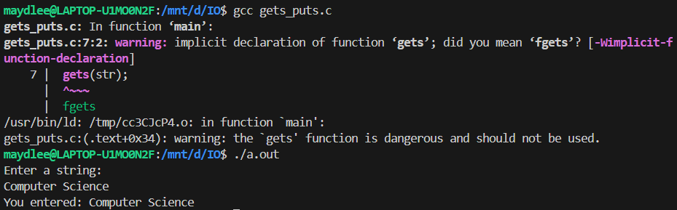
2. C: gets & puts
There is a warning due to using gets().
You can use fgets() function instead.
Use gets to gain a sentence with a space. gets() stops reading input when it encounters a newline or end of file.

Slide 19
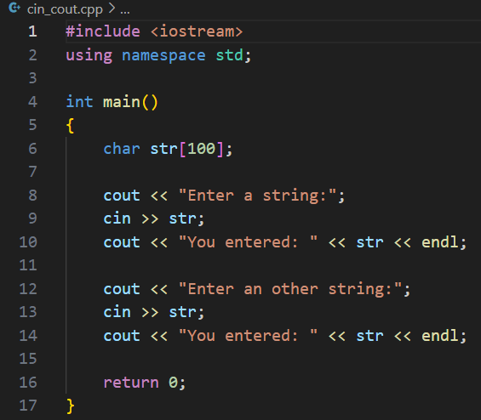


3. C++: cin & cout
The cin is to use whitespace-- spaces, tabs, and newlines to separate a string.

Slide 20
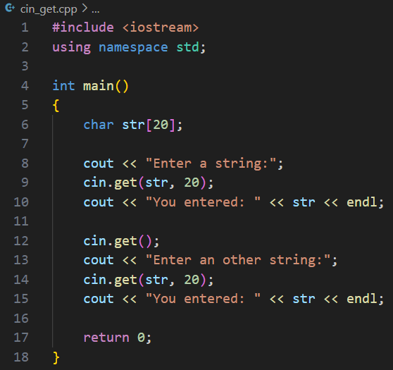


4. C++: cin.get( )
Input a single character:
istream& get(char&);
int get(void);
Input a string:
istream& get(char*,int);
If the statement is omitted, what will be the output?
If the length of input string is greater than 20,
it can only store first 19 characters in it.

Slide 21
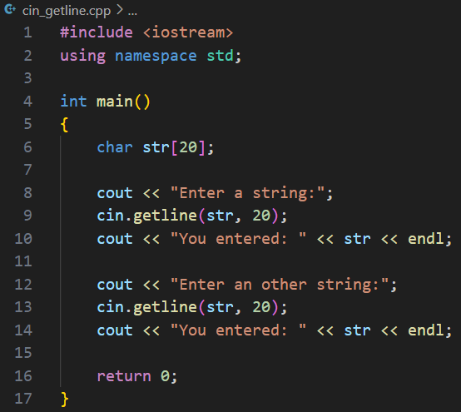

5. C++: cin.getline( )
Input a string:
istream& getline(char*,int);
If the length of input string is greater than 20,
it can only store first 19 characters in it.

Slide 22
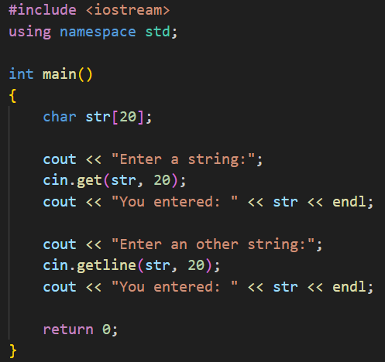

cin.get( ) vs cin.getline( )
getline() and get() both read an entire
input line—that is, up until a newline
character. However, getline() discard
the newline character, whereas get()
leave it in the input queue.
Program runs
without entering
another string

Slide 23
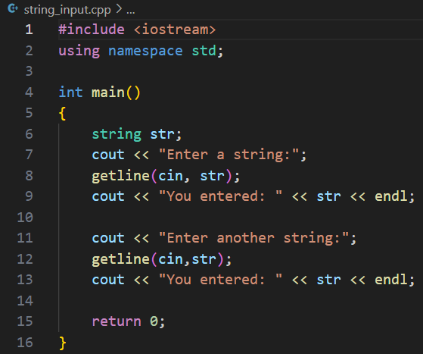

6. string class I/O
getline() function takes the input
stream as the first parameter which
is cin and str as the location of the
line to be stored.

Slide 24
Big-Endian and Little-Endian
BE stores the big-end first, the lowest memory address is the biggest.
LE stores the little-end first, the lowest memory address is the littlest.
#include<stdio.h>
union data
{
int a;
char c;
};
int main()
{
union data endian;
endian.a = 0x11223344;
if(endian.c == 0x11)
printf("Big-Endian\n");
else if(endian.c == 0x44)
printf("Little-Endian\n");
return 0;
}
Big-Endian
2003
44
2002
33
2001
22
2000
11
Little-Endian
2003
11
2002
22
2001
33
2000
44

Slide 25
Exercise 1
#include <iostream>
#include <string.h>
using namespace std;
int main()
{
int cards[4]{};
int hands[4];
int price[] = {2.8,3.7,5,9};
char direction[4] {'L',82,'U',68};
char title[] = "ChartGPT is an awesome tool.";
cout << "sizeof(cards) = " << sizeof(cards) << ",sizeof of cards[0] = " << sizeof(cards[0]) << endl;
cout << "sizeof(price) = " << sizeof(price) << ",sizeof of price[0] = " << sizeof(price[1]) << endl;
cout << "sizeof(direction) = " << sizeof(direction) << ",length of direction = " << strlen(direction) << endl;
cout << "sizeof(title) = " << sizeof(title) << ",length of title = " << strlen(title) << endl;
return 0;
}
First, complete the code, then run the program and explain the result to SA. If it has bugs, fix them.

Slide 26
Exercise 2
#include <stdio.h>
union data{
int n;
char ch;
short m;
};
int main()
{
union data a;
printf("%d, %d\n", sizeof(a), sizeof(union data) );
a.n = 0x40;
printf("%X, %c, %hX\n", a.n, a.ch, a.m);
a.ch = '9';
printf("%X, %c, %hX\n", a.n, a.ch, a.m);
a.m = 0x2059;
printf("%X, %c, %hX\n", a.n, a.ch, a.m);
a.n = 0x3E25AD54;
printf("%X, %c, %hX\n", a.n, a.ch, a.m);
return 0;
}
Run the program and explain the result to SA. You can write a program to check whether you system is little-endian or big-endian.

Slide 27
Exercise 3
Design a struct “DayInfo” which contains two enumeration types as its member. The first is an enum “Day” for (Sunday, Monday, ...), and the second is an enum “Weather” for (Sunny, Rainy, ...).
Define a boolean function “bool canTravel( DayInfo )” . It will return true if the day is at weekend and the weather is good.
Call function canTravel() in main().

Slide 28
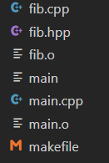
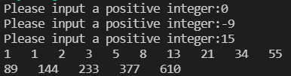
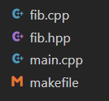
The Fibonacci numbers are : 1,1,2,3,5,8……. Please define a function in fib.cpp to compute the nth Fibonacci number. In main.cpp, prompts the user to input an integer n, then print Fibonacci numbers from 1 to n, 10 numbers per line. Write a makefile to manage the source files.
Exercise 4
Before clean:
After clean:

