Slide 1
C/C++ Program Design
Lab 5, CMake
廖琪梅，王大兴

Slide 2

What is CMake?
CMake is an open-source, cross-platform family of tools designed to build, test and package software. CMake is used to control the software compilation process using simple platform and compiler independent configuration files, and generate native makefiles and workspaces that can be used in the compiler environment of your choice.
For more information https://cmake.org/

Slide 3
CMake needs CMakeLists.txt to run properly.
A CMakeLists.txt consists of commands , comments and spaces.
The commands include command name, brackets and parameters ,
the parameters are separated by spaces. Commands are not case sensitive.
Comments begins with ‘#’.
Steps for generating a makefile and compiling on Linux using CMake:
Step1: Writes the CMake configuration file CMakeLists.txt.
Step2: Executes the command cmake PATH to generate the Makefile.
(PATH is the directory where the CMakeLists.txt resides.)
Step3: Compiles using the make command.

Slide 4
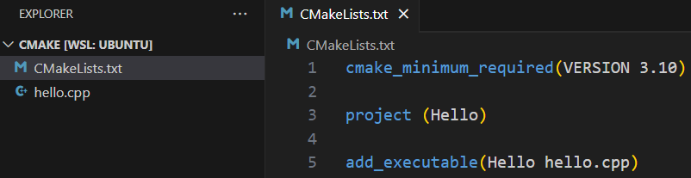
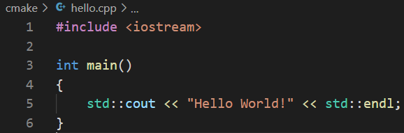
1. A single source file in a project
The most basic project is an executable built from source code files. For simple projects, a three-line CMakeLists.txt file is all that is required.
Specifies the minimum
required version of CMake.
Use cmake --version in Vscode terminal window to check the cmake version in your computer.
Defines the project
name.
Adds the Hello executable
target which will be built
from hello.cpp.
The first parameter indicates the filename of executable file.
The second parameter indicates the source file.
Suppose there is a hello.cpp
Stores the CMakeLists.txt file in the same directory as the hello.cpp.

Slide 5

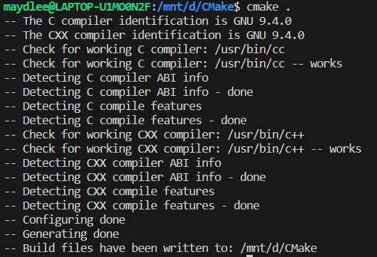
In current directory, type cmake . to generate makefile. If cmake does not be installed, follow the instruction to install cmake.
Install cmake first by instruction
Run cmake to generate makefle, . indicates the CMakeList.txt is in the current directory.
Makefile file is created automatically after running cmake in the current directory. Except Makefile, there are other new files and folders.

Slide 6
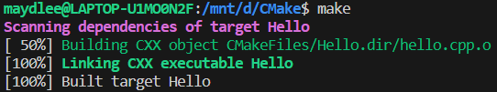
Execute make to compile the program.
Run the program

Slide 7
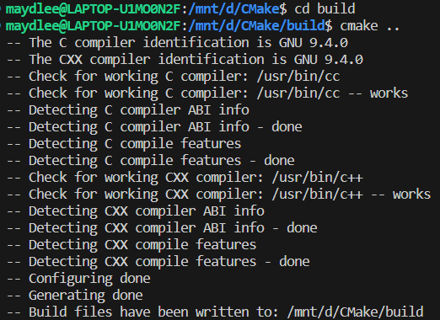
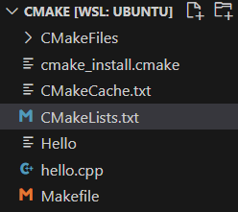
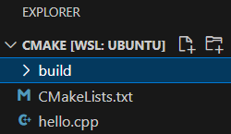
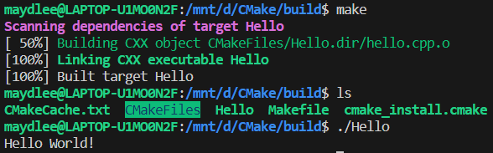
Deletes all the building files and directory by CMake.
Creates an empty folder to store the building files and directory by CMake.

Slide 8
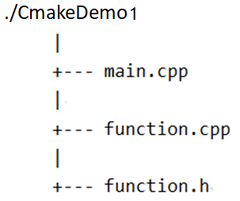
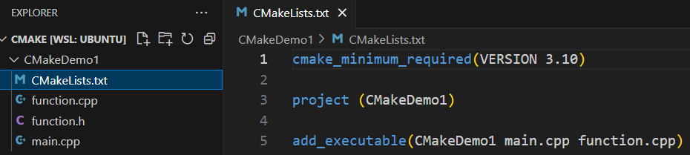
2. Multi-source files in a project
There are three files in the same directory.
List all the source files using space as the separator.

Slide 9
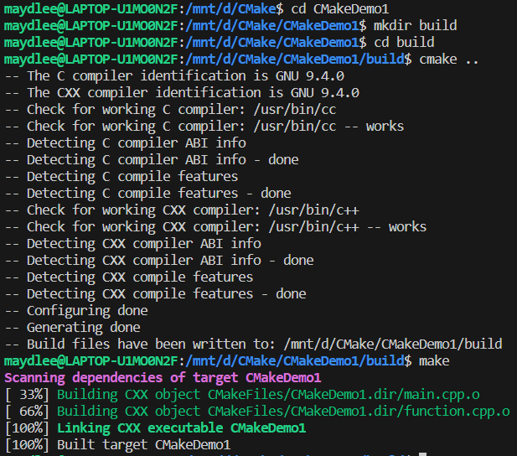
Creates a folder

Slide 10
2. Multi-source files in a project
If there are several files in directory, put each file into the add_executable command is not recommended. The better way is using aux_source_directory command.
aux_source_directory (<dir> <variable>)
The command finds all the source files in the specified directory indicated by <dir> and stores the results in the specified variable indicated by <variable>.

Slide 11
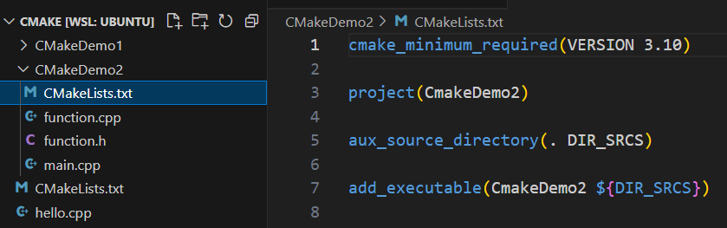
2. Multi-source files in a project
Stores all files in the current directory
into DIR_SRCS variable.
Compiles the source files in the variable by ${ } into an executable file named CmakeDemo2

Slide 12


Slide 13
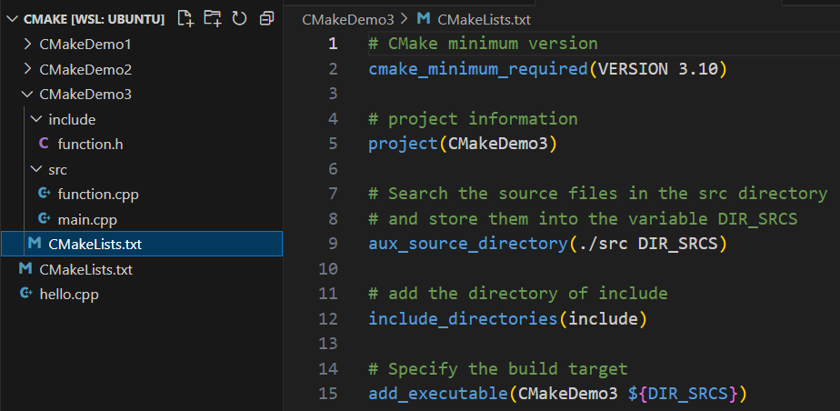
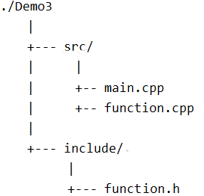
3. Multi-source files in a project in different directories
We write CMakeLists.txt in CmakeDemo3 folder.
./CMakeDemo3
All .cpp files are in the src directory
Include the header file which is stored in
include directory.

Slide 14
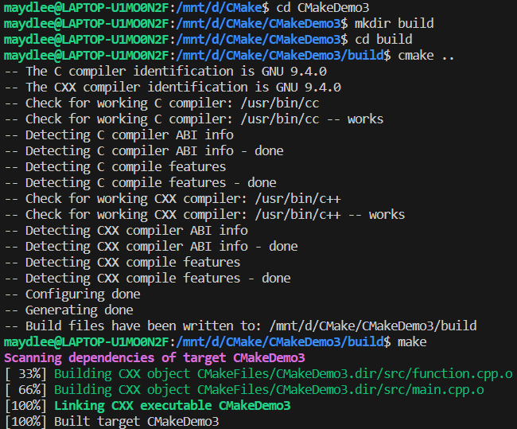
For more cmake tutorial:
https://cmake.org/cmake/help/latest/guide/tutorial/index.html
https://riptutorial.com/cmake

Slide 15
Exercise 1
#include<stdio.h>
int main()
{
int a[]={2,4,6,8,10},y=1,*p;
p=&a[1];
printf("a = %p\np = %p\n",a, p);
for(int i = 0; i < 3; i++)
y += *(p+i);
printf("y = %d\n\n",y);
int b[5]={1,2,3,4,5};
int *ptr=(int*)(&b+1);
printf("b = %p\nb+4 = %p\nptr = %p\n",b,b+4,ptr);
printf("%d,%d\n",*(b+1),*(ptr-1));
return 0;
}
Run the program and explain the result to SA.

Slide 16
Exercise 2
#include <iostream>
using namespace std;
int main()
{
int a[][4]={1,3,5,7,9,11,13,15,17,19};
int *p=*(a+1);
p += 3;
cout << "*p++ = " << *p++ << ",*p = " << *p << endl;
const char *pc = "Welcome to programming.", *r;
long *q = (long *)pc;
q++;
r = (char *)q;
cout << r << endl;
unsigned int m = 0x3E56AF67;
unsigned short *pm = (unsigned short *) &m;
cout << "*pm = " << hex << *pm << endl;
return 0;
}
Run the program and explain the result to SA.

Slide 17
Exercises 3
Declare a structure named stuinfo and two function prototypes below in a stuinfo.hpp. Implement the two functions in a stufun.cpp. Write a main.cpp which contains main() and demonstrate all the features of the prototyped functions.
Write a MakeLists.txt for cmake to create Makefile automatically. Run cmake and make, and then run the program at last.
struct stuinfo
{
char name[20];
double score[3];
double ave;
};
Function prototypes:
void inputstu(stuinfo stu[] , int n), asks the user to enter each of the preceding items of information to set the corresponding members of the structure and compute the average score for each student.
void showstu(stuinfo stu[] , int n) ,displays the contents of the structure, one student one line.

