Slide 1
C/C++ Program Design
CS205
Prof. Shiqi Yu (于仕琪)
yusq@sustech.edu.cn
http://faculty.sustech.edu.cn/yusq/

Slide 2
Functions

Slide 3
Why functions?
A compound statement may be needed to execute many times
You can copy them several times, but ...
struct Matrix
{
size_t rows;
size_t cols;
float * pData;
};
Matrix matA;
float maxa = FLT_MIN;
for(size_t r = 0; r < matA.rows; r++)
for (size_t c = 0; c < matA.cols; c++)
{
float val = matA.pData[ r * matA.cols + c];
maxa = ( maxa > val ? maxa : val);
}
nofunction.cpp

Slide 4
Why functions?
We can put the compound statement into a function
float matrix_max(struct Matrix mat)
{
float max = FLT_MIN;
for(size_t r = 0; r < mat.rows; r++)
for (size_t c = 0; c < mat.cols; c++)
{
float val = mat.pData[ r * mat.cols + c];
max = ( max > val ? max : val);
}
return max;
}
float maxa = matrix_max(matA);
float maxb = matrix_max(matB);
float maxc = matrix_max(matC);
function.cpp

Slide 5
A Question
If Matrix::pData is NULL or an invalid value, how to tell the calling function from the called one?
The pointer should be checked first!
float matrix_max(struct Matrix mat)
{
float max = FLT_MIN;
for(size_t r = 0; r < mat.rows; r++)
for (size_t c = 0; c < mat.cols; c++)
{
float val = mat.pData[ r * mat.cols + c];
max = ( max > val ? max : val);
}
return max;
}

Slide 6
Where should a function be? Option 1
// draw.cpp
// The function must be defined before it was called
bool drawLine(int x1, int y1, int x2, int y2)
{
// Source code here
return true;
}
bool drawRectangle(int x1, int y1, int x2, int y2)
{
// some calculation here
drawLine(...);
drawLine(...);
drawLine(...);
drawLine(...);
return true;
}

Slide 7
Where should a function be? Option 2
// draw.cpp
// declared first, parameter names can be omitted
bool drawLine(int x1, int y1, int x2, int y2);
bool drawRectangle(int x1, int y1, int x2, int y2)
{
// some calculation here
drawLine(...);
drawLine(...);
drawLine(...);
drawLine(...);
return true;
}
// define it later
bool drawLine(int x1, int y1, int x2, int y2)
{
// Source code here
return true;
}

Slide 8
Where should a function be? Option 3
// draw.h
#ifndef __DRAW_H__
#define __DRAW_H__
bool drawLine(int x1, int y1, int x2, int y2);
bool drawRectangle(int x1, int y1, int x2, int y2);
#endif
// main.cpp
#include <draw.h>
int main()
{
// ...
drawRectangle(10, 20, 50, 100);
// ...
}
// draw.cpp
#include <draw.h>
bool drawRectangle(int x1, int y1, int x2, int y2)
{
// some calculation here
drawLine(...);
drawLine(...);
drawLine(...);
drawLine(...);
return true;
}
// define it later
bool drawLine(int x1, int y1, int x2, int y2)
{
// Source code here
return true;
}

Slide 9
How are functions called?
A call stack can store information about the active functions of a program
Store the address the program returns after the function call
Store the registers
Store the local variables
//do some work of the called function
Restore the registers
Restore the local variables
Store the function returned result
Jump to the return address
The cost to call a function!

Slide 10
Function Parameters

Slide 11
Parameters
The symbolic name for "data" that passes into a function.
Two ways to pass into a function:
Pass by value
Pass by reference

Slide 12


Pass by value: fundamental type
The parameter is a copy of the original variable
int foo(int x)
{ // x is a copy
x += 10;
return x;
}
int main()
{
int num1 = 20;
int num2 = foo( num1 );
return 0;
}
Will num1 be changed in foo()?

Slide 13
Pass by value: pointer
What’s the difference?
int foo(int * p)
{
(*p) += 10;
return *p;
}
int main()
{
int num1 = 20;
int * p = &num1;
int num2 = foo( p );
return 0;
}
It still is passing by value (the address!)
A copy of the address
param-pointer.cpp

Slide 14
Pass by value: structure
How about structure parameter?
struct Matrix
{
int rows;
int cols;
float * pData;
};
float matrix_max(struct Matrix mat)
{
float max = FLT_MIN;
for(int r = 0; r < mat.rows; r++)
for (int c = 0; c < mat.cols; c++)
{
float val = mat.pData[ r * mat.cols + c];
max = ( max > val ? max : val);
}
return max;
}

Slide 15
Pass by value: structure
. . .
matA | pData
 | cols:4
 | rows:3
Matrix matA = {3,4};
matrix_max(matA);
float matrix_max(struct Matrix mat)
{
float max = FLT_MIN;
for(size_t r = 0; r < mat.rows; r++)
for (size_t c = 0; c < mat.cols; c++)
{
float val = mat.pData[ r * mat.cols + c];
max = ( max > val ? max : val);
}
return max;
}
mat | pData
 | cols:4
 | rows:3

Slide 16
Pass by value: structure
If the structure is a huge one, such as 1K bytes.
A copy will cost 1KB memory, and time consuming to copy it.
?

Slide 17
References

Slide 18
References in C++
References are in C++, not in C.
A reference is an alias to an already-existing variable/object.
int num = 0;
int & num_ref = num;
num | 0 | 0xABCDEF03
 |  | 0xABCDEF02
 |  | 0xABCDEF01
 |  | 0xABCDEF00
num,
num_ref
10
num_ref = 10;
reference.cpp

Slide 19
References in C++
. . .
matA | pData
 | cols:4
 | rows:3
A reference to an object
matA matA_ref
struct Matrix
{
size_t rows;
size_t cols;
float * pData;
};
pMatA | 0xABCDEF00
matB | pData
 | cols:4
 | rows:3
Matrix matA = {3,4};
matA.pData = new float[matA.rows * matA.cols]{};
Matrix & matA_ref = matA;
Matrix * pMatA = &matA;
Matrix matB = matA;

Slide 20
References in C++
A reference must be initialized after its declaration.
Reference VS Pointer: References are much safer
int & num_ref; // error
Matrix & mat_ref; // error

Slide 21
Function parameters with a huge structure
If the huge struct is passed as a function parameter
struct PersonInfo
{
char firstname[256];
char middlename[256];
char lastname[256];
char address[256];
char nationalID[16];
// and more
};
char * fullname(struct PersonInfo pi)
{
// ...
}
The data will be copied. Not a good choice!

Slide 22
The problem
One solution is to use a pointer
struct PersonInfo
{
char firstname[256];
char middlename[256];
char lastname[256];
char address[256];
char nationalID[16];
// and more
};
char * fullname(struct PersonInfo * ppi)
{
if (ppi == NULL)
{
cerr << "Invalid pointer" << endl;
return NULL;
}
// ...
}

Slide 23
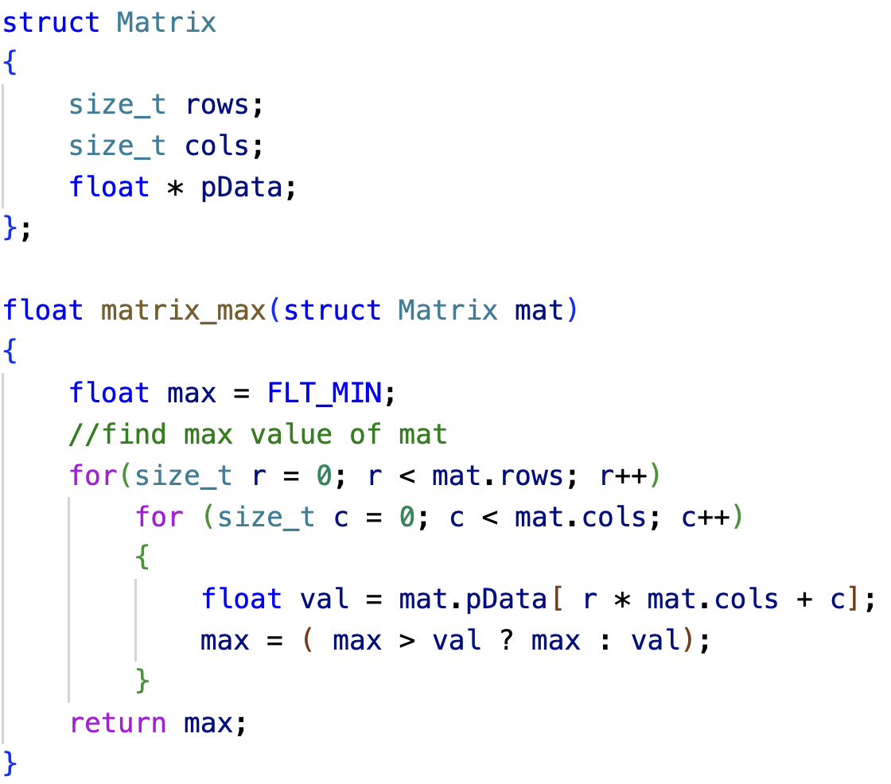
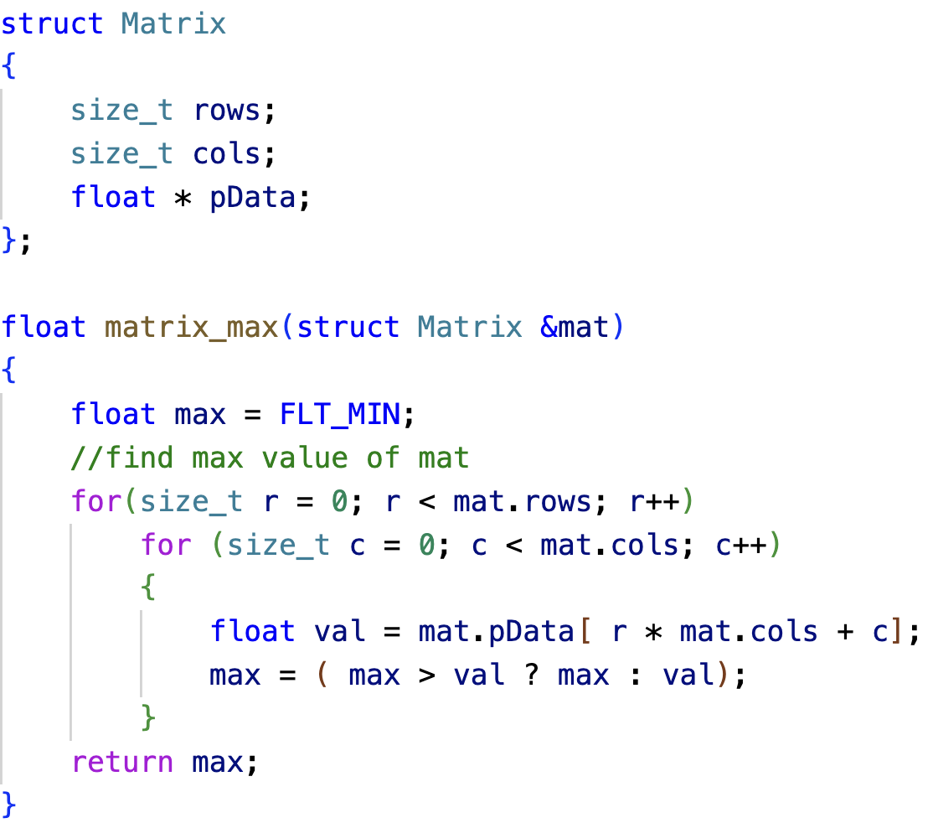

References as function parameters
No data copying in the reference version; Better efficiency
The modification to a reference will affect the original object

Slide 24
References as function parameters
To avoid the data is modified by mistakes,
float matrix_max(const struct Matrix & mat)
{
float max = FLT_MIN;
// ...
return max;
}

Slide 25
Return statement

Slide 26
Return statement
Statement return; is only valid if the function return type is void.
Just finish the execution of the function, no value returned.
void print_gender(bool isMale)
{
if(isMale)
cout << "Male" << endl;
else
cout << "Female" << endl;
return;
}
void print_gender(bool isMale)
{
if(isMale)
cout << "Male" << endl;
else
cout << "Female" << endl;
}

Slide 27
Return statement
The return type can be a fundamental type or a compound type.
Pass by value:
Fundamental types: the value of a constant/variable is copied
Pointers: the address is copied
Structures: the whole structure is copied
float maxa = matrix_max(matA);
Matrix * pMat = create_matrix(4,5);
Matrix * create_matrix(size_t rows, size_t cols)
{
Matrix * p = new Matrix{rows, cols};
p->pData = new float[p->rows * p->cols]{1.f, 2.f, 3.f};
// you should check if the memory is allocated successfully
// and don’t forget to release the memory
return p;
}

Slide 28
If we have a lot to return
Such as a matrix addition function (A+B->C)
A suggested prototype:
To use references to avoid data copying
To use const parameters to avoid the input data is modified
To use non-const reference parameters to receive the output
bool matrix_add(const Matrix & matA, const Matrix & matB, Matrix & matC)
{
// check the dimensions of the three matrices
// re-create matC if needed
// do: matC = matA + matB
// return true if everything is right
}

Slide 29
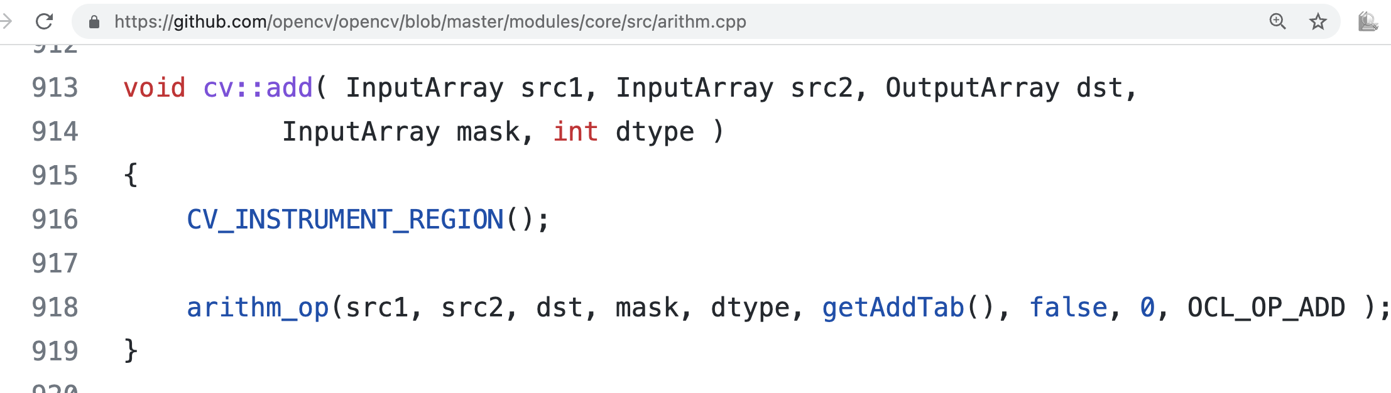
Similar mechanism in OpenCV
Matrix add in OpenCV
https://github.com/opencv/opencv/blob/master/modules/core/src/arithm.cpp

Slide 30
Inline functions

Slide 31
Inline functions
Stack operations and jumps are needed for a function call.
It is a heavy cost for some frequently called tiny functions.
float max_function(float a, float b)
{
if (a > b)
return a;
else
return b;
}
int main()
{
int num1 = 20;
int num2 = 30;
int maxv = max_function(num1, num2);
maxv = max_function(numn, maxv);
}

Slide 32
Inline functions
The generated instructions by a compiler can be as follows to improve efficiency
int main()
{
int num1 = 20;
int num2 = 30;
int maxv =
maxv =
}
{if (num1 > num2)
return num1;
else
return num2;}
{if (numn > maxv)
return numn;
else
return maxv;}

Slide 33
Inline functions
inline suggests the compiler to perform that kind of optimizations.
The compiler may not follow your suggestion if the function is too complex or contains some constrains.
Some functions without inline may be optimized as an inline one.
inline float max_function(float a, float b)
{
if (a > b)
return a;
else
return b;
}

Slide 34
Why not use a macros?
#define MAX_MACRO(a, b) (a)>(b) ? (a) : (b)
The source code will be replaced by a preprocessor.
Surely no cost of a function call,
And a, b can be any types which can compare.
inline.cpp

Slide 35
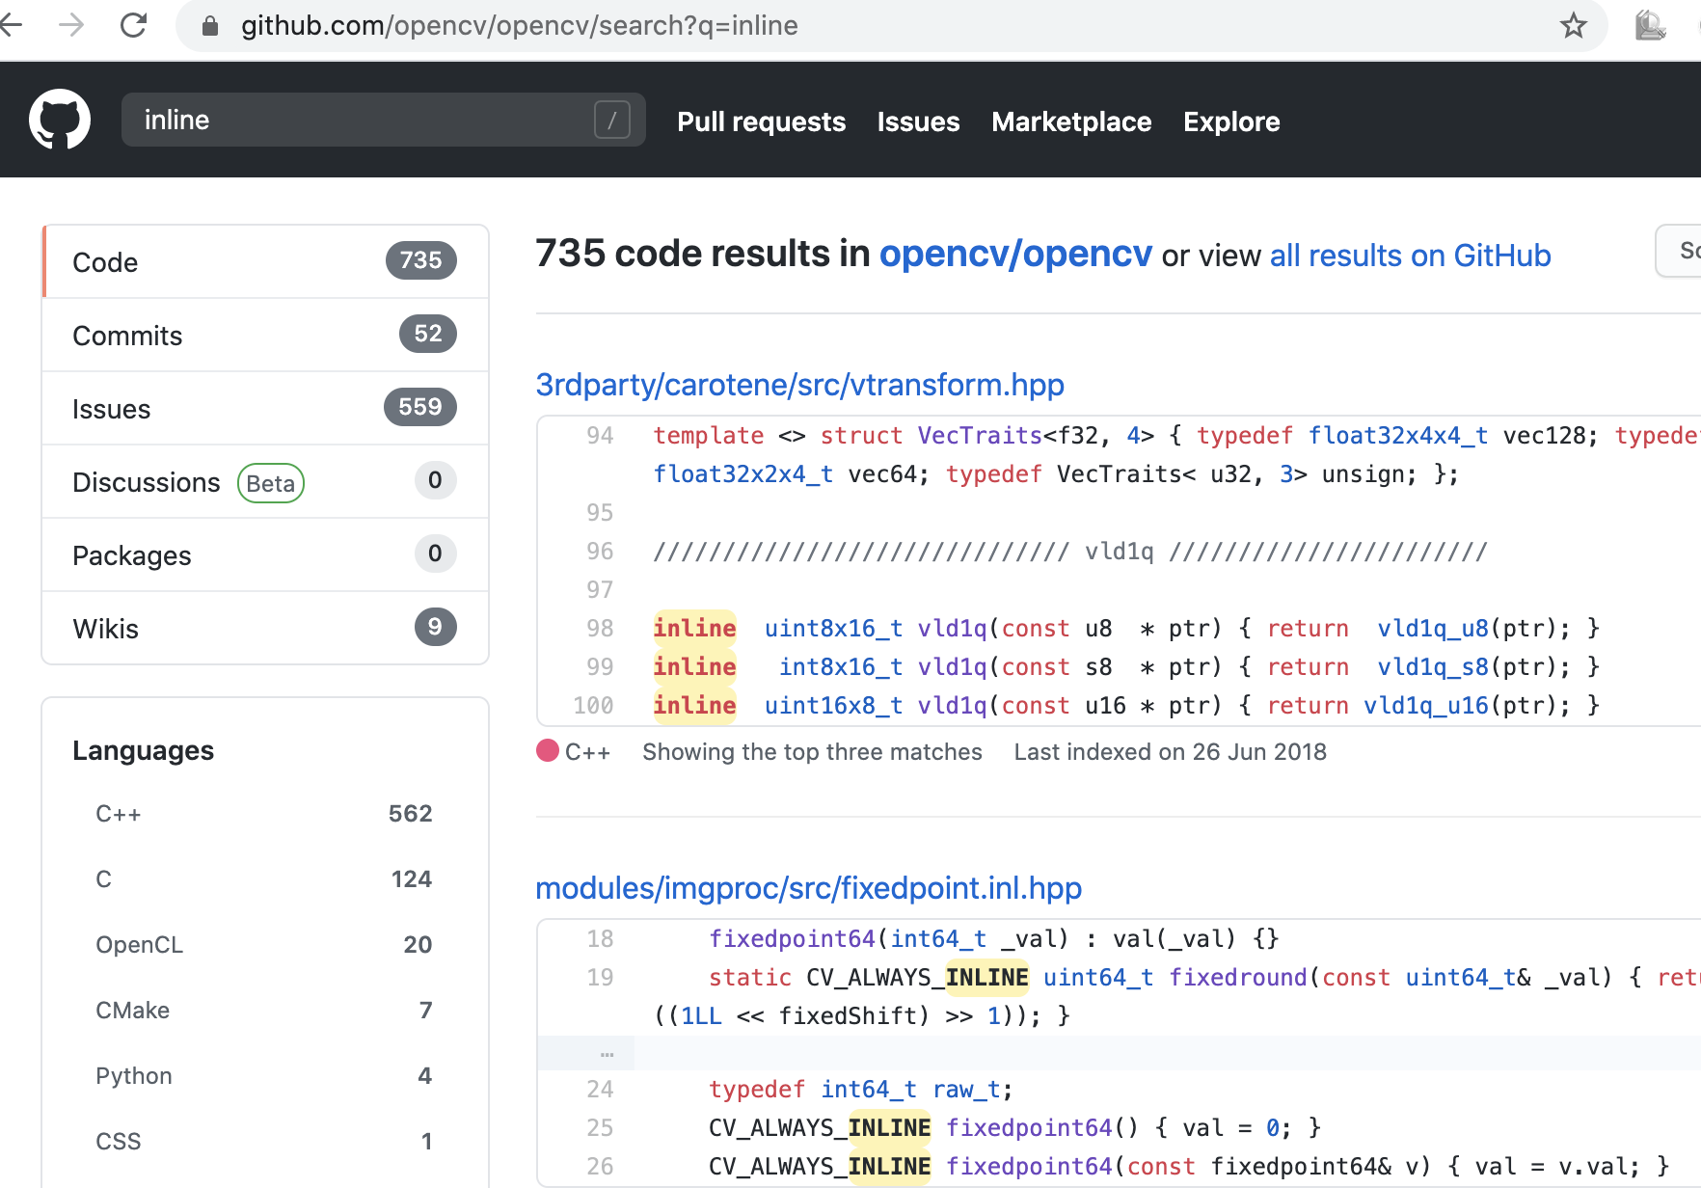
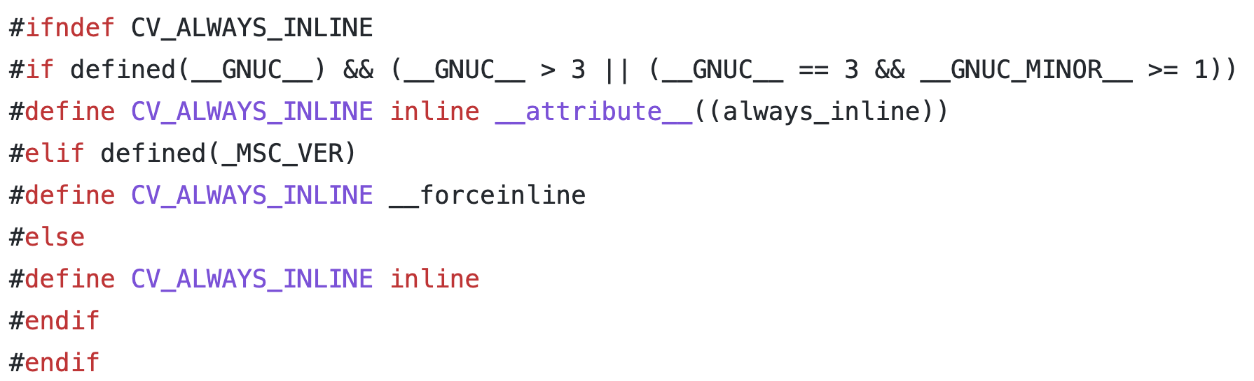
Inline in OpenCV

