Slide 1
C/C++ Program Design
Lab 8, SIMD and OpenMP
于仕琪，廖琪梅

Slide 2

Intel Intrinsics

Slide 3

SIMD@Intel
MMX: 1997, 8 registers, 64 bits,
SSE (Streaming SIMD Extensions): 1999, 128 bits
SSE2: 2000
SSE3: 2004
SSSE3: 2006
SSE4.1: 2006
SSE4.2
AVX (Advanced Vector Extensions): 2011, 256 bits
AVX2: 2013
AVX-512: 2016

Slide 4
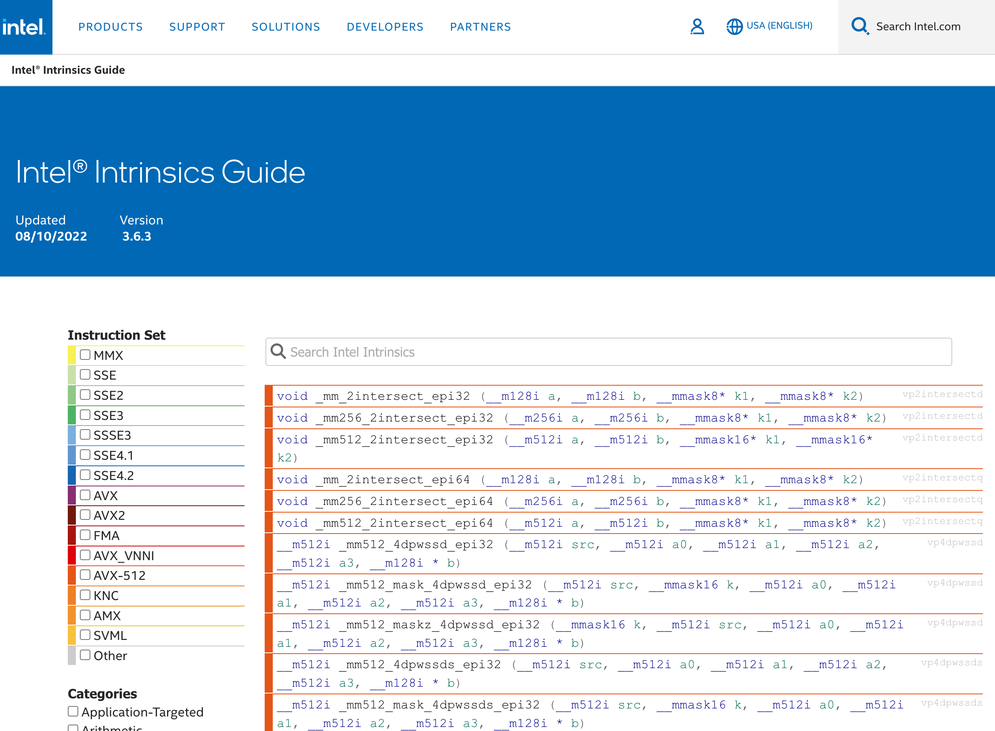
Intel® Intrinsics Guide
https://www.intel.com/content/www/us/en/docs/intrinsics-guide/index.html

Slide 5
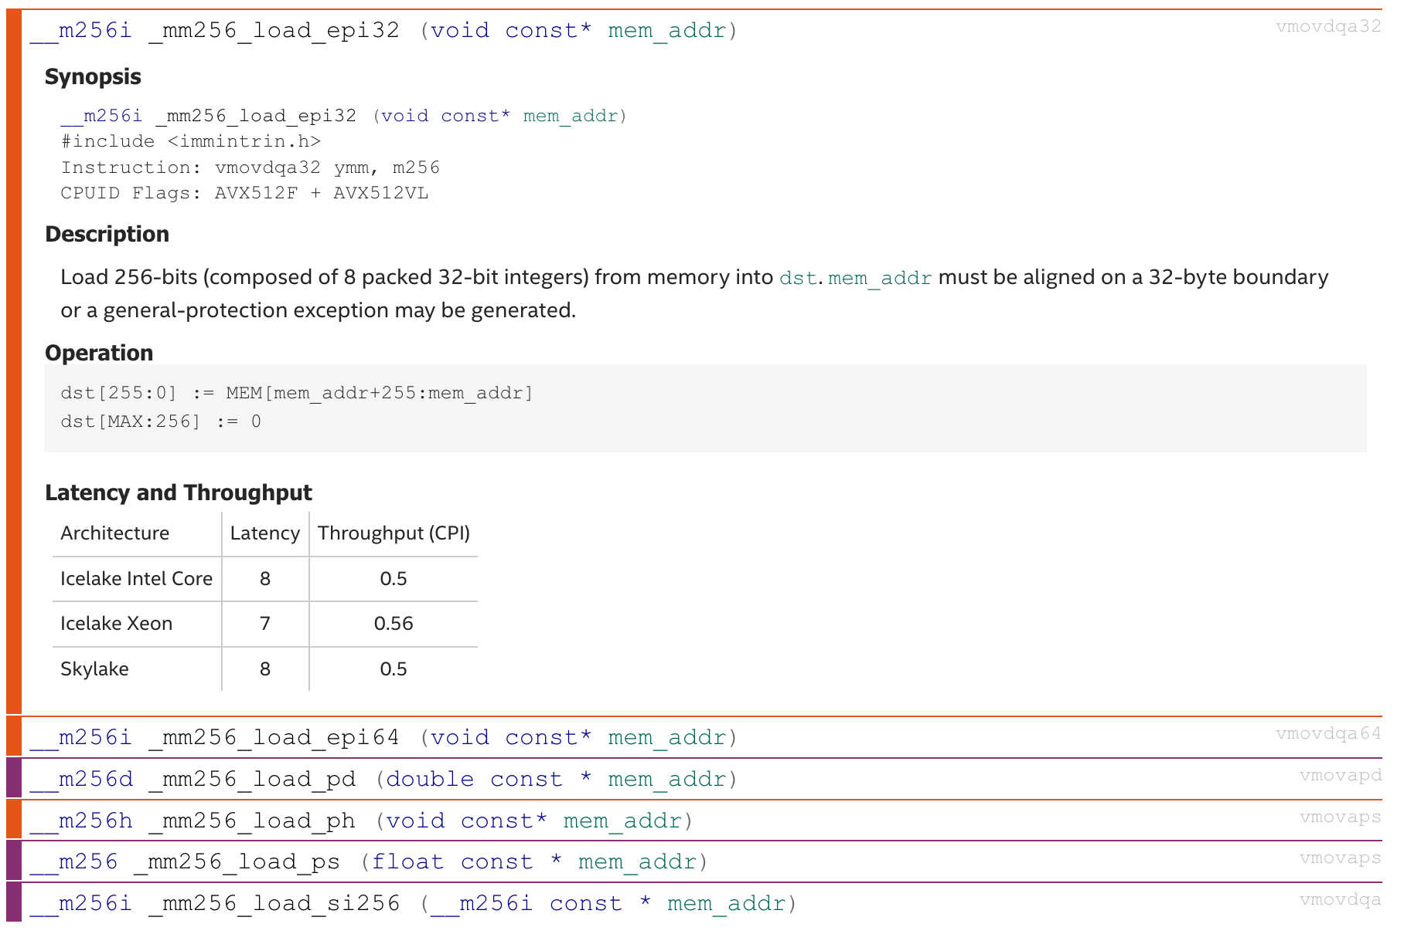
Load data from memory to registers
float * p = ...;
__m256 a;
a = _mm256_load_ps(p);

Slide 6
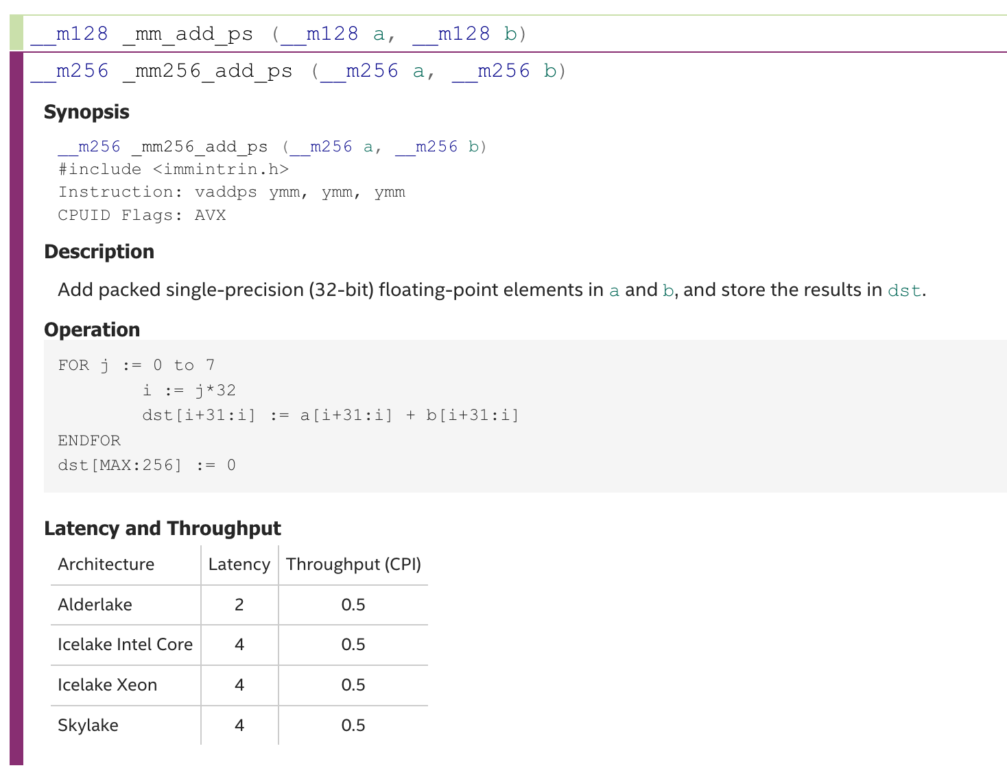
Add operation
s is for single precision floating point (float); d is for double precision floating point (double)
__m256 a, b, c;
a = _mm256_load_ps(p1 + i);
b = _mm256_load_ps(p2 + i);
c = _mm256_add_ps(a, b);
p is for packed data, all scalars will be in the operation.
s is for scalar, only the first scaler will be involved.

Slide 7
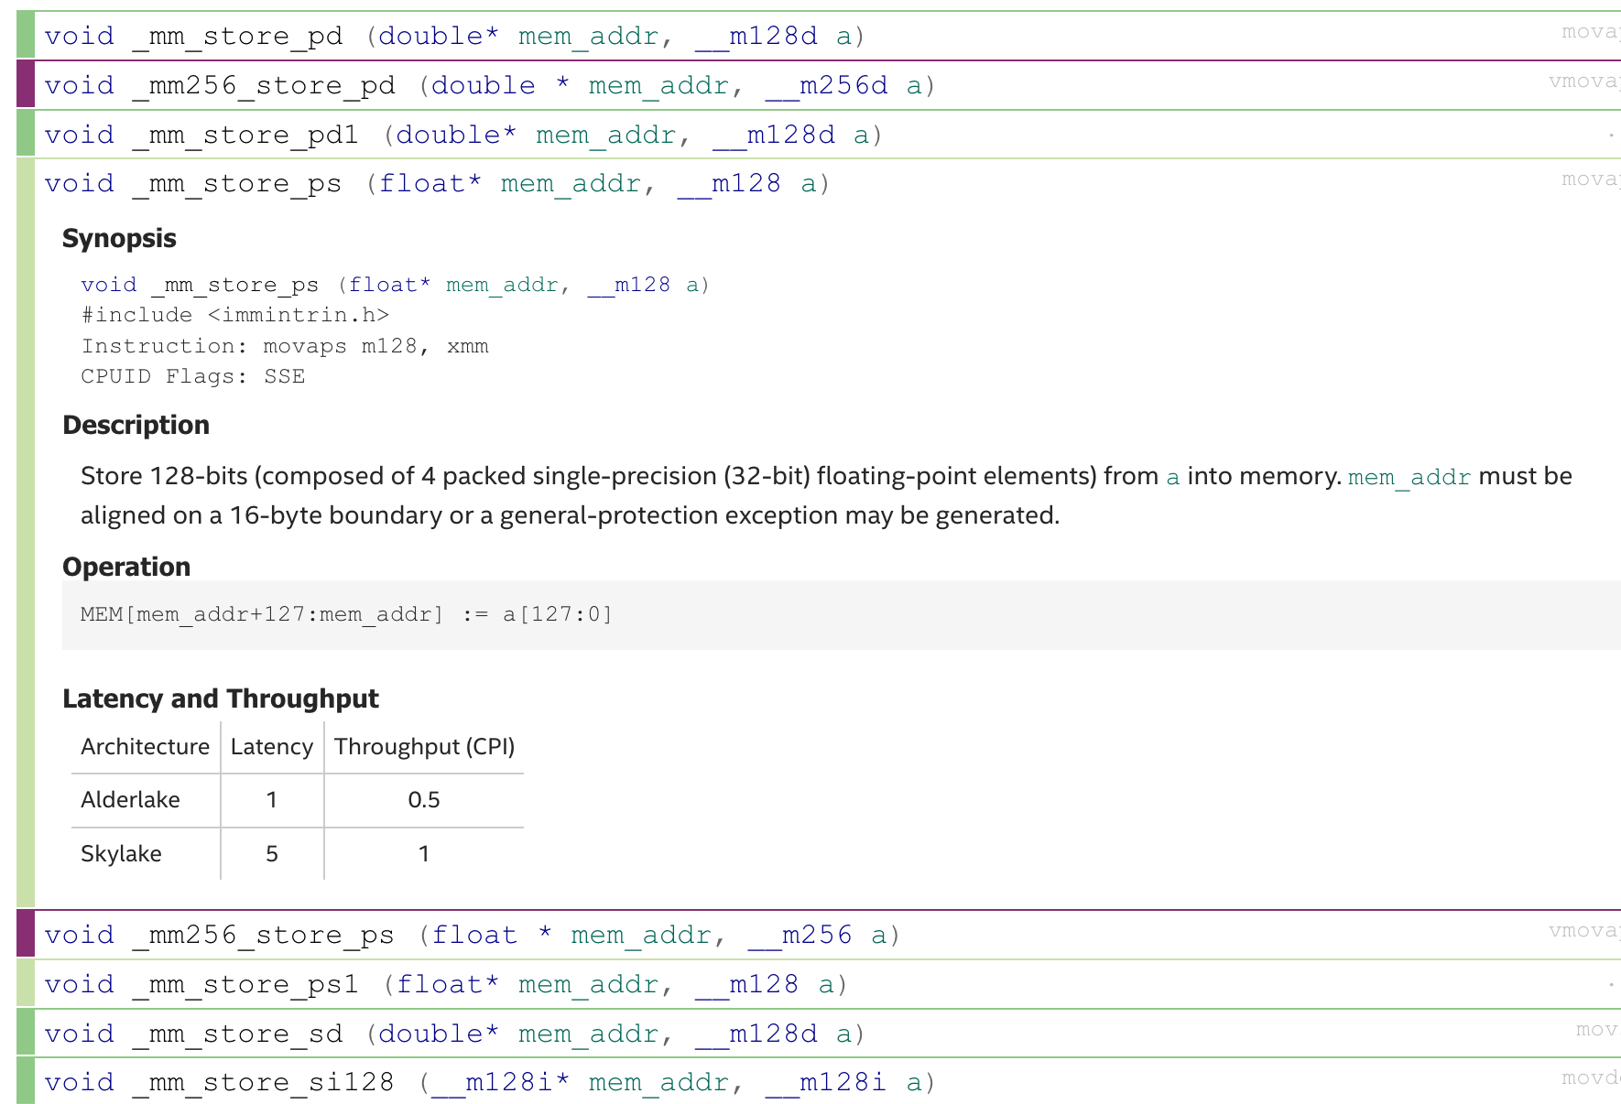
Store data from registers to memory
__m256 c;
float * p = ...;
_mm256_store_ps(p, c);

Slide 8

ARM Neon Intrinsics

Slide 9
SIMD@ARM
Neon: 64 bits and 128 bits
Helium (or MVE): More instructions
SVE (Scalable Vector Extension): 128 bits to 2048 bits
SVE2

Slide 10
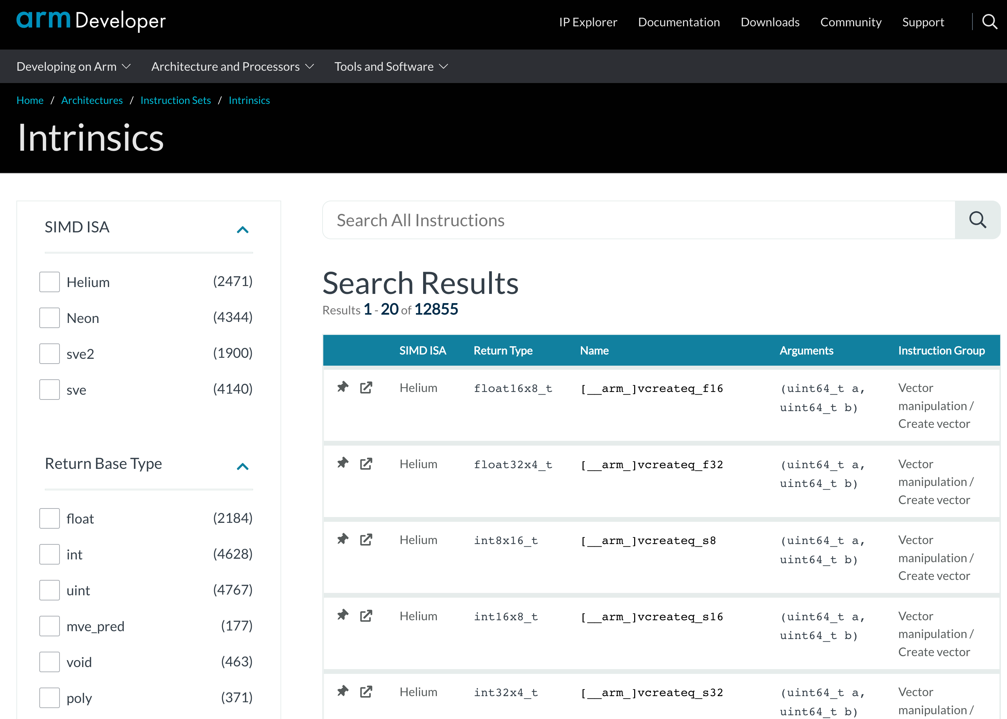
ARM Intrinsics
https://developer.arm.com/architectures/instruction-sets/intrinsics/

Slide 11
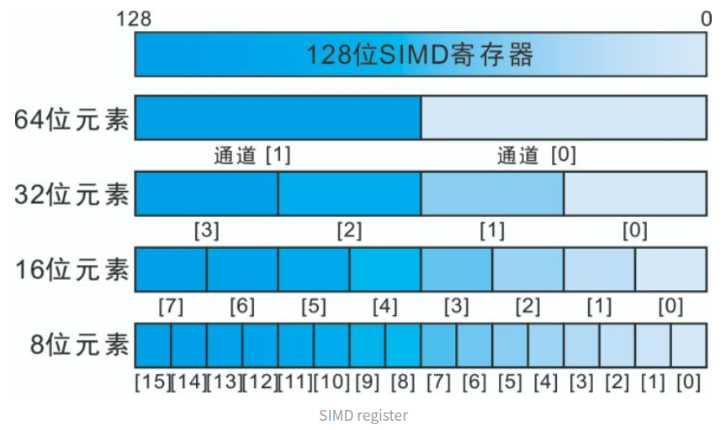
The NEON Intrinsics can operator on 128-bit registers
https://manzp.blog.csdn.net/article/details/114686930

Slide 12
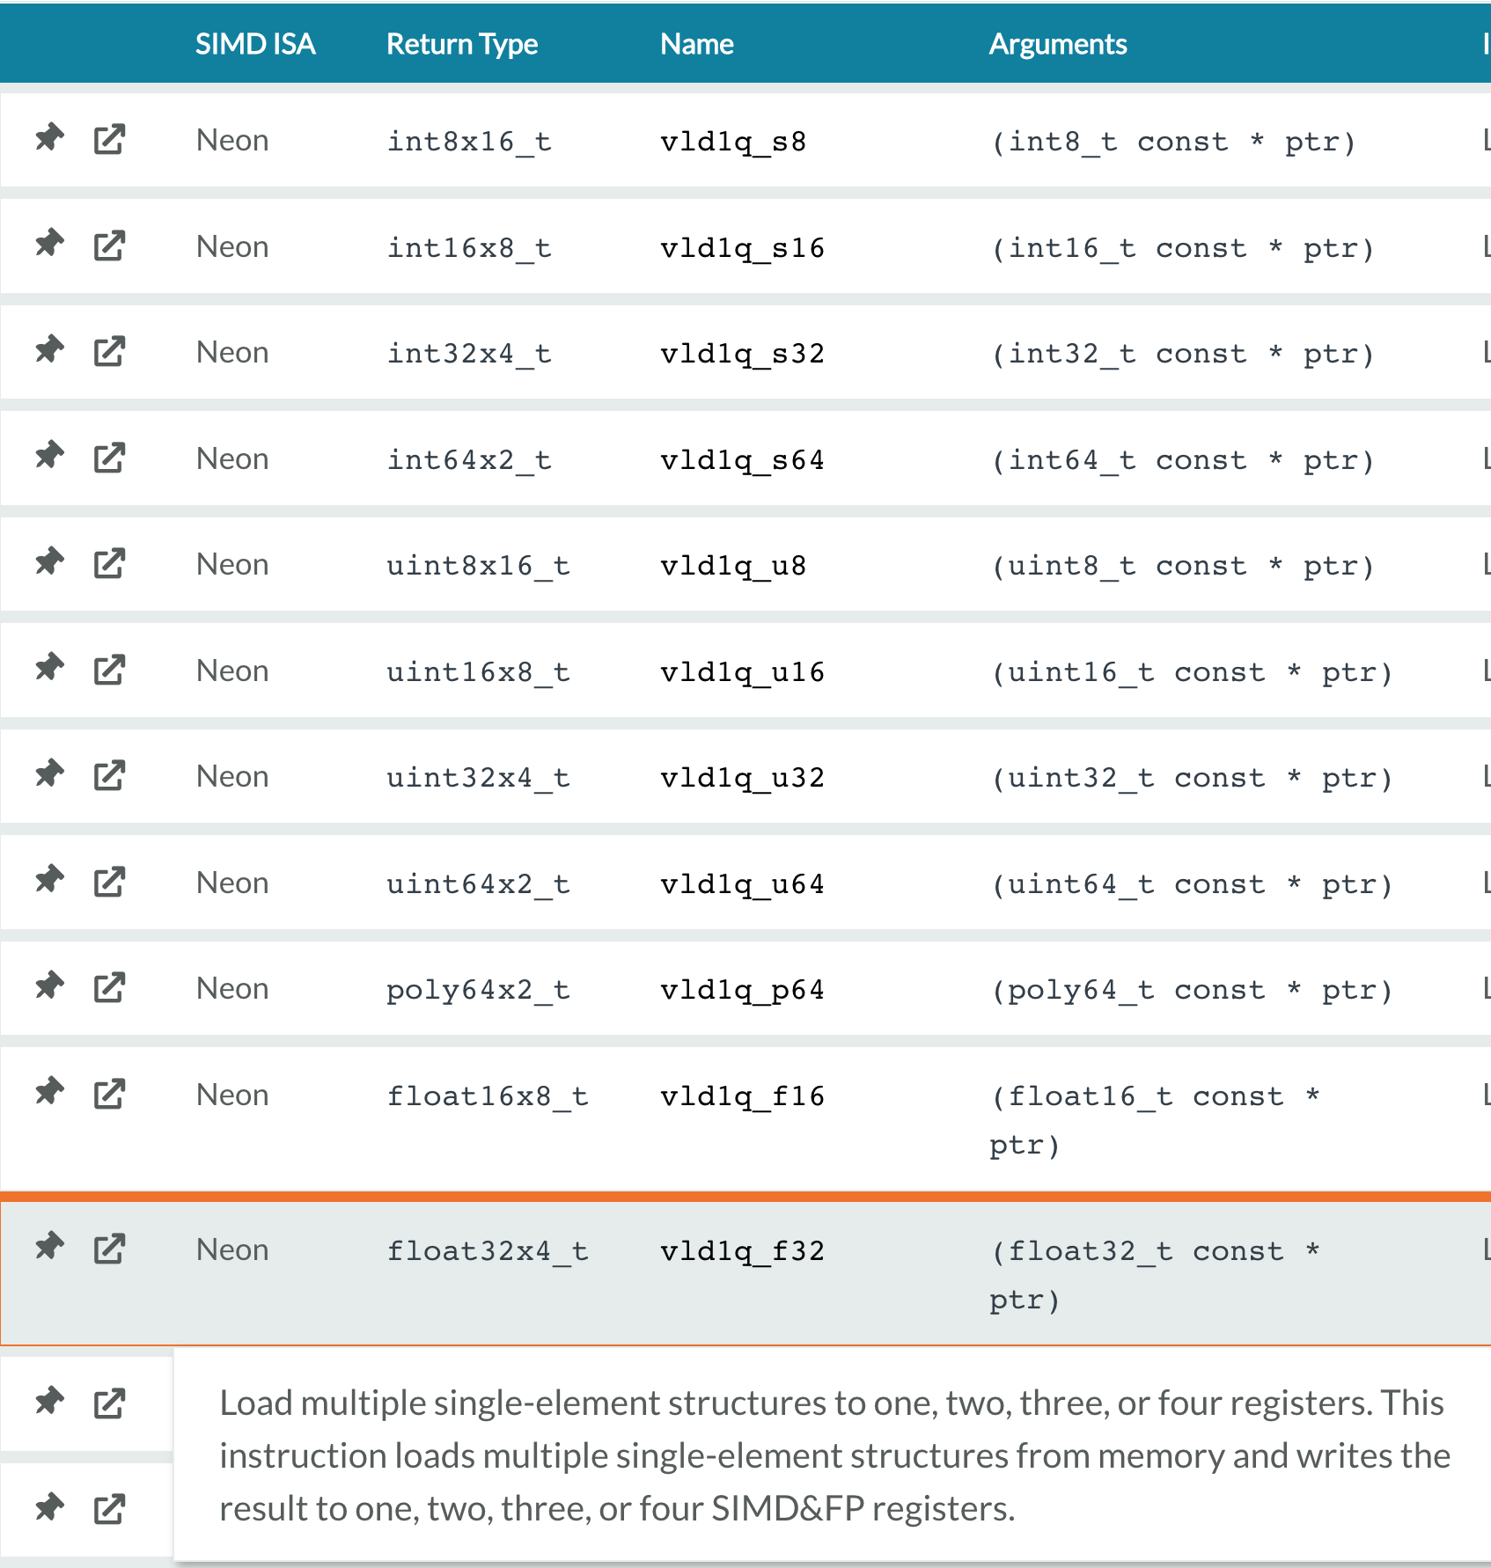
Load data from memory to registers

Slide 13
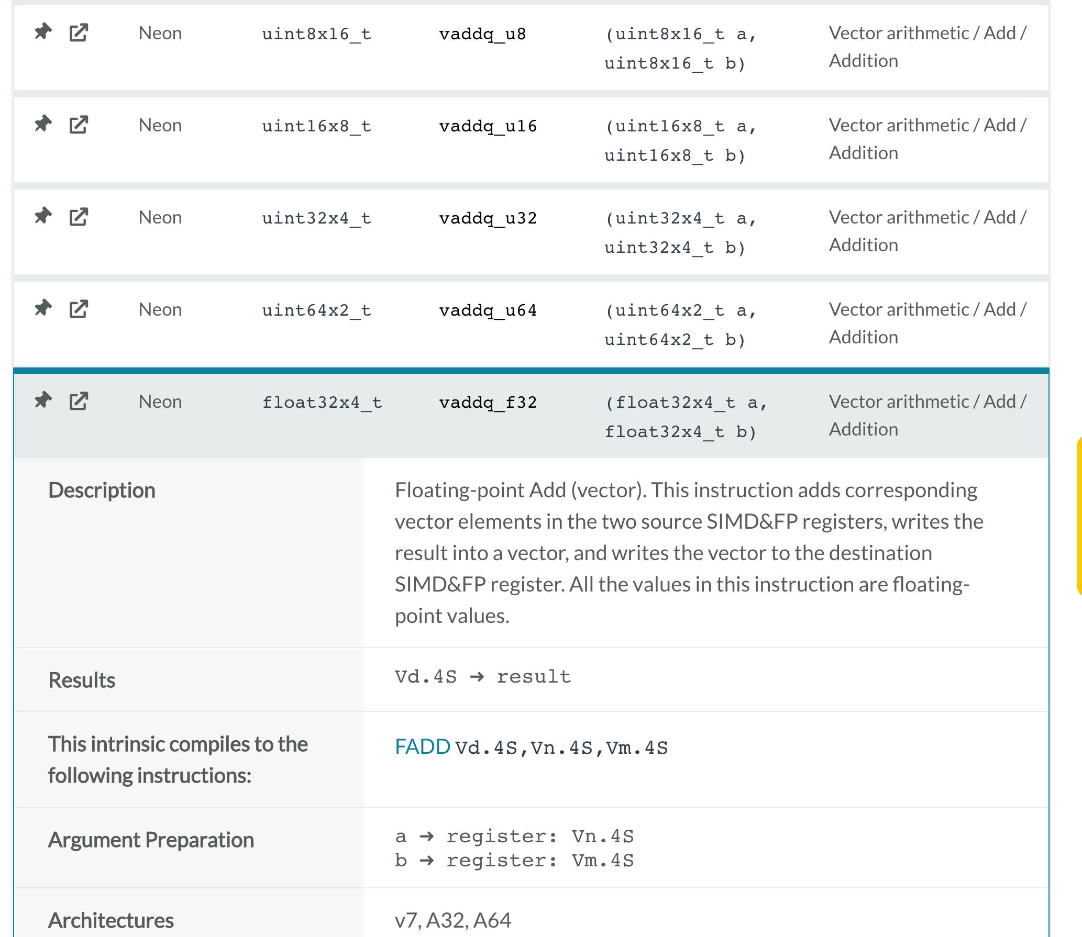
Add operation

Slide 14
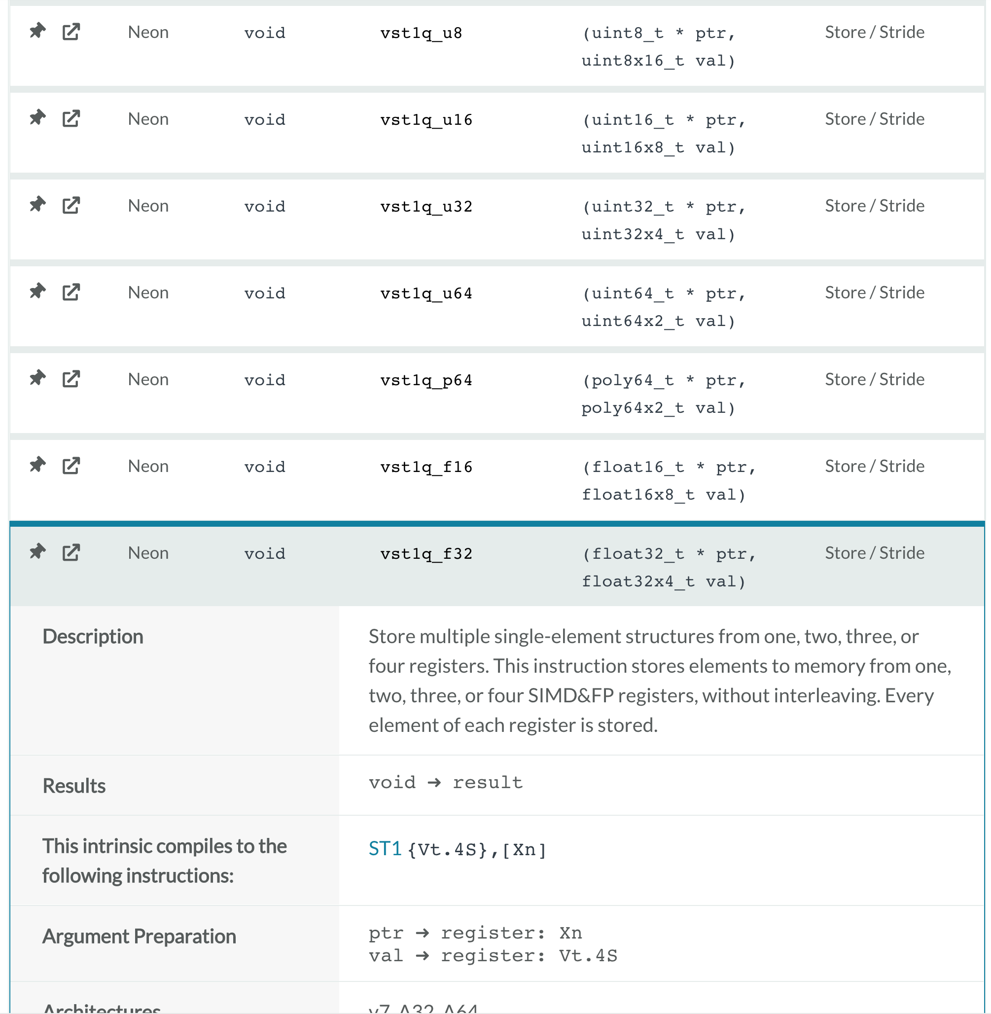
Store data from registers to memory

Slide 15
Some tips for the example of Week 8

Slide 16
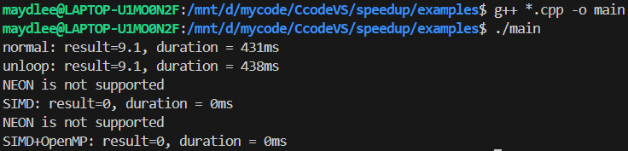
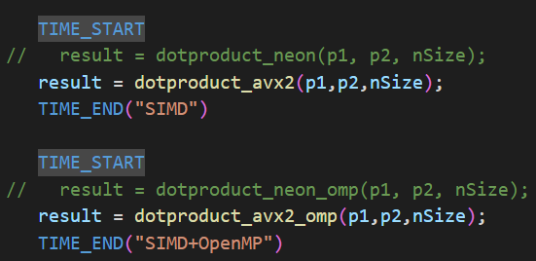
If you compile the source code using “g++ *.cpp –o main”
They mean you did not compile the
source code with NEON.
If you run the example at Intel CPU, please enable the function call of dotproduct_avx2() in main.cpp.

Slide 17
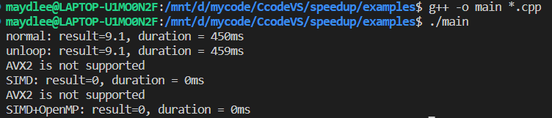
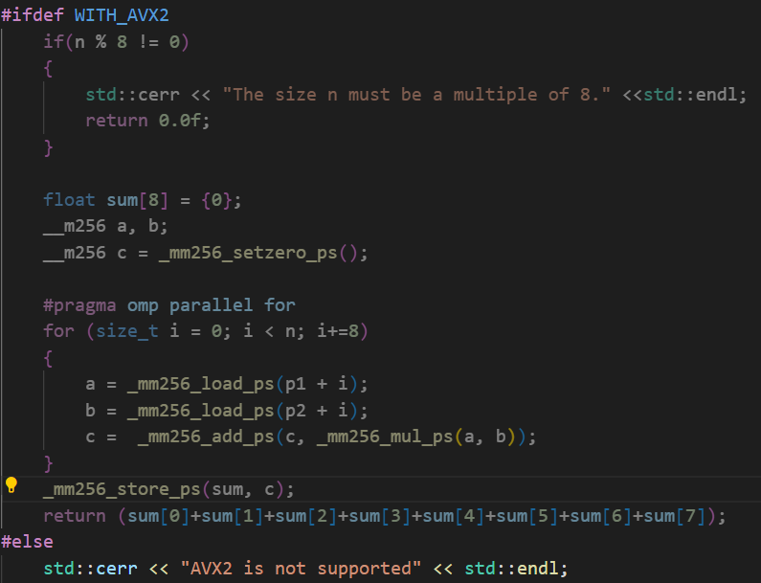
2. If you compile it again, the output still mentions AVX2 is not supported.
The macro WITH_AVX2 should be enabled when you compile.
No AVX2 support

Slide 18
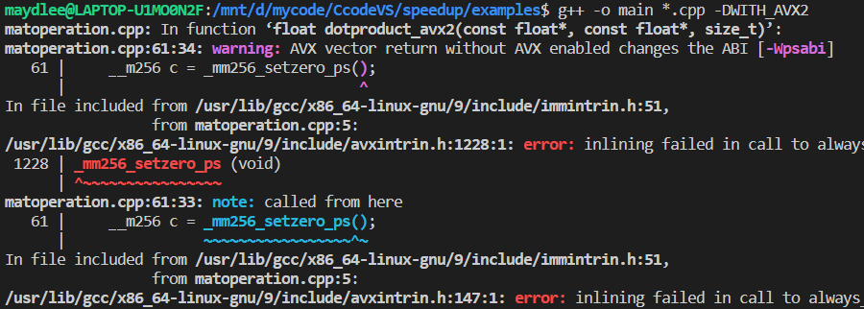
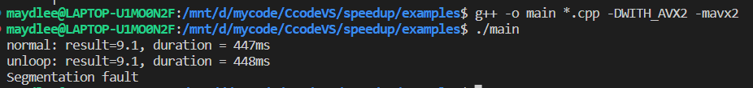
To enable the macro by the option -DWITH_AVX2
You may get the error message: error:inlining failed .. because you didn’t tell the compiler to enable AVX2.
Please use the option -mavx2 to let g++ enable AVX2 support.
运行到调用avx2指令时出现段错误

Slide 19
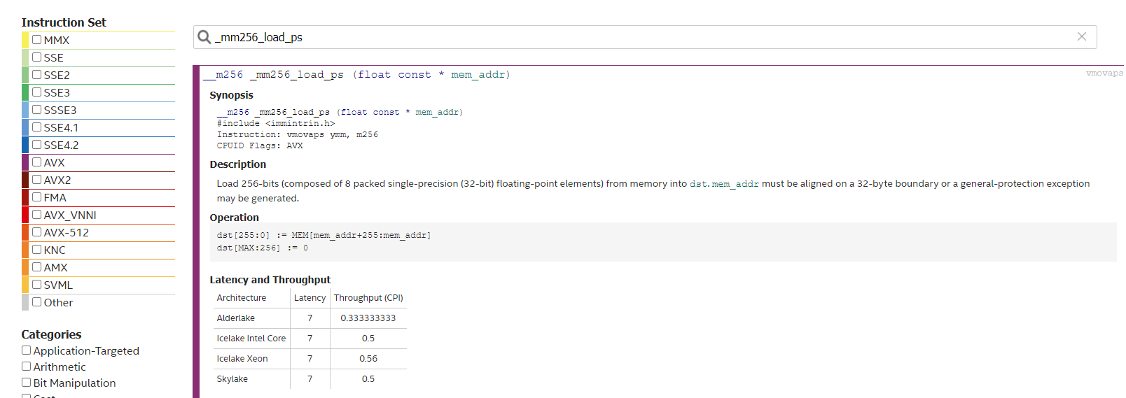
https://www.intel.com/content/www/us/en/docs/intrinsics-guide/index.html
Input the name you search
It means _mm256_load_ps() is in AVX (not AVX2)
The option -mavx is for AVX, and -mavx is for AVX2
g++ main.cpp matoperation.cpp -mavx
g++ main.cpp matoperation.cpp -mavx2

Slide 20
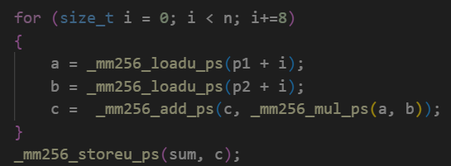
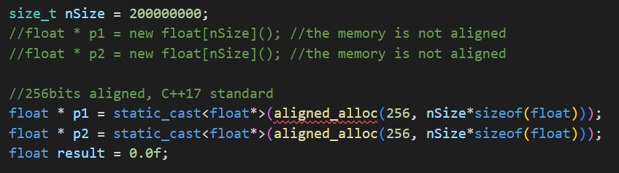
You still may get segment fault or wrong results.
①For Intel CPU, it’s better to use loadu & storeu, nor load/store.
②load and store are for aligned memory only.
_loadu here is for unaligned memeory
_storeu here is for unaligned memory
Unaligned memory allocation
Aligned memory allocation

Slide 21
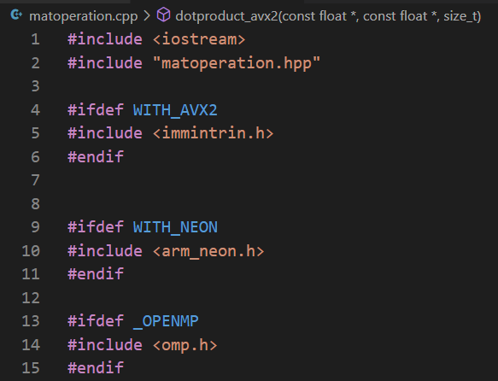
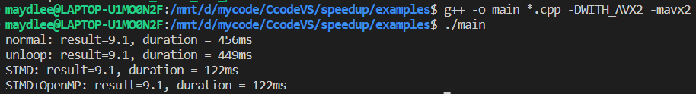
3. To include different header files by different macros.
If you CPU supports AVX2, enable the macro WITH_AVX2
If you CPU supports AVX2, enable the macro WITH_NEON
If you you want OpenMP
OpenMP没有启动

Slide 22
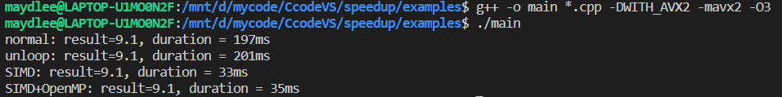
You can use –O3 to gain the maximum speed.

Slide 23
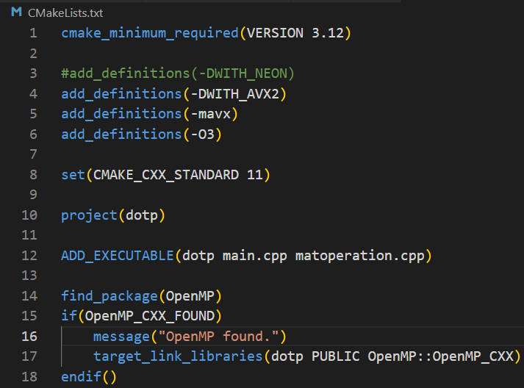
How to do the previous mentioned in CMakeLists.txt
Add some options for the compiler

Slide 24
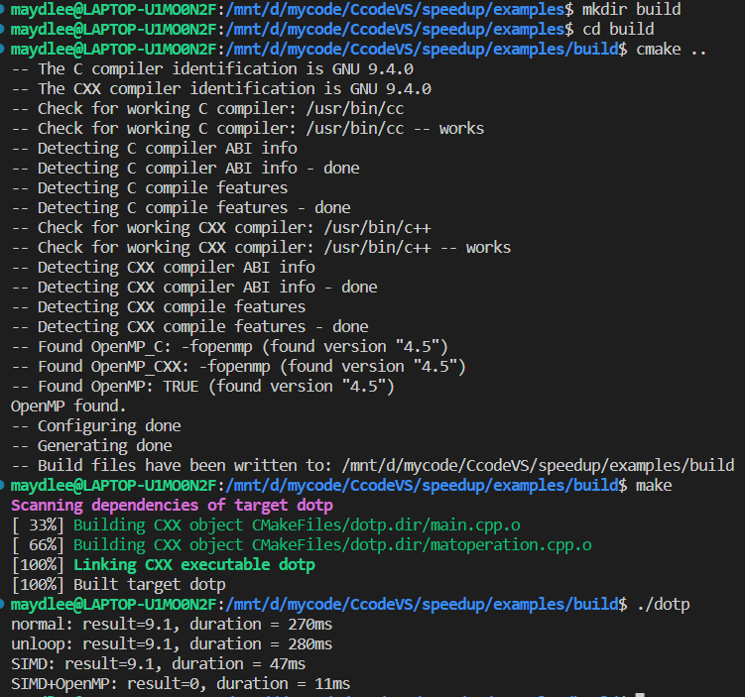
You can create a directory for generated files by cmake
To use the file CMakeLists.txt in the parent directory
Make it!
Run it!

Slide 25
Exercise:
Write a program to add 2 float vectors whose size should be more than 1M. You can initialize the two vectors with values like 0.f, 1.f, 2.f, …
Use pure C source code and SIMD (AVX2 or NEON) separately, and compare their speeds
Use OpenMP to speed up the addition. Can you get the correct result?

