Slide 1
C/C++ Program Design
Lab 10, operator overloading
廖琪梅，王大兴

Slide 2
Operator overloading and friend function
Operator overloading
Returning object
Conversion of class

Slide 3
Operator overloading
To overload an operator, use a special function form called an operator function.
return_type operator op(argument-list)
op is the symbol for the operator being overloaded
An operator function must either be a member function of a class or have at least one parameter of class type.

Slide 4
member function, non-member function, friend function
Only a non-member operator overloading function can implement type conversion on its left argument, so if a function need convert type on its left argument, define the function as non-member function; if the function must get the non-public members of the class, define it as a friend function of the class.
Other cases beyond the above, define the function as a member function.
The assignment (=)operators must be defined as member function. However, IO operators(<< and >>) must be non-member functions.

Slide 5
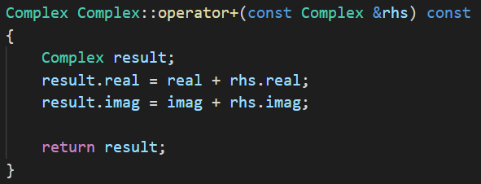
Returning object
When a member function or standard function returns an object, you have choices. The function could return an object , or return a reference to an object.
1. Returning an object
When a function returns an object, a temporary object will be created. There is the added expense of calling the copy constructor to create the temporary object, it is less efficient. It is invisible and does not appear in your source code. The temporary object is automatically destroyed when the function call terminates.

Slide 6
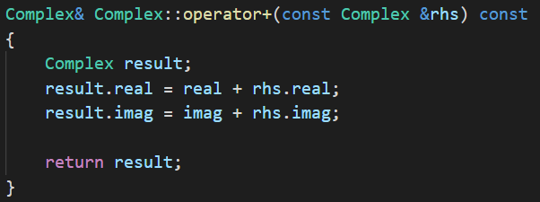
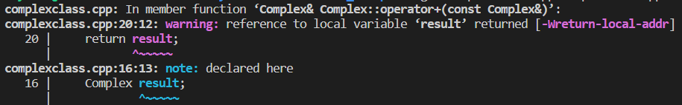
Do not return the reference of a local object, because when the function terminates, the reference would be a reference to a non-existent object.

Slide 7
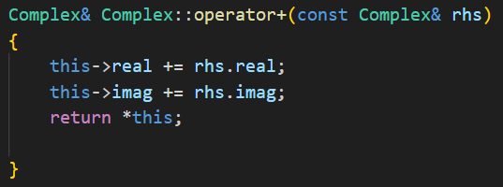
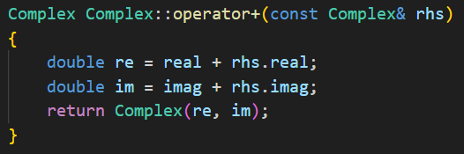
Returning a reference to this object works efficiently, but it modifies the values of the data member of this object.
This return style is known as return constructor argument. By using this style instead of returning an object, the compiler can eliminate the cost of the temporary object. This even has a name: the return value optimization.

Slide 8
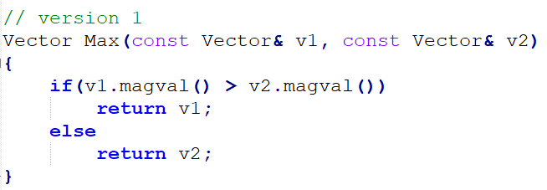
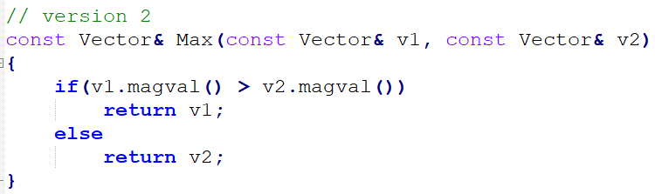
2. Returning a reference to an object
Returning an object invokes the copy constructor, whereas returning a reference doesn’t. Thus version 2 does less work and is more efficient.
The reference should be to an object that exists when the calling function is executing.
Both v1 and v2 are declared as being const references, so the return type has to be const to match.
Two common examples of returning a non-const object are overloading the assignment operator and overloading the << operator for use with cout.

Slide 9
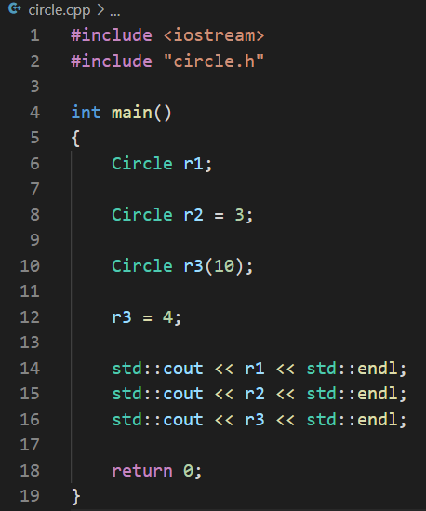
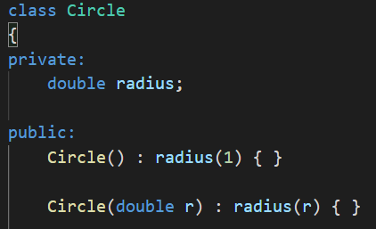
Conversion of class
1. Implicit Class-Type Conversions
Every constructor that can be called with a single argument defines an implicit conversion to a class type. Such constructors are sometimes referred to as converting constructors.
Convert int
to Circle type
when we use the copy form of initialization or assignment (with an =), implicit conversions happens.
Convert int
to Circle type
Converting constructor

Slide 10
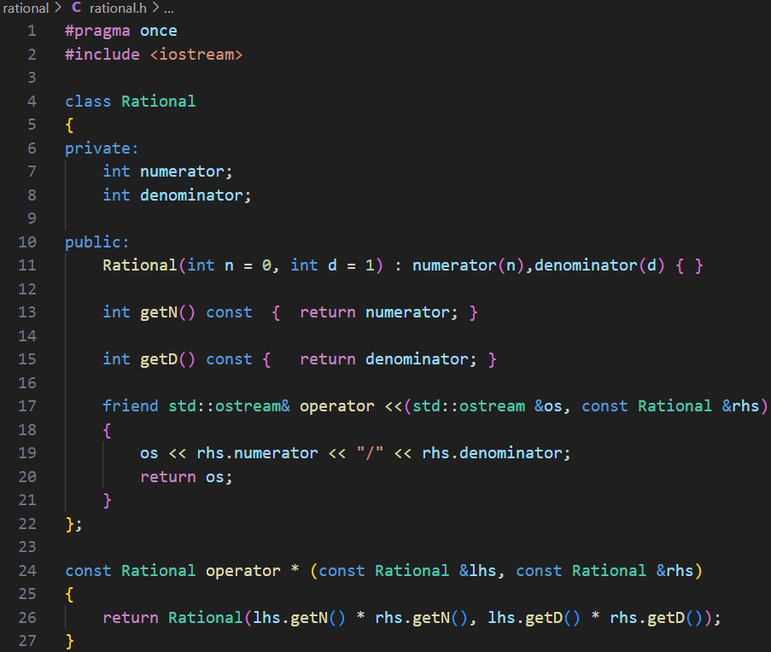
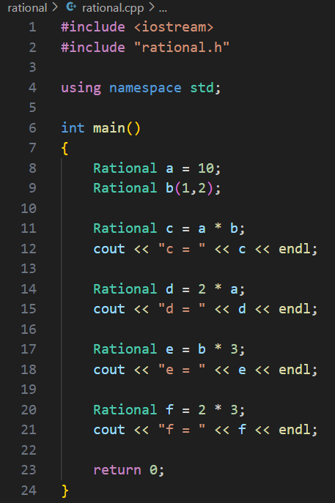

Convert int to Rational type
Constructor with default arguments works as a converting constructor.
We define the operator * as a normal function not a friend function of the Rational class.

Slide 11
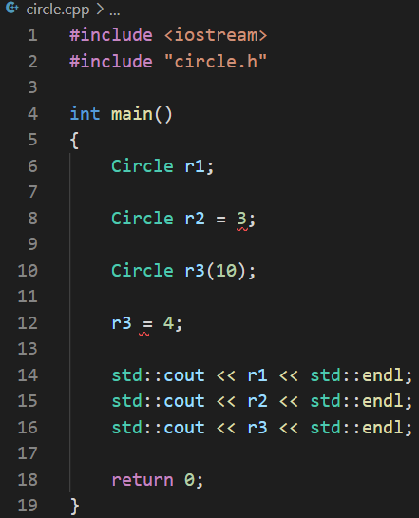
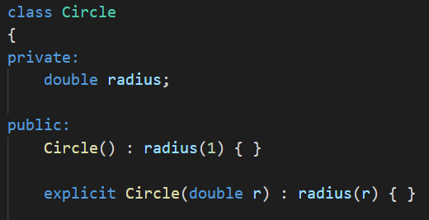

Use explicit to supper the implicit conversion
We can prevent the use of a constructor in a context that requires an implicit conversion by declaring the constructor as explicit:
Can not do the implicit conversion
Turn off implicit conversion
Use these two styles for explicit conversion

Slide 12
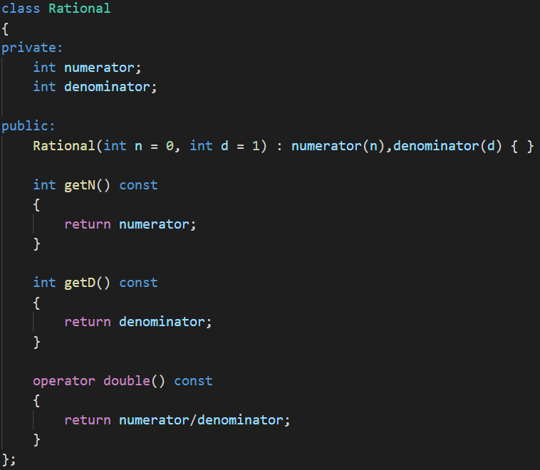


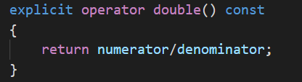
2. Conversion function
Conversion function is a member function with the name operator followed by a type specification, no return type, no arguments.
operator typeName( );
Convert Rational object a to double by conversion function
Declare a conversion operator as explicit for calling it explicitly
Caution: You should use implicit conversion functions with care. Often a function that can only be invoked explicitly is the best choice.
conversion function

Slide 13
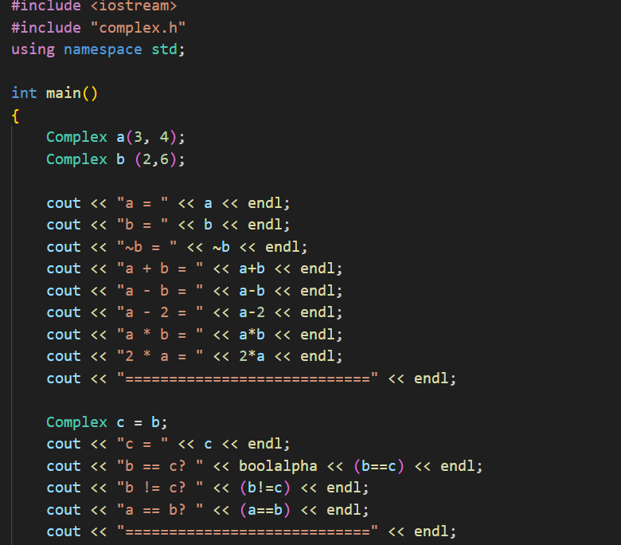
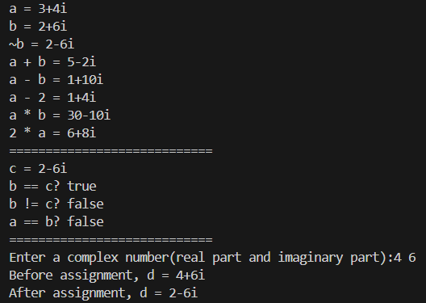
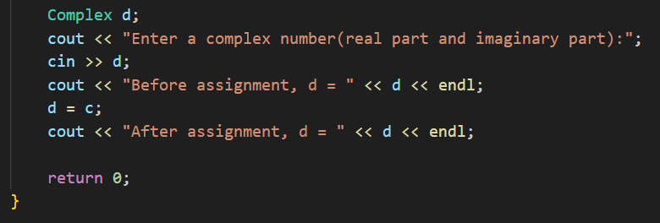
Exercises
Continue improving the Complex class and adding more operations for it, such as: -, *, ~, ==, != etc. Make the following program run correctly.
Note that you have to overload the << and >> operators. Use reference to object and const whenever warranted.
A sample runs might look like this:

