Slide 1
C/C++ Program Design
CS205
Prof. Shiqi Yu (于仕琪)
yusq@sustech.edu.cn
http://faculty.sustech.edu.cn/yusq/

Slide 2
Operators for cv::Mat

Slide 3
Function overloading
Mat add(Mat& A, Mat& B);
Mat add(Mat& A, float b);
Mat add(float a, Mat& B);
Mat mul(Mat& A, Mat& B);
Mat mul(Mat& A, float b);
Mat mul(float a, Mat& B);
...
More convenient to code as follows
Mat A, B;
float a, b;
//…
Mat C = A + B;
Mat D = A * B;
Mat E = a * A;

Slide 4
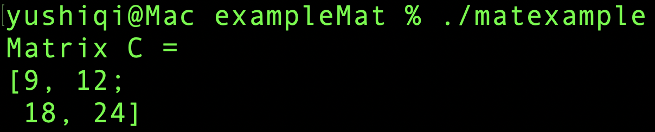
operators for cv::Mat
#include <iostream>
#include <opencv2/opencv.hpp>
using namespace std;
int main()
{
float a[6]={1.0f, 1.0f, 1.0f, 2.0f, 2.0f, 2.0f};
float b[6]={1.0f, 2.0f, 3.0f, 4.0f, 5.0f, 6.0f};
cv::Mat A(2, 3, CV_32FC1, a);
cv::Mat B(3, 2, CV_32FC1, b);
cv::Mat C = A * B;
cout << "Matrix C = " << endl
<< C << endl;
return 0;
}

Slide 5
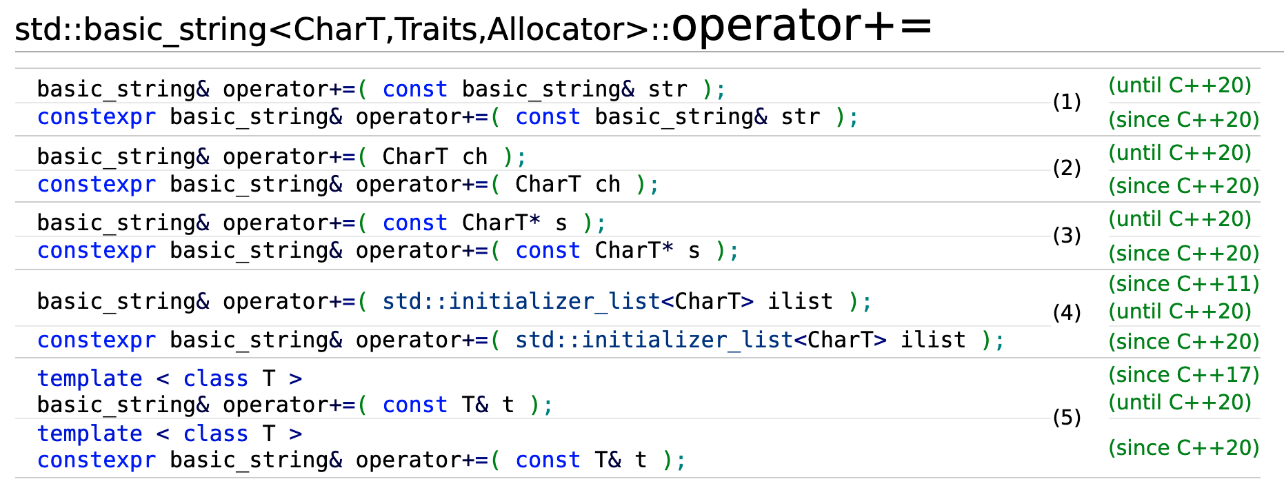
Operator overloading
Customizes the C++ operators for operands of user-defined types.
Overloaded operators are functions with special function names:
std::string s("Hello ");
s += "C";
s.operator+=(" and CPP!");
stringdemo.cpp

Slide 6
Operator Overloading

Slide 7
Operator overloading
Implementation of operator+() and operator+=()
class MyTime
{
int hours;
int minutes;
public:
MyTime(): hours(0), minutes(0){}
MyTime(int h, int m): hours(h), minutes(m){}
MyTime operator+(const MyTime & t) const
{
MyTime sum;
sum.minutes = this->minutes + t.minutes;
sum.hours = this->hours + t.hours; sum.hours += sum.minutes / 60;
sum.minutes %= 60;
return sum;
}
std::string getTime() const;
};
MyTime t1(2, 40);
MyTime t2(0, 50);
cout << (t1 + t2).getTime() << endl;
example1.cpp

Slide 8
Operator overloading
If one operand is not MyTime, and is an int
MyTime t1(2, 40);
MyTime t2 = t1 + 20;
The function can be
MyTime operator+(int m) const
{
MyTime sum;
sum.minutes = this->minutes + m;
sum.hours = this->hours;
sum.hours += sum.minutes / 60;
sum.minutes %= 60;
return sum;
}

Slide 9
Operator overloading
We can even support the following operation to be more user friendly
MyTime t1(2, 40);
MyTime t2 = t1 + "one hour";
MyTime operator+(const std::string str) const
{
MyTime sum = *this;
if(str=="one hour")
sum.hours = this->hours + 1;
else
std::cerr<< "Only \"one hour\" is supported." << std::endl;
return sum;
}
example2.cpp

Slide 10
Operator overloading
Overloaded operators is more user-friendly than functions.
But , wait ..
How about the expression
t1 + 20; //operator
t1.operator+(20); // equivalent function invoking
20 + t1;

Slide 11
friend Functions

Slide 12
friend Functions
If we want that operator + can support (int + MyTime)
Let a friend function to help
Friend functions
Declare in a class body
Granted class access to members (including private members)
But not members
MyTime t1(2, 40);
20 + t1;

Slide 13
friend Functions
Again, friend functions are not members! They just declared in the class body.
class MyTime
{
// ...
public:
friend MyTime operator+(int m, const MyTime & t)
{
return t + m;
}
};

Slide 14
friend Functions
A friend function is defined out of the class.
No MyTime:: before its function name
class MyTime
{
// ...
public:
friend MyTime operator+(int m, const MyTime & t);
};
MyTime operator+(int m, const MyTime & t)
{
return t + m;
}
example3.cpp

Slide 15
friend Functions
Operator << can also be overloaded.
But in (cout << t1; ) , the first operand is std::ostream, not MyTime.
To modify the definition of std::ostream? No!
Use a friend function
friend std::ostream & operator<<(std::ostream & os, const MyTime & t)
{
std::string str = std::to_string(t.hours) + " hours and "
+ std::to_string(t.minutes) + " minutes.";
os << str;
return os;
}
friend std::istream & operator>>(std::istream & is, MyTime & t);
example3.cpp

Slide 16
User-defined Type Conversion

Slide 17
operator type()
Overloaded type conversion: convert the current type to another
//implicit conversion
operator int() const
{
return this->hours * 60 + this->minutes;
}
//explicit conversion
explicit operator float() const
{
return float(this->hours * 60 + this->minutes);
}
MyTime t1(1, 20);
int minutes = t1; //implicit conversion
float f = float(t1); //explicit conversion.

Slide 18
Converting constructor
Convert anther type to the current
MyTime(int m): hours(0), minutes(m)
{
this->hours += this->minutes / 60;
this->minutes %= 60;
}
MyTime t2 = 70;
MyTime t2(70);

Slide 19
Assignment operator overloading
Convert anther type to the current
MyTime & operator=(int m)
{
this->hours = 0;
this->minutes = m;
this->hours = this->minutes / 60;
this->minutes %= 60;
return *this;
}
MyTime t3;
t3 = 80;

Slide 20
Be careful
What is the difference in creating object t2/t3 and t4?
MyTime t2 = 80;
MyTime t3(80);
MyTime t4;
t4 = 80;
example4.cpp

Slide 21
Increment and decrement operators

Slide 22
Increment
Two operators: prefix increment & postfix increment
// prefix increment
MyTime& operator++()
{
this->minutes++;
this->hours += this->minutes / 60;
this->minutes = this->minutes % 60;
return *this;
}
// postfix increment
MyTime operator++(int)
{
MyTime old = *this; // keep the old value
operator++(); // prefix increment
return old;
}
example5.cpp

Slide 23
Operators
Operators which can be overloaded
+ | % | ~ | > | /= | << | == | <=> | -- | ()
- | ^ | ! | += | %= | >> | != | && | , | []
* | & | = | -= | &= | <<= | <= | || | ->*
/ | | | < | *= | |= | >>= | >= | ++ | ->

