Slide 1
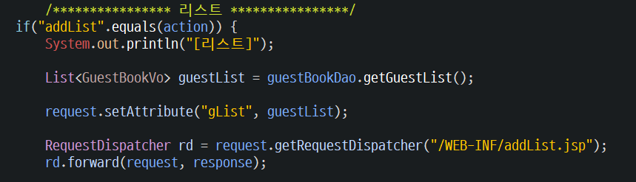
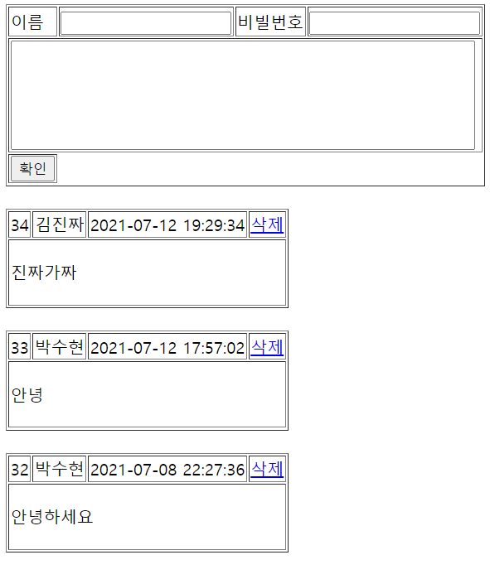
GuestBook2 - addList
Tomcat
Contoller(servlet)
gusetbookDao
getGuestList()
Attribute
Forward
Request(요청)
DB
Request(요청)
Response(응답)
Response(응답)
HTML

Slide 2
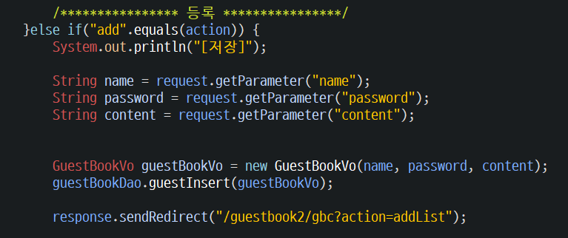
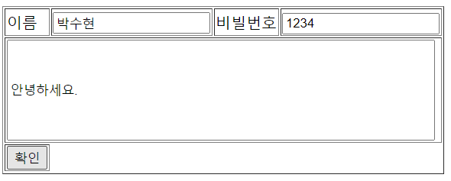
GuestBook2 - add
Tomcat
Contoller(servlet)
gusetbookDao
guestInsert()
파라미터
Name
Password
content
리다이렉트
WebUtil.redirect(
request, response, "/phonebook2/pbc?
action=list");
Request(요청)
Response(응답)
DB
Request(요청)
Response(응답)
HTML

Slide 3
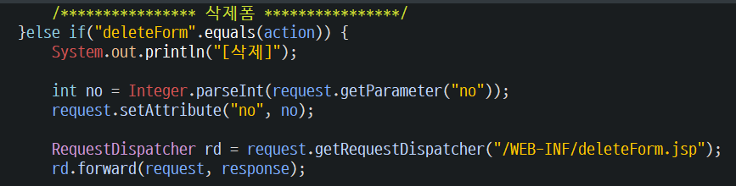
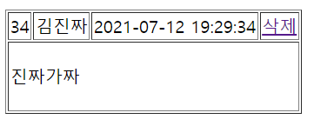

GuestBook2 - deleteForm
Tomcat
Contoller(servlet)
파라미터
Attribute
forward
Request(요청)
Request(요청)
Response(응답)
Response(응답)

Slide 4
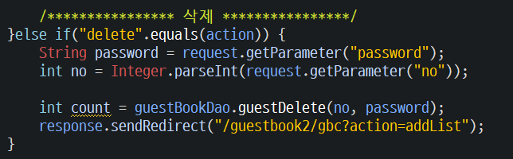
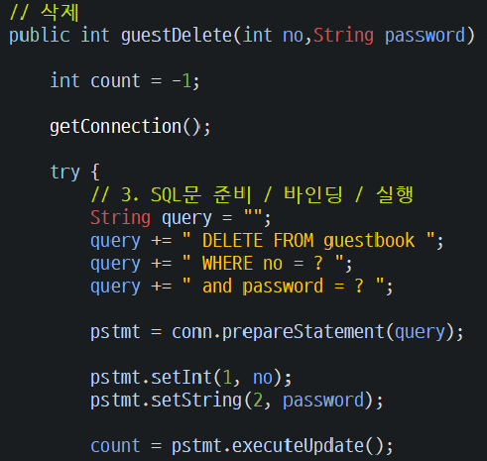
GuestBook2 - delete
Tomcat
******
Contoller(servlet)
Action=delete
gusetbookDao
guestDelete()
파라미터값
Password,no
Request(요청)
Response(응답)
Respones.sendRedirect
Request(요청)
DB
Response(응답)

