Slide 1
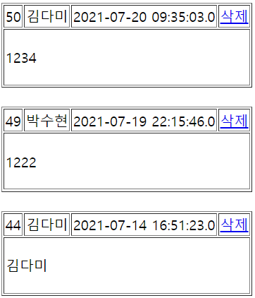
addList
Tomcat
Phonebook3
guestbook3/addlist
web.xml
spring-servlet
Hander Mapping
controller
addlist
Front Controller
DispatcherServlet
PhoneController
request
/addlist
View
return "/WEB-INF/views/addList.jsp";
포워드-addList.jsp
모델 - guestList
Model
addAttribute("guestList", guestList);
response
DAO
addlist()
DB

Slide 2
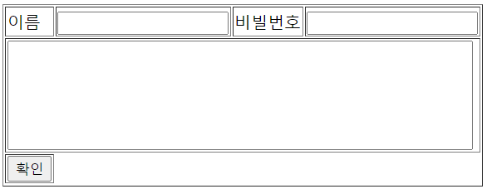
add
Tomcat
Phonebook3
web.xml
spring-servlet
Hander Mapping
controller
add
Front Controller
DispatcherServlet
PhoneController
request
guestbook3/add
Name=박수현
Password=1234
Content=1234
param
Name=박수현
Password=1234
Content=1234
/add
View
return "redirect:/addlist";
리다이렉트
return "redirect:/addlist";
response
리다이렉트
addlist
DAO
add()
DB

Slide 3
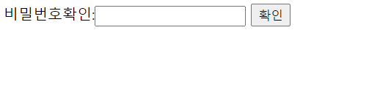
deleteForm
Tomcat
Phonebook3
guestbook3/deleteForm
web.xml
spring-servlet
Hander Mapping
controller
deleteForm
Front Controller
DispatcherServlet
PhoneController
request
Param
No=50
/deleteForm
View
return "/WEB-INF/views/deleteForm.jsp";
포워드- deleteForm.jsp
모델 - no
Model
model.addAttribute("no", no);
response

Slide 4
delete
Tomcat
Phonebook3
web.xml
spring-servlet
Hander Mapping
controller
delete
guestbook3/delete
No=50
Password=1234
Front Controller
DispatcherServlet
PhoneController
request
param
No=50
Password=1234
/delete
View
return "redirect:/addlist";
리다이렉트
addList
response
빈화면
리다이렉트
addList
DAO
delete()
DB

