Slide 1
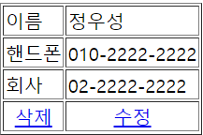
delete
Tomcat
Phonebook3
web.xml
spring-servlet
Hander Mapping
controller
delete
/phonebook3/delete?personId=1
Front Controller
DispatcherServlet
request
PhoneController
/delete
param
personId=1
view
리다이렉트list
리다이렉트
response
빈화면
리다이렉트list
DAO
personDelete()
DB

Slide 2
updateform
Tomcat
Phonebook3
web.xml
spring-servlet
Hander Mapping
controller
updateForm
Front Controller
DispatcherServlet
/phonebook3/updateForm?id=1
request
PhoneController
/updateForm
param
personId=1
View
return "/WEB-INF/views/updateForm.jsp";
포워드-updateForm.j네
Model-updateOne
Model
addAttribute("updateOne", updateOne);
response
updateForm
DAO
updateOne()
DB

Slide 3
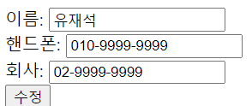
update
Tomcat
Phonebook3
web.xml
spring-servlet
Hander Mapping
controller
update
/phonebook3/update
name=유재석
Hp=010-9999-9999
Company=02-9999-9999
Front Controller
DispatcherServlet
request
PhoneController
param
name=유재석
Hp=010-9999-9999
Company=02-9999-9999
/update
View
return "redirect:/list";
return "redirect:/list";
response
빈화면
리다이렉트
list
DAO
personUpdate()
DB

