Slide 1
StackOverflow Auto-Tagger
2020.6.18
Team 29
김재우, 김태윤, 이준형, 전선영
Notes:
Hello, we are team 29 and we designed an automatic Stackoverflow tagger.

Slide 2
Problem Statement
Design an algorithm that helps users of StackOverflow in the cumbersome process of manually attaching tags to their questions.
tags
like
these
Notes:
Our problem statement was that the users of stackoverflow have to manually attach tags to their questions.
Some of you might agree that adding the tags when posting a stackoverflow question is quite cumbersome.
So we aimed to design an algorithm that helps them with the process.

Slide 3
Technical Approach
Prepare corpus using StackOverflow API
Extract important words using tf-idf
Determine important sentences
Evaluate the performance against real tags
Provide suggestions from popular tags
Visualize the results
Notes:
We first prepared the corpus by crawling stackoverflow using its API.
Then we determined which words in the post are important enough to be considered a tag.
The prediction was evaluated against the real tags.
If there was an incorrect prediction, we checked if it was one of popular tags.
Then we visualized the results.

Slide 4
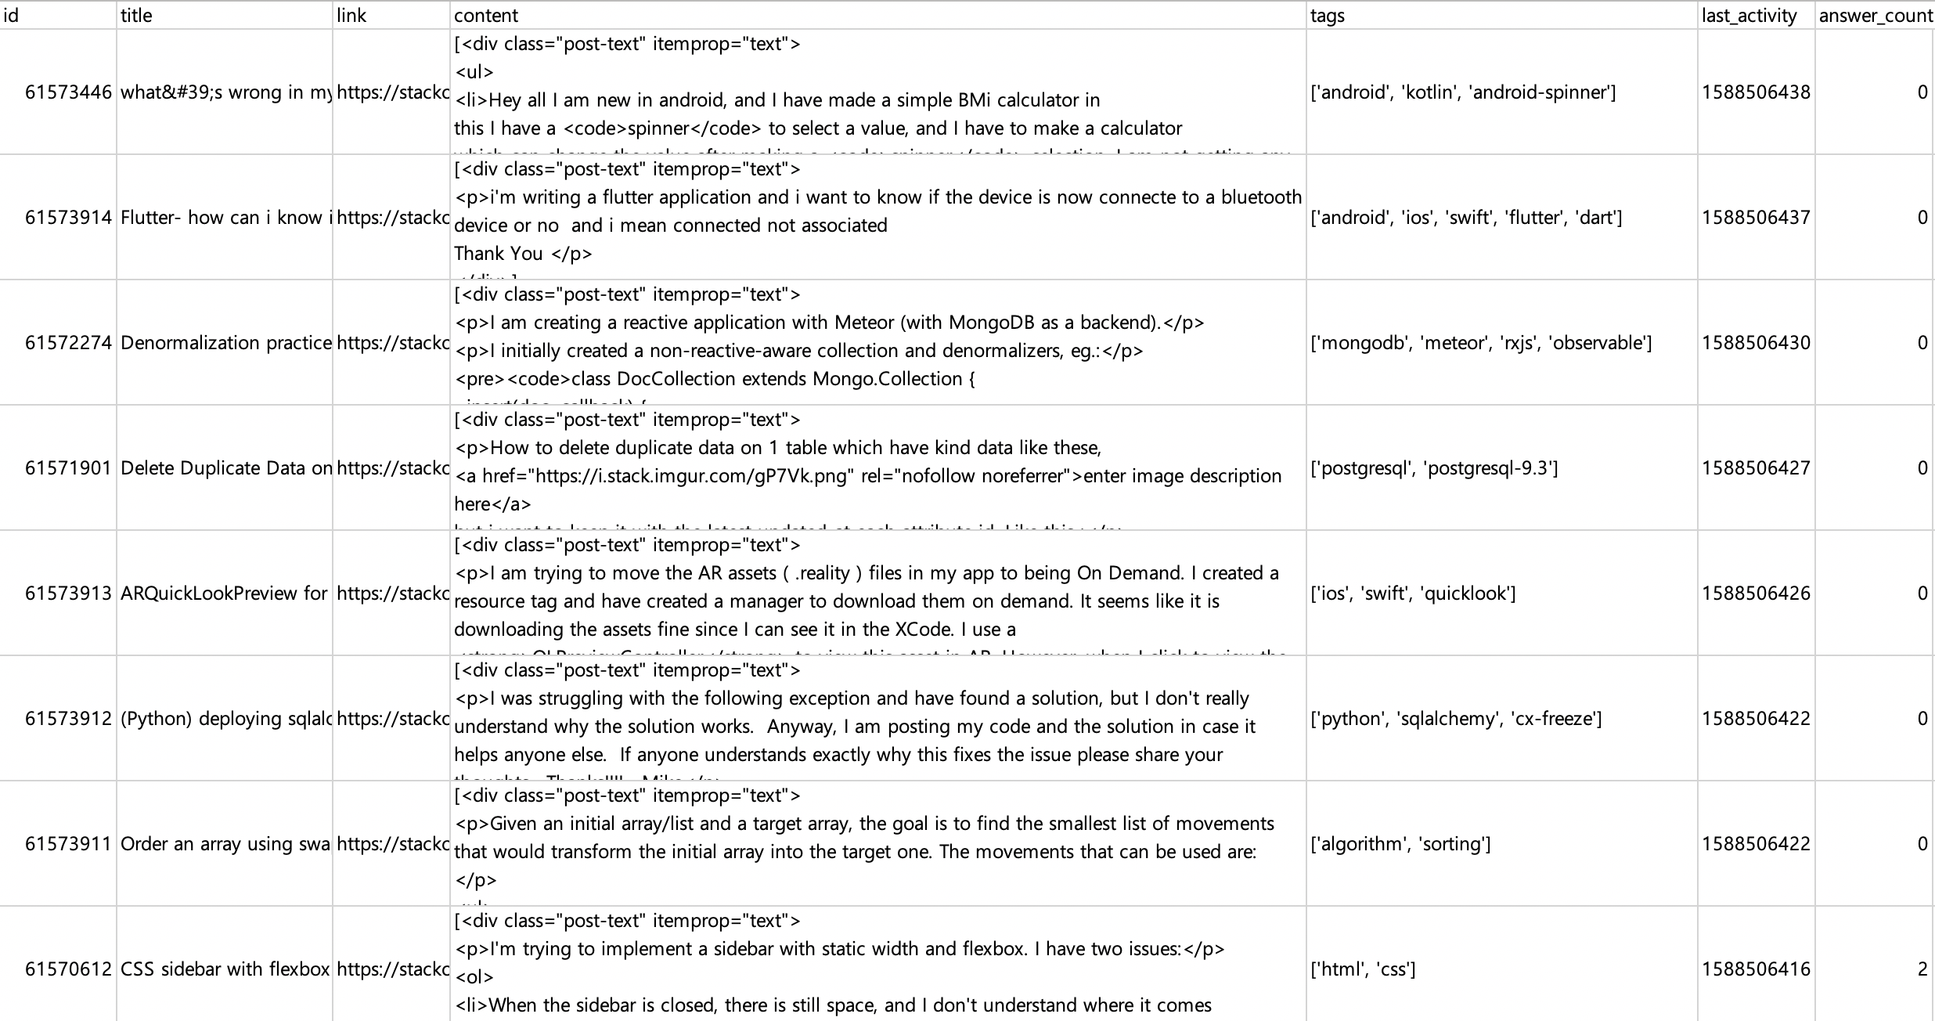
Corpus
Notes:
This is what the corpus looks like.
It is comprised of the id, title, link, content and tags etc and contains around 8000 questions.

Slide 5
Extracting Important Words
TF-IDF (term frequency, inverse document frequency)
Measures the significance of a word in a document in terms of the amount of information it contains.
tf-idf(t, d) = tf(t, d) * idf(t)
where
tf(t,d) = count of t in d / number of words in d
df(t) = occurrence of t in documents
idf(t) = log(N/(df(t) + 1))
Measured the degree of grammatical dependency of a word in a sentence using ShiftReduceParser
Scored each word based on the above two criteria
Optionally, consider the length and position of sentences the words are contained in
Notes:
To extract important words from the question, we used a formula called TF-IDF. It measures the significance of a word in a document using the following formula.
We also measured the degree of grammatical dependency of a word because highly dependent words are likely to be the important ones.
We also considered the length and position of each sentence because longer sentences contain more keywords, and sentences at the front or the end are likely to contain the main idea.

Slide 6
Evaluating Performance
Compare predicted tags with actual tags with two parameters
STRICT: ignore tags that are different but have same lemma
e.g. ‘python2’ and ‘python3’
INCLUSIVE: count tags that are part of another
e.g. ‘react’ and ‘react-native’
Check and suggest if predictions are one of popular tags of StackOverflow:
('javascript', 2030742), ('java', 1684580), ('python', 1461591), ('c#', 1414574), ('php', 1356698), ('android', 1281286), ('html', 1000331), ('jquery', 989318), ('c++', 677591), ('css', 668868), ('ios', 632876), ('mysql', 599509), ('sql', 547382), ('asp.net', 356558), ('r', 350335), ('node.js', 333901), ('c', 333280), ('arrays', 332805), ('ruby-on-rails', 318341), ('.net', 297755), ('json', 293988), ('objective-c', 290115), ('sql-server', 286924), ('swift', 269448), ('angularjs', 260707), ('python-3.x', 235231), ('django', 234845), ('regex', 227935), ('excel', 224195), ('reactjs', 221150), ('iphone', 220455), ('angular', 220405) …
Notes:
When evaluating the performance, we compared the predicted tags with the real tags.
There were two parameters we used.
Strict means we ignore words that share the common lemma but are not identical, such as python2 and python3. This was set to false by default.
Inclusive means we count tags that are part of another, such as react and react-native. This was set to true by default.
If a prediction does not match any real tag, we checked if it is one of the popular tags of stackoverflow. The stackoverflow API was used here as well.

Slide 7
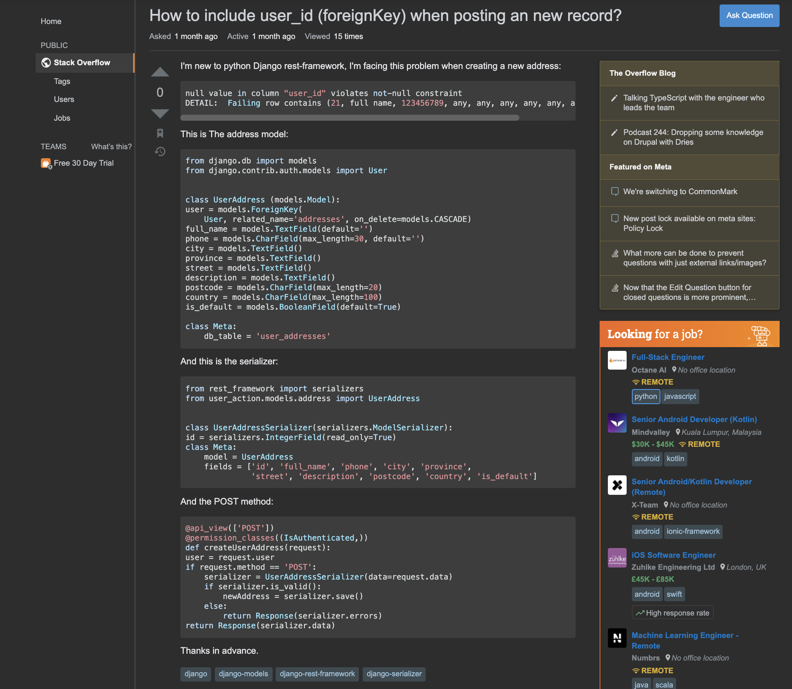
An Example
Real tags:
django, django-models, django-rest-framework, django-serializer
Predicted tags:
django, serialiser, serializer, address, framework
Notes:
Here is an example. This is a question about Django, with tags such as Django-rest-framework and Django-serializer etc.
Using our tool, the predicted tags were django, serializer and framework etc.

Slide 8
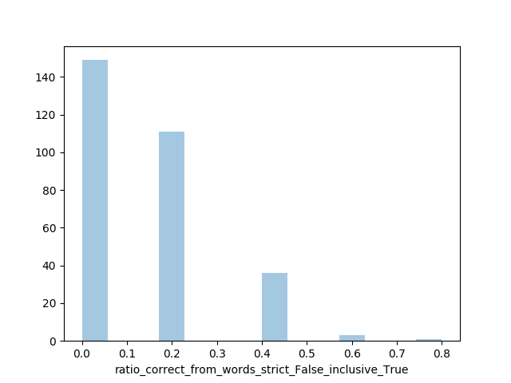
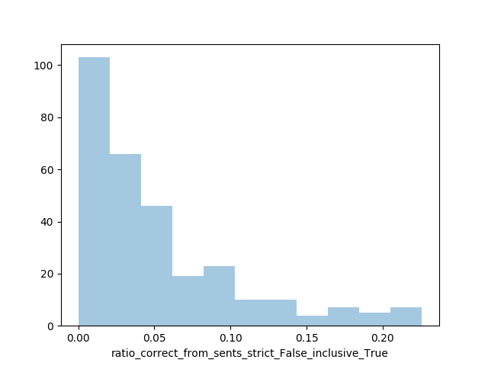
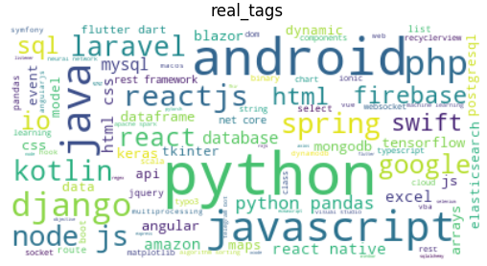
Results
From words | Strict | Not Strict
Inclusive | 0.109 | 0.131
Non-inclusive | 0.077 | 0.090
From sentences | Strict | Not Strict
Inclusive | 0.031 | 0.049
Non-inclusive | 0.018 | 0.030
Notes:
These are the results evaluated for 300 questions. The highest accuracy is achieved in inclusive and not-strict cases, which is the default.
The accuracy was lowered when we took the length and position of sentences into account.

Slide 9
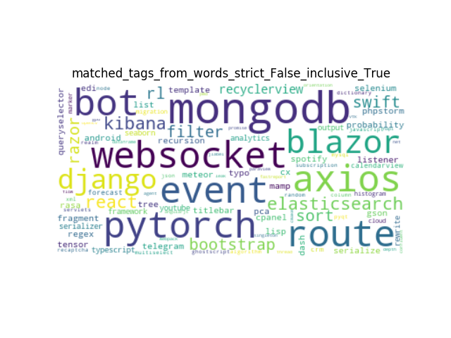
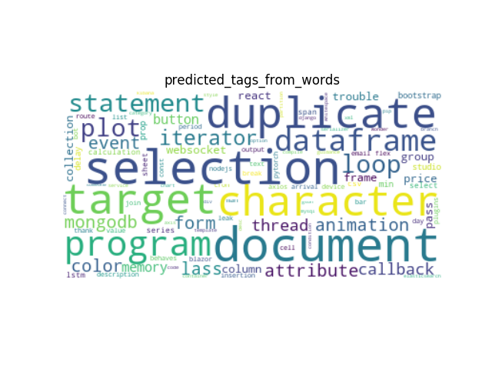
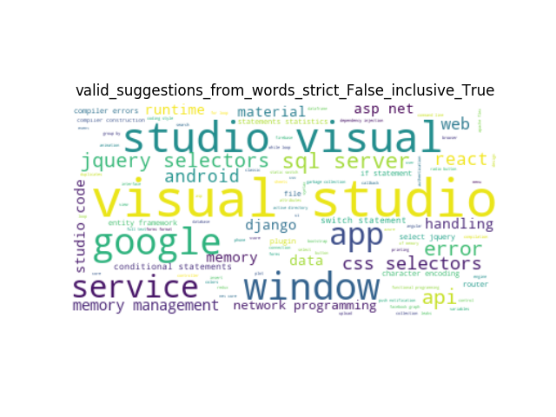
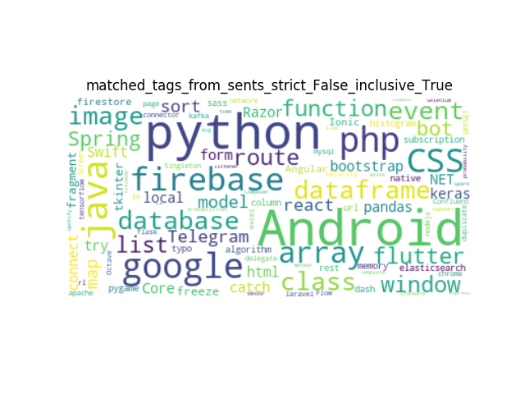
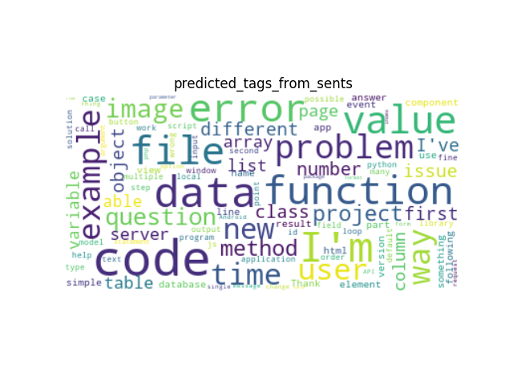
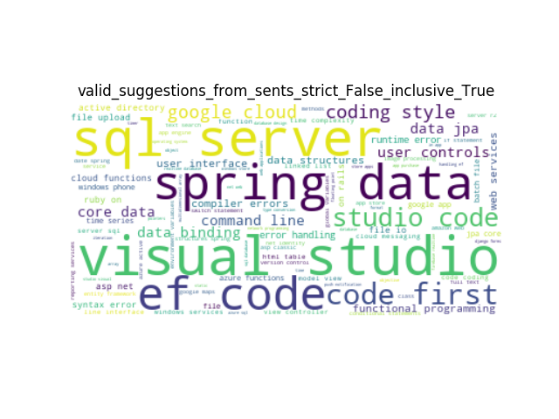
Results
Notes:
The left-most column shows correctly matched predictions. It seems these appeared in text and were significant enough to be found by our tool.
The middle column shows all the predicted tags. Some tags that are not likely to be used as a tag are also included.
The right-most column is the tags not attached by the user but suggested because they are often used in stackoverflow.

Slide 10
Conclusion
Considering important sentences had no apparent benefit in finding tag words.
Predicted tags that match actual tags are usually proper nouns, such as SW/HW products and packages etc.
e.g.) mongodb, django, pytorch, android, python, etc.
Predicted tags that do not match with actual tags are usually more abstract words that are used widely across various fields.
e.g.) duplicate, iterate, selection, dataframe, function, etc
This algorithm is most useful when you want to add such abstract tags.
Notes:
In conclusion, considering the length and position of sentences had no benefit in accuracy.
Correctly matched tags are usually proper nouns, and not matched predictions are more general terms.
Thus, this algorithm is most useful when you want to consider such tags.

Slide 11
Thank you
github.com/tykimseoul/CS372_NLP_Project
Notes:
Thank you.
Please visit the link provided if you are interested.

