Slide 1
StackOverflow Auto-Tagger
2020.6.18
김재우, 김태윤, 이준형, 전선영
Notes:
안녕하세요, 아이오에스 겟짤 스위프트 전환을 담당한 김태윤입니다.

Slide 2
Problem Statement
Design an algorithm that helps users of StackOverflow in the cumbersome process of manually attaching tags to their questions.
tags
like
these

Slide 3
Technical Approach
Prepare corpus using StackOverflow API
Extract important words using tf-idf
Determine important sentences
Evaluate the performance against real tags
Provide suggestions from popular tags
Visualize the results

Slide 4
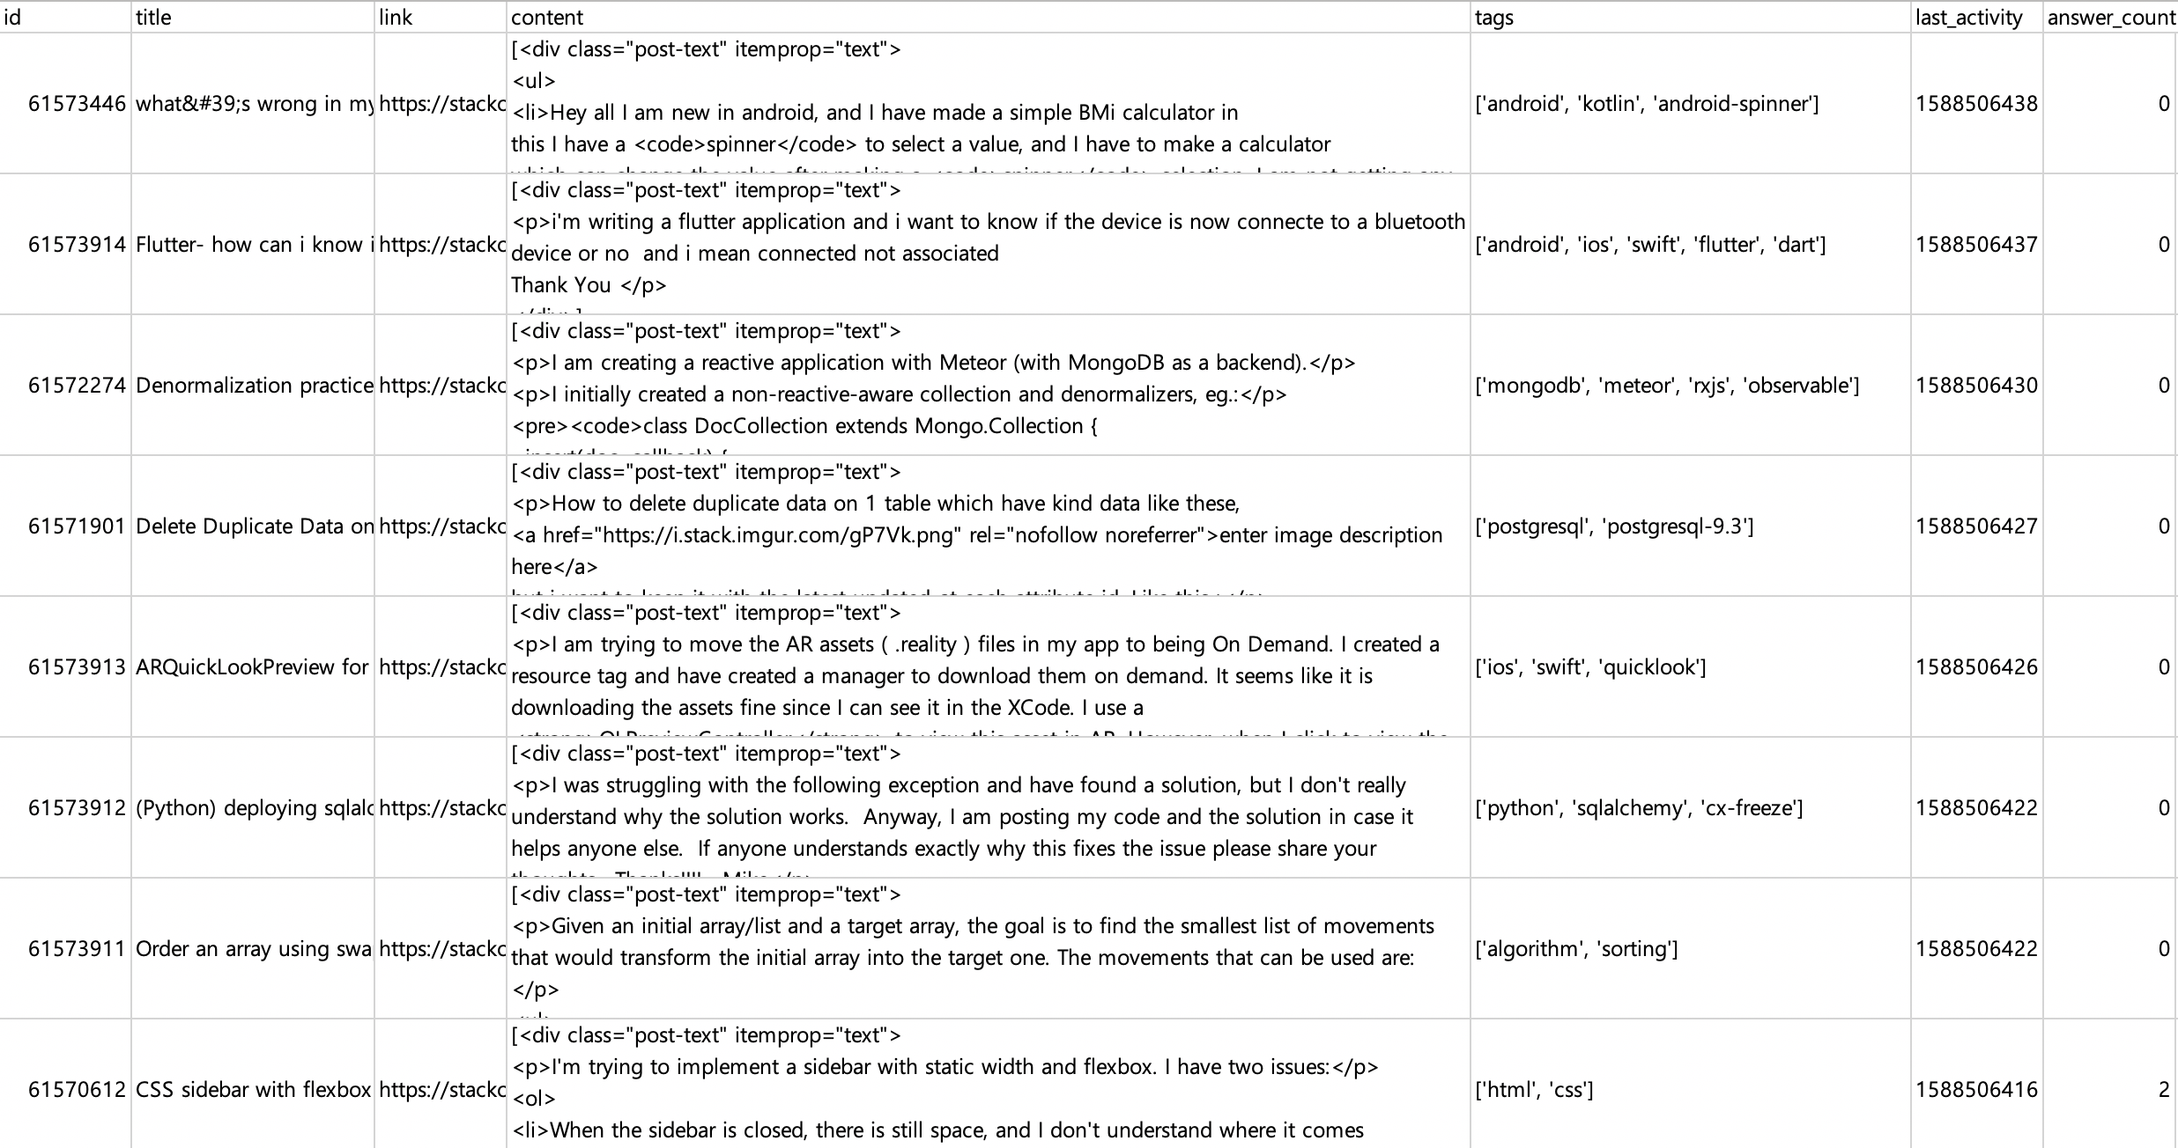
Corpus

Slide 5
Extracting Important Words
TF-IDF (term frequency, inverse document frequency)
Measures the significance of a word in a document in terms of the amount of information it contains.
tf-idf(t, d) = tf(t, d) * idf(t)
where
tf(t,d) = count of t in d / number of words in d
df(t) = occurrence of t in documents
idf(t) = log(N/(df(t) + 1))
Measured the degree of grammatical dependency of a word in a sentence using ShiftReduceParser
Scored each word based on the above two criteria
Optionally, consider the length and position of sentences the words are contained in

Slide 6
Evaluating Performance
Compare predicted tags with actual tags with two parameters
STRICT: ignore tags that are different but have same lemma
e.g. ‘python2’ and ‘python3’
INCLUSIVE: count tags that are part of another
e.g. ‘react’ and ‘react-native’
Check and suggest if predictions are one of popular tags of StackOverflow:
('javascript', 2030742), ('java', 1684580), ('python', 1461591), ('c#', 1414574), ('php', 1356698), ('android', 1281286), ('html', 1000331), ('jquery', 989318), ('c++', 677591), ('css', 668868), ('ios', 632876), ('mysql', 599509), ('sql', 547382), ('asp.net', 356558), ('r', 350335), ('node.js', 333901), ('c', 333280), ('arrays', 332805), ('ruby-on-rails', 318341), ('.net', 297755), ('json', 293988), ('objective-c', 290115), ('sql-server', 286924), ('swift', 269448), ('angularjs', 260707), ('python-3.x', 235231), ('django', 234845), ('regex', 227935), ('excel', 224195), ('reactjs', 221150), ('iphone', 220455), ('angular', 220405) …

Slide 7
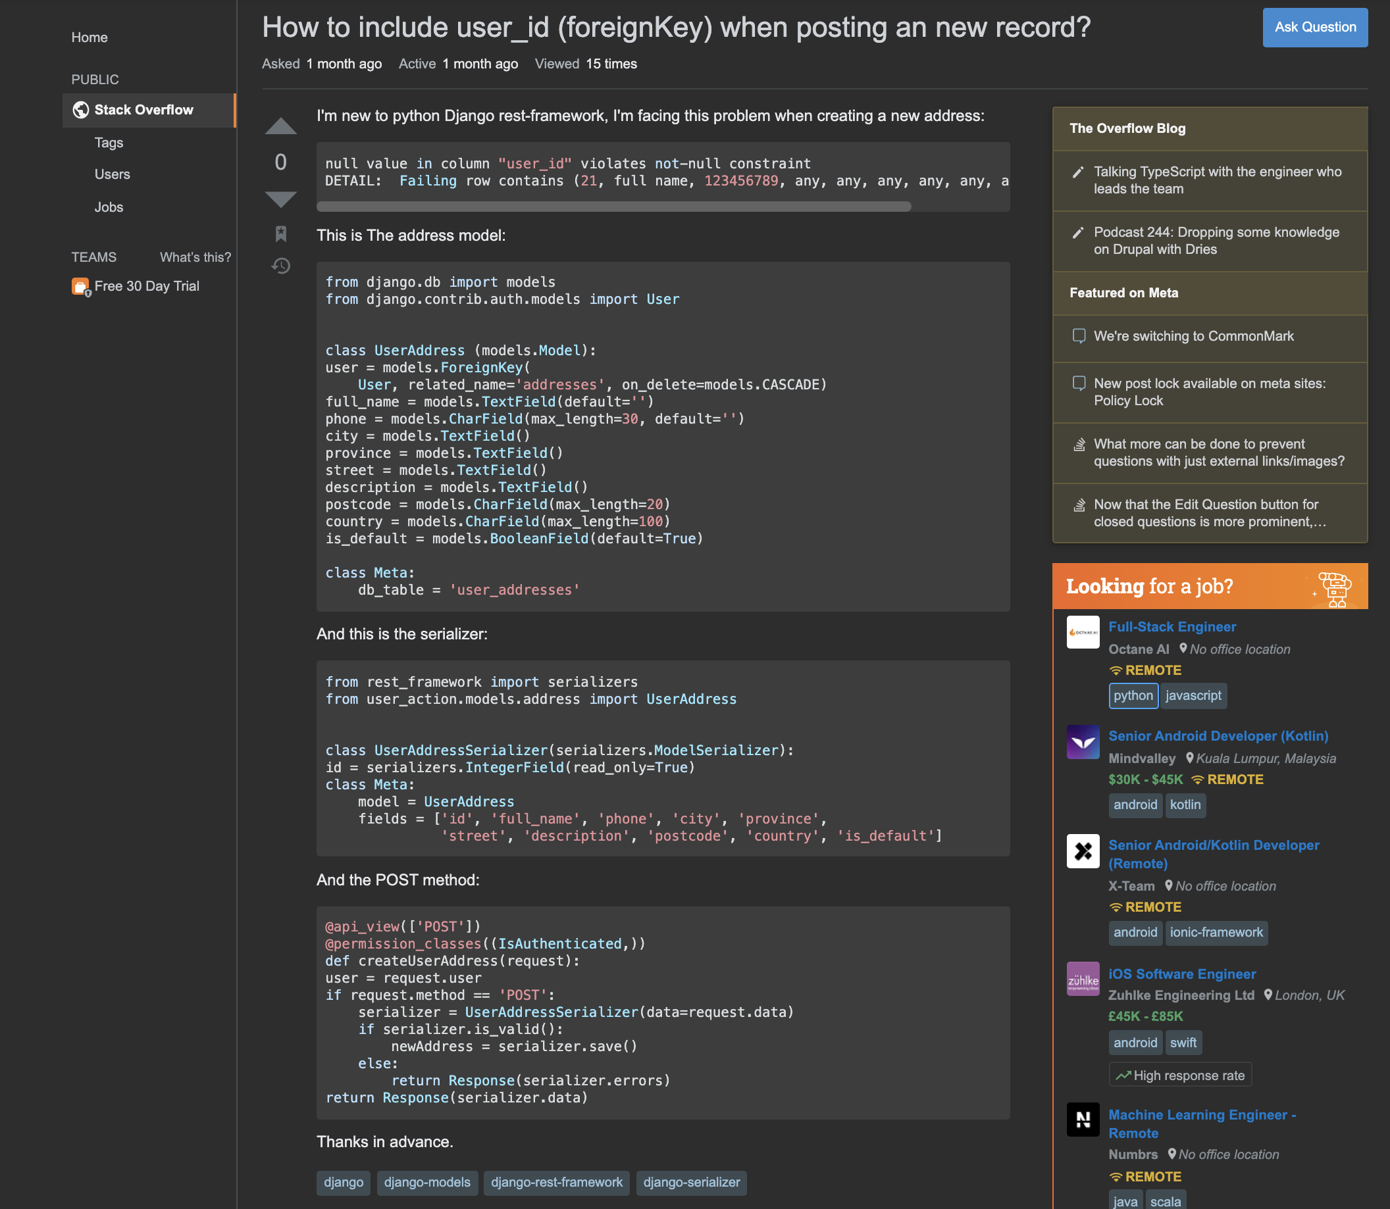
An Example
Real tags:
django, django-models, django-rest-framework, django-serializer
Predicted tags:
django, serialiser, serializer, address, framework

Slide 8
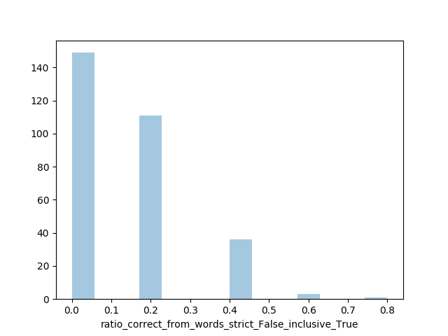
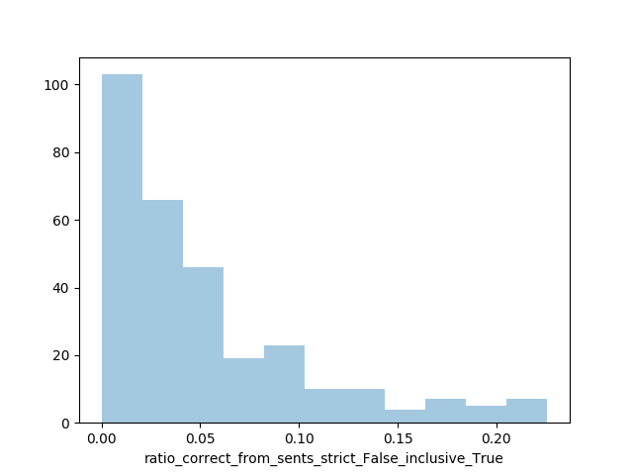
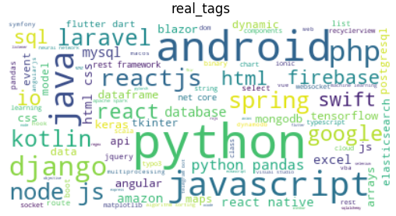
Results
From words | Strict | Not Strict
Inclusive | 0.109 | 0.131
Non-inclusive | 0.077 | 0.090
From sentences | Strict | Not Strict
Inclusive | 0.031 | 0.049
Non-inclusive | 0.018 | 0.030

Slide 9
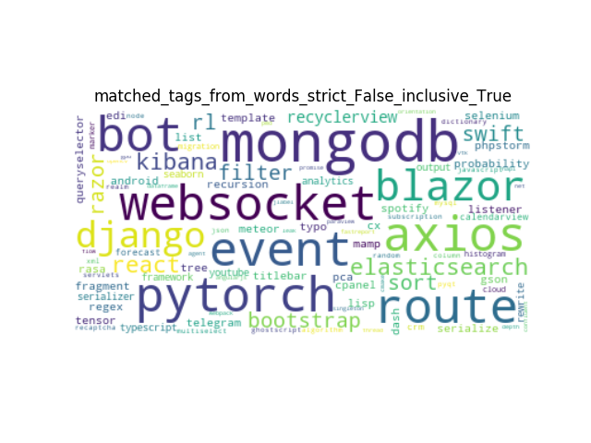
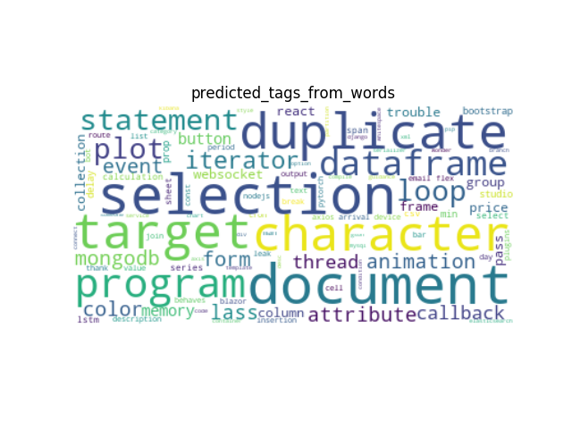
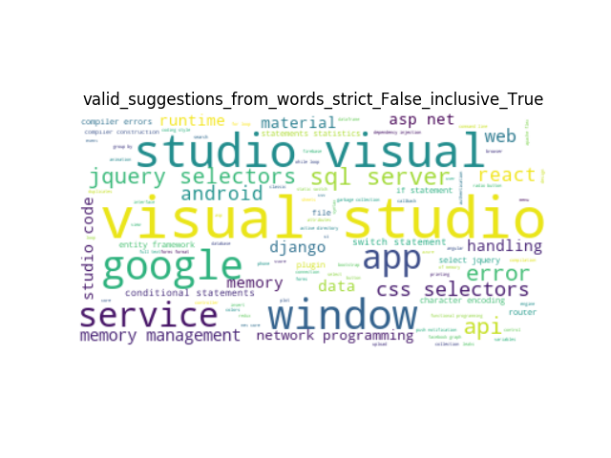
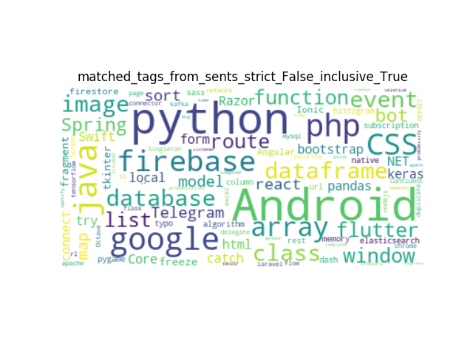
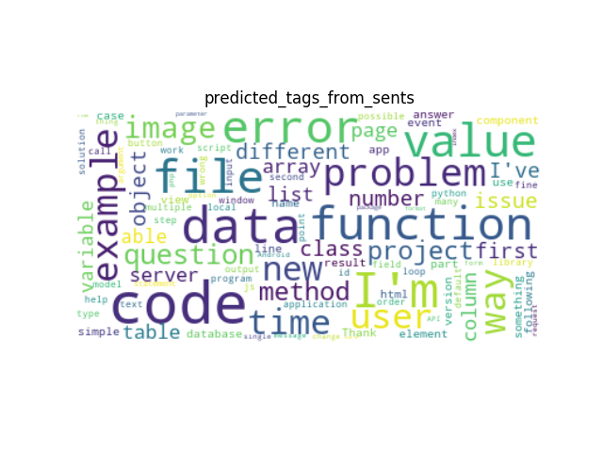
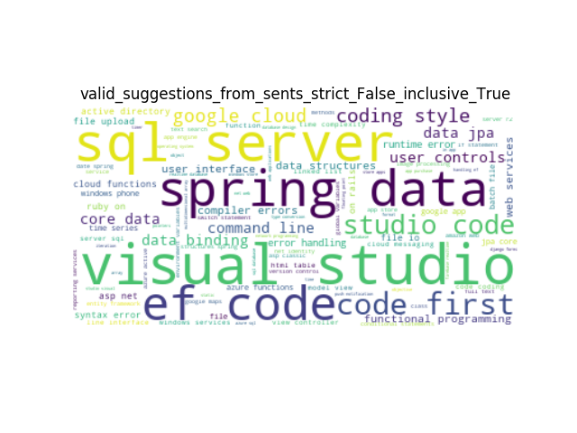
Results

Slide 10
Conclusion
Considering important sentences had no apparent benefit in finding tag words.
Predicted tags that match actual tags are usually proper nouns, such as SW/HW products and packages etc.
e.g.) mongodb, django, pytorch, android, python, etc.
Predicted tags that do not match with actual tags are usually more abstract words that are used widely across various fields.
e.g.) duplicate, iterate, selection, dataframe, function, etc
This algorithm is most useful when you want to add such abstract tags.

Slide 11
Thank you
github.com/tykimseoul/CS372_NLP_Project
Notes:
이상입니다. 감사합니다.

