Slide 1

Momentum
Builder
Small Steps, Big Changes

Slide 2
Challenge Statement - Planning
Problem:
Young adults struggle to turn intention into routine due to stress, burnout, or financial pressure.
Our Goal:
Use positive feedback loops via wearable data to suggest micro-goals that build momentum.
Our Users:
6 Personas experiencing anxiety, financial stress, sleep issues, burnout etc

Slide 3
Our Solution
A web application that uses IoT data to suggest ‘micro-goals’ to elivate stress or build/ create new habits
A Wellness Bite ‘micro-goal’ for users experiencing high levels of anxiety we can suggest breathing exercise
Users will be rewarded for completing their ‘micro-goals’ earn points that can be spent on subscription or Lloyds products
NEXT
2029
Presentation Slide

Slide 4
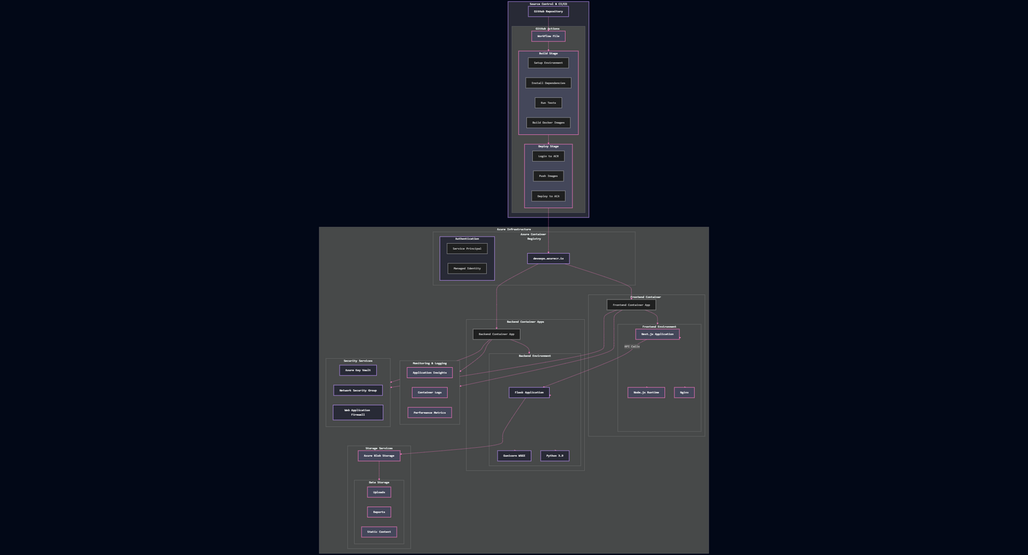
System Design

Slide 5
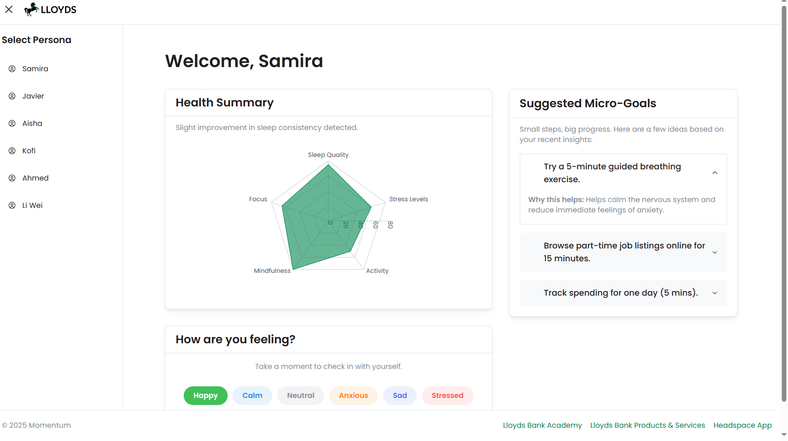
Demo
momentum-builder.bluepebble-fb2e811b.uksouth.azurecontainerapps.io

Slide 6
Thank you for listening

