Slide 1

Hypertech Growth Strategy: Identifying Free Trials
Tyler Rogers

Slide 2
Agenda 📝
Introduction
Solution Overview
Results and Insights from Solution
What does this mean for Hypertech?
Recommendations for Improvement
Q&A!

Slide 3
Introduction – Who we are. 👋
Pioneers of predictive models to drive marketing strategies & fuel customer success initiatives.
We are your magnifying glass of Customer Profiles & Buyer’s Intent
We are growth gladiators!

Slide 4
Solution Overview, Automated Web Detective 🔎
Our solution goes through your list of websites to see who offers a free trial (or demo!)
The script checks to make sure the website is real (or online!)
Your Curated report breaks down results in a easily digestable fashion.

Slide 5
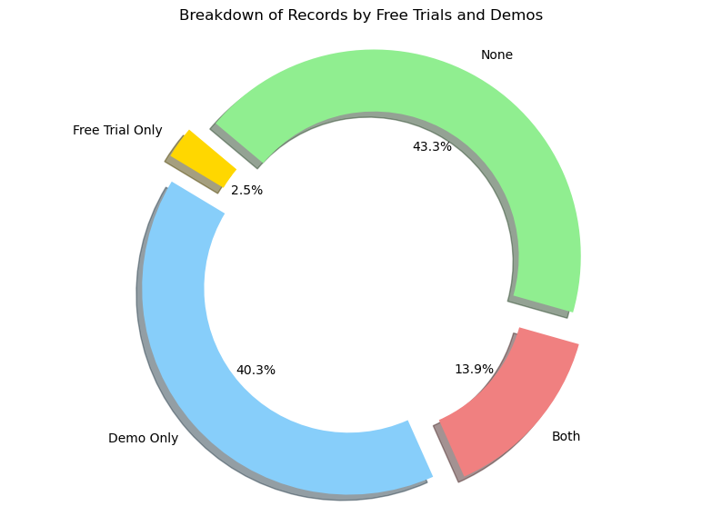
Results & Insights from Solution 📊
Notes:
We found that:
13.9% of the list of companies offer a trial or Demo! (2.5% offers only a free trial)
Your Curated report breaks down results in a easily digestable fashion.

Slide 6
What does this mean for HyperTech? 🤔
Broad Partnership Potential through the 13.5% of companies offering free trials & demos.
Hyper targeting trial only seekers by doing outreach to the 2.5%
Trial only scarcity would position Hypertech to be the go-to company for innovative solutions risk free.
Notes:
We found that:
13.9% of the list of companies offer a trial or Demo! (2.5% offers only a free trial)
Your Curated report breaks down results in a easily digestable fashion.

Slide 7
Recommendations & Improvements 💡
Company Data Enrichment using Generative AI or industry data to understand the kind of industry/product offerings each website has.
Regular monitoring to understand shifts in free trial offerings.
Key word expansion to understand what language to look for when gathering data from the web.
Notes:
We found that:
13.9% of the list of companies offer a trial or Demo! (2.5% offers only a free trial)
Your Curated report breaks down results in a easily digestable fashion.

Slide 8
Thank you for your time! Any Questions?

Slide 9
Understanding Hypertech’s Needs
Desires to grow by finding more customers who like trying new tech for free.
Values simplicity in growth plans to capitalize on emerging market opportunities

