Slide 1
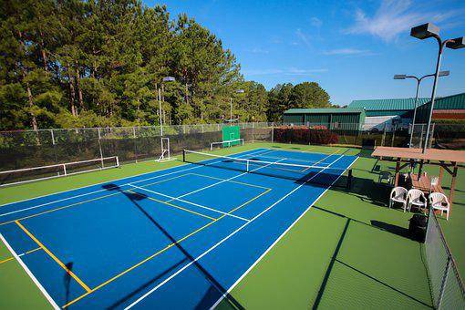
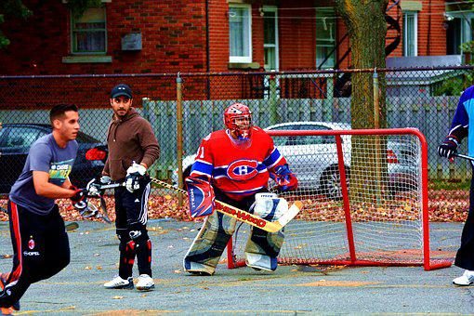
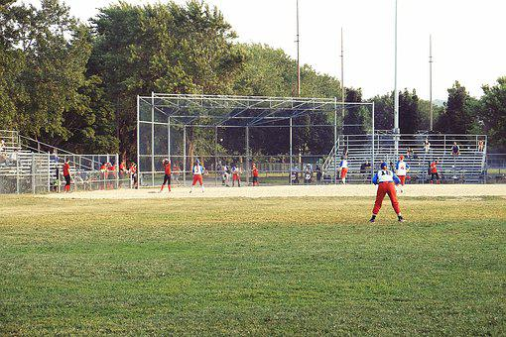
O AllSports
=
Signup
Find Your Next Sports Venue
search
Go
Player 1:
Tyler Hargrave
https://cdn.pixabay.com/photo/2020/06/29/20/37/asphalt-tennis-court-5354328__480.jpg
https://cdn.pixabay.com/photo/2016/12/26/19/56/hockey-1932650__480.jpg
https://cdn.pixabay.com/photo/2017/08/10/21/07/baseball-2627837__480.jpg
Computer
Popular Venues
Pick your sport
Pine Point Park
Ball Hockey
****__
Pine Point Park
Ball Hockey
****__
© Tyler Hargrave 2022

Slide 2
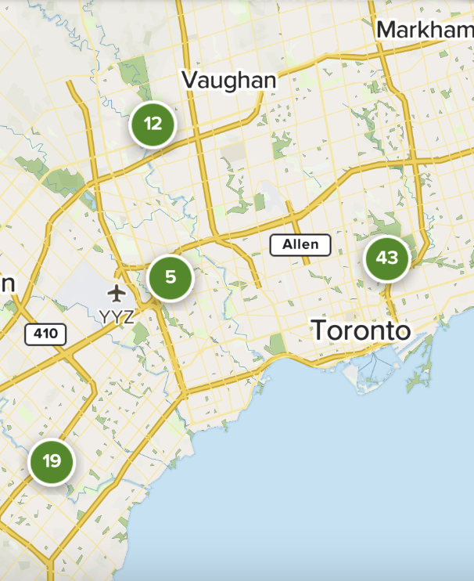
O AllSports
=
Signup
search
Go
Tennis
Courts
Lights
https://cdn.pixabay.com/photo/2020/06/29/20/37/asphalt-tennis-court-5354328__480.jpg
https://cdn.pixabay.com/photo/2016/12/26/19/56/hockey-1932650__480.jpg
https://cdn.pixabay.com/photo/2017/08/10/21/07/baseball-2627837__480.jpg
© Tyler Hargrave 2022

Slide 3
O AllSports
=
Signup
search
Go
https://cdn.pixabay.com/photo/2020/06/29/20/37/asphalt-tennis-court-5354328__480.jpg
https://cdn.pixabay.com/photo/2016/12/26/19/56/hockey-1932650__480.jpg
https://cdn.pixabay.com/photo/2017/08/10/21/07/baseball-2627837__480.jpg
Pine Point Park
★★★★☆
Directions
Add Review
Ball Hockey
2 courts
Nets Available
Not Busy
Nearby Venues
© Tyler Hargrave 2022

Slide 4
O AllSports
=
Signup
search
Go
New Venue
Name:
Sport:
Address:
City:
Pine Point Park
Ball Hockey
60 Byng Ave
https://cdn.pixabay.com/photo/2020/06/29/20/37/asphalt-tennis-court-5354328__480.jpg
https://cdn.pixabay.com/photo/2016/12/26/19/56/hockey-1932650__480.jpg
https://cdn.pixabay.com/photo/2017/08/10/21/07/baseball-2627837__480.jpg
Lights:
Rating:
Busy:
Pine Point Park
Ball Hockey
60 Byng Ave
Add Venue
© Tyler Hargrave 2022

Slide 5
Venues
-----------------------
_id
sport: string
name: string
address: string
longitude: float
latitude: float
reviews:{
rating: number
lights: Boolean
busy: number
}
Users
----------------------
_id
email: string
address: string
longitude: float
latitude: float
Favourite_venues:{[
Venue
]}

