Slide 1


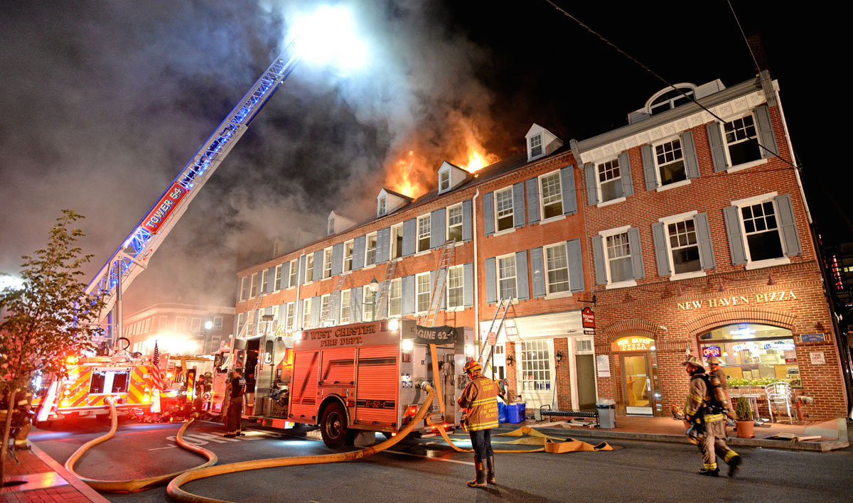
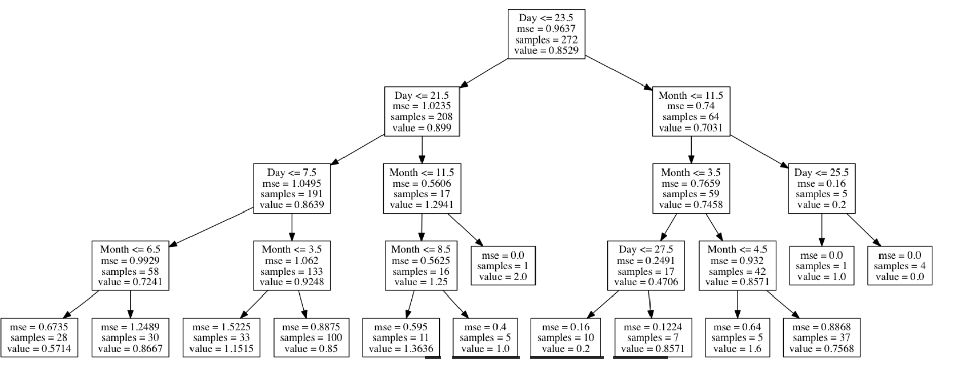


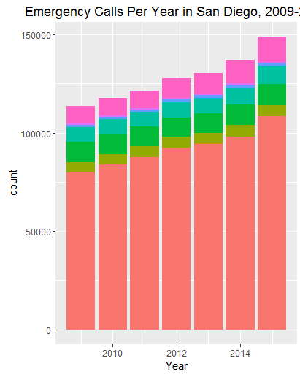
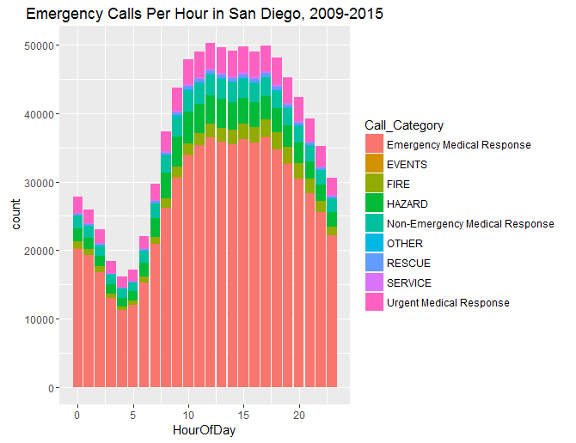
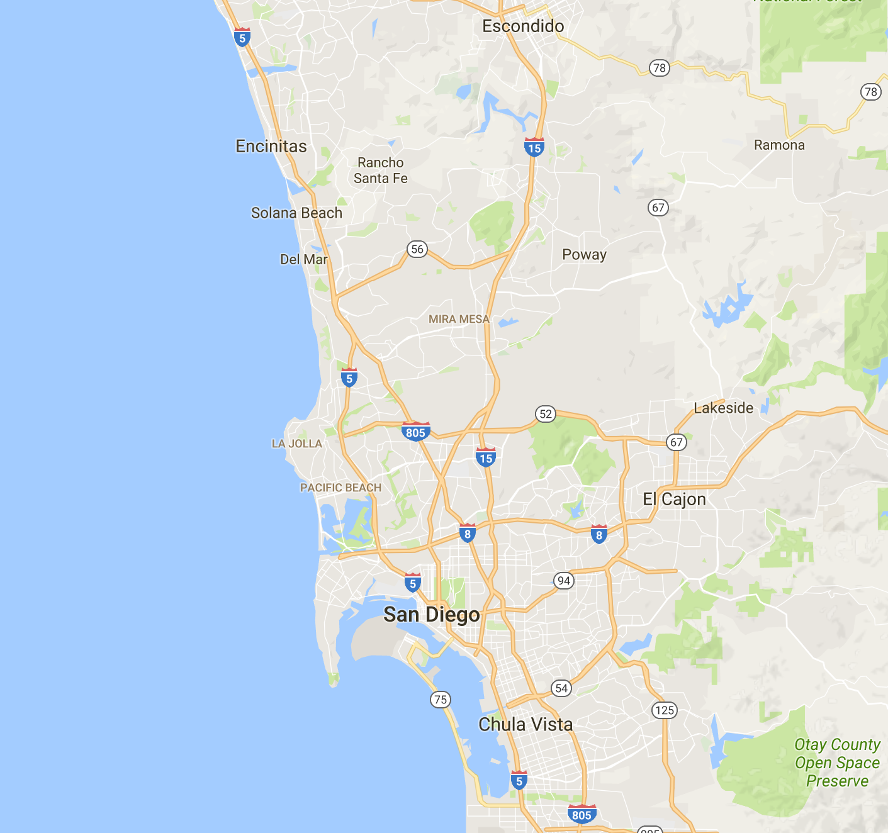
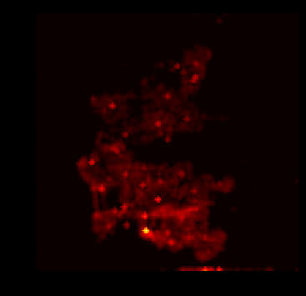

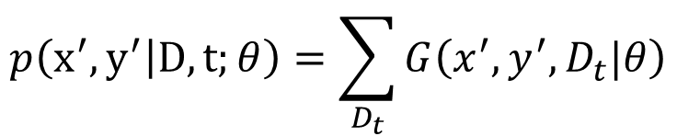
Predicting Emergency Incidents in San Diego
Zachary Barnes, Frank Cipollone, Tyler Romero
CS229 Final Project Poster
Motivation
Problem Descriptions
Results
At the end of each trial, the correct category was revealed and the subjects recorded the accuracy of their category guess.
Emergency services respond to millions of calls every year throughout the city of San Diego
Generate grid representation of San Diego
Problem 1:
Predict the number of incidents that will happen per day in each grid cell
Helpful for staffing decisions
Problem 2:
Identify which exact areas of San Diego are the most high-risk on a specific day
Helpful for emergency anticipation
Problem 1:
Tested our models using 10-fold cross validation
Experimental Model: | RMSE:
Decision Tree Regression | 0.7010 (incidents/hour)
Decision Tree Regression with Max Depth 10 | 0.4827 (incidents/hour)
Spatial Clustering with linear regression | 0.4583 (incidents/hour)
Minutes/seconds in response time difference between life/death
The ability to effectively predict where emergency incidents will occur could save both lives and money
Models
Problem 2:
Tested our model on ten randomly selected days
Trained model on the
weeks leading up to
each of those days
Model selects the top
1% of at-risk locations
Decision Tree Regression:
Example of selections for a given day:
Used month, day, hour, and grid location as covariates
Effective, but prone to overfitting
Non-representative of underlying
distribution
Uses categorical data well
Figure 1: Burning building
Average Proportion of Daily Incidents Captured:
0.338
Our goal is to create a model that can effectively predict where incidents are likely to occur over the next several hours.
Spatial Clustering:
Data
Identify locations that are both contiguous and similar in nature based
Use these clusters in order to build better-informed models
Steps:
Generate a model for each cluster
Evaluate and update model on cluster
Re-cluster based on model performance
Discussion
8 years of emergency incident data from the city of San Diego
Cleaned, and converted to include latitude and longitude
Small variation and little information returned by solutions to problem 1 leads to the need for a solution to problem 2
Temporal fluctuations are important, but difficult to anticipate
Our solution to problem 2 would could effectively inform a dynamic resource allocation model
Next Steps:
Model each type of incident separately
Predict type of incident as well
Example spatial clustering
Spatial-Temporal Prospective Excitation Model:
Example likelihood for given day
Utilize temporal and spatial difference in determining likelihood at each locations
Choose top x% of points that capture Y% of events in a day.
$$p\left(x^{′},y^{′} | D,t;θ\right)=\sum_{D_{t}}{G\left(x^{′},y^{′},D_{t}|θ\right)}$$
References
[1] Haynes, Hylton JG. “Fire loss in the United States during 2015.” National Fire Protection Association. Fire Analysis and Research Division, 2016.
[2] San Diego Open Data Portal. The City of San Diego, n.d. Web. 21 Oct. 2016.
Figure 2: Data
Temporal-spatial correlation but unknown underlying dynamics.
0
1
Notes:
Behavioral results: make bar graphs of RT?
fMRI results: labels, figure caption, make blues in graph the same color
References: add marcel 2004, add numbers, rearrange

