Slide 1
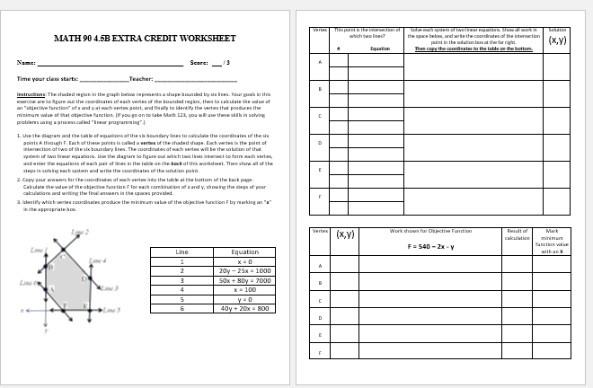
Extra Credit Assignment – Due at start of class:

Slide 2
Extra Credit Assignment Information:
This assignment is especially important for those of you who need to take Math 123 for your major.
You will use these skills in Math 123 to solve problems using a process called “linear programming”.
We encourage EVERYBODY in the class to do this extra credit worksheet, whether or not your next class is Math 123.
The assignment should take about 15-20 minutes. There are six systems of linear equations to solve, but five of them are simple substitution problems.
We’ll do the first one together in class now to show you how the process works.

Slide 3
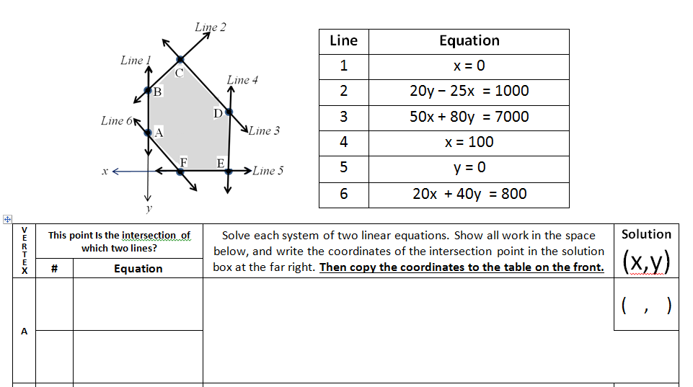
1. Use the diagram and the table of equations of the six boundary lines to calculate the coordinates of the six points A through F. Each of these points is called a vertex of the shaded shape.
Each vertex is the point of intersection of two of the six boundary lines. The coordinates of each vertex will be the solution of that system of two linear equations.
Use the diagram to figure out which two lines intersect to form each vertex, and enter the equations of each pair of lines in the table on the back of this worksheet.
Then show all of the steps in solving each system and write the coordinates of the solution point.
1
Eqn. 1. x = 0
Eqn. 2. 20x + 40y = 800
Substitute x = 0 into equation 2:
20∙0 + 40y = 800
40y = 800
y = 800/40 = 20
y= 20
x = 0
0
20
A
6

Slide 4
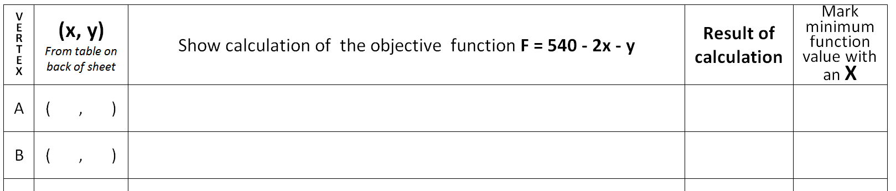
2. Copy your answers for the coordinates of each vertex into the table at the bottom of the front page.
Calculate the value of the objective function F for each combination of x and y, showing the steps of your calculations and writing the final answers in the spaces provided.
3. Identify which vertex coordinates produce the minimum value of the objective function F by marking an “x” in the appropriate box.
0
20
F = 540 - 2∙0 – 20 = 540 – 0 – 20 = 540
F = 540 - 2∙0 – 20
F = 540 - 2∙0 – 20 = 540 – 0 – 20
540
REMINDERS:
This assignment is due AT THE START OF THE NEXT CLASS.
No late submissions will be accepted.

