Slide 1

Welcome to Math 90!

Slide 2
Instructor:
Dr. Tyler Skorczewski
Email: skorczewskit@uwstout.edu
Office: JHSW 311
Phone: 232-5392
Please note: We will NOT be using D2L for this course. All assignments and grades will be posted on the MyMathLab course website that you’ll be registering for.

Slide 3
Course grading is based on 1000 points:
Daily Homework Assignments: (19%) 188 points
44 regular online assignments @ 4 points each
Final exam review assignments @ 6 points each
Quizzes: (4%) 42 points
3 @ 14 points
Tests: (77%) 770 points
Gateway Test: 10 points
Test 1: 100 points
Test 2: 100 points
Test 3: 100 points
Test 4: 100 points
Final Exam: 300 points (comprehensive)
Practice tests: 60 points total

Slide 4
Grade Scale:
Grade | A | A- | B+ | B | B- | C+ | C | C- | F
Points | ≥ 925 | ≥ 900 | ≥ 875 | ≥ 825 | ≥ 800 | ≥ 775 | ≥ 725 | ≥ 700 | < 700
% Score | ≥ 92.5 | ≥ 90 | ≥ 87.5 | ≥ 82.5 | ≥ 80 | ≥ 77.5 | ≥ 72.5 | ≥ 70 | < 70
Note that the minimum grade to pass this class is 70% (C-). Anything below 70% earns an F; no D grades are given.
IMPORTANT NOTE: The 4 credits for this course DO NOT count as credit towards graduation or towards the 6-credit General Education Analytical Skills requirement.

Slide 5
Notebooks/note taking:
Written notes should be taken during studying. You should have a notebook that you use specifically for this class, and take notes while reading the online textbook or watching videos.
You should also have a page in your notebook for each homework assignment and practice quiz/test. For each online problem, you should write the problem in your notebook, then show all steps of the work you do to get the answer.
These notes will be very helpful to you in studying for tests and quizzes, and you’ll also want to be in the habit of showing detailed work on problems for subsequent classes.

Slide 6
Homework guidelines:
Each homework assignment is due at 11:59PM on the due date. All deadlines are given in the calendar and in the on-line assignment list.
Each homework assignment is designed to take the average student one to two hours. Expect to spend an average of at least 8-10 hours a week on homework outside of reading the online text and watching videos.
Homework assignments can be completed on any computer with internet access.
Homework deadlines can be extended by your instructor if extreme unforeseen circumstances warrant, but you should work ahead if you know you will miss a deadline. Getting one or two days behind can make it very hard to catch up with the pace of the daily homework and quizzes in this class.

Slide 7
Calculators:
A basic calculator will available on your laptop for homework assignments, tests and quizzes.
Any other calculators are not allowed on tests or quizzes, so you shouldn’t use one for your homework or practice exams.
Calculator apps on cell phones, tablets, iPods and other electronic devices are not allowed either, so you shouldn’t rely on these for your homework or practice exams.

Slide 8
Quiz and test guidelines:
Each test will have a practice version available online.
Practice tests:
count a small amount (10 points) towards your grade.
can be taken as many times as you want, with only your best score counting towards your course grade.
are due on the deadline given on the course calendar.
can be done anywhere you have internet access, just like homework.
Tests:
must be taken on the days scheduled unless prior arrangements are made with your course instructor. Arrangements will only be made for extreme unforeseen circumstances.
are given online with a lockdown browser that blocks other screens.
For all quizzes and tests except the Gateway Test, a basic calculator is included in the lockdown browser and will be accessible on your laptop during the test. A formula sheet will be handed out for use on tests. No other notes or stand-alone calculators or other devices are allowed on quizzes or tests.
If a test is missed due to an unavoidable circumstance, a makeup may be given. Contact your instructor as soon as possible after the missed exam. Documentation of reason for absence may be required . If approved by your instructor, a makeup will be scheduled.

Slide 9
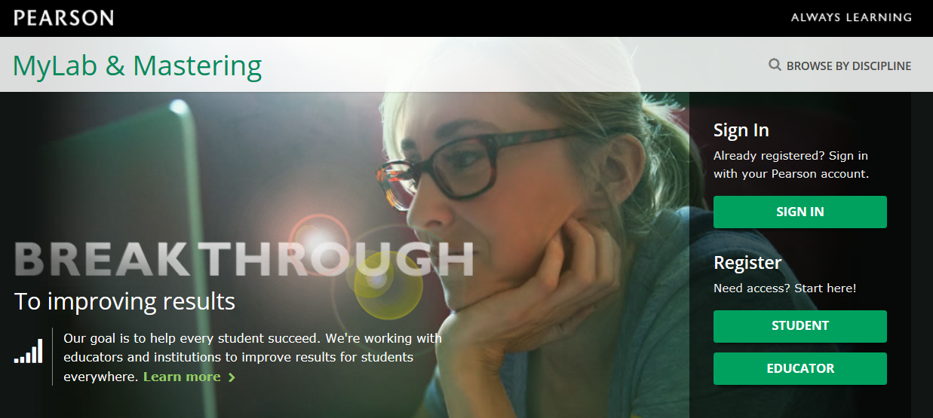
Website and Login information: http://pearsonmylabandmastering.com
NOTE: Even if you have used the MyLab or CourseCompass software before, start by clicking the Register/Student button and then OK! Register now.
The Course ID for this course is
XXXXX

Slide 10

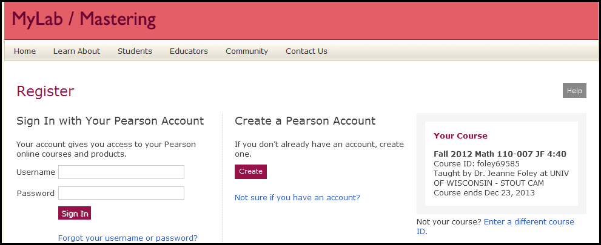
The Course ID for this course is
XXXXX
Next: After you enter the course ID, click “continue”.
Then, if you have used MyLab/CourseCompass software for any previous course, sign in with your existing username so you don’t have to re-enter all of the registration information. If not, select “Create a Pearson Account”.

Slide 11
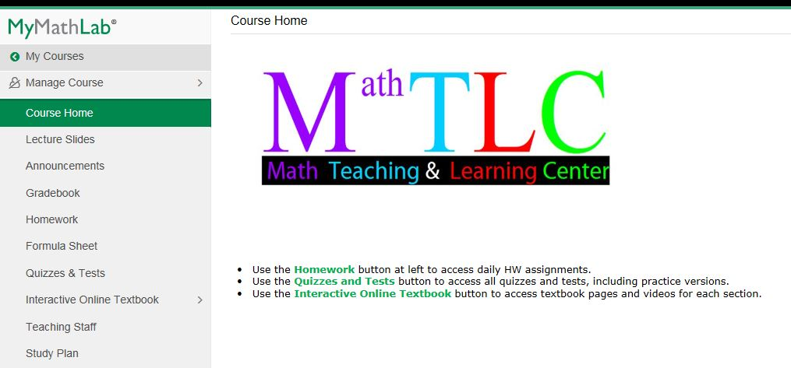
Once you’re at the course site, the Home Page looks like this:
Use this button if you want to look at the daily lecture slides before or after they’re covered in class. Some people like to print the slides out 2 or 3 to a page to take notes on them.
You will need to disable pop-ups for the Pearson sites in order for the software to work properly.

Slide 12
Your First Assignments
Using MS Excel or any spreadsheet program make a schedule of a typical week for you during the timeframe of the course.
Include all major time commitments including
this course
work
family
other classes
Any Highlight (using bold and/or a different color) the 3-4 hours each day you will work on this course.
Email this file to the instructor on or before 5/29 at skorczewskit@uwstout.edu with the subject line MATH 90 Schedule.
In addition to this calendar, please install the lockdown browser if you haven’t already (found on the Quizzes and Tests tab of MyMathLab).

