Slide 1
Please
CLOSE
YOUR LAPTOPS,
and turn off and put away your cell phones,
and get out your note-taking materials.

Slide 2
Section 10.1
Radicals and Radical Functions

Slide 3
Today’s Homework Assignment:
Don’t panic when you see that there are 53 problems on today’s homework assignment on section 10.1. Most of them are quick, simple problems like finding the square root of 25 or the cube root of 8.
In previous semesters, this has been one of the shortest homework assignments of the semester in terms of the time spent to complete it.

Slide 4
In what occupations or situations would you need square roots?
Answer: Any kind of job that deals with triangles.
Carpenters
Artists
Engineers
Architects
Designers of many sorts (game design, apparel design, package design)
Construction workers
Surveyors

Slide 5
Where will I use radicals in my higher level classes?
Math 120, 123 and up: Solving polynomial equations.
Classes using trigonometry. (Math 121, calculus)
Most physics classes.
Classes using mathematical models to predict things in the future. (economics, environmental biology, population studies, business plans)

Slide 6
Square Root
The opposite of squaring a number is taking the square root of a number.
A number b is a square root of a number a
if b² = a.
In order to find a square root of a, you need a number that, when squared, equals a.
NOTE: For many square and cube root problems, you may find it faster to use the list of perfect squares and cubes on your formula sheet than to use your calculator.

Slide 7
Examples:
How would you check this answer?
not a real number
(there’s no real number that
gives -4 when squared.)

Slide 8
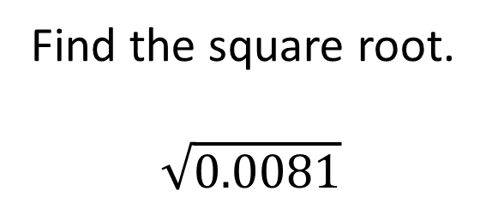
Problem from today’s homework:
Find the square root.
$$\sqrt{0.0081}$$
0.09

Slide 9
Square roots of perfect square radicands simplify to rational numbers (numbers that can be written as a quotient of integers).
Square roots of numbers that are not perfect squares (like 7, 10, etc.) are irrational numbers.
IF REQUESTED in the problem statement you can find a decimal approximation for these irrational numbers using your calculator.
Unless an approximation is requested, leave answers in radical form. (This is also referred to as the “exact answer”.)
Do not convert to an approximation (decimal form) unless explicitly requested to do so.

Slide 10
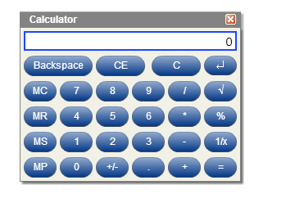
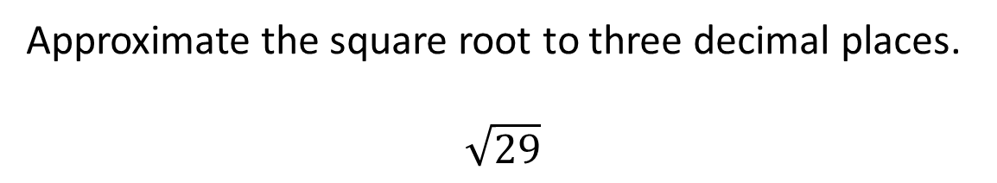
Problem from today’s homework:
Approximate the square root to three decimal places.
$$\sqrt{29}$$
Use the online calculator for these problems so you will know how to use it for quizzes and tests.
5.385

Slide 11
Radicands might also contain variables and powers of variables.
Example
Simplify. Assume that all variables represent positive numbers.
How would you check this answer?
Check?

Slide 12
The cube root of a real number a
Note: a is not restricted to non-negative numbers for cubes. The cube root of a negative number is a negative number.
Think about this: What is (-2)³?
Answer: -8
Therefore

Slide 13
(You can use your formula sheet to find the cubed numbers)
Example
How would you check this answer?
Check?
Check?

Slide 14
Other roots besides square and cube roots can be found, as well.
The nth root of a is defined as
If the index, n, is even, the root is NOT a real number when a is negative.
If the index is odd, the root will be a real number when a is negative.

Slide 15
Example
Simplify the following. Assume that all variables represent positive numbers.
Check?

Slide 16
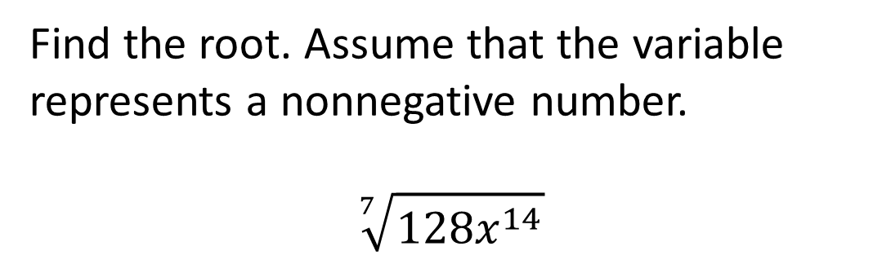
Problem from today’s homework:
Find the root. Assume that the variable
represents a nonnegative number.
$$\sqrt[7]{128x^{14}}$$
2x²
Check?
Hint: to find the seventh root of 128, start by breaking 128 down into its prime factors. Start by dividing by 2, then by 2 again, and so on.
You will find that 128 is the product of seven 2’s, i.e. that 128 = 2⁷.

Slide 17
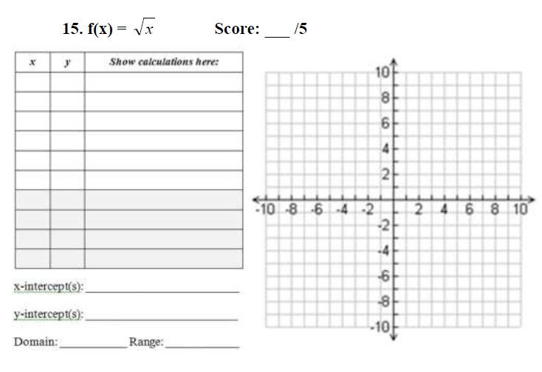
We previously worked with graphing basic forms of several types of nonlinear functions in the HW 8.2 worksheets, so you should be familiar with the general shape of the square root function.

Slide 18
Review
Graph
x y
y
0
0
1
1
(6, )
(4, 2)
2
(2, )
(1, 1)
4
2
x
(0, 0)
6

Slide 19
Now, what is the domain of this function? (in other words, for what values of x is it defined?)
The square root function is only defined for values of x that make the radicand (the number under the radical) ≥ 0.
So for the function , the domain is
{ x | x ≥ 0} (in set notation)
What would this be in interval notation?
Answer: [0, ∞)

Slide 20
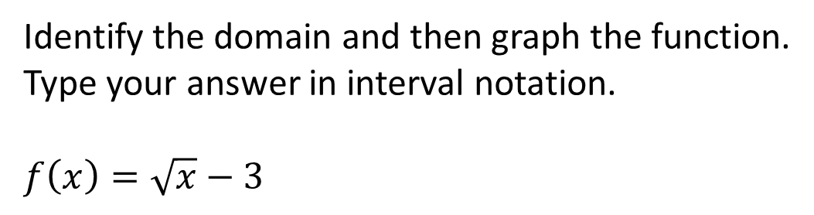
Problem from today’s homework:
Identify the domain and then graph the function.
Type your answer in interval notation.
$f\left(x\right)=\sqrt{x}−3$
[0, ∞)

Slide 21
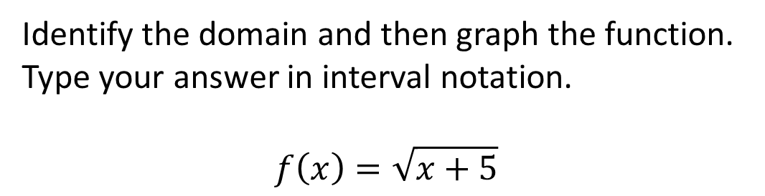
Problem from today’s homework:
Identify the domain and then graph the function.
Type your answer in interval notation.
$$f\left(x\right)=\sqrt{x+5}$$
[-5, ∞)

Slide 22
Example
Graph
x y
y
8
2
4
(8, 2)
1
1
(4, )
(1, 1)
0
0
x
(-1, -1)
(0, 0)
-1
-1
(-8, -2)
(-4, )
-4
-8
-2

Slide 23
Now, what is the domain of this function? (in other words, for what values of x is it defined?)
The cube root function is defined for ALL values of x.
So for the function y = , the domain is
{ x | x is a real number}
What would this be in interval notation?
Answer: (-∞, ∞)

Slide 24
The assignment on this material (HW 10.1)
Is due at the start of the next class session.
You may now OPEN
your LAPTOPS
and begin working on the homework assignment.
We expect all students to stay in the classroom to work on your homework till the end of the 55-minute class period. If you have already finished the homework assignment for today’s section, you should work ahead on the next one or work on the next practice test.

