Slide 1
Please
CLOSE
YOUR LAPTOPS,
and turn off and put away your cell phones,
and get out your note-taking materials.

Slide 2
Section 10.2
Radicals and Rational Exponents

Slide 3
Definition of a rational exponent in terms of a radical:
If n is a positive integer greater than 1 and a is a real number, then

Slide 4
Why does this definition make sense?
Recall that a cube root is defined so that
However, if we let b = a^{1/3}, then
Since both values of b give us the same a,

Slide 5
Example
Use radical notation to write the following. Simplify if possible.

Slide 6
We can expand our use of rational exponents to include fractions of the type m/n, where m and n are both integers, n is positive, and a is a positive number,

Slide 7
Example
Use radical notation to write the following. Simplify if possible.

Slide 8
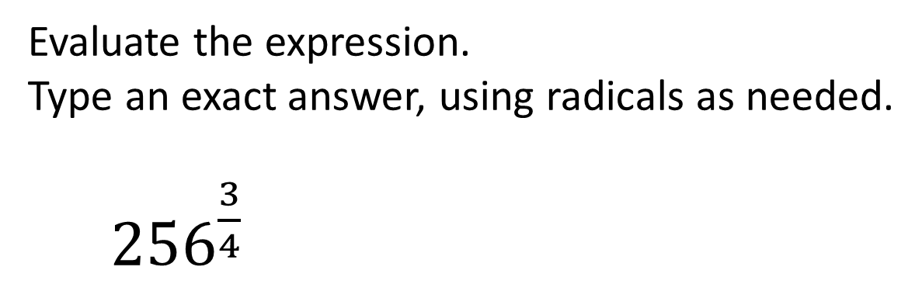
Problem from today’s homework:
Evaluate the expression.
Type an exact answer, using radicals as needed.
${256}^{\frac{3}{4}}$
64

Slide 9
Now to complete our definitions, we want to include negative rational exponents.
If a^{-m/n} is a nonzero real number,

Slide 10
Example
Use radical notation to write the following. Simplify if possible.
What if the previous problem was ?
The answer would be “N” (not a real number) because you’d be trying to take an even root of a negative number.

Slide 11
All the properties that we have previously derived for integer exponents hold for rational number exponents, as well.
We can use these properties to simplify expressions with rational exponents.

Slide 12
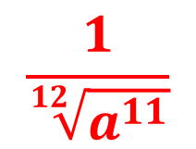
Example
Use properties of exponents to simplify the following. Write results with only positive exponents.
What would this answer look like in radical form?
$$\frac{1}{\sqrt[12]{a^{11}}}$$

Slide 13
Example
Use rational exponents to write as a single radical.

Slide 14
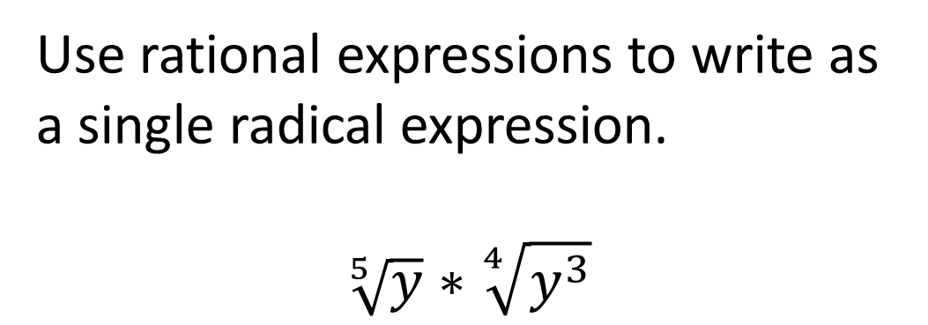
Problem from today’s homework:
Use rational expressions to write as
a single radical expression.
$$\sqrt[5]{y}∗\sqrt[4]{y^{3}}$$
Final answer:
Hints: Start by writing each radical as a rational (fraction) exponent,
then add the fractions by finding a common denominator.
For your final step, convert back into radical form.

Slide 15
The assignment on this material (HW 10.2) is due at the start of the next class session.
You may now OPEN
your LAPTOPS
and begin working on the homework assignment until the end of the class period.

