Slide 1
Please
CLOSE
YOUR LAPTOPS,
and turn off and put away your cell phones,
and get out your note-taking materials.

Slide 2
Make sure you know the day and time of the final exam for this section of Math 90:
All Math 90 finals will be given in your regular classroom.
Check with your instructor on your final exam time and date.
Schedules will be posted during the last week of class.

Slide 3
Section 10.3
Simplifying Radical Expressions

Slide 4
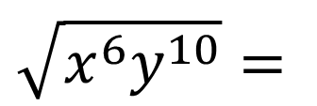
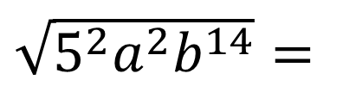
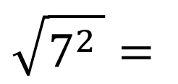
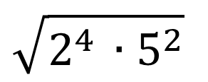
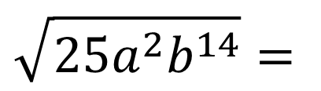
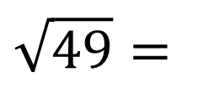
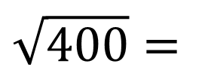

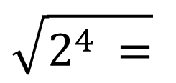
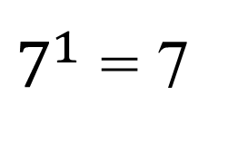

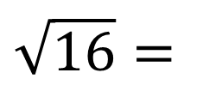


Recall these square root problems from Section 10.1:
Examples:
$$\sqrt{49}=$$
$$\sqrt{7^{2 }}=$$
(7²)^{½} =
$7^{1}$ = 7
$$\sqrt{16}=$$
$$\sqrt{2^{4 }=}$$
$$2^{2}=4$$
$$\sqrt{400}=$$
$$\sqrt{2^{4 }{∙5}^{2}}$$
$$=2^{2}∙5=20$$
$$\sqrt{x^{6}y^{10}}=$$
$$x^{3}y^{5}$$
$$\sqrt{25a^{2}b^{14}}=$$
$\sqrt{5^{2}a^{2}b^{14}}=$
$$5ab^{7}$$

Slide 5


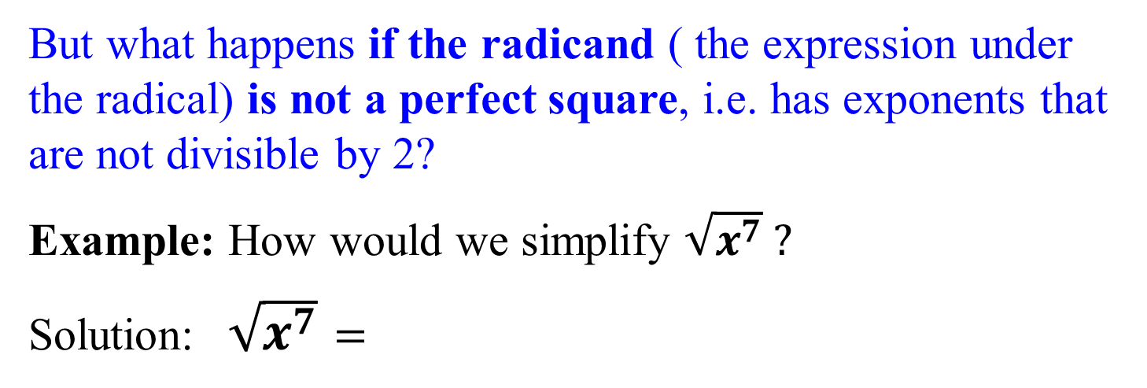

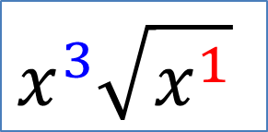

What we did in the previous examples was essentially to divide the exponent of each base by 2, which is index of the radical for square roots.
But what happens if the radicand ( the expression under the radical) is not a perfect square, i.e. has exponents that are not divisible by 2?
Example: How would we simplify $\sqrt{x^{7}} ?$
Solution:$\sqrt{x^{7}}$ $=$
$$x^{7/2}=$$
$$x^{3½}=$$
$$x^{3}x^{½}=$$
$x^{3}\sqrt{x}$
Think of this as dividing the exponent 7 by the index 2
Two goes into seven 3 times with a remainder of 1
$$x^{3}\sqrt{x^{1}}$$

Slide 6

Example
Simplify
First, break down 12 into its prime factors:
12 = 4∙3 = 2∙2∙3 = 2²∙3¹
This gives
Now divide the exponents by 2 (square root, so the index is 2). Answer:

Slide 7
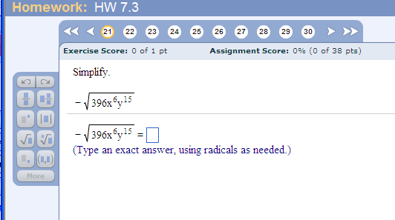
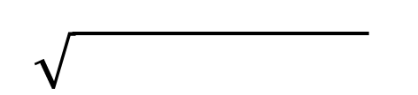
Problem from today’s homework:
Final Answer:
-
2²3²11¹x⁶y¹⁵
Start by breaking down 396: 396
(use your calculator, and start by dividing by 2) 2 198
2 99
9 11
3 3
So 396 = 2²3²11¹

Slide 8


If we have a radical with an index of 3 or higher, we can use the same process to simplify the radical.
Example: How would we simplify $\sqrt[3]{x^{7}} ?$
Solution:
$\sqrt[ 3]{x^{7}}=$
Divide the exponent 7 by the index 3
Three goes into seven 2 times with a remainder of 1
$$x^{2} \sqrt[3]{x^{1}}$$

Slide 9
Example
Simplify
Answer:

Slide 10
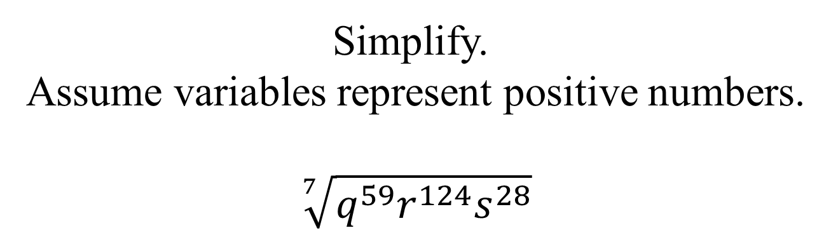
Problem from today’s homework:
Simplify.
Assume variables represent positive numbers.
$$\sqrt[7]{q^{59}r^{124}s^{28}}$$

Slide 11
Product and Quotient Rules for Radicals:
If and are real numbers, then
Product Rule:
Why is this condition important?
Quotient Rule:
Because division by zero gives an undefined quotient.
No, because square roots of negative numbers
are not real numbers.

Slide 12
Example
Simplify the following radical expressions.
(Assume x and y are ≥ 0)
(Assume a > 0 and b ≠ 0)

Slide 13
Example
Use the quotient rule to divide, then simplify if possible:
Answer:

Slide 14
In previous chapters, we’ve discussed the concept of “like” terms.
These are terms with the same variables raised to the same powers.
They can be combined through addition and subtraction.
Example: (x² + 5x – 1) + (6x² - 3x + 4) =
7x² + 2x + 3
Similarly, we can work with the concept of “like” radicals to combine radicals with the same radicand.

Slide 15
Like radicals are radicals with the same index and the same radicand.
Like radicals can also be combined with addition or subtraction by using the distributive property.

Slide 16
Example
Can not simplify (different indices)
Can not simplify (different radicands)

Slide 17
Always simplify radicals FIRST to determine whether there are like radicals to be combined.

Slide 18
Example
Simplify the following radical expression.

Slide 19
REMINDER:
The assignment on today’s material (HW 10.3) is due at the start of the next class session.
Please open your laptops and work on the homework assignment until the end of the class period.
Lab hours in 203:
Mondays through Thursdays

