Slide 1
Please CLOSE YOUR LAPTOPS,
and turn off and put away
your cell phones,
and get out your note-taking materials.

Slide 2
Section 11.2
The Quadratic Formula

Slide 3
The Quadratic Formula
The quadratic formula is another technique we can use for solving quadratic equations.
Remember, quadratic equations are polynomial equations of degree 2, such as
x² + 3x -7 = 0
or
5x² – 14 = 0.

Slide 4
The quadratic formula is derived from a process called “completing the square” for a general quadratic equation.
See Section 11.1 in the online textbook if you’re interested in seeing how this formula is derived.
If you are taking Math 120 next, this will be covered in that class in more detail, along with the technique called “completing the square”.

Slide 5
The Quadratic Formula:
The two solutions to the equation
ax² + bx + c = 0
(where a is the coefficient of the x² term, b for the x term, and c is the constant term.)
are given by the formula
Notes:
The symbol ± means “plus or minus”.
Using the + version gives you one solution, and using the ˗ version gives you the second solution.
This formula IS on the formula sheet, but you’ll probably have it memorized by the time you’ve done the first few homework problems.

Slide 6
If you think a polynomial is prime, a good way to check is by calculating the discriminant (the b² – 4ac part under the radical in the quadratic formula).
If the discriminant is negative, then you know for sure that your polynomial is prime and there are no real solutions. (There will be two complex but not real solutions involving the square root of -1, which is given the symbol “ i ”.)
If the discriminant is positive and a perfect square, then you will get two real solutions that are real and rational numbers.
If the discriminant is positive but not a perfect square, then you know for sure that your polynomial is prime (can’t be factored without using radicals), but there will be two irrational solutions that will contain radicals.
If the discriminant is zero, there is only one real solution, and the two factors of the quadratic trinomial will be the same binomial.

Slide 7
Visual Representations of Solutions
Discriminant
b² – 4ac
Kinds of solutions
to ax² + bx + c = 0
Graph of
y = ax² + bx + c
b² – 4ac > 0
Two unequal real solutions
(If b² – 4ac is a perfect square, the two solutions will be rational numbers. If not, they’re both irrational.)
Two x-intercepts
b² – 4ac = 0
One real solution
(a repeated solution)
(If b² – 4ac is a perfect square, the solution will be a rational number. If not, it’s irrational.)
One x-intercept
b² – 4ac < 0
No real solution;
two complex imaginary solutions
No x-intercepts

Slide 8
Example 1
Solve x² + 4x + 3 = 0
How many solutions and of what type?
Which method to use to solve?
Factoring
The quadratic formula.
Which way works best?

Slide 9
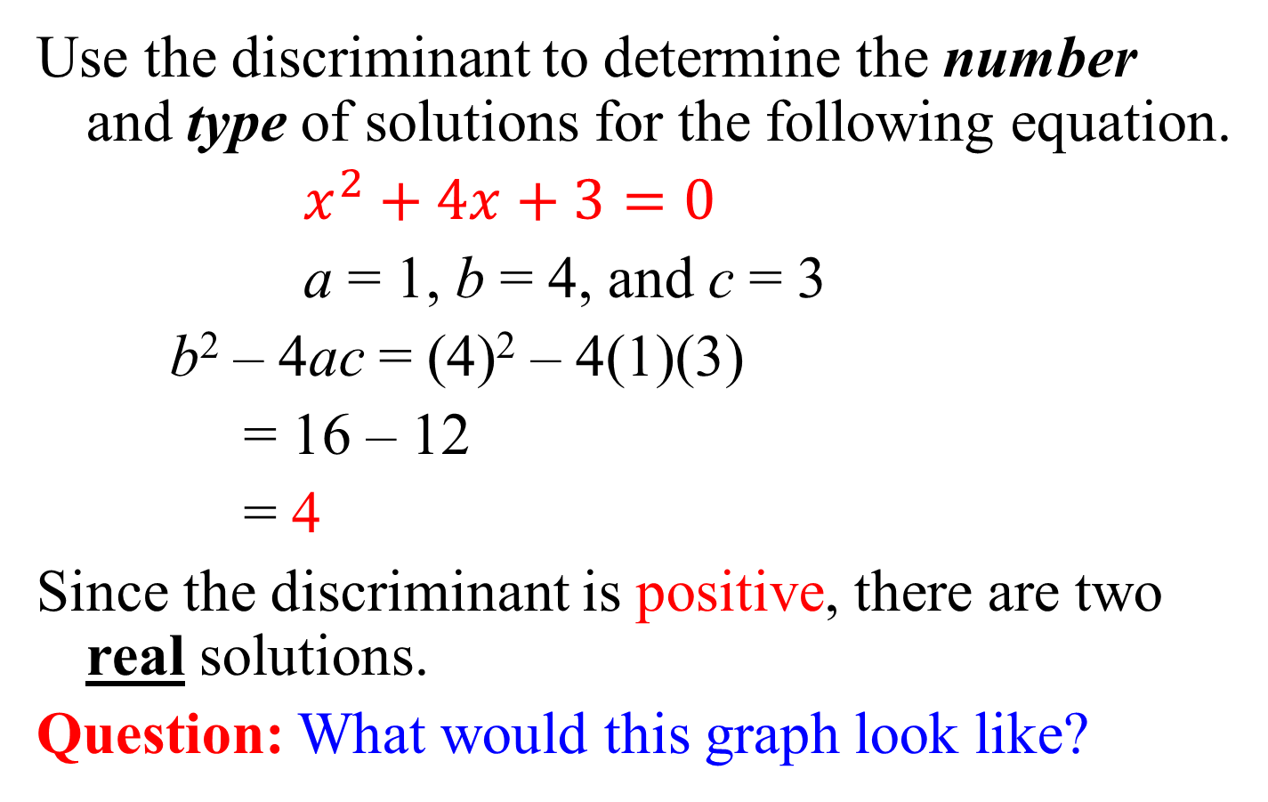
Example
Use the discriminant to determine the number and type of solutions for the following equation.
$x^{2}+4x+3=0$
a = 1, b = 4, and c = 3
b² – 4ac = (4)² – 4(1)(3)
= 16 – 12
= 4
Since the discriminant is positive, there are two real solutions.
Question: What would this graph look like?

Slide 10
Solve x² + 4x + 3 = 0 by factoring:
This one is pretty easy to factor.
The factoring is (x + 3)(x + 1) = 0,
so the solutions are given by
x + 3 = 0,
giving x = -3,
and x + 1 = 0,
giving x = -1.

Slide 11
Now, solve x² + 4x + 3 = 0 by the quadratic formula:
a = 1, b = 4, c = 3, so the formula gives:

Slide 12
Which way works best for this problem?
In this case, the factoring method is much quicker, although BOTH methods give the same answer.
And by the way,
how would we check these answers
on a quiz or a test?

Slide 13
Example:
Solve x² + 5x + 12 = 0 by
How many solutions and of what type?
Which method to use to solve?
Factoring
The quadratic formula.
Which way works best?

Slide 14
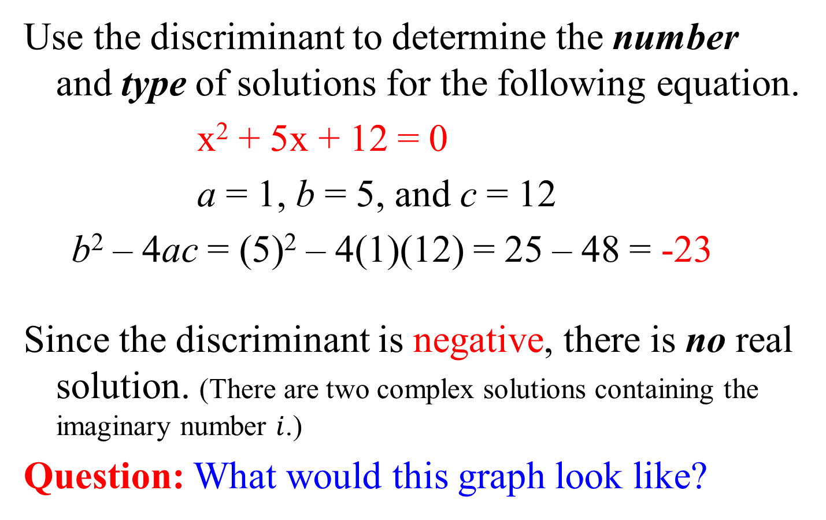
Example
Use the discriminant to determine the number and type of solutions for the following equation.
x² + 5x + 12 = 0
a = 1, b = 5, and c = 12
b² – 4ac = (5)² – 4(1)(12) = 25 – 48 = -23
Since the discriminant is negative, there is no real solution. (There are two complex solutions containing the imaginary number $i$.)
Question: What would this graph look like?

Slide 15
Solve x² + 5x + 12 = 0 by factoring:
This one looks pretty easy to factor, but when you start trying to find two factors of 12 that add up to 5, nothing works.
(1+12=13, 2+6=8, 3+4=7).
What does this mean?
It means that the polynomial is PRIME, and there are no rational solutions. (Remember, a rational number is either an integer or a fraction.)

Slide 16
Solve x² + 5x + 12 = 0 (continued):
Let’s see what the quadratic formula gives in this case:
a = 1, b = 5, c = 12
so the formula gives:
Notice that the number under the radical sign is negative, which means there are no real answers.
There will be two complex but not real solutions involving the symbol “ i ” which is the square root of -1.

Slide 17
Example:
Solve x² + 2x - 4 = 0 by
How many solutions and of what type?
Which method to use to solve?
Factoring
The quadratic formula.
Which way works best?

Slide 18
Example
Use the discriminant to determine the number and type of solutions for the following equation.
x² + 2x – 4 = 0
a = 1, b = 2, and c = -4
b² – 4ac = (2)² – 4(1)(-4) = 4 – (-16) = 20
Since the discriminant is positive, there are two real solutions.
Question: What would this graph look like?

Slide 19
Solve x² + 2x - 4 = 0 by factoring:
Again, this one looks like it would be easy to factor, but when you start trying to find two factors of 4 that add up to 2, nothing works.
(-1 + 4 = 3, -4 + 1=-3, -2+2 = 0)
What does this mean?
It means that the polynomial is PRIME, and there are no rational solutions. (Remember, a rational number is a real number that is either an integer or a fraction.)

Slide 20
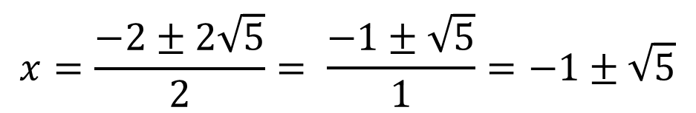
Solve x² + 2x - 4 = 0 (continued):
Let’s see what the quadratic formula gives in this case:
a = 1, b = 2, c = -4
so the formula gives:
$$x=\frac{−2±2\sqrt{5}}{2}= \frac{−1±\sqrt{5}}{1}=−1±\sqrt{5}$$
(exact answer)
Notice that the number (20) under the radical sign is positive, which means there are two real answers. However, since 20 is not a perfect square, its square root is irrational. In this case, we’d again say that the polynomial is prime, because it has no rational roots.

Slide 21
Question: What if some coefficients in your quadratic equation are fractions?
ANSWER: Clear them first by multiplying all terms by the LCD:
Solve x² + x – = 0 by the quadratic formula.
Step 1: Multiply every term by 8 to get
x² + 8x – 20 = 0
Therefore a = 1, b = 8, c = -20
IMPORTANT:
When you check these answers, plug them back into the ORIGINAL equation, the one with the fractions, just in case you made a mistake when you cleared the fractions in Step 1.
+ version gives: 4/2 = 2
- version gives -20/2 = -10

Slide 22
REMINDER:
The assignment on today’s material (HW 11.2) is due at the start of the next class session.
Visit the MathTLC
for homework help!

