Slide 1
Please CLOSE YOUR LAPTOPS,
and turn off and put away
your cell phones,
and get out your note-taking materials.

Slide 2
Section 11.5
Graphing Quadratic Equations

Slide 3
Graphing quadratic functions of the form
f(x) = ax² + c .
If a > 0, the parabola opens upward.
If a < 0, the parabola opens downward.
The point (0, C) is the y-intercept of the graph.

Slide 4
Examples
y
f(x) = x²
f(x) = -x²
g(x) = x² + 3
x
h(x) = x² – 3

Slide 5
Two new terms we’ll be introducing in this section:
The highest point or lowest point on the parabola is called the vertex.
The axis of symmetry is the line that runs through the vertex and through the middle of the parabola.

Slide 6
Examples
y
f(x) = x²
Vertex = (0,0)
f(x) = -x²
Vertex = (0,0)
g(x) = x² + 3
Vertex = (0,3)
x
h(x) = x² – 3
Vertex = (0,-3)
The axis of symmetry for all four of these graphs is the vertical line x = 0

Slide 7
Graphing the parabola f(x) = (x – h)²
If h is positive, the graph of f(x) = (x – h)² is the graph of y = x² shifted to the right h units.
If h is negative, the graph of f(x) = (x – h)² is the graph of y = x² shifted to the left |h| units.
The vertex is (h, 0) .
The axis of symmetry is the vertical line x = h.

Slide 8
Example (cont)
f(x) = x²
g(x) = (x – 3)²
Vertex: (3, 0)
Axis: x = 3
h(x) = (x + 3)²
Vertex: (−3, 0)
Axis: x = −3

Slide 9
Graphing the parabola f(x) = (x – h)² + k
The parabola has the same shape as y = x².
The vertex is the point (h, k).
The axis of symmetry is the vertical line x = h.

Slide 10
Example (cont)
f(x) = x²
y
g(x) = (x – 2)² + 4
Vertex: (2, 4)
Axis: x = 2
x

Slide 11
Graphing the parabola f(x) = ax²
If a is positive, the parabola opens upward
If a is negative, the parabola opens downward.
If |a| > 1, the graph of the parabola is narrower than the graph of y = x².
If |a| < 1, the graph of the parabola is wider than the graph of y = x².

Slide 12
Example (cont)
y
f(x) = x²
g(x) = 3x²
x
h(x) = (1/3)x²
The vertex of all three of these graphs is the point (0,0).
The axis of symmetry for all three of these graphs is the vertical line x = 0

Slide 13
Example
Graph g(x) = –4(x + 2)² – 1. Find the vertex and axis of symmetry.
Rewrite the function: g(x) = –4(x – (–2))² – 1.
The graphs opens down and is narrower than f(x) = x² .
The graph is the graph of
f(x) = x² shifted two units to the left and one unit down.
Vertex: (–2, –1)
Axis: x = –2

Slide 14
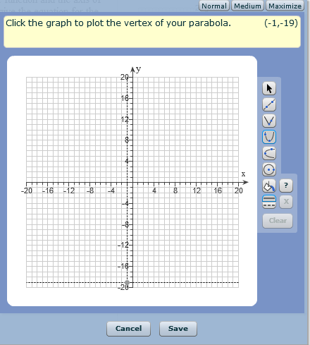
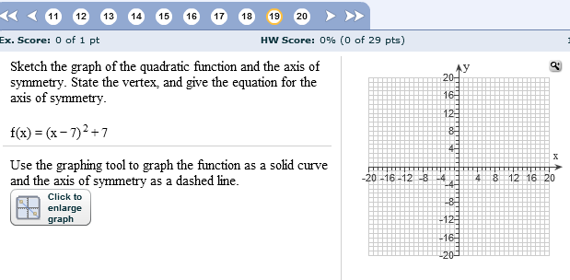
Using the online graphing tool for this assignment:
First, select the parabola tool.
(7, 7)

Slide 15
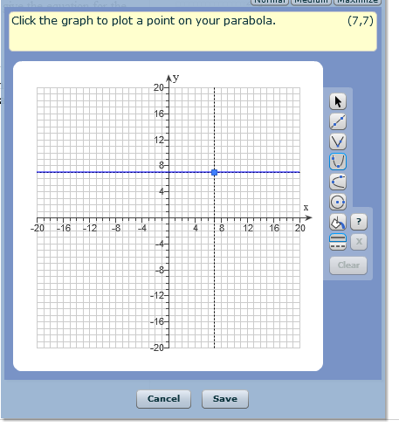
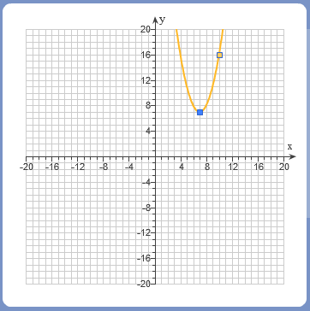

(10,16)
Next, find a second point on the graph by picking a number to plug in for x and calculating the y coordinate.
Pick an x that is not part of the vertex point, and choose it so that the x and y values can be plotted on the scale of the graph. (More than one choice will work.)
For example, if we choose x = 10, then y = (10 - 7)² + 7 = 3² + 7 = 16.
Then (10,16) would be a second point we can plot on the parabola.

Slide 16
Next, select the line tool.
(7, 7)
Use the line tool to graph the axis of symmetry.
Pay attention to this next part!!
After you graph the axis of symmetry line, you have to change it to a dotted line in order for the software to know that you’ve got the correct answer.

Slide 17
Once you have the parabola AND the axis of symmetry graphed, and have changed the axis to a dotted line, click “save”.
Then you’ll be asked to type in the vertex as an ordered pair.
That would be (7,7) in the previous example.
Finally, you’ll be asked to give the equation of the axis of symmetry.
That would be x = 7 in the previous example.
You can now open your laptops and try using this tool on HW 11.5
Make sure you can successfully use the tool (i.e. “check answer” and get it right) before you leave class today.

Slide 18
REMINDER:
The assignment on today’s material (HW 11.5) is due at the start of the next class session.
If time remains, please open your laptops and work on the homework assignment until the end of the class period.
Visit the MathTLC
for homework help!

