Slide 1
Please
CLOSE
YOUR LAPTOPS,
and turn off and put away your cell phones,
and get out your note-taking materials.

Slide 2

If you are on the class roster but are attending class for the first time today, please check with the TA to get registered in the online software.
If you are not yet on the class roster and are trying to add the class, please see the instructor after the lecture is finished.

Slide 3
Results of yesterday’s quiz:
Graded quiz worksheets will be handed back now.
Your score on this quiz WILL NOT count towards your course grade, but we will be giving you a similar test that will count 25 points towards your course grade.
We will be spending part of this week teaching you a method for doing these kinds of problems without a calculator.
You will have problems like these in your daily homework assignments this week, which you should practice doing without a calculator.
There is also a timed Practice Gateway Test available online now that you can take as many times as you want.

Slide 4
NOTE:
Today’s homework (HW 1.3A) is due at the start of the next class.
You should do these problems without using a calculator, since you won’t be allowed to use one on the Gateway Test.

Slide 5
Lecture Slides:
Power Point lecture slides for each day are always posted in the “Daily Lecture Slides” link from the MyMathLab course homepage, so you can copy, view, or print them at any time.
The slides might not always be projected during the lecture, but they will give you a good overview/ preview and will also help you review for tests and quizzes.
If you have trouble keeping up with the pace of the lecture, you can print the slides as a handout (3 or 4 to a page) before you come to class and then take notes on them during the lecture.

Slide 6
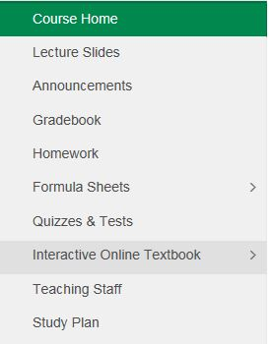
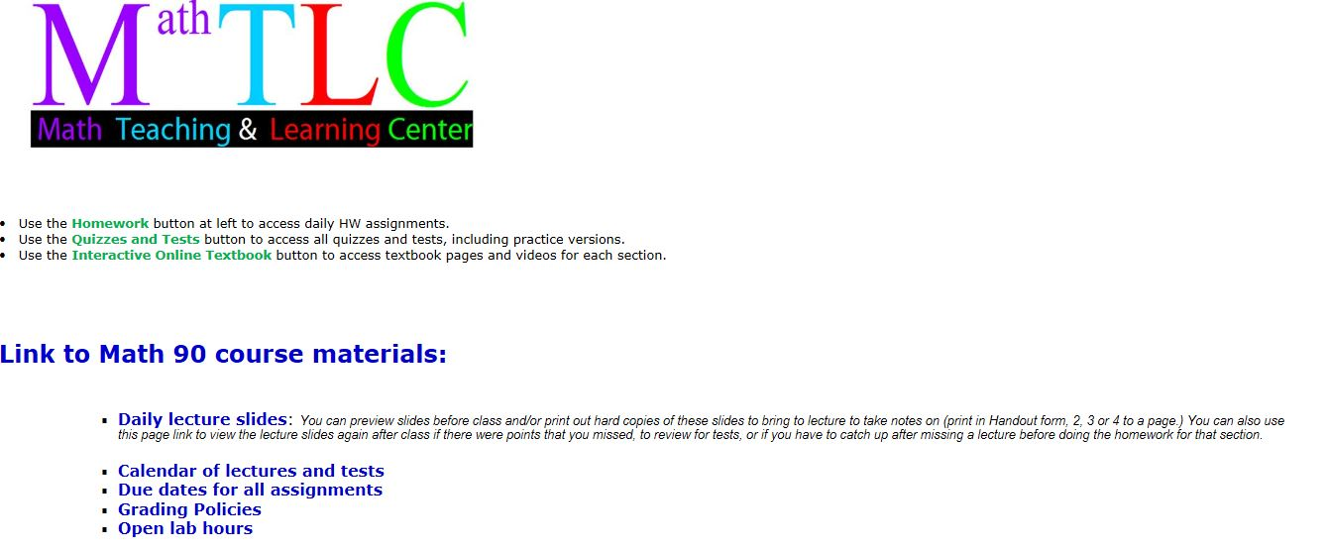
Lecture slides also available from this menu button
Practice Gateway Test is accessible from this menu button

Slide 7
Other study aids available for each day’s lecture topic:
Additional video lectures by the textbook author are available online for each book section we cover in class.
An on-line version of the textbook is also provided for each section, with interactive practice problems and video clips.
Both of these can be accessed from the “Interactive Online Textbook” menu button by clicking on the Chapter and Section for that day.

Slide 9
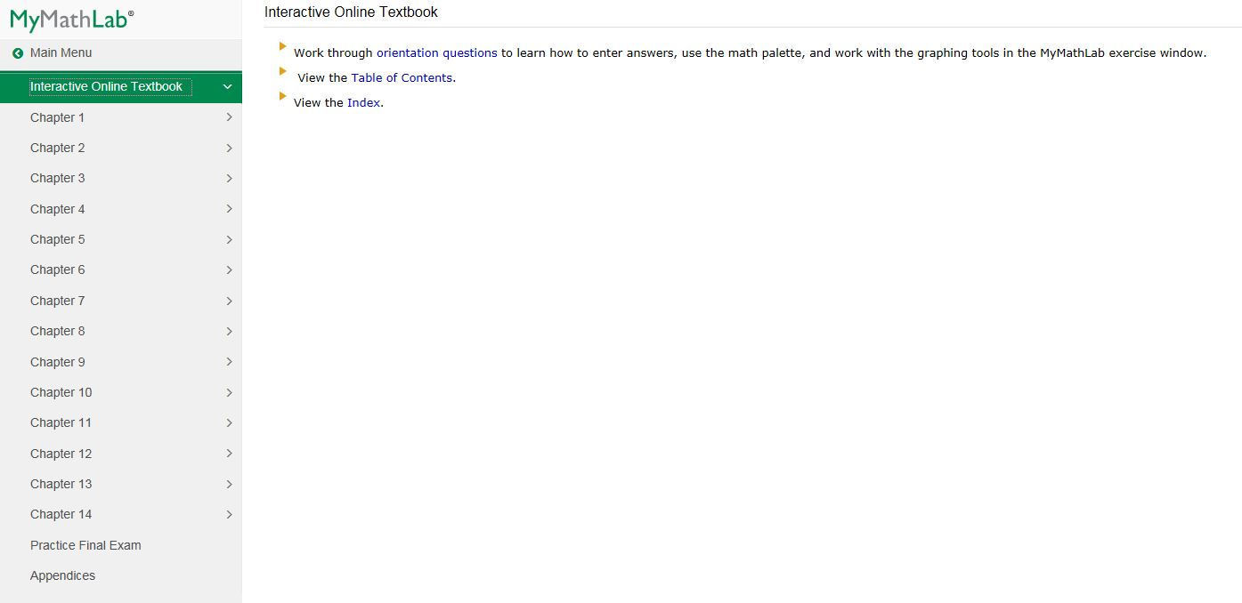

Slide 10
Section 1.3 Prime numbers and fractions
Factoring a number means writing it as a product of two or more prime number factors.
A prime number is a natural number (other than 1) whose only factors are 1 and itself.
The first few prime numbers are:
2, 3, 5, 7, 11, 13, 17, 19, 23, 29
(It will help you on the Homework & Quizzes if you learn these by heart!)
Question: Why isn’t 6 a prime number?
Answer: Because it can be written as 2 times 3 (or 2·3)
Why isn’t 8 a prime number? 9? 10? 12?

Slide 11
Question:
What’s the next prime number after 29?
Check 30: Can you divide 30 by anything other than 1 and 30?
Yes, so it’s NOT prime.
(Numbers that are not prime are called composite numbers.)
Check 31: Try dividing it by all of the prime numbers up to half of 31. If none of them work, then 31 is prime.
Can you divide 31 by 2? NO By 3? NO By 5? NO
By 7? By 11? By 13? By 17?
( 17 is a little more than half of 31, and none of the primes up through 17 divide into 31, so we conclude that 31 is a prime number.)

Slide 12
Back to factoring numbers:
Factor the number 44 into a product of primes.
Solution:
First, think of some number that divides into 44.
How about 2?
Then write 44 as 2·22. (Because 44÷2 = 22)
2 is prime, but 22 can be factored further, into 2·11
So 2·22 = 2·2·11 (NOTE: We could also write this as 2²·11)
These are now all prime numbers, so we’re done.
(Always arrange the numbers in order from smallest to largest in your final answer).

Slide 13
Another example:
Factor the number 150 into a product of primes.
Solution:
First, think of some number that divides into 150.
How about 10?
Then write 150 as 10·15. (Because 150÷10 = 15)
Both of these can be factored further:
10·15 = 2·5·3·5
These are now all prime numbers, so we’re done, except for arranging the numbers in order from smallest to largest.
Final answer: 2·3·5·5 (or 2·3·5²)

Slide 14
Recall that a fraction is a quotient of two numbers.
(“quotient” means you’re dividing the top number by the bottom number)
The numerator is the top number.
The denominator is the bottom number.
Simplifying fractions (reducing to lowest terms) involves factoring numerator and denominator into prime numbers and then canceling any primes that appear on both top and bottom.

Slide 15
Example
Simplify the following fractions.
Since there are no common factors, the original fraction is already simplified.

Slide 16
. . Multiplying and Dividing Fractions Without Using a Calculator Using Factoring
NOTE: Problems 3 & 5 from the quiz you took on the first day of class (and will take again next week) on multiplying and dividing fractions can both be done using the factoring steps that will be covered in the following slides. There will be some problems in the online homework for section 1.3 that also use these techniques.

Slide 17
Basic strategy for multiplying and dividing fractions:
These kinds of problems DO NOT require finding a common denominator. They can be most easily done by factoring both the numerator (top number) and denominator of both fractions into a product of prime numbers, and then canceling any common factors (numbers that appear on both the top and the bottom).

Slide 18
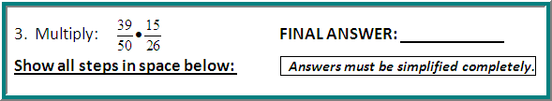
Sample Problem: Multiplying fractions
Step 1: Factor both the numerators and denominators into
prime factors, then write each fraction in factored form:
First fraction: 39= 3∙13 and 50 = 2∙5∙5
Second fraction: 15= 3∙5 and 26 = 2∙13
So you can write 39 • 15 as 3∙13 • 3∙5 .
50 26 2∙5∙5 2∙13

Slide 19
Sample Problem: Multiplying fractions (continued)
Step 2: Now just cancel any common factors that appear in both numerator and denominator. Once you multiply out any remaining factors, the result is your simplified answer.
3∙13 • 3∙5 = 3∙3 = 9 .
2∙5∙5 2∙13 2∙5∙2 20
/ /
/ /
NOTE: It is much easier to factor first and then cancel, rather than multiplying out the numerators and denominators and then trying to simplify the answer (especially if you aren’t using a calculator!) If you multiplied first, you’d have gotten
585, which would be nasty to simplify by hand…
1300

Slide 20

Sample Problem: Dividing fractions
Step 1: Multiply the first fraction by the 45 ÷ 21 = 45 • 26
reciprocal of the second fraction. 13 26 13 21
(i.e. flip the second fraction upside down and change ÷ to • .)
Step 2: Factor both the numerators and denominators into
prime factors, then write each fraction in factored form:
First fraction: 45 = 3∙3∙5 and 13 = 13 (prime)
Second fraction: 26 = 2∙13 and 21 = 3∙7
So you can write 45 • 26 as 3∙3∙5 • 2∙13 .
13 21 13 3∙7

Slide 21
Sample Problem: Dividing fractions (continued)
Step 3: Now just cancel any common factors that appear in both numerator and denominator. Once you multiply out any remaining factors, the result is your simplified answer.
3∙3∙5 • 2∙13 = 3∙5∙2 = 30
13 3∙7 7 7
/ /
/ /
NOTE: Once again, it is much easier to factor first and then cancel, rather than multiplying out the numerators and denominators and then trying to simplify the answer (especially if you aren’t using a calculator!) If you multiplied first, you’d have gotten 1170 , which would be pretty hard to simplify by hand.
273

Slide 22
NOTE: Gateway problems 4 & 6 and several of today’s homework problems using mixed numbers all start with the same step.
A mixed fraction (mixed number) consists of an integer part and a fraction part.
We want to covert the mixed number into an improper fraction (one with the numerator larger than the denominator). This is done by multiplying the integer part by the denominator of the fraction part, then adding that product to the numerator of the fraction and putting that sum over the original denominator.

Slide 23
Converting a Mixed Number
Into an Improper Fraction:
Example: Convert the mixed number into
an improper fraction:
Solution: First, note that
Then:

Slide 24
Converting a Mixed Number Into an Improper Fraction Another way to look at it:
To convert 5 ¼:
Multiply the denominator of the fraction part (4) by the whole number part (5) 5 ∙ 4 = 20
Add the numerator of the fraction part (1) to this result: 1 + 20 = 21
Write this number over the denominator of the original fraction : ANSWER: 21/4

Slide 25
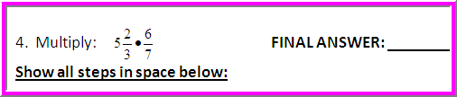
Sample Gateway Problem #4: Multiplying mixed numbers
Step 1: Convert the mixed number into
an improper fraction: (Note that )
.
So becomes , which we can then solve the same
way we did our fraction multiplication problems.

Slide 26
Sample Problem #4 (continued)
Step 2: Factor both the numerators and denominators into
prime factors, then write each fraction in factored form:
First fraction: 17 and 3 are both prime
Second fraction: 6 = 2∙3 and 7 is prime
So you can write 17 ∙ 6 as 17 ∙ 2∙3 .
3 7 3 7
Step 3: Now just cancel any common factors that appear in both
numerator and denominator. Once you multiply out any remaining
factors, the result is your simplified answer.
/
/
17 ∙ 2∙3 = 17∙2 = 34 .
3 7 7 7

Slide 27
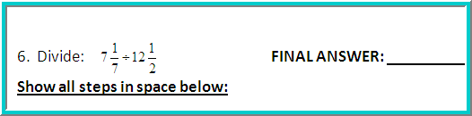
Sample Gateway Problem #6: Dividing with mixed numbers
Step 1: Convert the mixed numbers into improper fractions:
Now we can rewrite the problem as:
Then convert from division
to multiplication by using the
reciprocal of the second fraction:

Slide 28
Sample Problem #6 (continued)
Step 2: Factor both the numerators and denominators into
prime factors, then write each fraction in factored form:
First fraction: 50 = 2∙5∙5 and 7 is prime
Second fraction: 2 is prime and 25 = 5∙5
So you can write 50 • 2 as 2∙5∙5 • 2 .
7 25 7 5∙5
Step 3: Now just cancel any common factors that appear in
Both numerator and denominator. Once you multiply out any
remaining factors, the result is your simplified answer.
2∙5∙5 • 2 = 2∙2 = 4
7 5∙5 7 7
/ /
/ /

Slide 29
IMPORTANT: Even if you get a problem wrong on each of your three tries, you can still go back and do it again by clicking “similar exercise” at the bottom of the exercise box. You can do this nine times, for a total of 30 tries (3 tries at each of 10 different problems). You should always work to get 100% on each assignment!

Slide 30
REMINDER:
HW 1.3A is due at the start of the next class period. You should complete all problems and redo any you get wrong until your score is 100%
You should work the problems in this assignment
WITHOUT A CALCULATOR
Visit the Math TLC Open Lab
for homework help!

Slide 31
You may now OPEN
your LAPTOPS
and begin working on the homework assignment.
We expect all students to stay in the classroom to work on your homework till the end of the 55-minute class period. If you have already finished the homework assignment for today’s section, you should work ahead on the next one or work on the next practice quiz/test.

