Slide 1
Please
CLOSE
YOUR LAPTOPS,
and turn off and put away your cell phones,
and get out your note-taking materials.

Slide 2
Yesterday we worked on multiplying and dividing fractions. Now we’ll move on to adding and subtracting fractions.
This is usually a little more work than multiplying or dividing fractions, because before you add or subtract, both fractions have to be converted so they have the same denominator.
If your two fractions already have the same denominator, just add (or subtract) the numerators and put the result over that denominator. Some examples:
Are these answers simplified?
How would you check that?

Slide 3
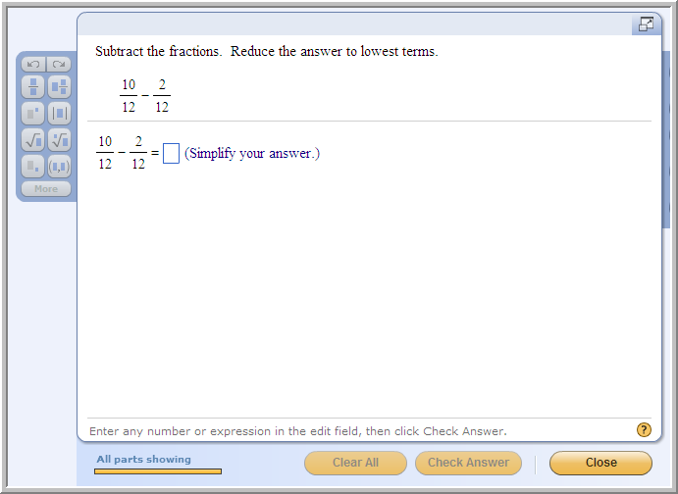
Example from today’s homework:
ANSWER: 2
3

Slide 4
Steps to follow for finding the least common denominator (LCD) of two fractions:
But what if you need to add fractions in which the two denominators are different?
In that case, you have to find a COMMON (same) DENOMINATOR before you can add the numerators together. Simplifying your answer will be MUCH easier if you use the smallest possible (“least”) denominator that works for both fractions.
Factor both denominators into primes.
List all the primes in the first denominator (with multiplication signs between each number)
After these numbers, list any NEW primes that appear in the second denominator but not the first.
Multiply this whole list of primes together. This is your LCD.

Slide 5
Finding the least common denominator (LCD) of two fractions:
Example: Find the LCD of 3/4 and 7/18:
Factor both denominators into primes.
4 = 2*2 18 = 2*9 = 2*3*3
Start with all the primes in the first denominator (with multiplication signs between each number). If any prime number appears more than once in the first denominator, include each one in the LCD.
2*2
After these numbers, list any NEW primes that appear in the second denominator but not the first.
2*2*3*3
Multiply this whole list of primes together. This is your LCD.
2*2*3*3= 4*9 = 36

Slide 6
NOTE: Gateway problems 1 & 2 on adding and subtracting fractions as well as many of the problems on today’s homework assignment can all be done using the same set of steps.
Adding fractions and subtracting fractions both require finding a least common denominator (LCD), which as we just saw is most reliably done by factoring the denominator (bottom number) of each fraction into a product of prime numbers (a number that can be divided only by itself and 1).

Slide 7
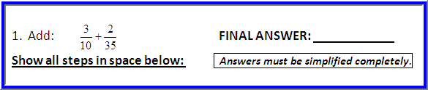
Sample Gateway Problem #1: Adding Fractions
Step 1: Factor the two denominators into prime factors, then
write each fraction with its denominator in factored form:
10 = 2∙5 and 35 = 5∙7, so 3 + 2 = 3 + 2 . . 10 35 2∙5 5∙7
Step 2: Find the least common denominator (LCD):
LCD = 2∙5∙7

Slide 8
Sample Problem #1 (continued)
Step 3: Multiply the numerator (top)and denominator of each fraction by the factor(s) needed to turn each denominator into the LCD.
LCD = 2∙5∙7 3∙7 + 2 ∙2 .
2∙5∙7 5∙7∙2
Step 4: Multiply each numerator out, leaving the denominators in factored form, then add the two numerators and put them over the common denominator.
21 + 4 = 21 + 4 = 25 (note that 5∙7∙2 = 2∙5∙7 by
2∙5∙7 5∙7∙2 2∙5∙7 2∙5∙7 the commutative property)
Step 5: Now factor the numerator, then cancel any common factors that appear in both numerator and denominator. Once you multiply out any remaining factors, the result is your simplified answer.
= 25 = 5∙5 = 5∙5 = 5 = 5 .
2∙5∙7 2∙5∙7 2∙5∙7 2∙7 14
/
/

Slide 9
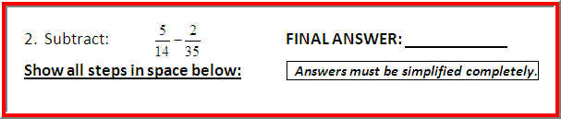
Sample Gateway Problem #2: Subtracting Fractions
Step 1: Factor the two denominators into prime factors, then
write each fraction with its denominator in factored form:
14 = 2∙7 and 35 = 5∙7, so 5 - 2 .
2∙7 5∙7
Step 2: Find the least common denominator (LCD):
LCD = 2∙7∙5

Slide 10
Sample Problem #2 (continued)
Step 3: Multiply the numerator and denominator of each fraction by the factor(s) needed to turn each denominator into the LCD: form:
LCD = 2∙7∙5 5∙5 - 2 ∙2
2∙7∙5 5∙7∙2
Step 4: Multiply out the numerators, leaving the denominators in factored form, then add the two numerators and put them over the common denominator.
25 - 4 = 25 - 4 = 21 .
2∙5∙7 5∙7∙2 2∙5∙7 2∙5∙7
Step 5: Now factor the numerator, then cancel any common factors that appear in both numerator and denominator. Once you multiply out any remaining factors, the result is your simplified answer.
21 = 3∙7 = 3∙7 = 3 = 3 .
2∙5∙7 2∙5∙7 2∙5∙7 2∙5 10
/
/

Slide 11
Section 1.2
The Real Number System

Slide 12
Sets of numbers:
Natural (counting) numbers :
N = {1, 2, 3, 4, 5, 6 . . .}
Whole numbers :
W = {0, 1, 2, 3, 4 . . .}
Integers :
Z = {. . . -3, -2, -1, 0, 1, 2, 3 . . .}

Slide 13
More sets of numbers:
Rational numbers : the set (Q) of all numbers that can be expressed as a quotient of integers, with denominator ≠ 0
Irrational numbers : the set (I) of all numbers that can NOT be expressed as a quotient of integers
Real numbers : the set (R) of all rational and irrational numbers combined
The information on sets is easy to forget come quiz or test time, so make sure you have it written down in your notes!

Slide 14
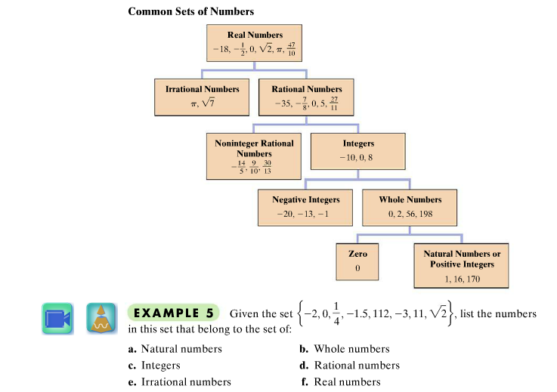
Your online textbook (same in hardcopy version) provides a helpful diagram of all these number sets and their relationships to each other. Underneath this diagram are some example problems that will be useful in preparing to do the homework problems.

Slide 15
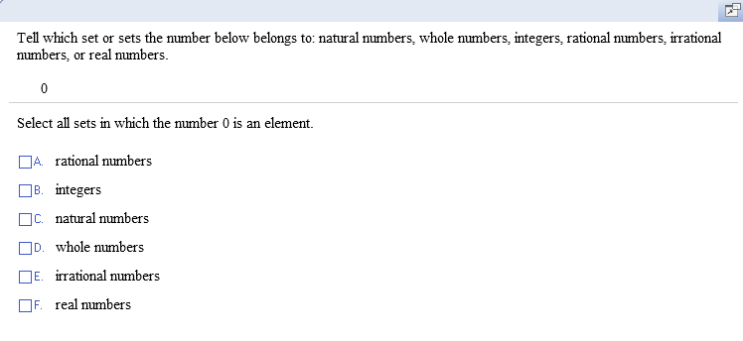
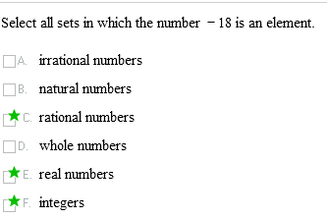

Sample problems with real numbers and subsets:
What would be the answer if this question used the number -18 instead of 0?

Slide 16
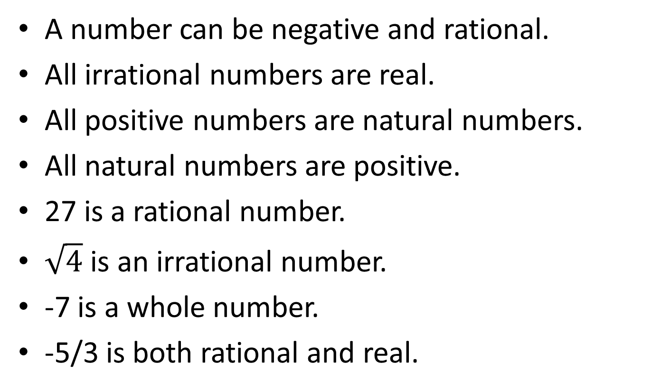
Which of the following statements are true?
T
T
F
T
T
F
F
T
A number can be negative and rational.
All irrational numbers are real.
All positive numbers are natural numbers.
All natural numbers are positive.
27 is a rational number.
$\sqrt{4}$ is an irrational number.
-7 is a whole number.
-5/3 is both rational and real.

Slide 17
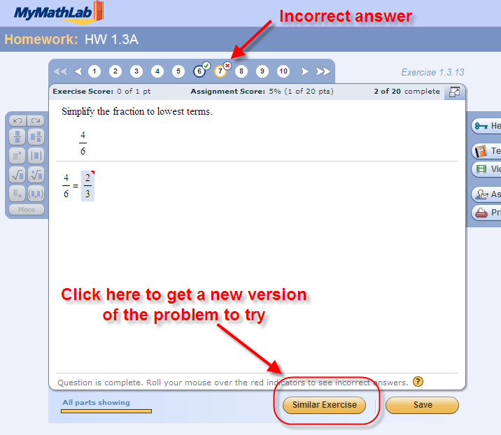
REMEMBER: Even if you get a problem wrong on each of your three tries, you can still go back and do it again by clicking “similar exercise” at the bottom of the exercise box. You can do this nine times, for a total of 30 tries (3 tries at each of 10 different problems).
You should always work to get 100% on each assignment!

Slide 18
The assignment on this material (HW 1.3B/1.2) is due at the start of class tomorrow. You’ll have time to get started on it in class now, but you won’t have time to finish it in class.
(You should do these problems by hand, without a calculator.)

Slide 19
You may now OPEN
your LAPTOPS
and begin working on the homework assignment.
We expect all students to stay in the classroom to work on your homework till the end of the 55-minute class period. If you have already finished the homework assignment for today’s section, you should work ahead on the next one or work on the next practice quiz/test.

