Slide 1
Please
CLOSE
YOUR LAPTOPS,
and turn off and put away your cell phones,
and get out your note-taking materials.

Slide 2
Sections 1.4 and 1.5 Order of Operations, Part 1
You should work the homework problems in this assignment
WITHOUT A CALCULATOR

Slide 3
Working with zero:
The product of any real number and 0 is 0.
Example: 15∙0 = 0
The quotient of any real number and 0 is undefined.
Example: 15 = undefined
0
The quotient of 0 and any nonzero real number is 0.
Example: . 0 . = 0
15

Slide 4
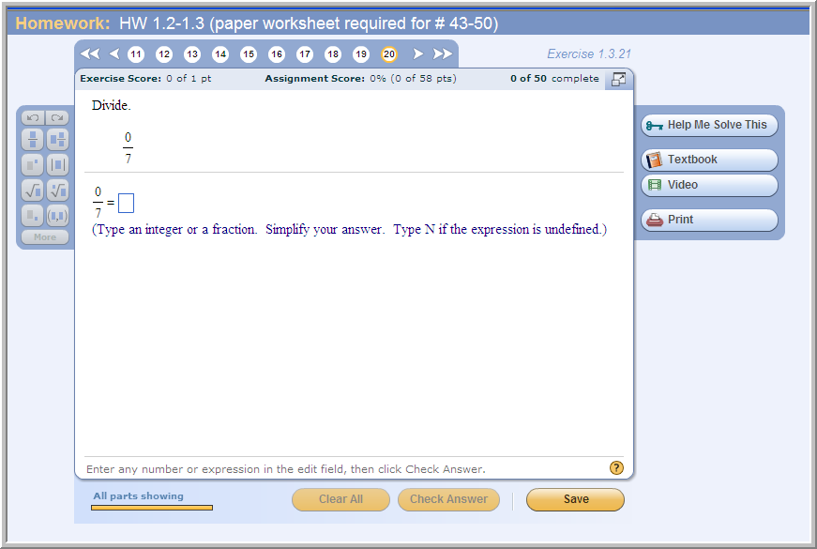
Sample problem from today’s homework:
If this problem had been 7/0,
the answer would be “N” (undefined)

Slide 5
Exponents
We may use exponential notation to write products in a more compact form.
Exponential notation for the product of five threes is 3⁵
Base is 3
Exponent is 5
The notation means 3 • 3 • 3 • 3 • 3, or 243

Slide 6
Examples:
Evaluate each of the following expressions.
3⁴
= 3 · 3 · 3 · 3
= 9 · 9 = 81
(–5)²
= (– 5)(–5)
= 25
–6²
= – (6)(6)
= –36
It may help to think of this as -1 · 6².
(2 · 4)³
= (2 · 4)(2 · 4)(2 · 4)
= 8 · 8 · 8
= 512
(The operation inside the parentheses is done first, THEN the exponent is applied.)
3 · 4²
= 3 · 4 · 4 = 3 ·16
= 48
(No parentheses here, so the exponent is calculated first, followed by the multiplication.)

Slide 7
Those last two examples required using the correct “order of operations”. Notice that you’d get a very different answer to the last two examples if you did the operations in a different order.
Order of Operations
Simplify expressions using the order that follows. If grouping symbols such as parentheses or brackets are present, simplify expressions within those first, starting with the innermost set. If fraction bars are present, simplify the numerator and denominator separately.
1. Evaluate exponential expressions, roots, or absolute values in order from left to right.
2. Multiply or divide in order from left to right.
3. Add or subtract in order from left to right.
Notes:
Objective D

Slide 8
Order of Operations Memory Device:
“Please Excuse My Dear Aunt Sally”
1. Please Parentheses (and other grouping symbols)
2. Excuse Exponents (including numbers inside radicals)
3. My Dear Multiply and Divide (left to right)
4. Aunt Sally Add and Subtract (left to right)
… or just remember PEMDAS

Slide 9
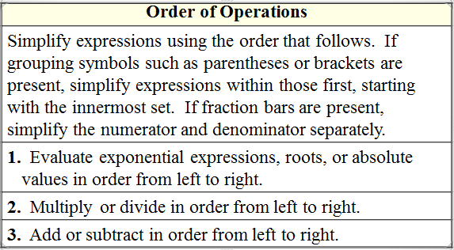
Using the Order of Operations
Example:
Evaluate:
Solution:
Write 3² as 9.
Divide 9 by 3.
Add 3 to 6.
Divide 9 by 9.
Notes:
Objective D Continued

Slide 10
More examples
Simplify the following expressions.

Slide 11
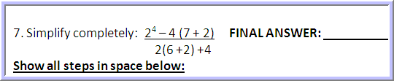
Sample problem from Gateway Quiz:
Strategy: Calculate out the entire top expression and then the entire bottom
expression, using the order of operations on each part. Then simplify the resulting fraction, if necessary.
TOP EXPRESSION: 2⁴ – 4(7 + 2)
Step 1: Parentheses: 2⁴ – 4(7 + 2) = 2⁴ – 4(9)
Step 2: Exponents: 2⁴ – 4(9) = 2•2•2•2 – 4(9) = 16 – 4(9)
(because 2•2•2•2 = 4•2•2 = 8•2 = 16)
Step 3: Multiply/Divide: 16 – 4(9) = 16 – 4•9 = 16 – 36
Step 4: Add/Subtract: 16 – 36 = -20

Slide 12
Now calculate the bottom expression: 2(6+2) + 4
Step 1: Parentheses: 2(6+2) + 4 = 2(8) + 4
Step 2: Exponents: There aren’t any in this part.
Step 3: Multiply/Divide: 2(8) + 4 = 2•8 + 4 = 16 + 4
Step 4: Add/Subtract: 16 + 4 = 20
Now put the top over the bottom and simplify the resulting fraction:
TOP = 2⁴ – 4(7 + 2) = -20 = -1 = -1
BOTTOM 2(6+2) + 4 20 1

Slide 13

Full Solution to Sample Problem:
Here is the complete solution with all steps shown:
2⁴ – 4(7 + 2) = 2⁴ – 4(9) = 16 – 4(9) = 16 – 36 = -20 = -1 = -1
2(6+2) + 4 2(8) + 4 16 + 4 20 20 1

Slide 14

Another sample problem from Gateway Quiz:
Strategy: Deal with the expressions inside the grouping symbols (parentheses, brackets) first, starting with the innermost set (-3 + 6).
STEP 1: (inside the parentheses)
3[17 + 5(-3 + 6) - 10] = 3[17 + 5(3) - 10]
STEP 2: (inside the brackets; multiply first, then add and subtract)
3[17 + 5(3) -10] = 3[17 + 5•3 -10] = 3[17 + 15 - 10]
= 3[17 + 15 - 10] = 3[32 - 10] = 3[22]
STEP 3: Do the final multiplication: 3[22] = 3•22 = 66

Slide 15

Full Solution to Sample Problem:
Here is the complete solution with all steps shown:
3[17 + 5(-3 + 6) - 10] = 3[17 + 5(3) - 10] =
3[17 + 15 - 10] = 3[32 - 10] = 3[22] = 66

Slide 16
Evaluating Algebraic Expressions
A variable is a symbol used to represent a number.
An algebraic expression is a collection of numbers, variables, operations, grouping symbols, but NO equal signs (=) or inequalities (< , > , ≤ , ≥ )

Slide 17
We can evaluate an algebraic expression by assigning specific values to any variables that might be in the expression. All calculations must be done following the Order of Operations.
Example
Evaluate 3x² – 2y + 5 when x = 2 and y = 4.
3(2)² – 2(4) + 5 =
3·4 – 8 + 5 =
12 – 8 + 5 =
9

Slide 18
More Examples:
Evaluate each expression for the given value.
(a) 5x – 2 for x = 8
5(8) – 2 = 40 – 2 = 38
(b) 3a² + 2a + 4 for a = – 4
3(– 4)² + 2(– 4) + 4
= 3(16) + (– 8) + 4 = 44

Slide 19
An algebraic equation is a statement that two expressions have equal value.
Example of an equation: 2x – 4 = 5 - x
A solution to an equation is a number that you can substitute in place of the variable that makes both sides of the equation come out to the same answer.
Example: The number 3 is a solution of the equation 2x – 4 = 5 – x.
We show this by replacing all x’s with 3’s, then calculating each side:
2∙x – 4 = 2∙3 – 4 = 6 – 4 = 2
5 – x = 5 – 3 = 2
The two sides are equal, so 3 is a solution of 2x – 4 = 5 – x.

Slide 20
The assignment on this material (HW 1.4/5) is due at the start of the next class period. You’ll have time to get started on it in class now, but you won’t have time to finish it in class.
(You should do these problems by hand, without a calculator.)

Slide 21
You may now OPEN
your LAPTOPS
and begin working on the homework assignment.
We expect all students to stay in the classroom to work on your homework till the end of the 55-minute class period. If you have already finished the homework assignment for today’s section, you should work ahead on the next one or work on the next practice quiz/test.

