Slide 1
Please
CLOSE
YOUR LAPTOPS,
and turn off and put away your cell phones,
and get out your note-taking materials.

Slide 2
Sections 1.6-1.8, 2.1 Order of Operations, Part 2
Properties of Real Numbers
Simplifying Algebraic Expressions
You should work the homework problems in this assignment
WITHOUT A CALCULATOR
(after this assignment, a calculator can be used and will be available as a button in each online HW assignment)

Slide 3
Working with positive and negative signs
A number line is a line on which each point is associated with a number.
– 5
– 4
– 3
– 2
– 1
0
1
2
3
4
5
Negative numbers
Positive numbers

Slide 4
To add two numbers, especially if one (or both) of them is
negative, it often helps to picture them on a number line.
Example 1 : 3 + (-5)
Locate the first number on the number line.
Starting from that number, if the second number is positive, move to the right by that many units. If it’s negative, move to the left that many units.
(-5)
(Count 5 units to the left from 3)
– 5
– 4
– 3
– 2
– 1
0
1
2
3
4
5
Answer is: -2

Slide 5
Example 2: -2 + (-3)
Locate the first number on the number line.
Start from that first number. The second number is negative, so move to the left by that many units.
(-3)
(Count 3 units to the left from -2)
– 5
– 4
– 3
– 2
– 1
0
1
2
3
4
5
Answer is: -5

Slide 6
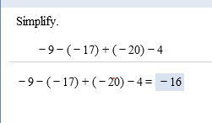
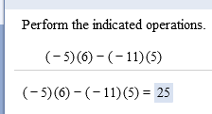
Sample homework problem:
Compare to this problem:

Slide 7
Absolute Value:
The absolute value of a number is the distance of that number away from 0 on a number line.
⏐a⏐≥ 0 always, since distances are non-negative.
(We say non-negative to include positive numbers and zero.)
⏐a⏐= a, if a is 0 or a positive number.
Example: |0| = 0, ⏐10⏐= 10
⏐a⏐= -a, if a is a negative number
Example: ⏐-10⏐= -(-10) = 10

Slide 8
Examples:
⏐5⏐ = 5
⏐-5⏐= 5
-⏐5⏐= -5
⏐0⏐= 0
-⏐-5⏐= -5
Note the difference the placement
of the negative sign makes!!!
It may help to think of this as -1 · |5|.

Slide 9
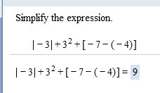
Sample homework problems using absolute value:

Slide 10
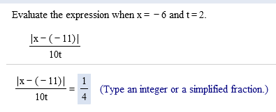

Slide 11
Properties of Real Numbers:
Commutative property
of addition: a + b = b + a
of multiplication: a · b = b · a
Associative property
of addition: (a + b) + c = a + (b + c)
of multiplication: (a · b) · c = a · (b · c)
Distributive property of multiplication over addition:
a(b + c) = ab + ac

Slide 12
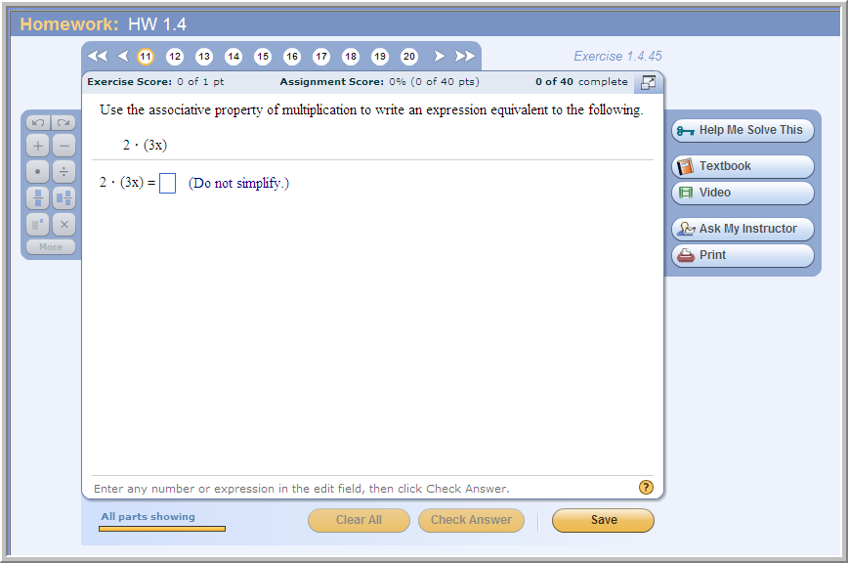
Sample problem from today’s homework:

Slide 13
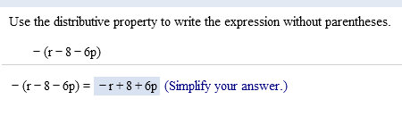
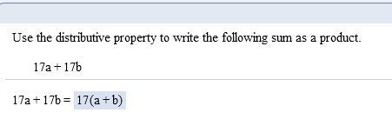
Sample problems from today’s homework:

Slide 14
Simplifying Algebraic Expressions:
The terms of an expression are the addends of the expression (parts separated by + or – signs).
Like terms contain the same variables raised to the same powers.
To combine like terms, add or subtract their numerical coefficients, then multiply the result by the common variable factors.
(The coefficient is the number in front of a term.)

Slide 15
Examples of Combining Terms
Terms Before Combining
After Combining Terms
6x² + 7x²
19xy – 30xy
13xy² – 7x²y
13x²
-11xy
Can’t be combined
(since the terms are not like terms)

Slide 16
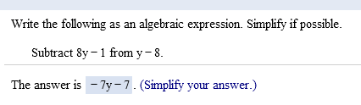
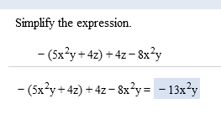
Sample problems from today’s homework:

Slide 17
If you’re having a lot of trouble understanding how to do a set of problems, come to the open lab (beyond your required time) and our TAs will work with you one-on-one to help you learn the easiest way to work the problems on your own.

Slide 18
The assignment on this material (HW 1.6/7&2.1) is due at the start of class tomorrow. (Remember: You should do these problems by hand, without a calculator.)
You also have the Practice Gateway Test due at the start of class tomorrow. This is a required assignment worth 5 points.
Tomorrow at the end of class you will be taking the 25-point Gateway Test, which is similar to the quiz you did on the first day of class.
The practice test has similar questions and can be done as many times as you want. Only your best score on that counts for points. No calculators can be used on this test, so do the practice test without one, too.

Slide 19
You may now OPEN
your LAPTOPS
and begin working on the homework assignment.
We expect all students to stay in the classroom to work on your homework till the end of the 55-minute class period. If you have already finished the homework assignment for today’s section, you should work ahead on the next one or work on the next practice quiz/test.

