Slide 1
Please
CLOSE
YOUR LAPTOPS,
and turn off and put away your cell phones,
and get out your note-taking materials.

Slide 2
Math 90 Gateway Test Results
(Teachers: Enter scores for your section/s here before partial credit corrections.
Partial credit will be minimal for this quiz, mainly for typos or very minor mistakes.)
Average Score: xx% (x.x/8)
Median Score: xx%
Average N of Practice Quiz tries: x.x (max = x tries)
Average Best Score Practice Quiz: xx%
If you scored less than 75%, please check with me before the next class session to go over your Gateway Quiz worksheet together and make sure you are clear on how to do each of these problems.
If you scored less than 50%, you should consider whether you might be better off dropping Math 90 and enrolling in Math 10. You have until Wednesday for free drops/adds.

Slide 3
Comment on HW 2.2/2.3: Types of outcomes when solving linear equations in one variable:
1. One solution (nonzero). (most problems in HW 5)
Example: 2x + 4 = 4(x + 3)
Answer: x = -4
2. One solution (zero).
Example: 2x + 4 = 4(x + 1)
Answer: x = 0
3. Solution = “All real numbers”.
Example: 2x + 4 = 2(x + 2)
Answer: All real numbers. (Type in “R” on computer.)
4. No solutions. Example: 2x + 4 = 2(x + 3)
Answer: No solution (“N” on computer.)

Slide 4
Section 2.4 Introduction to Problem Solving

Slide 5
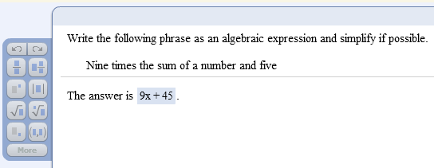
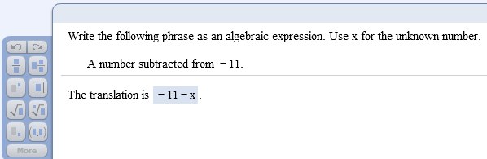
Translating words into algebraic expressions: Examples from the homework due today:

Slide 6
General strategy for problem solving:
Understand the problem
Read and reread the problem
Choose a variable to represent the unknown
Construct a drawing, whenever possible
Translate the problem into an equation
Solve the equation
Interpret the result
Check solution
State your conclusion

Slide 7
Example 1:
The product of twice a number and three is the same as the difference of five times the number and ¾. Find the number.
Understand
Read and reread the problem.
If we let x = the unknown number, then
“twice a number” translates to 2x,
“the product of twice a number and three” translates to 2x · 3,
“five times the number” translates to 5x, and
“the difference of five times the number and ¾” translates to 5x - ¾.

Slide 8
Example (cont.)
Translate
The product of
the difference of
is the same as
twice a number
5 times the number
and 3
and ¾
2x
·
3
=
5x
–
¾

Slide 9
Example (cont.)
Solve
2x · 3 = 5x – ¾
6x = 5x – ¾ (simplify left side)
6x + (-5x) = 5x + (-5x) – ¾ (add –5x to both sides)
x = - ¾ (simplify both sides)
Now CHECK your answer:
Left side: 2x·3= (2·-3/4)·3 = -6/4·3 = -3/2·3= -9/2
Right side: 5x-3/4 = 5·-3/4 – 3/4 = -15/4 – 3/4 = -18/4 = -9/2 
(You can perform this check quickly by using your online calculator in the homework or quiz window.)

Slide 10
Sample problem from today’s homework:
Five times the difference of a number and 4 is the same as 4 increased by five
times the number plus four times the number. Find the number.

Slide 11
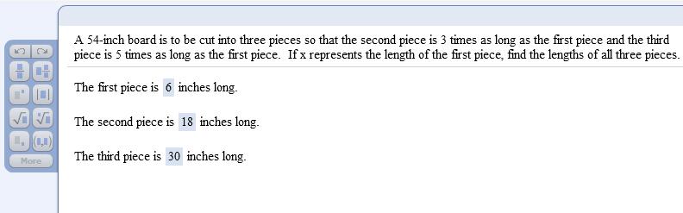
Sample problem from today’s homework:

Slide 12
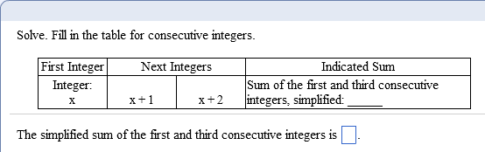
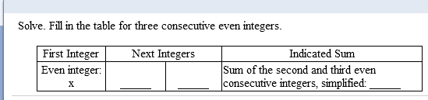
Consecutive integer problems
2x + 2
x + 2
x + 4
2x + 6

Slide 13
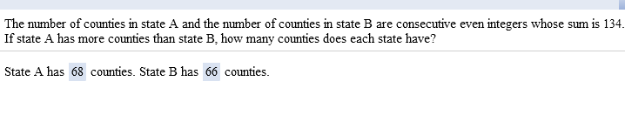
Sample problem from today’s homework:

Slide 14
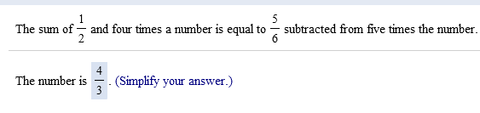
Sample problem from today’s homework:

Slide 15
The assignment on this material (HW 2.4)
is due at the start of the next class session.
Visit the MathTLC for
homework help.

Slide 16
You may now OPEN
your LAPTOPS
and begin working on the homework assignment.
We expect all students to stay in the classroom to work on your homework till the end of the 55-minute class period. If you have already finished the homework assignment for today’s section, you should work ahead on the next one or work on the next practice quiz/test.

