Slide 1
Sections 2.8 and 9.1
Linear Inequalities

Slide 2
Linear Inequalities
An inequality is a statement that contains one of the symbols: < , >, ≤ or ≥.
Linear equations: Linear inequalities:
x = 3 x > 3
12 = 7 – 3y 12 ≤ 7 – 3y

Slide 3


Graphing solutions to linear inequalities in one variable
Use a number line.
Use a square bracket at the endpoint of an interval if you want to include the point.
Use a parenthesis at the endpoint if you DO NOT want to include the point.
Graph the inequality x ≤ 7:
Graph the inequality x > – 4:

Slide 4
Using graphs to figure out how to write a solution in interval notation:
-∞
∞
The inequality x ≤ 7 is expressed in interval notation as (-∞, 7]
-∞
∞
The inequality x > -4 is expressed in interval notation as (-4, ∞)

Slide 5
IMPORTANT:
In interval notation, ∞ and -∞ ALWAYS are enclosed by
a (round bracket)
NEVER by a [ square bracket].

Slide 6
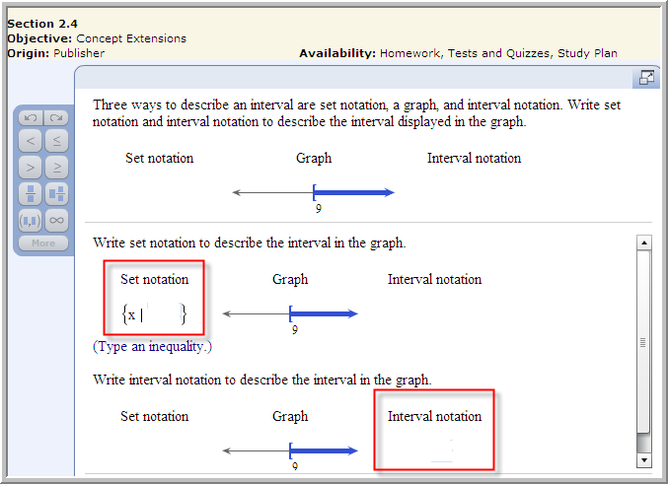
Example from today’s homework:

Slide 7
Addition property of inequality
a< b and a + c < b + c are equivalent inequalities.
Example: 2 ≤ 4 and 2 + (-3) ≤ 4 + (-3) are equivalent
Multiplication property of inequality
if c is positive, then:
a< b and ac < bc are equivalent inequalities,
Example: 3 ≥ 1 (multiply both sides by 2); so 6 ≥ 2 is equivalent.
if c is negative, then:
a< b and ac > bc are equivalent inequalities,
Example: 3 ≥ 1 (multiply both sides by -2); so -6 ≤ -2 is equivalent.
.

Slide 8
Solving linear inequalities in one variable
Multiply by LCD to clear fractions. Make sure to distribute to each term.
Use the distributive property (parentheses).
Simplify each side of the inequality.
Get all variable terms on one side and numbers on the other side of inequality (addition property of inequality).
Isolate variable by dividing both sides by the number in front of the variable (multiplication property of inequality).
Do not forget to change the direction of the inequality sign if you multiply or divide both sides by a negative number.

Slide 9
Caution:
Don’t forget that if both sides of an inequality are multiplied or divided by a negative number, the direction of the inequality sign MUST BE REVERSED.

Slide 10
Example 1:
-7(x – 2) - x < 4(5 – x) + 12
-7x + 14 - x < 20 - 4x + 12 (use distributive property)
- 8x + 14 < - 4x + 32 (simplify both sides)
- 8x + 4x + 14 < - 4x + 4x + 32 (add 4x to both sides)
- 4x + 14 < 32 (simplify both sides)
- 4x + 14 - 14 < 32 - 14 (subtract 14 from both sides)
- 4x < 18 (simplify both sides)
(divide both sides by -4)
(simplify)
Graph of solution ( ,∞)

Slide 11
Example 2:

Slide 12
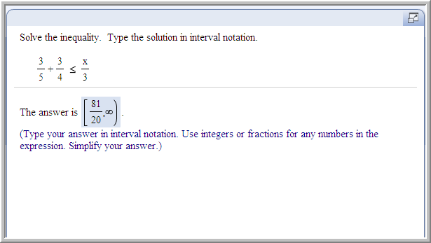
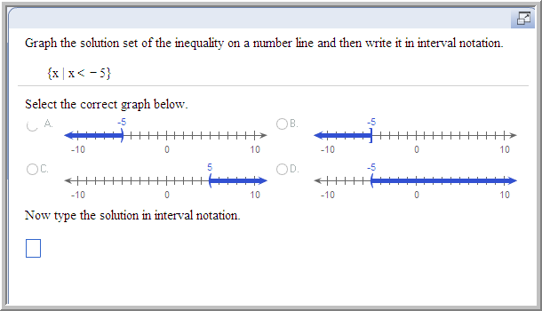
Example from today’s homework:

Slide 13
Something to think about:
How would you graph the inequality 2 > x?
What would this look like in interval notation?
Note that 2 > x is equivalent to x < 2.
Writing the inequality with the variable term on the left makes it easier to “see” what the graph and the interval notation should look like.
Interval notation: (-∞, 2)
This is an argument for working to put/keep your variables on the left side of the expression as you solve linear inequalities.

Slide 14
Compound Inequalities
A compound inequality contains two inequality symbols.
Example: 0 ≤ 4(5 – x) < 8
This means that 0 ≤ 4(5 – x) and
4(5 – x) < 8 must both be true.

Slide 15
Interval Notation for Compound Inequalities:
Inequality: -5 < x < -2
The interval notation (-5,-2) represents all the numbers in between -2 and -5, excluding -2 and -5.
Inequality: -5 < x ≤ -2
The interval notation (-5,-2] represents all the numbers in between -2 and -5, including -2 and excluding -5.
Inequality: -5 ≤ x < -2
The interval notation [-5,-2) represents all the numbers in between -2 and -5, excluding -2 and including -5.
Inequality: -5 ≤ x ≤ -2
The interval notation [-5,-2] represents all the numbers in between -2 and -5, including -2 and -5.

Slide 16
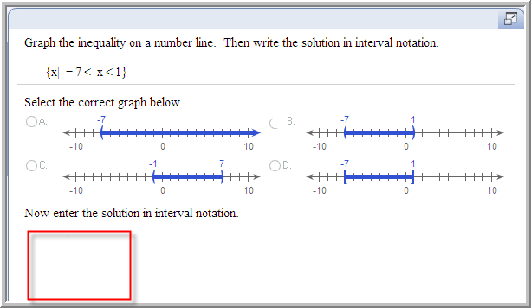
Example from today’s homework:

Slide 17
Example
Graph:
How would you write this in interval notation?
Answer: (-2, 5]

Slide 18
To solve a compound inequality, perform operations simultaneously to all three parts of the inequality (left, middle, and right) until you get the variable isolated by itself in the middle.
Example: Solve the inequality 9 < z + 5 < 13 , then graph the solution set and write it in interval notation.
9 < z + 5 < 13
9 – 5 < z + 5 – 5 < 13 – 5 Subtract 5 from all three parts.
4 < z < 8
Graph:
Interval notation:
(4, 8)

Slide 19
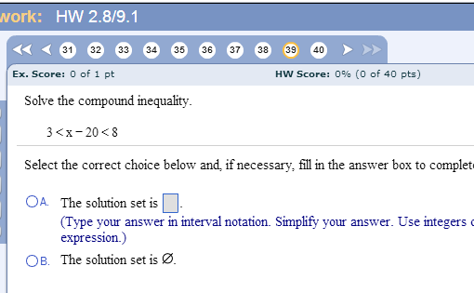
NOTE: Some of the problems near the end of this assignments will have “the solution set is ᴓ “ as an answer choice. None of the problems in your assignment have an empty solution set, so you should always choose “A” and enter an answer in interval notation.
(23, 28)

Slide 20
Example:
Solve the inequality 0 ≤ 4(5 – x) < 8 . Graph the solution set and write it in interval notation.
0 ≤ 20 – 4x < 8 Use the distributive property.
0 – 20 ≤ 20 – 20 – 4x < 8 – 20 Subtract 20 from each part.
– 20 ≤ – 4x < – 12 Simplify each part.
5 ≥ x > 3 Divide each part by –4.
Remember that the sign changes direction when you divide by a negative number.
Graph:
Interval notation:
(3,5]

Slide 21
REMINDER:
In interval notation, ∞ and -∞ ALWAYS are enclosed by
a (round bracket)
NEVER by a [ square bracket].

Slide 22
Next class: Review for Test 1
The assignment on this material (HW 2.8/9.1) is due at the start of the next class session.
In lecture, we will review for the test by going over some example problems.
At the end of class, you will have some time to work on the practice test.
YOU WILL GET MORE OUT OF THAT DAY’S REVIEW IF YOU AT LEAST LOOK AT THE PRACTICE TEST BEFORE CLASS TIME.
The practice test is already open, and you can take it as many times as you want, so start on it SOON.

Slide 23
Test 1 :
Take the practice test early enough so you’ll have time to review it, retake it, email the instructor for help if needed.
Review each practice test after you submit it. (The “help me solve this” buttons will appear when you review the test.)
You have unlimited attempts, so retake the practice test until you score at least 90%.
If you score < 90%, retake the exam once, then email the instructor with questions.

