Slide 1
Section 3.1
Graphing With Two Variables

Slide 2
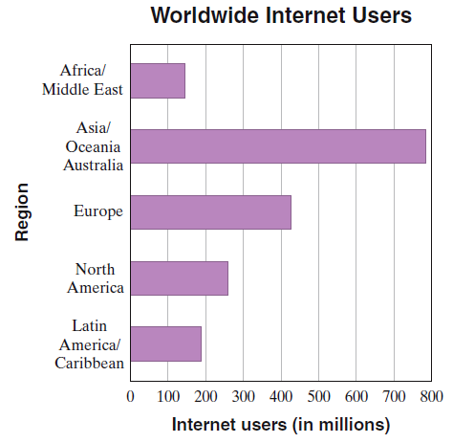
Reading Bar and Line Graphs
The following bar graph shows the estimated number of Internet users worldwide by region.
Find the region that has the most Internet users, and
estimate the approximate number of users.
To answer, look for the longest bar:
a. Asia/Oceania/Australia.
b. About 790 million
(Any answer from 780 to 795 would be accepted by the software.)

Slide 3
Graphing with two variables:
Ordered pair – a sequence of 2 numbers where the order of the numbers is important, normally (x, y)
Axis – horizontal or vertical number line
Origin – point of intersection of two axes
Quadrants – Four regions created by intersection of 2 axes (usually numbered as Roman numerals I, II, III, IV in COUNTERclockwise order)
The location of a point residing in the rectangular coordinate system created by a horizontal (x-) axis and vertical (y-) axis can be described by an ordered pair. Each number in the ordered pair is referred to as a coordinate.

Slide 4
Quadrant II (2)
y-axis
Quadrant I (1)
( - , + )
( + , + )
x-axis
Origin (0,0)
Quadrant III (3)
Quadrant IV (4)
( - , - )
( + , - )

Slide 5
Graphing an Ordered Pair
To graph the point corresponding to a particular ordered pair (a,b), you must start at the origin and move a units to the left or right (right if a is positive, left if a is negative), then move b units up or down (up if b is positive, down if b is negative).

Slide 6
y-axis
Quadrant II
Quadrant I
Note that the order of the coordinates is very important, since (-4, 2) and (2, -4) are located in different positions (and in different quadrants!)
(0, 5)
(5, 3)
(-4, 2)
3 units up
(0, 0)
(-6, 0)
x-axis
5 units right
origin
(2, -4)
Quadrant III
Quadrant IV

Slide 7
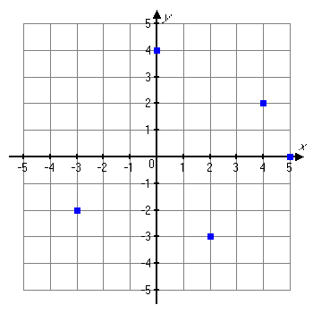
Example
Plot each ordered pair. State in which quadrant, or on which axis the point lies.
a. (4, 2) b. (‒3, ‒2)
c. (2, ‒3) d. (0, 4)
e. (5, 0)
Solution
a. (4, 2) Quadrant I
b. (‒3, ‒2) Quadrant III
c. (2, ‒3) Quadrant IV
d. (0, 4) y-axis
e. (5, 0) x-axis

Slide 8
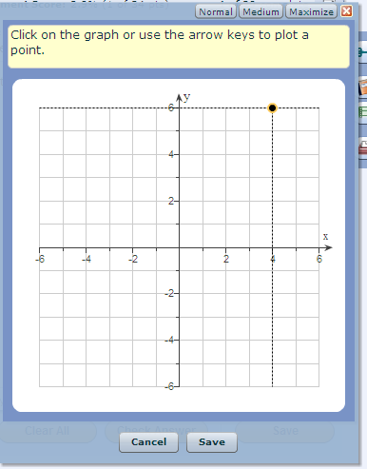
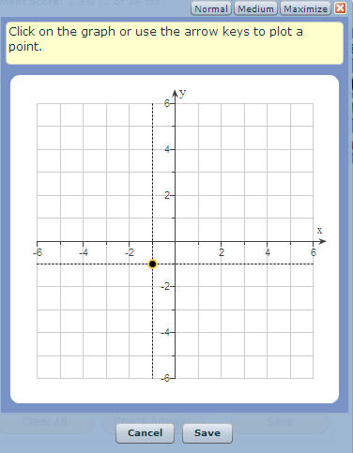
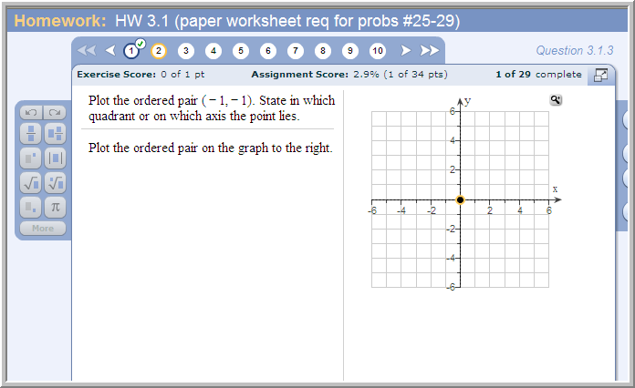
Problem from today’s homework assignment:
Tip: Click the magnifier icon to increase the size of the graph
so it’s easier to work with.
Quadrant?
III

Slide 9
An ordered pair is a solution of an equation in two variables if replacing the variables by the appropriate values of the ordered pair results in a true statement.

Slide 10
Example
Determine whether (3, -2) is a solution of 2x + 5y = -4.
Let x = 3 and y = -2 in the equation.
2x + 5y = -4
(now replace x with 3 and y with –2):
2(3) + 5(-2) = -4
(now compute the products):
6 + -10 = -4
-4 = -4
(True)
So (3, -2) is a solution of 2x + 5y = -4.

Slide 11
Example
Determine whether (-1, 6) is a solution of 3x - y = 5.
Let x = -1 and y = 6 in the equation.
3x - y = 5
3(-1) - 6 = 5 (replace x with -1 and y with 6)
-3 - 6 = 5 (compute the product)
-9 = 5 (False)
So (-1, 6) is not a solution of 3x - y = 5.

Slide 12
Vocabulary
Paired data are data that can be represented as ordered pairs.
A scatter diagram is the graph of paired data as points in the rectangular coordinate system.

Slide 13
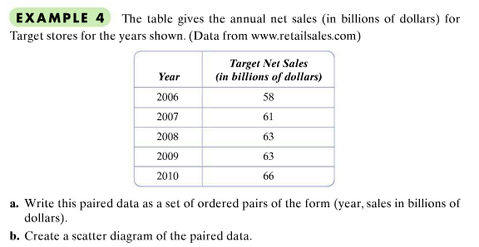

Slide 14
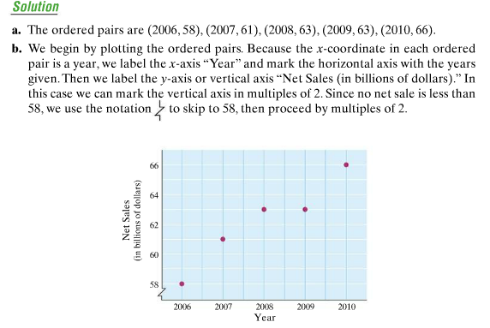
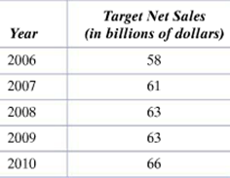

Slide 15
Completing Ordered Pair Solutions
In general, an ordered pair is a solution of an equation in two variables if replacing the variables by the values of the ordered pair results in a true statement.
If you know one coordinate of an ordered pair that is a solution for an equation, you can find the other coordinate through substitution and solving the resulting equation.

Slide 16
Example
Complete the ordered pair (3, ) so that it is a solution to the equation 2x + 5y = – 4.
Let x = 3 in the equation and solve for y.
2x + 5y = – 4
2(3) + 5y = – 4 Replace x with 3.
6 + 5y = – 4
5y = – 10 Subtract 6 from both sides.
y = – 2 Divide both sides by 5.
The completed ordered pair is (3, –2).

Slide 17
Example
Complete the ordered pair ( , –7 ) so that it is a solution to 3x – y = –5.
Let y = –7 in the equation and solve for x.
3x – y = –5
3x – (–7 ) = –5 Replace y with –7 .
3x + 7 = –5 Simplify.
3x = –12 Subtract 7 on both sides.
x = – 4 Divide both sides by 3.
The completed ordered pair is (–4, –7).

Slide 18
Example
Complete the table for the equation y = 5x.
Replace x with –4.
y = 5x
y = 5(–4)
y = –20
Replace y with 10
y = 5x
20 = 5x
2 = x
x | y
–4
 | 10
3
Replace x with 3.
y = 5x
y = 5(3)
y = 15
x | y
–4 | –20
2 | 10
3 | 15

