Slide 1
Sections 3.3 & 3.4 Graphing Linear Equations 2

Slide 2
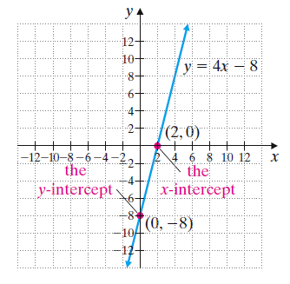
Identifying Intercepts
The graph of y = 4x – 8 is shown at right.
Notice that this graph crosses the y-axis at the point (0, –8). This point is called the y-intercept.
Likewise the graph crosses the x-axis at (2, 0). This point is called the x-intercept.
IMPORTANT:
The intercepts are written as the ordered pairs
(2, 0) and (0, –8) ,
not simply as the
numbers 2 and -8.

Slide 3
What is the y-intercept of this graph?
Answer: the point (0,3)
What is the x-intercept?
Answer: the point (-4, 0)
y
(4, 6)
(0, 3)
(-4, 0)
x
Notice that for the x-intercept, the y-value is 0 and for the y-intercept, the x-value is 0.

Slide 4
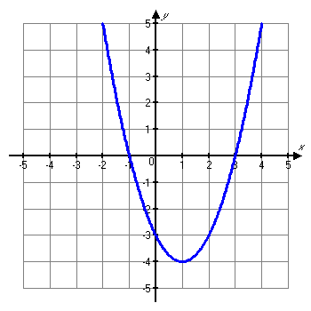
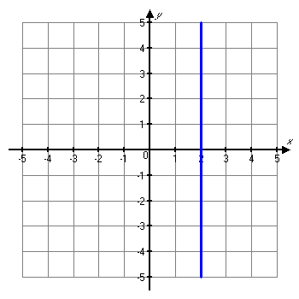
Example
Identify the x- and y-intercepts:
x-intercepts: (-1, 0), (3, 0)
y-intercept: (0, -3)
x-intercept: (2, 0)
There is no y-intercept.

Slide 5
Finding x- and y-intercepts from an equation:
To find the x-intercept, plug 0 in for y in the equation, then solve for x.
To find the y-intercept, plug 0 in for x. then solve for y.
Example: For the equation 2x – 3y = 6,
To find the x-intercept, substitute 0 in place of y:
2x - 3∙0 = 6 → 2x – 0 = 6 → 2x = 6 → x = 3
So the x-intercept is the ordered pair (3, 0).
To find the y-intercept, substitute 0 in place of x:
2∙0 – 3y = 6 → 0 – 3y = 6 → -3y = 6 → y = -2
So the y-intercept is the ordered pair (0, -2).

Slide 6
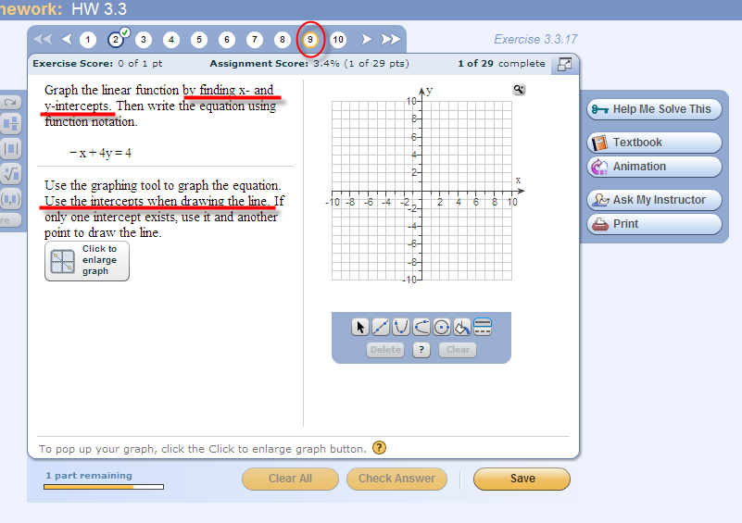
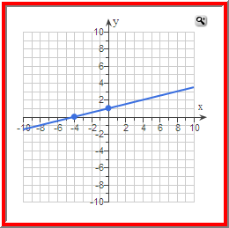
Graph the linear equation
When the problem asks you to graph x- and y-intercepts,
you MUST graph these two points.
For example, in this problem, you would have to graph
(0, 1) and (-4, 0). If you used (0, 1) and (4, 2), you’d get the
same line, but the computer would mark your answer wrong.

Slide 7
Example
Graph 2x = y by plotting intercepts.
To find the y-intercept, let x = 0.
2(0) = y
0 = y, so the y-intercept is (0,0).
To find the x-intercept, let y = 0.
2x = 0
x = 0, so the x-intercept is (0,0).
Oops! It’s the same point. What do we do?

Slide 8
Helpful Hint
Notice that any time (0, 0) is a point of a graph, then it is an x-intercept and a y-intercept. Why? It is the only point that lies on both axes.

Slide 9
Example (cont.)
Graph 2x = y by plotting intercepts.
Since we need at least 2 points to graph a line, we will have to find at least one more point.
Let x = 3 (For this second point, you can pick any
value for x that you want.)
2(3) = y
6 = y, so another point is (3, 6).
To be safe, let’s also find a third point:
Let x = 2
2(2) = 4
y = 4, so another point is (2, 4).

Slide 10
Now we plot all three of the solutions (0, 0), (3, 6) and (2, 4).
y
And then we draw the line that contains the three points.
(3, 6)
(2, 4)
x
(0, 0)

Slide 11
Example
Graph y = 3.
Note that this line can be written as y = 0•x + 3.
The y-intercept is (0, 3), but there is no x-intercept!
(Since an x-intercept would be found by letting y = 0, and 0 can’t equal 0•x + 3, there is no x-intercept.)
Every value we substitute for x gives a y-coordinate of 3.
The graph will be a horizontal line through the point (0,3) on the y-axis.

Slide 12
Example (cont.)
y
(0, 3)
x

Slide 13
Example
Graph x = -3.
This equation can be written x = 0•y – 3.
When y = 0, x = -3, so the x-intercept is (-3,0), but there is no y-intercept.
Any value we substitute for y gives an x-coordinate of –3.
So the graph will be a vertical line through the point (-3,0) on the x-axis.

Slide 14
Example (cont.)
y
x
(-3, 0)

Slide 15
Slope of Lines
Positive Slope
Line goes up to the right
y
Lines with positive slopes go upward as x increases.
x
m > 0
Negative Slope
Line goes downward to the right
y
Lines with negative slopes go downward as x increases.
x
m < 0

Slide 16
Calculating the slope of a line:
Slope of a line:
Informally, slope is the tilt of a line.
It is the ratio of vertical change to horizontal change, or
slope =

Slide 17
Helpful Hint
When finding slope, it makes no difference which point is identified as (x₁, y₁) and which is identified as (x₂, y₂). Just remember that whatever y-value is first in the numerator, its corresponding x-value is first in the denominator.

Slide 18
Example
Find the slope of the line through (4, -3) and (2, 2).
If we let (x₁, y₁) be (4, -3) and (x₂, y₂) be (2, 2), then
Note: If we let (x₁, y₁) be (2, 2) and (x₂, y₂) be (4, -3), then we get the same result.

Slide 19
Given the graph of a line, how do you find the slope?
Find 2 points on the graph, then use those points in the slope formula.

Slide 20
Which points do you use?
It’s your choice, but it’s much easier if you pick points whose x- and y-coordinates are both integers.
(2, 2)
Slope = -4 – 2 = -6 = 3 = 3
0 – 2 -2 1
(0, -4)

Slide 21
Slope of a Horizontal Line
y
Horizontal lines have a slope of 0.
x
For any two points, the y values will be equal to the same real number.
The numerator in the slope formula = 0 (the difference of the y-coordinates), but the denominator ≠ 0 (two different points would have two different x-coordinates).
So m = 0

Slide 22
Slope of a Vertical Line
y
Vertical lines have undefined slope.
x
For any two points, the x values will be equal to the same real number.
The denominator in the slope formula = 0 (the difference of the x-coordinates), but the numerator ≠ 0 (two different points would have two different y-coordinates).
So the slope is undefined (since you can’t divide by 0).

Slide 23
Summary of relationship between graphs of lines and slope
If a line moves up as it moves from left to right, the slope is positive.
If a line moves down as it moves from left to right, the slope is negative.
Horizontal lines have a slope of 0.
Vertical lines have undefined slope (or no slope).

