Slide 1
Sections 3.4 & 3.5 Writing Linear Equations 1

Slide 2
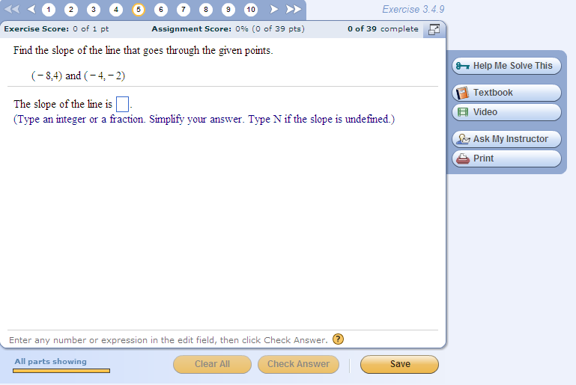
Tip for quizzes and tests:
A quick way to check if you goofed on a negative sign when calculating the slope of a line given two points on the line:
Graph the two points and see if the slope should be positive or negative.
NOTE: On a quiz or a test, it would be worth taking the time to do a quick graph of these two points to check and see if you made a sign error in your calculation. (This happens a LOT, so it’s worth checking before you go on to the next question on the quiz.)
Do this now, and you will see that the line DOES slope downward from left to right, so a negative slope does make sense.
If you had messed up a negative sign in your calculation and come up with +3/2, the 30 seconds you spent doing the check graph would have shown you immediately that something was wrong with your slope.
Even though you always have the “check answer” button on homework assignments, you should practice doing a few check graphs on HW so you know how to do it for quizzes.
-3/2

Slide 3
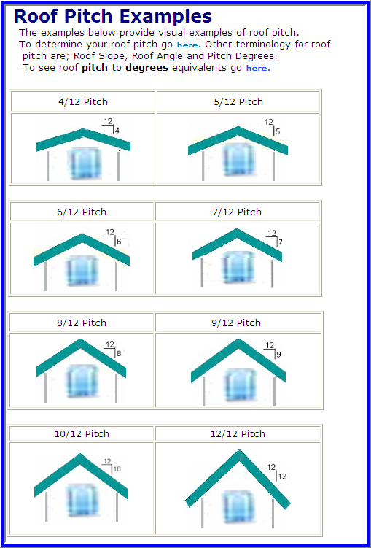
Practical application of slope to construction:
Pitch of a roof = rise/run
Just make sure you measure both rise and run in the same units (e.g. feet, meters, inches)

Slide 4
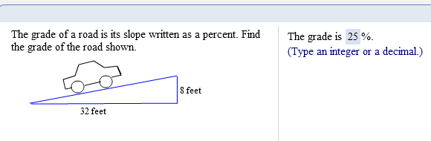
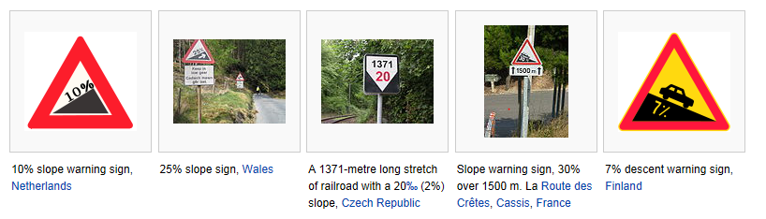
Another practical application of slope:
NOTE: The grade of a road is always expressed as a positive percentage, whether you’re going uphill or downhill.

Slide 5
Recall that an equation of the form Ax + By = C
is called the “standard form” of a linear equation in two variables.
“Standard form” has the x and y terms on the left and the constant (number) term on right, and usually, all fractions cleared away by multiplying by LCD.
Today we will be studying two other forms of a linear equation:
“slope-intercept” form
“point-slope” form

Slide 6
The slope-intercept form of a line
To find the slope-intercept form of a linear equation given in standard form, just solve the equation for y.
This gives an equation that looks like y = mx + b
The slope of this line is the number m.
The y-intercept of this line is the point (0, b).
This form is useful for graphing, since you have a point and the slope readily visible.

Slide 7
Example
Graph y = x – 2.
We can use the slope-intercept form to help us graph the equation.
We know that the y-intercept is (0, -2), which gives us one point for the line.
We can also use the definition of slope to help us get another point.
slope = , which in this case is

Slide 8
Example (cont.)
Graph y = x – 2.
y
First we graph the y-intercept.
Then we use the slope of -4/5 to find another point.
Move down 4 and to the right 5.
x
(0, -2)
This gives us the new point (5, -6).
4 units down
(5, -6)
5 units right
Now draw the line.

Slide 9
Example
Find the slope and y-intercept of the line 2x – 6y = 12.
First, we need to solve the linear equation for y.
-6y = -2x + 12 (subtract 2x from both sides)
y = x – 2 (divide both sides by –6, then simplify)
Since the equation is now in the form of y = mx + b,
 slope is 1/3
 y-intercept is (0,-2)

Slide 10
Example
Find an equation of a line with slope of -3 and y-intercept of (0, ).
By substituting the appropriate values into the slope-intercept form, we get
y = -3x – .
Note: If you’re asked to write the equation in standard form, the answer could be converted to 3x + y = .
If you prefer to not use fractions in your final answer, multiply by 5 to get 15x + 5y = -1. (This is the way “standard form” is usually written, without fractions.)

Slide 11
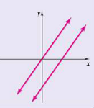
Two lines that never intersect are called parallel lines.
Parallel lines have the same slope
(unless they are vertical lines, which have no defined slope)
Vertical lines are also parallel to each other, even though their slope is undefined.

Slide 12
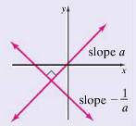
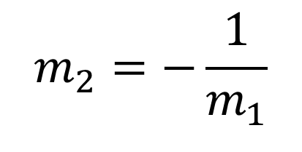
Two lines that intersect at right angles are called perpendicular lines.
Two nonvertical perpendicular lines have slopes that are negative reciprocals of each other.
The product of their slopes will be –1.
Horizontal and vertical lines are perpendicular to each other.

Slide 13
Example
Determine whether the following lines are parallel, perpendicular, or neither.
-5x + y = -6 and x + 5y = 5
First, we need to solve both equations for y.
In the first equation,
y = 5x – 6 (add 5x to both sides)
In the second equation,
5y = -x + 5 (subtract x from both sides)
y = x + 1 (divide both sides by 5)
The first equation has a slope of 5 and the second equation has a slope of , so the lines are perpendicular.

Slide 14
Example
Determine whether the following lines are parallel, perpendicular, or neither.
-x + 2y = -2 and 2x = 4y + 3
In the first equation,
2y = x – 2 (add x to both sides)
y = x – 1 (divide both sides by 2)
In the second equation,
4y = 2x – 3 (subtract 3 from both sides)
y = x – (divide both sides by 4)
Both lines have a slope of , so the lines are parallel.

Slide 15
The point-slope form of a line
Recall that the slope-intercept form of a line tells us the coordinates of one point on the line, namely the y-intercept (0,b).
The point-slope form allows you to use ANY point, together with the slope, to form the equation of the line.
Point-slope formula for linear equations:
Where m is the slope,
and (x₁, y₁) is a point on the line.

Slide 16
Example
Find an equation of a line with slope –2, through the point (-11,-12). Write the final equation in slope-intercept form.
(Note: it’s always a good idea to graph the line first. This will help you see if your equation makes sense, which is especially helpful on quizzes and tests.
Solution: Substitute the slope and point into the point-slope form of the linear equation:
y – (-12) = -2(x – (-11))
y + 12 = -2x – 22 (use distributive property)
y = -2x - 34 (subtract 12 from both sides)
So the slope is -2, and the y-intercept is (0,-34)

