Slide 1
Section 3.6 Introduction to Functions
Equations in two variables define relations between the two variables.
There are also other ways besides equations to describe relations between variables, for example ordered pairs or set-to-set maps.

Slide 2
A set of ordered pairs (x, y) is also called a relation between the x and y values.
The domain is the set of x-coordinates of the ordered pairs.
The range is the set of y-coordinates of the ordered pairs.

Slide 3
Example
Find the domain and range of the relation
{(4,9), (-4,9), (2,3), (10,-5)}
.
Find the domain and range of the relation
{(4,9), (-4,9), (2,3), (10,-5)}
Find the domain and range of the relation
{(4,9), (-4,9), (2,3), (10,-5)}
Domain is the set of all x-values:
{4, -4, 2, 10}.
Range is the set of all y-values:
{9, 3, -5}.
Note: if an element (number) is repeated, it only appears in the list one time.

Slide 4
Some relations are also functions.
A function is a set of ordered pairs in which each unique first component in the ordered pairs corresponds to exactly one second component.

Slide 5
Example
Given the relation {(4,9), (-4,9), (2,3), (10,-5)}, is it a function?
Since each element of the domain (x-values) is paired with only one element of the range (y-values) , it is a function.
Note: It’s okay for a y-value to be assigned to more than one x-value, but an x-value cannot be assigned to more than one y-value if the relation is a function. (Each x-value has to be assigned to ONLY one y-value).

Slide 6
Example
Given the relation {(4,9), (4,-9), (2,3), (10,-5)}, is it a function?
Since the number 4 of the domain (x-values) is paired with two different elements of the range (the y-values 9 and -9) , this relation is not a function.

Slide 7
Relations and functions can also be described by graphing their ordered pairs.
Graphs can be used to determine if a relation is a function.
If an x-coordinate is paired with more than one y-coordinate, a vertical line can be drawn that will intersect the graph at more than one point.
If no vertical line can be drawn so that it intersects a graph more than once, the graph is the graph of a function. This is the vertical line test.

Slide 8
Example
y
Use the vertical line test to determine whether the graph to the right is the graph of a function.
x
Since no vertical line will intersect this graph more than once, it is the graph of a function.

Slide 9
Example
y
Use the vertical line test to determine whether the graph to the right is the graph of a function.
x
Since no vertical line will intersect this graph more than once, it is the graph of a function.

Slide 10
Example
y
Use the vertical line test to determine whether the graph to the right is the graph of a function.
x
Since a vertical line can be drawn that intersects the graph at every point, it is NOT the graph of a function.

Slide 11
Since the graph of a linear equation is a line, all linear equations are functions, except those whose graph is a vertical line.
Note: An equation of the form y = c, where c is a constant (a fixed number), is a horizontal line and IS a function.
An equation of the form x = c is a
vertical line and IS NOT a function.

Slide 12
Example
y
Use the vertical line test to determine whether the graph to the right is the graph of a function.
x
Since vertical lines can be drawn that intersect the graph in two points, it is NOT the graph of a function.

Slide 13
Determining the domain and range from the graph of a relation:
Example:
y
Find the domain and range of the relation graphed (in red) to the right. Use interval notation.
Domain
x
Domain is [-3, 4]
Range
Range is [-4, 2]
(Note that this is a line SEGMENT that stops at definite endpoints, rather than an entire LINE with arrows at the ends indicating that is goes on forever at both ends.)
Q: Is this relation a FUNCTION?
A: Yes

Slide 14
Example
y
Find the domain and range of the function graphed to the right. Use interval notation.
Range
x
Domain is (-∞, ∞)
Range is [-2, ∞)
Domain

Slide 15
Example
y
Find the domain and range of the function graphed to the right. Use interval notation.
x
Domain: (-∞, ∞)
Range: (-∞, ∞)

Slide 16
Example
y
Find the domain and range of the function graphed to the right. Use interval notation.
x
Domain: (-∞, ∞)
Range: [-2.5]
(The range in this case consists of one single y-value.)

Slide 17
Example
y
Find the domain and range of the relation graphed to the right. Use interval notation.
(Note this relation is NOT a function, but it still has a domain and range.)
x
Domain: [-4, 4]
Range: [-5, 0]

Slide 18
Example
y
Find the domain and range of the relation graphed to the right. Use interval notation.
(Note this relation is NOT a function, but it still has a domain and range.)
x
Domain: [2]
Range: (-∞, ∞)

Slide 19
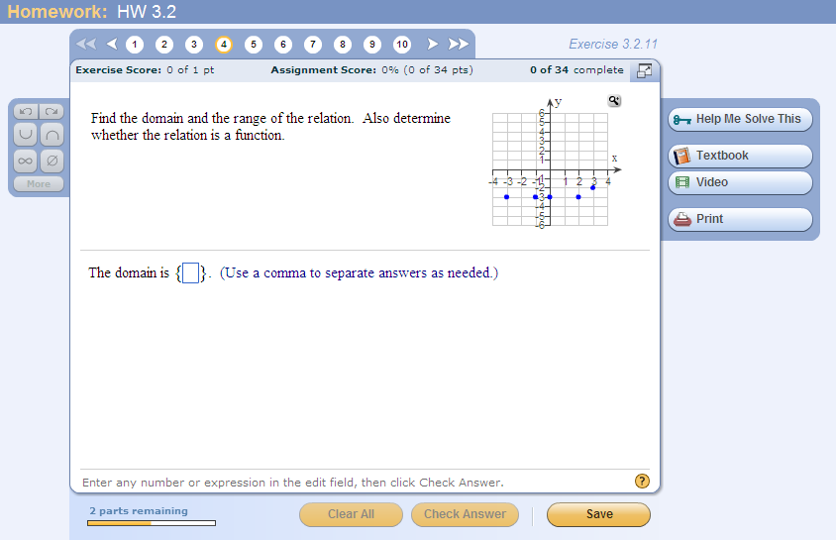
Problem from today’s homework:
Answer: Domain is {-3, -1, 0, 2, 3}
Range is {-3, -2}
This relation IS a function.

Slide 20
What about this one?
Answer: Domain is {-3, -1, 0, 2, 3}
Range is {-3, -2, 2}
This relation IS NOT a function.

Slide 21
Using Function Notation
In a two-variable equation, the variable y is a function of the variable x, if for each value of x in the domain, there is only one value of y.
Thus, we say the variable x is the independent variable because any value in the domain can be assigned to x. The variable y is the dependent variable because its value depends on x.
We often use letters such as f, g, and h to name functions. For example, the symbol f(x) means function of x and is read “f of x”. This notation is called function notation.

Slide 22
This function notation is often used when we know a relation is a function and it has been solved for y.
For example, the graph of the linear equation y = -3x + 2 passes the vertical line test, so it represents a function.
Therefore we can use the function notation f(x) and write the equation as f(x) = -3x + 2.
Note: The symbol f(x), read “f of x”, is a specialized notation that does NOT mean f • x (f times x).

Slide 23
When we want to evaluate a function at a particular value of x, we substitute the x-value into the notation.
For example, f(2) means to evaluate the function f when x = 2. So we replace x with 2 in the equation.
For our previous example when f(x) = -3x + 2, f(2) = -3(2) + 2 = -6 + 2 = -4.
When x = 2, then f(x) = -4, giving us the ordered pair (2, -4).

Slide 24
Example
Given that g(x) = x² – 2x, find g(-3). Then write down the corresponding ordered pair.
g(-3) = (-3)² – 2(-3) = 9 – (-6) = 15.
The ordered pair is (-3, 15).

