Slide 1
Section 3.6B More About Functions: Functions that are non-linear, i.e. that can’t be represented in the form Ax + By = C

Slide 2
Example
Given the graph of the following function, find each function value by inspecting the graph.
y
f(x)
f(0) =
2
x
f(4) =
3
f(-5) =
-1
f(-6) =
-7

Slide 3
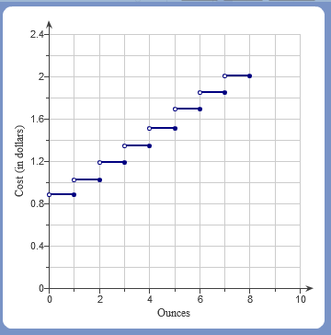
This graph represents the cost of mailing a large envelope through the postal service by weight.
The open circles indicate points that are not included in the relation.
The filled circles indicate points that are included in the relation.
Reading the graph:
A package that weighs more than 4 ounces but no more than 5 ounces costs $1.50 to mail
We can also interpret this graph using an inequality or interval notation to express parts of the domain:
A package whose weight falls within the interval (4,5] costs $1.50 to mail.
Or, package whose weight x is in the interval 4 < x ≤ 5 will cost $1.50 to mail.

Slide 4
Does the relation depicted by this graph satisfy the definition of “function”?
To answer this question, use the vertical line test.
There is no vertical line that will intersect more than one point of the graph at a time, so this relation IS a function.
Practically speaking, this means that there can’t be more than one price assigned to any one weight: A 4-ounce package costs about $1.35 to mail; a 4.2 ounce package costs $1.50 to mail.
This kind of function is called a piecewise-defined function.

Slide 5
Example: Is this a function?
Example: Is this a function?
y
Graph y = | x |.
x y
2
2
(-2, 2)
(2, 2)
1
1
(-1, 1)
(1, 1)
x
0
0
(0, 0)
– 1
1
ANSWER: Yes, so we can write it as f(x) = | x |, which is the absolute value function.
– 2
2
Notes:
5

Slide 6
Example: Is this a function?
Graph y = 2x².
(-2, 8)
(2, 8)
y
x y
2
8
1
2
(-1, 2)
(1, 2)
0
0
x
– 1
2
(0, 0)
– 2
8
ANSWER: Yes, so we can write it as f(x) =2x², which is a quadratic function.

Slide 7
Evaluating a function for a variable instead of a number:
Example: Evaluate f(x) = 2x + 5 for:
x = 6:
f(6) = 2*6 + 5 = 12+ 5 = 17.
x = t:
f(t) = 2*t + 5 = 2t + 5
x = p:
f(p) = 2*p + 5 = 2p + 5
x = h + 3:
f(h +3) = 2*(h + 3) + 5 = 2*h + 2*3 + 5
= 2h + 6 + 5 = 2h + 11

Slide 8
Evaluating a function for a variable instead of a number:
Example 2: Evaluate f(x) = x² + 1 for:
x = 6:
f(6) = 6² + 1= 36 + 1 = 37 .
x = t:
f(t) = t² + 1
x = p:
f(p) = p² + 1
x = h + 3:
f(h +3) = (h + 3) ² + 1 = (h+3)(h+3) + 1
= h² +3h +3h +3*3 + 1 = h² + 6h + 10

