Slide 1
Section 4.2 Solving Systems of Equations in Two Variables by Substitution
Substitution is the second of three methods for solving systems of equations that we will be studying in this chapter. Your homework due today covered the graphing method (Section 4.1). The last method, the addition or elimination method will be covered in Section 4.3.

Slide 2
Review:
The SOLUTION to a system of two linear equations is the intersection (if any) of the two lines.
There are only three possible solution scenarios:
The lines intersect in a single point (so the answer is one ordered pair).
The lines don’t intersect at all, i.e. they are parallel (so the answer is “no solution”.)
The two lines are identical, i.e. coincident, so there are infinitely many solutions (all of the points that fall on that line.)

Slide 3
To be a SOLUTION of a system of equations, an ordered pair must result in true statements for BOTH equations when the values for x & y are plugged into them. If either one (or both) gives a false statement, the ordered pair is NOT a solution of the system.

Slide 4
Substitution Method
A second method that can be used to solve systems of equations is called the substitution method.
To use this method, you solve one equation for one of the variables, then substitute the new form of the equation into the other equation for the solved variable. This gives an equation with only one variable, which then can be solved using the methods from Chapter 2.

Slide 5
Solving a system of linear equations in two variables by the substitution method:
Solve one of the equations for one of the two variables (if this is not already done for you).
Substitute the expression from step 1 into the other equation.
Solve the new equation for that one remaining variable.
Substitute the value found in step 3 into either of the original equations containing both variables.
Check the proposed solution in the original equations.

Slide 6
Example
Solve the following system of equations using the substitution method.
y = 4x and 4x + y = 32
Since the first equation is already solved for y (y = 4x), substitute 4x into the second equation in place of y.
4x + y = 32
4x + 4x = 32 (replace y with result from first equation)
8x = 32 (simplify left side)
x = 4 (divide both sides by 8)

Slide 7
Example (cont.)
Substitute the solution (x = 4) into either equation and solve for the other variable.
y = 4x or 4x + y = 32
y = 4(4) 4(4) + y = 32
y = 16 16 + y = 32
y = 16
The solution to the system of equations is (4, 16).
Make sure you check your answer in BOTH ORIGINAL EQUATIONS to make sure it is a true solution.
This is especially important on tests and quizzes when you don’t have the “check answer” button, so practice it in the homework assignments.

Slide 8
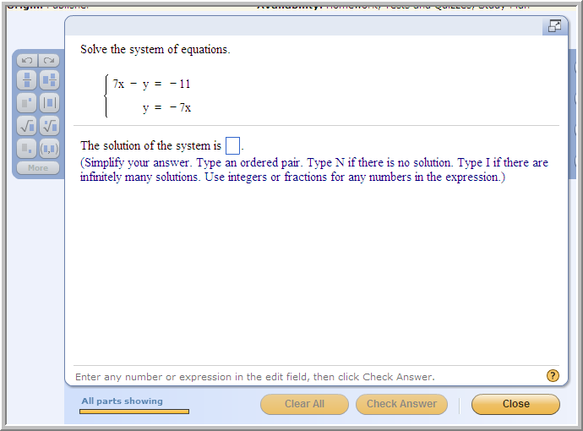
Problem from today’s homework: (try this one in your notebook)
(-11/14, 11/2)

Slide 9
Example
Solve the following system of equations using the substitution method.
y = 2x – 5 and 8x – 4y = 20
Since the first equation is already solved for y, substitute this value (2x – 5) into the second equation.
8x – 4y = 20
8x – 4(2x – 5) = 20 (replace y with result from first equation)
8x – 8x + 20 = 20 (use distributive property)
20 = 20 (simplify left side)

Slide 10
Example (cont.)
When you get a result like the one on the previous slide, that is a true statement containing no variables at all, this indicates that the two equations actually represent the same line (also called coincident lines).
There are an infinite number of solutions for this system. Any solution of one equation would automatically be a solution of the other equation.
Q: How could you confirm this answer (no solution/parallel lines) if this was a question on a test or quiz?
A: Solve both equations for y and compare the slopes (they should be the same) and the y-intercepts (they should also be the same).

Slide 11
Example
Solve the following system of equations using the substitution method
3x – y = 4 and 6x – 2y = 4
Solve the first equation for y.
3x – y = 4
-y = -3x + 4 (subtract 3x from both sides)
y = 3x – 4 (multiply both sides by –1)
Substitute this value for y into the second equation.
6x – 2y = 4
6x – 2(3x – 4) = 4 (replace y with the result from the first equation)
6x – 6x + 8 = 4 (use distributive property)
8 = 4 (simplify the left side)

Slide 12
Example (cont.)
When you get a result, like the one on the previous slide, that is never true for any value of the replacements for the variables, this indicates that the two equations actually are parallel and never intersect.
There is no solution to this system.
Q: How could you confirm this answer (no solution/parallel lines) if this was a question on a test or quiz?
A: Solve both equations for y and compare the slopes (they should be the same) and the y-intercepts (they should be different).

Slide 13
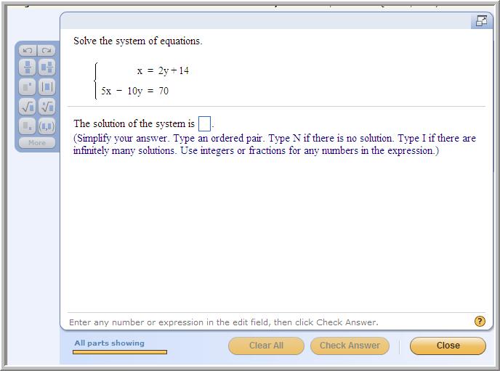
Problem from today’s homework:
(try this one in your notebook)
I (infinitely many solutions)

