Slide 1
Section 4.3
Solving Systems of Equations by Elimination

Slide 2
In addition to the graphing and substitution methods you learned in the last two sections, a third method that can be used to solve systems of equations is called the addition or elimination method.
This method is probably the one you will use most often, so pay special attention to these next few slides!
To use this method, you multiply one or both equations by numbers that will allow you to add the two equations together and eliminate one of the variables.
From that point on, the rest of the solution follows the same steps as the substitution method (solving for the one remaining variable, then plugging that back in to the original equations to get the value of the other variable.)

Slide 3
Steps in solving a system of linear equations by the addition method, also known as the elimination method:
Rewrite each equation in standard form, eliminating fraction coefficients.
If necessary, multiply one or both equations by a number so that the coefficients of either x or y are opposites.
Add the equations to eliminate the chosen variable.
Find the value of the remaining variable by solving the equation from step 3.
Find the value of the second variable by substituting the value found in step 4 into either original equation.
Check the proposed solution in the original equations. (ALWAYS do this, since it’s very easy to make one of those annoying arithmetic mistakes in these kinds of problems!)

Slide 4
Example
Solve the following system of equations using the elimination method.
6x – 3y = -3 and 4x + 5y = -9
SOLUTION: Multiply both sides of the first equation by 5 and the second equation by 3. (NOTE: It’s easier to eliminate y, since the coefficients already have opposite signs so we don’t need to multiply by any negatives. We would get the same solution, however, if we choose to multiply the first equation by 2 and the second one by -3 to eliminate the x terms.)
First equation,
5(6x – 3y) = 5(-3)
30x – 15y = -15 (use the distributive property)
Second equation,
3(4x + 5y) = 3(-9)
12x + 15y = -27 (use the distributive property)

Slide 5
Example (cont.)
Combine the two resulting equations (eliminating the variable y).
30x – 15y = -15
12x + 15y = -27
42x = -42
x = -1 (divide both sides by 42)

Slide 6
Example (cont.)
Substitute the value for x into one of the original equations.
6x – 3y = -3
6(-1) – 3y = -3 (replace the x value in the first equation)
-6 – 3y = -3 (simplify the left side)
-3y = -3 + 6 = 3 (add 6 to both sides and simplify)
y = -1 (divide both sides by -3)
Our computations have produced the point (-1,-1).

Slide 7
Example (cont.)
Check the point in the original equations.
First equation,
6x – 3y = -3
6(-1) – 3(-1) = -3 true
Second equation,
4x + 5y = -9
4(-1) + 5(-1) = -9 true
The solution of the system is (-1, -1).

Slide 8
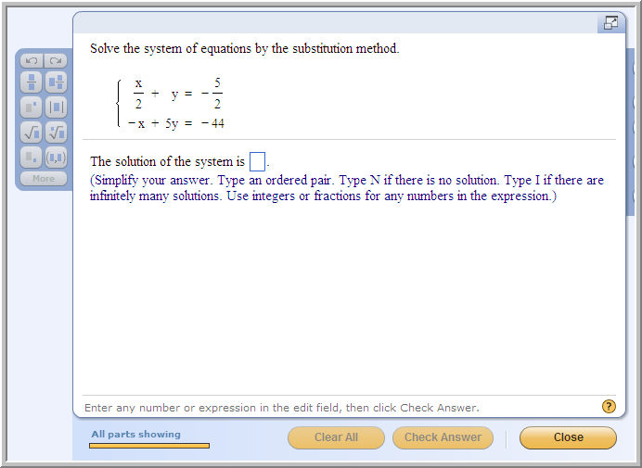
Problem from 4.2 lecture:
(9,-7)
Note: This problem can also be solved by the elimination method.
What would be the best first step in solving this problem with the substitution method?
What would be the best first step in using the elimination method on this problem?
Which method is easier to use on this problem?

Slide 9
There are three types of answers you will encounter in the Section 4.3 homework problems, corresponding to the three different ways two lines can intersect:
1. Intersection in a single point (Answer is an ordered pair.)
(The two lines have different slopes)
2. No common intersection (parallel lines)
(Answer: N for No Solution)
(The lines have the same slope, different y-intercepts; all variables drop out by elimination, leaving a false statement such as “0 = 3”)
3. The two equations represent the same line, so the Intersection is all the points on the line
(Answer: I for Infinitely many solutions)
(Lines have same slope AND y-intercept;
all variables drop out by elimination, leaving a true statement such as “0 = 0” )

Slide 10
What if you end up with “y = 0” when solving a system?
Example: 2x + 5y = 5
-2x + 2y = -5
7y = 0
y = 0/7 = 0
Now plug y = 0 back into one of the two original equations :
2x + 5·0 = 5 → 2x + 0 = 5 → 2x =5 → x = 5/2
So the solution is (5/2, 0), a single ordered pair.
Now check that ordered pair in the second equation:
-2x + 2y = -5
-2·5/2 + 2·0 = -5 + 0 = -5 checks!

Slide 11
Recap of methods for solving a system of linear equations:
Graphing method: Not usually the method of choice for getting an exact solution.
Substitution method: Works especially well when one equation is already solved for one of the two variables.
Elimination (addition) method: Works well for equations in standard form and for equations with fractional coefficients.

Slide 12
To solve each of the following systems: Which would be the easiest method to use? What would be the best first step to take?
4x + 7y = 8 and x = 2y – 1
2x + 3y = 10 and 2x – 3y = -2
2x + 3y = 10 and 5x + 6y = 7
4x + 7y = 8 and 3x + 19y = -12
Answer: Substitution. (Substitute 2y-1 in for x in 1st equation.)
Answer: Elimination. (Just add the two equations together as they are, and y will be eliminated.)
Answer: Elimination. (Multiply 1st equation by -2, then add to second equation to eliminate y.)
Answer: Elimination. (We’ll have to do two multiplications no matter which variable we eliminate, but we can eliminate x using smaller numbers, so multiply first eqn. by 3 and second eqn. by -4, then add the resulting eqns. together to eliminate x.)

