Slide 1
Next lesson: Reviewing for Test 2
If you want to get a head start preparing for Test 2, you can:
Start on Practice Test 2.
It’s available online now, and you can take it as many times as you want.
It IS a required assignment, worth 10 points and due on test day at class time.
Review your weekly quizzes from Chapters 3 & 4 by clicking on “Review” in your online gradebook.
Review your for Test 1. (Remember, there will be material from Unit 1 on Test 2.)

Slide 2
Section 4.5, Part B Solving Problems with Systems of Linear Equations 2

Slide 3
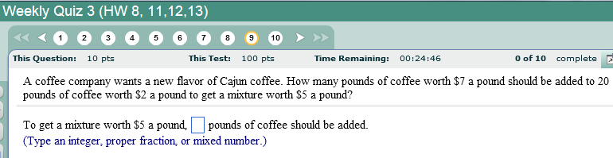
Remember this problem from Chapter 2?
Back then, we had to solve this problem by creating an equation containing only ONE variable.
Now that we know how to work with systems of equations with TWO variables, it’s actually easier to set up and solve this problem.
You might take this as a hint that you’ll be seeing another mixture problem like this on the next quiz and/or Test 2.

Slide 4
Example of a mixture problem solved using TWO variables:
A Candy Barrel shop manager mixes M&M’s worth $2.00 per pound with trail mix worth $1.50 per pound. How many pounds of each should she use to get 50 pounds of a party mix worth $1.80 per pound?
1. UNDERSTAND
Read and reread the problem.
First we need to understand the formulas we will be using. To find out the cost of any quantity of items we use the formula:
price per unit
•
number of units
=
Total cost of all units
continued

Slide 5
continued
1. UNDERSTAND (continued)
Since we are looking for two quantities, we let
x = the amount (in pounds) of M&M’s
y = the amount (in pounds) of trail mix
continued

Slide 6

continued
x = the amount (in pounds) of M&M’s
y = the amount (in pounds) of trail mix
2. Now TRANSLATE this into two equations, using the information given in the problem.
Equation 1:
There are fifty total pounds of party mix.
x + y = 50
Equation 2:
Using
price per pound
•
number of pounds
=
Total cost
Cost of M&M’s
Cost of trail mix
Cost of mixture
=
$2•x
+
$1.50•y
=
$1.80•50
continued

Slide 7
continued
3. SOLVE:
We are solving the system
x + y = 50
2x + 1.50y = 90
Since the equations are written in standard form, let’s solve by the addition/elimination method.
(Could we use substitution on this? If so, how might we start start?)
One approach to using the addition method:
Let’s get rid of y by multiplying the first equation by 3 and the second equation by –2 (which will also get rid of the decimal).
Note: We could also have chosen to eliminate x by simply multiplying the first equation by -2. This would work fine, but it would require that we work with decimals.
3(x + y) = 3(50)
3x + 3y = 150
–2(2x + 1.50y) = –2(90)
–4x – 3y = –180
–x = –30
Important note: Different people might decide to do this problem different ways, but if they did the calculations right, they would still come up with the same answer.
x = 30
continued

Slide 8
continued
x = 30
Now we substitute 30 for x into the first equation.
x + y = 50
30 + y = 50
y = 20
4. INTERPRET
Check: Substitute x = 30 and y = 20 into both of the equations.
x + y = 50 First equation
30 + 20 = 50 True
2x + 1.50y = 90 Second equation
2(30) + 1.50(20) = 90
60 + 30 = 90 True
State: The store manager needs to mix 30 pounds of M&M’s and 20 pounds of trail mix to get the mixture at $1.80 a pound.

Slide 9
Back to this problem from Chapter 2:
What two equations in x and y could we use to solve this problem using a system of equations?

Slide 10
Example: Solving a D = r • t problem using a system of two equations
Terry Watkins can row about 10.6 kilometers in 1 hour downstream and 6.8 kilometers upstream in 1 hour. Find how fast he can row in still water, and find the speed of the current.
1. UNDERSTAND Read and reread the problem.
We have two unknowns in this problem: the rate of the rower in still water (without the current), and the rate of the current pushing with or against the boat.
Let’s use r as the variable representing the speed of the rower in still water and w as the variable representing the speed of the current.
The rate when traveling downstream (with the current) would actually be r + w and the rate upstream (against the current) would be r – w, where r is the speed of the rower in still water, and w is the speed of the water current.
continued

Slide 11
continued
2. TRANSLATE
rate downstream
time downstream
distance downstream
(r + w)
•
1
=
10.6
rate upstream
time upstream
distance upstream
(r – w)
•
1
=
6.8
continued

Slide 12
continued
3. SOLVE
We are solving the system
r + w = 10.6
r – w = 6.8
Since the equations are written in standard form, we’ll solve by the addition method. Simply add the two equations together.
r + w = 10.6
r – w = 6.8
2r = 17.4
r = 8.7
continued

Slide 13
continued
Now we substitute 8.7 for r into the first equation.
r + w = 10.6
8.7 + w = 10.6
w = 1.9
4. INTERPRET
Check: Substitute r = 8.7 and w = 1.9 into both equations.
(r + w)1 = 10.6 First equation
(8.7 + 1.9)1 = 10.6 True
(r – w)1 = 1.9 Second equation
(8.7 – 1.9)1 = 6.8 True
State: Terry’s rate in still water is 8.7 km/hr and the rate of the water current is 1.9 km/hr.

Slide 14
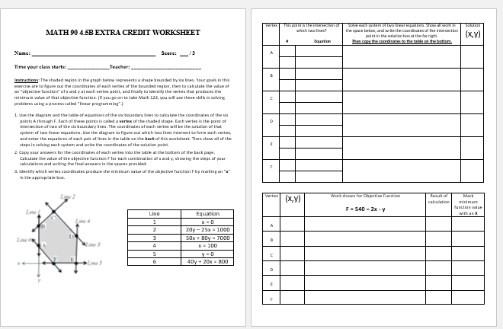
Extra Credit Assignment – Due next class at start of class:

Slide 15
Extra Credit Assignment Information:
Your score on this worksheet will be added to your quiz score.
This assignment is especially important for those of you who need to take Math 123 for your major.
You will use these skills in Math 123 to solve problems using a process called “linear programming”.
We encourage EVERYBODY in the class to do this extra credit worksheet, whether or not your next class is Math 123.
The assignment should take about 15-20 minutes. There are six systems of linear equations to solve, but five of them are simple substitution problems.
We’ll do the first one together in class now to show you how the process works.

Slide 16
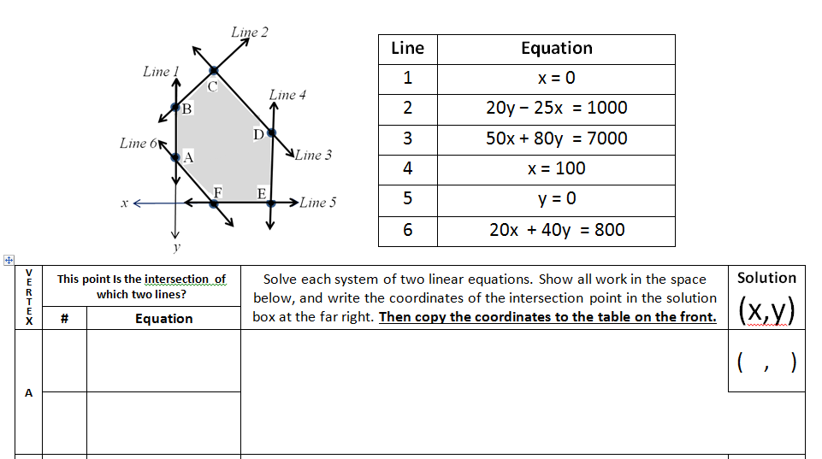
1. Use the diagram and the table of equations of the six boundary lines to calculate the coordinates of the six points A through F. Each of these points is called a vertex of the shaded shape.
Each vertex is the point of intersection of two of the six boundary lines. The coordinates of each vertex will be the solution of that system of two linear equations.
Use the diagram to figure out which two lines intersect to form each vertex, and enter the equations of each pair of lines in the table on the back of this worksheet.
Then show all of the steps in solving each system and write the coordinates of the solution point.
1
Eqn. 1. x = 0
Eqn. 2. 20x + 40y = 800
Substitute x = 0 into equation 2:
20∙0 + 40y = 800
40y = 800
y = 800/40 = 20
y= 20
x = 0
0
20
A
6

Slide 17
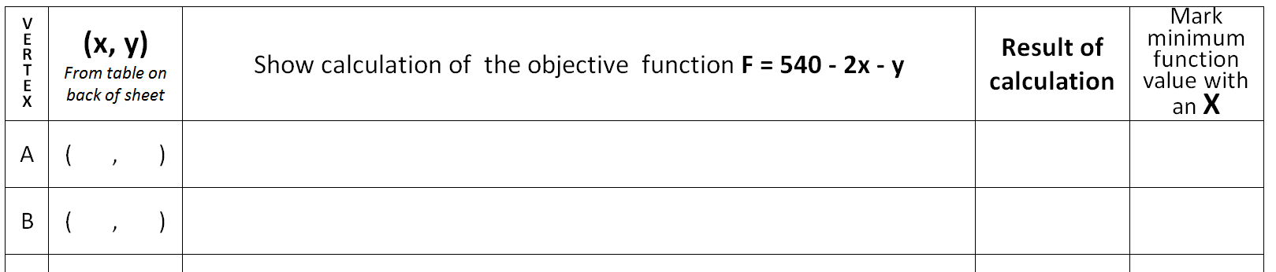
2. Copy your answers for the coordinates of each vertex into the table at the bottom of the front page.
Calculate the value of the objective function F for each combination of x and y, showing the steps of your calculations and writing the final answers in the spaces provided.
3. Identify which vertex coordinates produce the minimum value of the objective function F by marking an “x” in the appropriate box.
0
20
F = 540 - 2∙0 – 20 = 540 – 0 – 20 = 520
F = 540 - 2∙0 – 20
F = 540 - 2∙0 – 20 = 540 – 0 – 20
520
REMINDERS:
This assignment is due 6/24/2018 at 11:59 PM sent via email to Dr. S.
No late submissions will be accepted.
Your score on this worksheet will be added to your quiz score.

