Slide 1
Note: There are 56 problems in
The HW 5.1 assignment,
but most of them are very short.
(This assignment will take most students less than an hour to complete.)

Slide 2
Teachers: You can insert screen shots of any test problems you want to go over with your students here.

Slide 3
Please
CLOSE
YOUR LAPTOPS,
and turn off and put away your cell phones,
and get out your note-taking materials.

Slide 4
Section 5.1
Exponents

Slide 5
Exponents
Exponents that are natural numbers are shorthand notation for repeating factors.
3⁴ = 3 • 3 • 3 • 3
3 is the base
4 is the exponent (also called power)
Note, by the order of operations, exponents are calculated before all other operations, except expressions in parentheses or other grouping symbols.

Slide 6
Product Rule (applies to common bases only)
a^{m} • a^{n} = a^{m+n}
Example
Simplify each of the following expressions.
3² • 3⁴
= 3²⁺⁴
= 3⁶
= 3 • 3 • 3 • 3 • 3 • 3
= 729
x⁴ • x⁵
= x⁴⁺⁵
= x⁹
z³ • z² • z⁵
= z³⁺²⁺⁵
= z¹⁰
(3y²)(-4y⁴)
= 3 • y² • -4 • y⁴
= (3 • -4)(y² • y⁴)
= -12y⁶

Slide 7
Zero exponent
a⁰ = 1, a ≠ 0
Note: 0⁰ is undefined.
Example
(Assume all variables have nonzero values.)
Simplify each of the following expressions.
5⁰
= 1
(xyz³)⁰
= x⁰ • y⁰ • (z³)⁰
= 1 • 1 • 1 = 1
-x⁰
= -1∙x⁰
= -1 ∙1 = -1

Slide 8
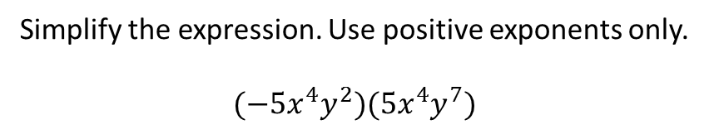
Problem from today’s homework:
Simplify the expression. Use positive exponents only.
$$(−5x^{4}y^{2})(5x^{4}y^{7})$$

Slide 9
Quotient Rule (applies to common bases only)
Example
Simplify the following expression.
Group common bases together

Slide 10
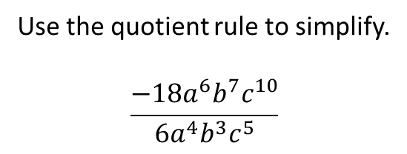
Problem from today’s homework:
Use the quotient rule to simplify.
$$\frac{−18a^{6}b^{7}c^{10}}{6a^{4}b^{3}c^{5}}$$

Slide 11
Power Rule:
(a^{m})^{n} = a^{mn} Note that you MULTIPLY the exponents in this case.
Example
Simplify each of the following expressions.
(2³)³
= 2^{3•3}
= 2⁹
= 512
(x⁴)²
= x^{4•2}
= x⁸

Slide 12
CAUTION: Notice the importance of considering the effect of the parentheses in the preceding example.
Compare the result of (2³)³ to the result of 2³·2^{3:}
2³·2³= 2³⁺³ = 2⁶ = 64
(2³)³
= 2^{3•3}
= 2⁹
= 512
Compare the result of (x⁴)² to the result of x⁴x²:
x⁴·x² = x⁴⁺² = x⁶
(x⁴)²
= x^{4•2}
= x⁸

Slide 13
Power of a Product Rule
(ab)^{n} = a^{n} • b^{n}
Example
Simplify (5x²y)³
= 5³ • (x²)³ • y³
= 125x⁶ y³

Slide 14
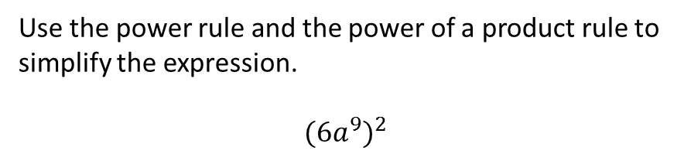
Example from today’s homework: (do this in your notebook)
Use the power rule and the power of a product rule to
simplify the expression.
$${(6a^{9})}^{2}$$
Answer: 36 a ¹⁸

Slide 15
Power of a Quotient Rule
Example
Simplify the following expression.
(Power of product rule in this step)
(Power rule in this step)

Slide 16
(All of these are on your formula sheet – use it while you do the homework.)
Summary of exponent rules
If m and n are integers and a and b are real numbers, then:
Product Rule for exponents a^{m} • a^{n} = a^{m+n}
Power Rule for exponents (a^{m})^{n} = a^{mn}
Power of a Product (ab)^{n} = a^{n} • b^{n}
Power of a Quotient
Quotient Rule for exponents
Zero exponent a⁰ = 1, a ≠ 0

Slide 17
The assignment on today’s material (HW 5.1)
is due at the start of the next class session.
Homework Questions?
Use the Open Lab!

