Slide 1
Please
CLOSE
YOUR LAPTOPS,
and turn off and put away your cell phones,
and get out your note-taking materials.

Slide 2
Note: There are 55 problems in
the HW 5.2 assignment, but again, most of them are very short.
(This assignment will take most students less than an hour and a half to complete.)

Slide 3
Section 5.2
Introduction to Polynomials

Slide 4
Review from last session:
These rules will all be used when we work with polynomials in the coming sections.
Summary of exponent rules
If m and n are integers and a and b are real numbers, then:
Product Rule for exponents a^{m} • a^{n} = a^{m+n}
Power Rule for exponents (a^{m})^{n} = a^{mn}
Power of a Product (ab)^{n} = a^{n} • b^{n}
Power of a Quotient
Quotient Rule for exponents
Zero exponent a⁰ = 1, a ≠ 0

Slide 5
Polynomials:
Polynomial vocabulary:
Term – a number or a product of a number and variables raised to powers (the terms in a polynomial are separated by + or - signs)
Coefficient – the number in front of a term
Constant – term which is only a number, no variables
A polynomial is a sum of terms involving coefficients (real numbers) times variables raised to a whole number (0, 1, 2, …) exponent, with no variables appearing in any denominator.

Slide 6
Consider the polynomial 7x⁵ + x²y² – 4xy + 7
How many TERMS does it have?
There are 4 terms: 7x⁵, x²y², -4xy and 7.
What are the coefficients of those terms?
The coefficient of term 7x⁵ is 7,
The coefficient of term x²y² is 1,
The coefficient of term –4xy is –4
The coefficient of term 7 is 7.
7 is a constant term. (no variable part, like x or y)

Slide 7
A Monomial is a polynomial with 1 term.
A Binomial is a polynomial with 2 terms.
A Trinomial is a polynomial with 3 terms.

Slide 8
Degree of a term:
To find the degree, take the sum of the exponents on the variables contained in the term.
Degree of the term 7x⁴ is 4
Degree of a constant (like 9) is 0.
(because you could write it as 9x⁰, since x⁰ = 1)
Degree of the term 5a⁴b³c is 8 (add all of the exponents on all variables, remembering that c can be written as c¹).
Degree of a polynomial:
To find the degree, take the largest degree of any term of the polynomial.
Example: The degree of 9x³ – 4x² + 7 is 3.

Slide 9
More examples:
1. Consider the polynomial 7x⁵ + x³y³ – 4xy
Is it a monomial, binomial or trinomial?
What is the degree of the polynomial?
trinomial
6

Slide 10
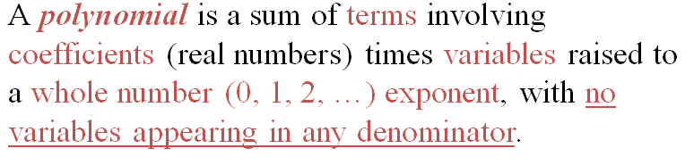
More examples:
1. Consider the polynomial 7x⁵ + x³y³ – 4xy
Is it a monomial, binomial or trinomial?
What is the degree of the polynomial?
2. Which of the following expressions are NOT polynomials?
_
5x⁴ - √5x + Π • -5x⁻³y⁷ + 2xy – 10
1 • 3x + 5
x + 5
-5x³y⁷ + 2xy – 10 • y² + 6y - 8
3
trinomial
6
NOT
NOT

Slide 11

Question:
Is $3\sqrt{x}$ + 10 a polynomial expression?
Why not?

Slide 12
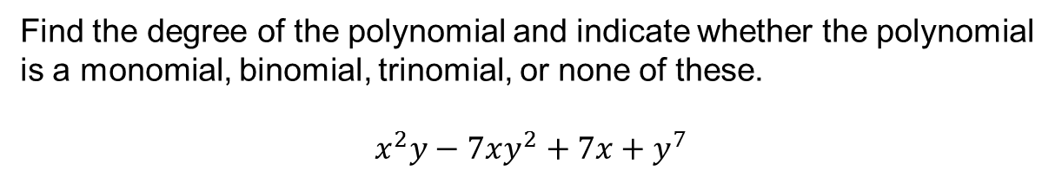
Problem from today’s homework:
Find the degree of the polynomial and indicate whether the polynomial
is a monomial, binomial, trinomial, or none of these.
$$x^{2}y−7xy^{2}+7x+y^{7}$$
7
The polynomial has four terms, so it is none of the listed names.

Slide 13
We can use function notation to represent polynomials.
Example: P(x) = 2x³ – 3x + 4 is a polynomial function.
Evaluating a polynomial for a particular value involves replacing the value for the variable(s) involved.
Example
Find the value P(-2) = 2x³ – 3x + 4.
P(-2)
= 2(-2)³ – 3(-2) + 4
= 2(-8) + 6 + 4
= -6
This means that the ordered pair (-2, -6) would be one point on the graph of this function.

Slide 14
Don’t forget how to work with fractions!
Example:
For the polynomial function f(x) = 7x² + x – 2
Calculate f(½)
(Answer: ¼)
Calculate f(-⅓)
(Answer: 14 )
9

Slide 15
Like terms
Terms that contain exactly the same variables raised to exactly the same powers.
Warning!
Only like terms can be combined by combining their coefficients.
Example
Combine like terms to simplify.
x²y + xy – y + 10x²y – 2y + xy =
x²y + 10x²y + xy + xy – y – 2y =
(like terms are grouped together)
(1 + 10)x²y + (1 + 1)xy + (-1 – 2)y =
11x²y + 2xy – 3y

Slide 16
Adding polynomials
Combine all the like terms.
Subtracting polynomials
Change the signs of the terms of the polynomial being subtracted, and then combine all the like terms.

Slide 17
Example
Add or subtract each of the following, as indicated.
1) (3x – 8) + (4x² – 3x +3)
= 3x – 8 + 4x² – 3x + 3
= 4x² + 3x – 3x – 8 + 3
= 4x² – 5
2) 4 – (-y – 4)
= 4 + y + 4
= y + 4 + 4
= y + 8
3) (-a² + 1) – (a² – 3) + (5a² – 6a + 7) =
-a² + 1 – a² + 3 + 5a² – 6a + 7 =
-a² – a² + 5a² – 6a + 1 + 3 + 7 =
3a² – 6a + 11

Slide 18
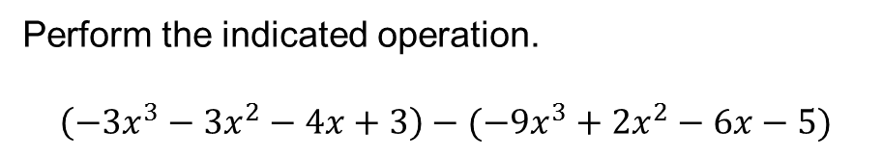
Problem from today’s homework:
Perform the indicated operation.
$$\left(−3x^{3}−3x^{2}−4x+3\right)−(−9x^{3}+2x^{2}−6x−5)$$
6x³ -5x² +2x +8

Slide 19

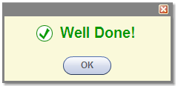
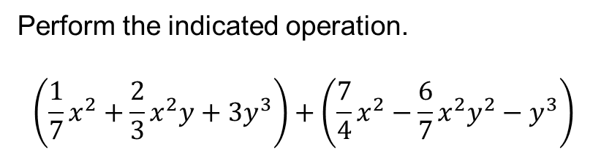
Problem from today’s homework:
Perform the indicated operation.
$$\left(\frac{1}{7}x^{2}+\frac{2}{3}x^{2}y+3y^{3}\right)+\left(\frac{7}{4}x^{2}−\frac{6}{7}x^{2}y^{2}−y^{3}\right)$$

Slide 20
You may now OPEN
your LAPTOPS
and begin working on the homework assignment.
We expect all students to stay in the classroom to work on your homework till the end of the 55-minute class period. If you have already finished the homework assignment for today’s section, you should work ahead on the next one or work on the next practice quiz/test.

