Slide 1
Please close your laptops
and turn off and put away your cell phones, and get out your note-taking materials.

Slide 2
Section 5.5A
Negative Exponents

Slide 3

When might you have to deal with a negative exponent?
Example: Use the quotient rule to simplify
(Assume that x ≠ 0.)
Solution:
But what does x ⁻² mean?
So:

Slide 4
In order to extend the quotient rule to cases where the difference of the exponents would give us a negative number we define negative exponents as follows:
If a ≠ 0, and n is an integer, then

Slide 5
Example
Simplify by writing each of the following expressions with positive exponents. (Calculate out any number terms.)
1)
2)
Remember that without parentheses, only the x is the base for the exponent –4, not the entire expression 2x.
3)

Slide 6
Note that in the previous problem, 2x⁻⁴
gave us 2 on top and x⁴ on the bottom,
and only the x term, not the 2,
was raised to the -4th power.
Here’s a question for you:
What would (2x)⁻⁴ look like when simplified?
Would it look different than 2x⁻⁴?
(Good question for a quiz!)

Slide 7
Watch out for negatives that are NOT in the exponent!
For example:
What’s the difference between 3⁻¹ and -3?

Slide 8
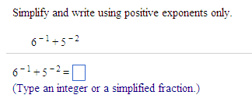
Problem from today’s homework:
Solution: 1/6 + 1/25 = 31/150

Slide 9
Example
Simplify by writing each of the following expressions with positive exponents.
1)
(Note that to convert a power with a negative exponent to one with a positive exponent, you simply switch the power from a numerator to a denominator, or vice versa, and switch the exponent to its positive value.)
2)

Slide 10
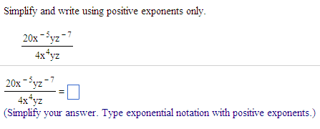
Problem from today’s homework:
Answer: 5 .
x⁹z⁸

Slide 11
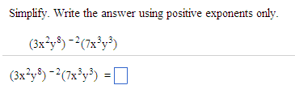
Example from today’s homework:
Answer: 7 .
9xy¹³

Slide 12
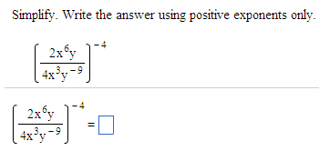
Example from today’s homework: (do this in your notebook)
Answer: 16 .
x¹²y⁴⁰

Slide 13
Summary of exponent rules
If m and n are integers and a and b are real numbers, then:
Product Rule for exponents a^{m} • a^{n} = a^{m+n}
Power Rule for exponents (a^{m})^{n} = a^{mn}
Power of a Product (ab)^{n} = a^{n} • b^{n}
Power of a Quotient
Quotient Rule for exponents
Zero exponent a⁰ = 1, a ≠ 0
Negative exponent

Slide 14
Simplify the following expression, using only positive exponents in your answer.
Example
Note: Problems like this are much easier to solve if you start by simplifying the part inside the parentheses by combining the exponents of identical bases using the quotient rule, and then apply the power rule using the exponent outside of the parentheses .
= (3⁻²⁻ ⁻⁴ a³⁻⁷ b¹⁻ ⁻ ³)⁻²
= (3² a ⁻⁴ b ⁴)⁻²
= 3^{2*-2} a^{-4*-2} b^{4*-2}
= 3⁻⁴ a⁸ b⁻⁸
= a ⁸
3⁴b⁸
= a⁸
81b⁸

Slide 15
REMINDER:
The assignment on today’s material (HW 5.5A) is due at the start of the next class session.
Homework Questions?
Use the Open Lab!

Slide 16
You may now OPEN
your LAPTOPS
and begin working on the homework assignment.
We expect all students to stay in the classroom to work on your homework till the end of the 55-minute class period. If you have already finished the homework assignment for today’s section, you should work ahead on the next one or work on the next practice quiz/test.

