Slide 1
Please close your laptops
and turn off and put away your cell phones, and get out your note-taking materials.

Slide 2
Section 5.5B
Scientific Notation

Slide 3
Review: Powers of 10
How would we write the following numbers as a power of 10?
1000 = 10³
1,000,000 = 10⁶
1/10 (or 0.1) = 10⁻¹
1/1000 (or 0.001) = 10⁻³

Slide 4
Review: Powers of 10
How would we write the following powers of 10 as integers or decimal numbers?
10⁹ = 1,000,000,000
10⁻¹ = 0.1
10⁻² = 0.01
10⁻³ = 0.001
10⁻¹⁰ = 0.0000000001

Slide 5
Review: Powers of 10
Simplify the following:
10⁹ *10⁻¹ = 10⁸
10⁻² *10⁻³ = 10⁻⁵
(10⁻³)⁻⁴ = 10¹²
10⁻¹⁰ = 10⁻¹⁶
10⁶
10⁶ = 10⁻²
10⁸

Slide 6
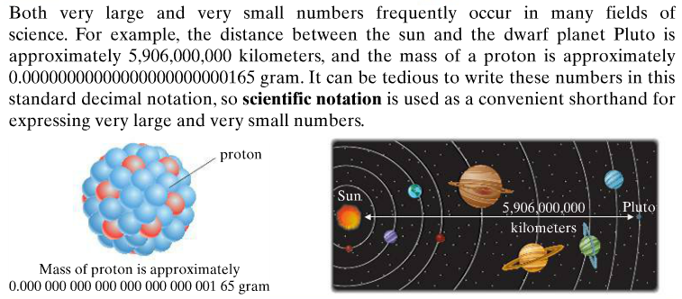
Scientific Notation

Slide 7
Scientific notation is a convenient shorthand for expressing such very large or very small numbers using powers of the base 10.
A positive number is written in scientific notation if it is written as a product of a number a, where 1 ≤ a < 10, and an integer power r of 10.
a × 10^{r}

Slide 8
To Write a Number in Scientific Notation
Move the decimal point in the original number to the left or right, so that the new number has a value in the interval [1, 10).
Count the number of decimal places the decimal point is moved in Step 1.
If the original number is 10 or greater, the count is positive.
If the original number is less than 1, the count is negative.
Multiply the new number in Step 1 by 10 raised to an exponent equal to the count found in Step 2.

Slide 9
Example
Write each of the following in scientific notation.
1)
4700
You must move the decimal 3 places to the left, so that the new number has a value between 1 and 10.
Since we moved the decimal 3 places, and the original number was > 10, our count is positive 3.
4700 = 4.7 × 10³
2)
0.00047
Have to move the decimal 4 places to the right, so that the new number has a value between 1 and 10.
Since we moved the decimal 4 places, and the original number was < 1, our count is negative 4.
0.00047 = 4.7 × 10⁻⁴

Slide 10
To Write a Scientific Notation Number in Standard Form
Move the decimal point the same number of spaces as the exponent on 10.
If the exponent is positive, move the decimal point to the right.
If the exponent is negative, move the decimal point to the left.

Slide 11
Example
Write each of the following in standard notation.
1)
5.2738 × 10³
Since the exponent is a positive 3, we move the decimal 3 places to the right.
5.2738 × 10³
= 5273.8
2)
6.45 × 10⁻⁵
Since the exponent is a negative 5, we move the decimal 5 places to the left.
00006.45 × 10⁻⁵
= 0.0000645

Slide 12
Multiplying and dividing with numbers written in scientific notation involves using properties of exponents.
Example
Perform the following operations.
1)
(7.3 × 10⁻²)(8.1 × 10⁵)
= (7.3 • 8.1) × (10⁻² • 10⁵)
= 59.13 × 10³
= 5.913 x 10⁴ (scientific notation)
= 59,130 (standard form)
2)

Slide 13
Example:
Note: A number is not in scientific notation if it has more than one digit in front of the decimal point.
Example problem:
Calculate 4.2 x 10⁴ * 6.3 x 10⁷
Solution: 4.2*6.3 x 10⁴*10⁷
= 26.46 x 10⁴⁺⁷
= 26.46 x 10¹¹
= 2.646 x 10¹²
Not in scientific notation!!!

Slide 14
Example
A number is not in scientific notation if it has no nonzero digit in front of the decimal point.
Example problem:
Calculate (4.2 x 10⁻⁴ ) / (8.4 x 10⁷)
Solution: 4.2/8.4 x 10⁻⁴/10⁷
= 0.5 x 10⁻⁴⁻⁷
= 0.5 x 10⁻¹¹
= 5 x 10⁻¹²
Not in scientific notation!!!

Slide 15
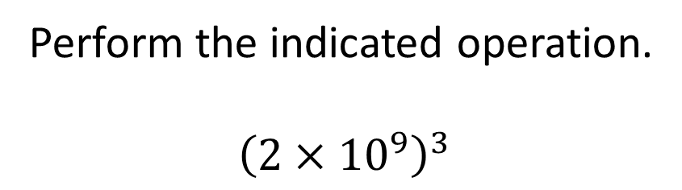
Example from today’s homework: (do this in your notebook)
Perform the indicated operation.
$${\left(2×{10}^{9}\right)}^{3}$$
Answer: 8 x 10 ²⁷
What if this was (2 x 10⁹)⁴ ?
Answer: 1.6 x 10 ³⁷
( NOT 16 x 10 ³⁶ )

Slide 16

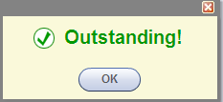
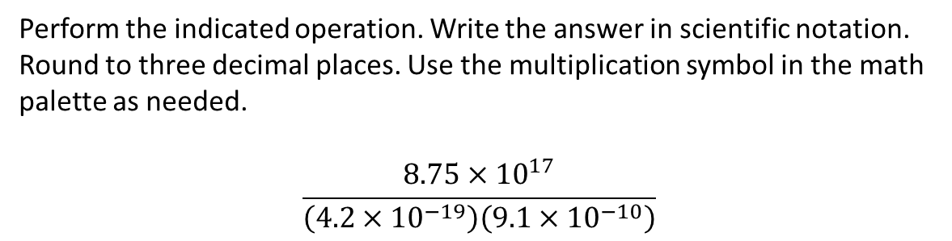
Example from today’s homework:
Perform the indicated operation. Write the answer in scientific notation.
Round to three decimal places. Use the multiplication symbol in the math
palette as needed.
$$\frac{8.75×{10}^{17}}{\left(4.2{×10}^{−19}\right)\left(9.1{×10}^{−10}\right)}$$

Slide 17
REMINDER:
The assignment on today’s material (HW 5.5B) is due at the start of the next class session.
Homework Questions?
Use the Open Lab!

Slide 18
You may now OPEN
your LAPTOPS
and begin working on the homework assignment.
We expect all students to stay in the classroom to work on your homework till the end of the 55-minute class period. If you have already finished the homework assignment for today’s section, you should work ahead on the next one or work on the next practice quiz/test.

