Slide 1
Please
CLOSE
YOUR LAPTOPS,
and turn off and put away your cell phones,
and get out your note-taking materials.

Slide 2
Section 5.6B
Dividing Polynomials, Part 2

Slide 3
Section 5.6 Part 2
Review of the steps in long division:
Divide
Multiply
Subtract
Bring down
Then repeat these steps until you can’t bring down or divide any longer.

Slide 4




Important: Remember that you DO NOT need to use long division when dividing a polynomial by a monomial!
Which of the following problems require long division?
Yes
No
No
Yes

Slide 5
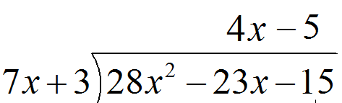

Make sure you know how to CHECK your answer from a long division problem
a). Without a remainder
b). With a remainder
Check this problem to see if the answer is correct:
5 .
+
X
Answer is: ____CORRECT ___INCORRECT

Slide 6
Two tricky things to watch out for:
When the terms of either the polynomial in a long division problem are not written in order of degree from highest to lowest.
First step in this case: Write the polynomial terms in the proper order BEFORE you start dividing.
2. When the polynomial is missing one or more terms in the degree order.
First step in this case: Insert a “0x^{n}” term in place of the missing nth degree term BEFORE you start dividing.
Why is this important?
Because you have to make sure you are always subtracting LIKE TERMS.

Slide 7


Example:
HINT: Start by rewriting the inside polynomial as 16b² – 8b – 5. This helps you make sure you are always subtracting like terms.
Answer:
Make sure you always practice CHECKING your answers on homework problems so you know how to do it on the test!

Slide 8
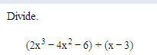
Example:
HINT: Start by rewriting the inside polynomial as 2x³ – 4x² + 0x – 6. This helps you make sure you are always subtracting like terms.
Answer: 2x² + 2x + 6 + 12 .
x – 3
Make sure you always practice CHECKING your answers on homework problems so you know how to do it on the test!

Slide 9
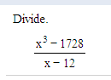
Example:
Answer: x² + 12x + 144.
Make sure you always practice CHECKING your answers on homework problems so you know how to do it on the test!

Slide 10
The assignment on this material
(HW 5.6B) is due at the start of the next class session.
You can now open your laptops and work on this assignment.

