Slide 1
Please close your laptops
and turn off and put away your cell phones, and get out your note-taking materials.

Slide 2
Section 6.6
Solving Polynomial Equations

Slide 3
Review: Choosing a Factoring Strategy
Steps for factoring a polynomial:
Factor out any common factors. (Always check this first, before doing any other factoring method.)
Look at number of terms in polynomial
If 2 terms, look for difference of squares, difference of cubes or sum of cubes. (Use the formula sheet for these!)
If 3 terms, use techniques for factoring into 2 binomials.
If 4 or more terms, try factoring by grouping.
See if any factors can be further factored.
Check by multiplying all factors out to make sure you get back to the original polynomial.

Slide 4
What possible use is there for factoring polynomials????

Slide 5
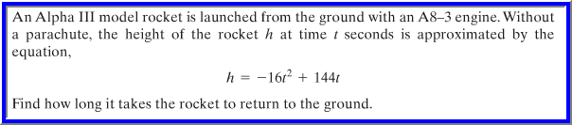


Slide 6
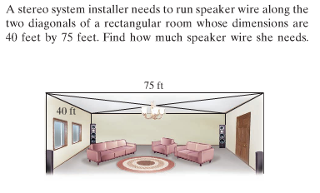
Take 2: What possible use is there for factoring polynomials????

Slide 7
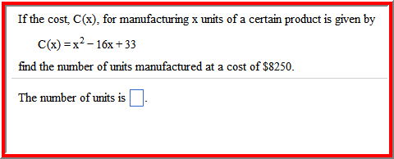
Take 3: What possible use is there for factoring polynomials????

Slide 8
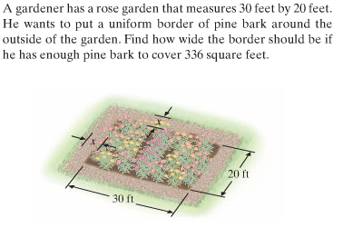
Take 4: What possible use is there for factoring polynomials????

Slide 9
Solving problems like these can be done by describing them using polynomial equations (the topic of our next lecture), and then factoring the polynomials.
Polynomial equations
Equations that set 2 polynomials equal to each other.
Standard form has a 0 on one side of the equation.
The maximum number of solutions to a polynomial equation is equal to the degree of the polynomial.
Quadratic equations
Polynomial equations of degree 2. (So how many possible solutions?)
Zero factor theorem
If a and b are real numbers and ab = 0, then a = 0 or b = 0.
This property is true for three or more factors, as well.

Slide 10
Steps for solving a polynomial equation by factoring:
Write the equation in standard form.
Clear any fractions.
Factor the polynomial completely.
Set each factor containing a variable equal to 0.
Solve the resulting equations.
Check each solution in the original equation.

Slide 11
Example
Solve x² – 5x = 24.
First write the polynomial equation in standard form.
x² – 5x – 24 = 0
Now we factor the polynomial using techniques from the previous sections.
x² – 5x – 24 = (x – 8)(x + 3) = 0
We set each factor equal to 0.
x – 8 = 0, which will simplify to x = 8
x + 3 = 0 which will simplify to x = -3

Slide 12
Example (cont.)
Check both possible answers in the original equation, x² – 5x = 24.
x = 8: 8² – 5(8) = 64 – 40 = 24 true
x = -3: (-3)² – 5(-3) = 9 – (-15) = 24 true
So our solutions for x are 8 or –3.
ALWAYS REMEMBER TO CHECK YOUR ANSWERS!!! (Especially on quizzes/tests, when there’s no “check answer” button...)

Slide 13
Example
Solve 4x(8x + 9) = 5
First, simplify the left side using the distributive property:
32x² + 36x = 5
Then write the polynomial equation in standard form:
32x² + 36x – 5 = 0
Now we factor the polynomial using techniques from the previous sections:
32x² + 36x – 5 = (8x – 1)(4x + 5) = 0
Finally, we set each factor equal to 0.
8x – 1 = 0 8x = 1 x = 1/8
4x + 5 = 0 4x = -5 x = -5/4
Note: This equation can also be solved (and probably more quickly)
using the quadratic formula, which is the topic of a future lecture.

Slide 14
Example (cont.)
Solve 4x(8x + 9) = 5
Now check both possible answers (x = 1/8 and x = -5/4) in the original equation. (This can be done fairly quickly if you use your calculator.)
true
true
So our solutions for x are or .

Slide 15


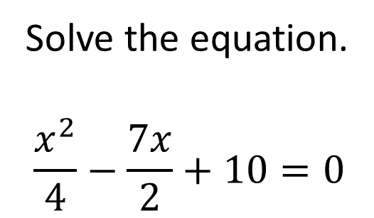
Example from today’s homework:
Solve the equation.
$$\frac{x^{2}}{4}−\frac{7x}{2}+10=0$$
HINT: Clear the fractions first, by multiplying everything on both sides by 4.

Slide 16

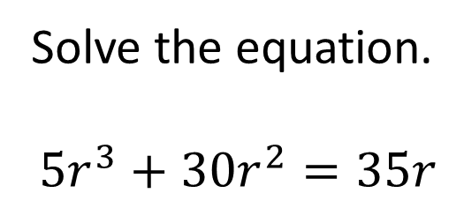
Example from today’s homework:
Solve the equation.
$$5r^{3}+30r^{2}=35r$$
HINT 1: How many answers are you expecting? What is the DEGREE of the polynomial?
HINT 2: Write in standard form, then factor out the GCF of 5r. Then factor the remaining trinomial.

Slide 17
The assignment on this material (HW 6.6)
Is due at the start of the next class session.
You may now OPEN
your LAPTOPS
and begin working on the homework assignment.

