Slide 1
Please close your laptops
and turn off and put away your cell phones, and get out your note-taking materials.

Slide 2
Coming up:
Today: Lecture on Section 6.7
HW 6.7 due tomorrow
Next Class: Review for Test 3
Practice Test 3 available now.
Try to get an early start on this!
Test 3 (150 points)
some points from Units 1 & 2 (Test 1 & Test 2 material)

Slide 3
Section 6.7
Applications of Polynomial Equations

Slide 4
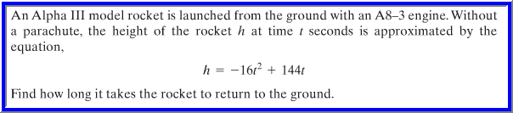
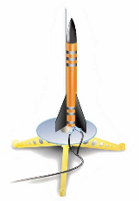

Slide 5
General strategy for solving
applied (word) problems:
Understand the problem:
Read and reread the problem.
Choose a variable to represent the unknown.
(These will be ONE VARIABLE equations.)
Construct a drawing, whenever possible.
Translate the problem into an equation.
Solve the equation.
Check your answers in the original equation.
Interpret the result:
Determine if any or all of the proposed solutions make sense in terms of the applied problem.
Convert your answer(s) into the appropriate form to answer the specific question(s) asked in the word problem.

Slide 6
Example
The product of two consecutive positive integers is 132. Find the two integers.
Understand
Read and reread the problem and choose a variable to represent the unknown quanitity.
If we let x = one of the unknown positive integers,
then x + 1 = the next consecutive positive integer.

Slide 7
Example (cont.)
Now translate this into an equation:
The product of
is
132
two consecutive positive integers
x
•
(x + 1)
=
132

Slide 8
Example (cont.)
Solve
x(x + 1) = 132
x² + x = 132 (distributive property)
x² + x – 132 = 0 (write equation in standard form)
(x + 12)(x – 11) = 0 (factor quadratic polynomial)
x + 12 = 0 or x – 11 = 0 (set factors equal to 0)
x = -12 or x = 11 (solve each factor for x)

Slide 9
Example (cont.)
Interpret
Possible solutions: x = -12 or x = 11
Remember that x is supposed to represent a positive integer. So, although x = -12 satisfies our equation, it cannot be a solution for the problem we were presented.
If we let x = 11 (the first integer), then the next consecutive integer is x + 1 = 12.
Check: The product of the two numbers is 11 · 12 = 132, our desired result.
State Solution: The two positive integers are 11 and 12.

Slide 10
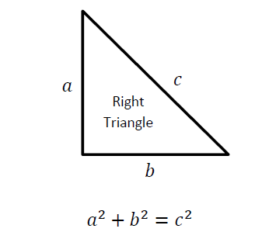
Pythagorean Theorem (used in some homework problems in today’s assignment)
In a right triangle, the sum of the squares of the lengths of the two legs is equal to the square of the length of the hypotenuse.
This formula
is on your formula sheet

Slide 11
Example
Find the length of the shorter leg of a right triangle if the longer leg is 10 miles more than the shorter leg and the hypotenuse is 10 miles less than twice the shorter leg.

Slide 12
Example (cont.)
Understand
Read and reread the problem. If we let
x = the length of the shorter leg, then
x + 10 = the length of the longer leg and
2x – 10 = the length of the hypotenuse.
Now draw a diagram:

Slide 13
Example (cont.)
Translate
By the Pythagorean Theorem,
(leg a)² + (leg b)² = (hypotenuse)²
x² + (x + 10)² = (2x – 10)²

Slide 14
Example (cont.)
Solve
x² + (x + 10)² = (2x – 10)²
x² + x² + 20x + 100 = 4x² – 40x + 100
(multiply the binomials)
2x² + 20x + 100 = 4x² – 40x + 100
(simplify left side)
0 = 2x² – 60x
(subtract 2x² + 20x + 100 from both sides)
0 = 2x(x – 30)
(factor right side)
x = 0 or x = 30
(set each factor = 0 and solve)

Slide 15
Example (cont.)
Interpret
Check: Remember that x is supposed to represent the length of the shorter side. So, although x = 0 satisfies our equation, it cannot be a solution for the problem we were presented.
If we let x = 30, then x + 10 = 40 and 2x – 10 = 50. Since 30² + 40² = 900 + 1600 = 2500 = 50², the Pythagorean Theorem checks out.
State Solution: The length of the shorter leg is 30 miles. (Remember that is all we were asked for in this problem.)

Slide 16
To solve this problem, we set h = 0 (since 0 = ground level).
Then we solve the equation
-16t² + 144t = 0
Factoring this equation gives two answers:
t = 0, which means the rocket is at ground level when it is launched,
and t = 9, which tells us that the rocket returns to the ground 9 seconds after it is launched.
Note: There are several problems
like this in today’s homework.
New question: How long will it take for the rocket to reach its peak height of 324 feet?
ANSWER:
Solve 324 = -16t² + 144t
Factoring gives:
4(2t – 9)(2t - 9)= 0
Answer: t = 4.5 sec.

Slide 17
Please Note:
You DO NOT have to memorize formulas for the word problems. You will have the sheet of formulas to use during quizzes and tests on this material.
Also, you’ll get more out of the review lecture if you try Practice Test 3 once before class. It’s not due yet, but it’s open and available now.

Slide 18
The assignment on this material (HW 6.7)
Is due at the start of the next class session.
You may now OPEN
your LAPTOPS
and begin working on the homework assignment.

