Slide 1
Please
CLOSE
YOUR LAPTOPS,
and turn off and put away your cell phones,
and get out your note-taking materials.

Slide 2
Teachers: You can insert screen shots of any test problems you want to go over with your students here.

Slide 3
Sections 7.1
Introduction to Rational Expressions

Slide 4
Rational Expressions
Rational expressions are ratios of two polynomials, just like a rational number is a ratio of two integers.
Examples of Rational Expressions:
For this last one, remember that 4 can be considered a polynomial of degree 0.
Rational expressions can be simplified, multiplied, divided, added and subtracted using factoring methods similar to the ones we use with regular fractions (rational numbers).

Slide 5
Simplifying a rational expression means writing it in lowest terms or simplest form.
To do this, we need to use the Fundamental Principle of Rational Expressions:
If P, Q, and R are polynomials, and Q and R are not 0, then
This is similar to what you do when you simplify a rational number (fraction):
Example: Simplify 105
49
Solution: First factor the numbers:
105 = 5*21 = 5*3*7 49 = 7*7
Next, rewrite the ratio in its factored form:
105 = 5*3*7
49 7*7
Finally, cancel the common factors and rewrite in simplified form:
105 = 5*3*7 = 5*3 = 15
49 7*7 7 7

Slide 6
Simplifying a Rational Expression:
1) Completely factor the numerator and denominator polynomials.
2) Apply the Fundamental Principle of Rational Expressions to cancel common factors in the numerator and denominator.
Warning! DO NOT multiply out the factors at the end like you did with the numbers in a simplified fraction.
Warning 2! Only common FACTORS can be canceled from the numerator and denominator. Make sure any expression you eliminate is a factor, not just a term within a factor.

Slide 7
Example
Simplify the following expression.

Slide 8
Question: Is the following simplification correct?
Question: Is the following simplification correct?
/
/
/
/
Answer: NO!!!!
Remember, we can only cancel entire FACTORS, not terms with factors.
2x+7 is a factor; it could be written as (2x+7).
The 2x and the 7 are terms in the factor.

Slide 9

The following example with numbers illustrates the error in the previous case of “bad cancelling”:
Would we get the same answer if we
cancelled the 7’s first?
/
/
Incorrect!!

Slide 10
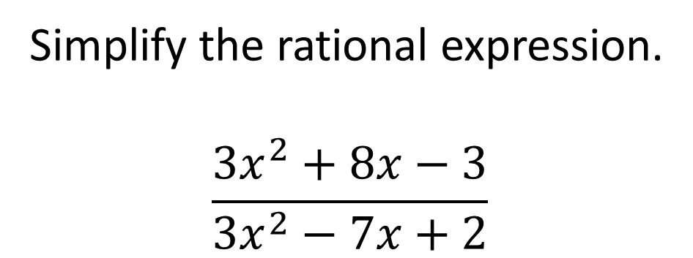
Problem from today’s homework:
Simplify the rational expression.
$$\frac{3x^{2}+8x−3}{3x^{2}−7x+2}$$
Solve by factoring both trinomials and then canceling any common factors.
/
/
x + 3
x - 2
(x + 3)(3x – 1)
(x – 2)(3x – 1)

Slide 11
Example
Simplify the following expression.

Slide 12
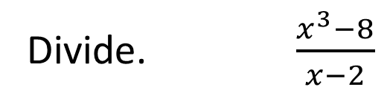
Revisiting this problem from Test 3:
Divide. $\frac{x^{3}−8}{x−2}$
Instead of using long division, let’s try factoring and canceling:
HINT: Use a³ – b³ = (a – b)(a² + ab + b²)
x³ – 8 = (x – 2)(x² + 2x + 4).
So x³ – 8 = (x – 2)(x² + 2x + 4) = x² + 2x + 4
(x – 2) (x – 2)
Note that this is the same answer we would have gotten using long division.

Slide 13
To evaluate a rational expression for a particular value of a variable, substitute the replacement value into the rational expression in place of that variable and simplify the result.

Slide 14
Example
Evaluate the following expression for y = -2.

Slide 15
In the previous example, what would happen if we tried to evaluate the rational expression for y = 5?
This expression is undefined!

Slide 16
We have to be able to determine when a rational expression is undefined.
A rational expression is undefined when the denominator is equal to zero.
The numerator being equal to zero is okay (the rational expression simply equals zero).

Slide 17
Example
Find any real numbers that make the following rational expression undefined.
The expression is undefined when 15x² + 45 = 0.
Factoring this gives 15x(x + 3) = 0,
so the expression is undefined when x = -3 or x = 0.
The set of numbers for which an expression is
defined is called the domain of the expression.
The domain is written in set notation.
The domain for the expression in this example would be:
{ x | x ≠ 0, -3}

Slide 18
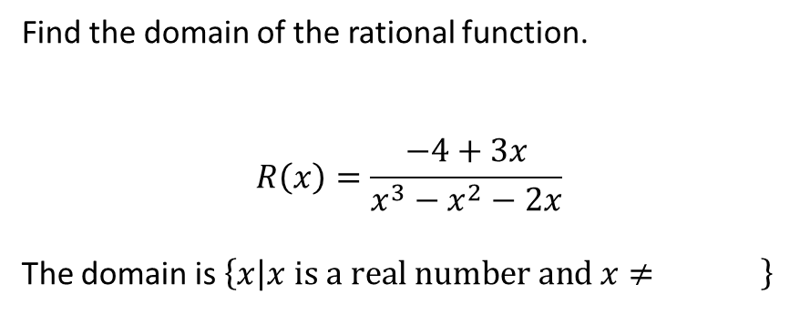
Problem from today’s homework:
Find the domain of the rational function.
$$R\left(x\right)=\frac{−4+3x}{x^{3}−x^{2}−2x}$$
The domain is $\left\{x | x \text{is} \text{a} \text{real} \text{number} \text{and} x≠ \right\}$
0, 2,-1
To answer this question, you need to find all solutions of the equation obtained by setting the denominator equal to zero.
(Notice that in DOMAIN questions, you focus only on the DENOMINATOR).
How many solutions are you expecting to find? Why?
Answer: At most three, because the polynomial is cubic, i.e. has a degree of three.
Find the answers by factoring the polynomial and setting each of the three factors to equal to zero.
Factoring: x(x - 2)(x + 1)
Solutions: x = 0, x = 2, x = -1. These are the numbers that are NOT in the domain.
Check: Plug each of these three numbers back into the denominator of the function and show that each one gives zero as the result.

Slide 19
REMINDER:
The assignment on today’s material (HW 7.1) is due at the start of the next class session. You may now open your laptops and get started on that HW assignment.
Lab hours in 203:
Mondays through Thursdays

