Slide 1
Please
CLOSE
YOUR LAPTOPS,
and turn off and put away your cell phones,
and get out your note-taking materials.

Slide 2
Section 7.2
Operations on Rational Expressions

Slide 3
Yesterday, we showed that we can simplify ratios of polynomials (rational expressions) in the same way that we simplify ratios of integers (fractions).
The process in both cases involves completely factoring the numerator and denominator, and then canceling any factors that appear in both.
We can also perform the operations of multiplication, division, addition and subtraction on rational expressions using the same methods we did back at the start of the semester with fractions.

Slide 4
Steps in multiplying two or more rational expressions:
Factor all numerators and denominators
Cancel any common factors between all numerators and all denominators
Simplify the remaining ratio by multiplying out any terms that remain, if necessary.
IMPORTANT: Always factor and cancel first, THEN multiply what’s left.

Slide 5
Example
Multiply:

Slide 6
Example
Multiply the following rational expressions.
STOP HERE!!!!
Nothing else cancels…

Slide 7
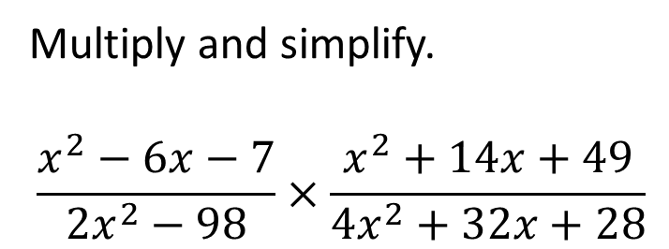
Problem from today’s homework:
Multiply and simplify.
$$\frac{x^{2}−6x−7}{2x^{2}−98}×\frac{x^{2}+14x+49}{4x^{2}+32x+28}$$
1
8

Slide 8
Example
Multiply the following rational expressions.
Solution: Factor each polynomial completely,
then cancel all factors that appear on both the top
and the bottom.
NOTE: A problem similar to this one appeared Test 4 and the final last semester…

Slide 9
When dividing rational expressions, first change the division into a multiplication problem, where you use the reciprocal of the divisor as the second part of the product.
Then treat it as a multiplication problem (factor, multiply, simplify).

Slide 10
Example
Divide the following rational expression.

Slide 11
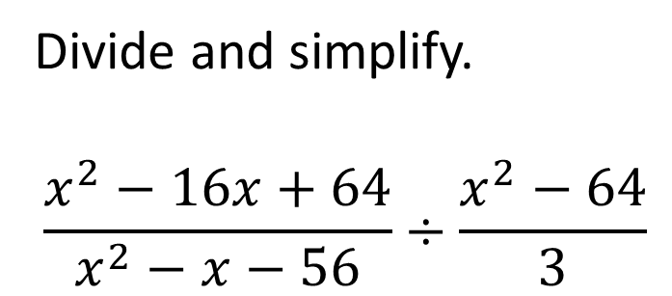
Problem from today’s homework:
Divide and simplify.
$$\frac{x^{2}−16x+64}{x^{2}−x−56}÷\frac{x^{2}−64}{3}$$
3 .
(x + 7)(x + 8)

Slide 12
Rational expressions can be also be added or subtracted in the same way as fractions:
If the denominators are already the same, we can just add or subtract the numerator polynomials and put the result over the common denominator polynomial
Then we check to see if the answer can be simplified, by seeing if we can factor the numerator polynomial, then cancelling any common factors.

Slide 13
Example
Subtract the following rational expressions.

Slide 14
As with adding rational numbers (fractions), to add or subtract rational expressions with unlike denominators, you have to change them to equivalent forms that have the same denominator (a common denominator).
This involves finding the least common denominator of the two original rational expressions, which is just like the process of finding the LCD of two numbers.
We won’t be covering this topic in Math 90, although it will be covered in Math 120 and used in subsequent courses.
If you’re interested in exploring these ideas, explanations and examples can be found in sections 7.3 and 7.4 of the online textbook.

Slide 15
The assignment on this material (HW 7.2)
Is due at the start of the next class session.
You may now OPEN
your LAPTOPS
and begin working on the homework assignment.
We expect all students to stay in the classroom to work on your homework till the end of the 55-minute class period. If you have already finished the homework assignment for today’s section, you should work ahead on the next one or work on the next practice test.

