Slide 1
Section 8.2 Graphing Nonlinear Equations

Slide 2
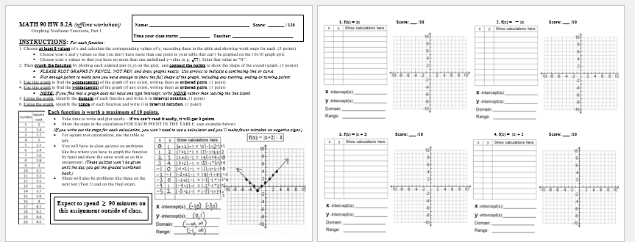
There a paper worksheet that covers some of this material. For this online course, this will not be graded. You should still look at it to help prepare you for future work.

Slide 3
INSTRUCTIONS:
For each function:
1. Choose at least 8 values of x and calculate the corresponding values of y, recording them in the table and showing work steps for each.
……………..….(This table is worth 3 points)……….………….
Choose your x and y values so that you don’t have more than one point in your table that can’t be graphed on the 10x10 graph grid.
Choose your x values so that you have no more than one undefined
y-value (like the square root of -1). Enter that value as “N”.
2. Then graph the function by plotting each ordered pair (x,y) on the grid; and connect the points to show the shape of the overall graph. ……………..….(This graph is worth 3 points)………….……….
PLEASE PLOT GRAPHS IN PENCIL, NOT PEN, and draw graphs neatly. Use arrows to indicate a continuing line or curve.
Plot enough points to make sure you have enough to show the full shape of the graph, including any starting, ending or turning points.

Slide 4
INSTRUCTIONS: (continued)
3. Use this graph to find the x-intercept(s) of the graph (if any exist), writing them as ordered pairs. (1 point)
4. Use this graph to find the y-intercept(s) of the graph (if any exist), writing them as ordered pairs. (1 point)
NOTE: If you find that a graph does not have one type of intercept, write NONE rather than leaving the line blank.
5. Using the graph, identify the domain of each function and write it in interval notation. (1 point)
6. Using the graph, identify the range of each function and write it in interval notation. (1 point)

Slide 5
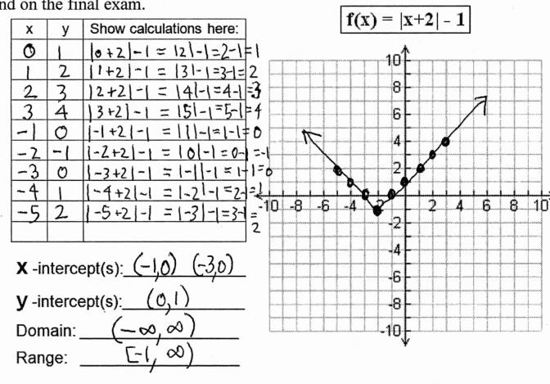
Each function is worth a maximum of 10 points.
Take time to write and plot neatly – if we can’t read it easily, it will get 0 points.
Show the steps in the calculation FOR EACH POINT IN THE TABLE. (see example below, also on page 1 of your worksheet.)

Slide 6
For square root calculations (functions # 9 - 12), you may use the table on page 1 of your worksheet (or your yellow formula sheet handout), since you won’t have access to the online calculator.
You will have an in-class quiz on problems like this where you have to graph the function by hand and show the same work as on this assignment.
There will also be problems like these on the next test (Test 2) and on the final exam.
Expect to spend ≥ 90 minutes on
this assignment outside of class.

Slide 7
Teachers: In class, do the two following basic graphs on the whiteboard to show them how to go about the process of graphing each shape. Don’t show the completed graph slide until after you have worked the problems out on the board. (The completed graph slides are mostly for the benefit of students reading the slides online.) You can do additional graphs in class if you have time, or just let students work on their own graphs for the rest of the hour.

Slide 8
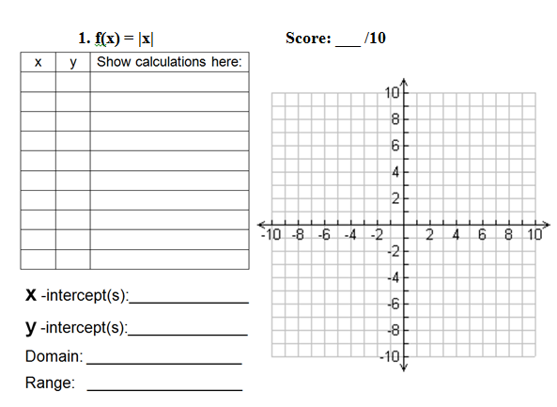

Slide 9
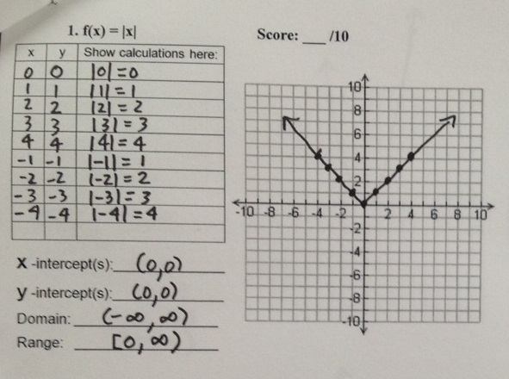
10/10

Slide 10
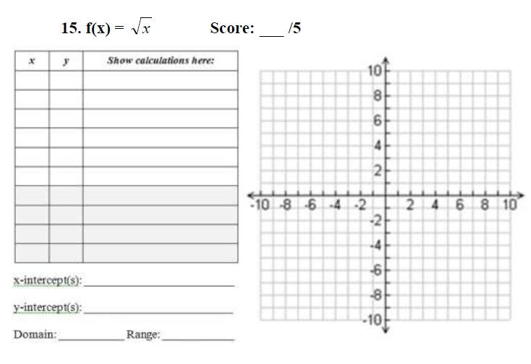

Slide 11
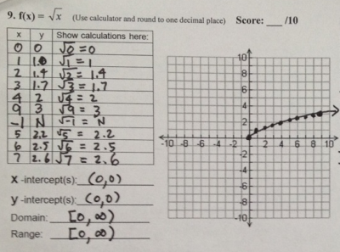
10/10

Slide 12
This offline worksheet is due at the start of the next class session. Your work will be graded by hand and your score entered manually in the online gradebook.
We expect all students to stay in the classroom to work on this homework till the end of the 55-minute class period.
Visit the MathTLC
For homework help!

