Slide 1
Please
CLOSE
YOUR LAPTOPS,
and turn off and put away your cell phones,
and get out your note-taking materials.

Slide 2
Section 8.2 Graphing Nonlinear Equations Part 2

Slide 3
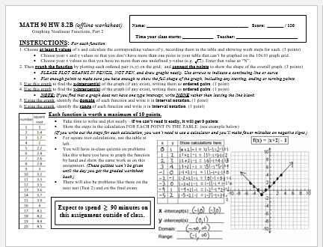
Today’s homework will be another paper worksheet that must be completed and turned in at the start of our next class session.
There are 12 new graphing problems on the worksheet.
The worksheet will be again graded by hand and the scores entered manually online. The TA will hand out the new worksheets to you now.

Slide 4
Teachers: For today’s lecture, do one or more of the worksheet graphs on the board with your students. During the remaining class time, have them work on their worksheets with help from you and the TA.
Slides of a few of the graphs from worksheet 2 are attached if you want to use one or more of these during your lecture.

Slide 5
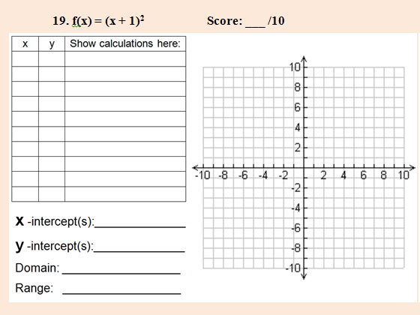

Slide 6
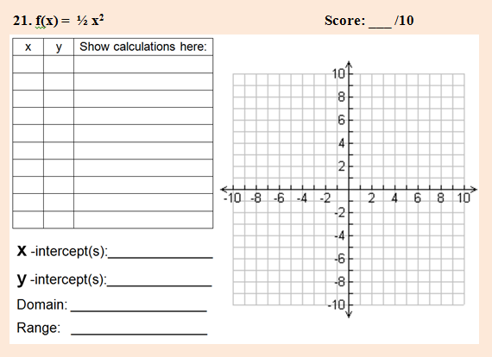

Slide 7
Please continue working on 8.2B Graphing Worksheet 2 for the remainder of the class period.
If you have any questions about
the worksheet instructions or specific problems on the worksheet, please ask the teacher or TA.

Slide 8
The worksheet on this material (HW 8.2B) is due at the start of the next class session. It will be graded by hand and the scores manually entered online.
Visit the MathTLC
for homework help!

